Slide 1
Plants vs Zombies Team: Critical Hit Studios
Restricted © Siemens AG 2019
Realize innovation.

Slide 2
Agenda: Topic 1 Topic 2 Topic 3 Topic 4 Please note that there a no bullets

Slide 3
Problem Statement
Creating a clone of Plant vs Zombies game, which is a desktop application. The aim of the game is to protect user’s house from zombies, using magical plants.

Slide 4
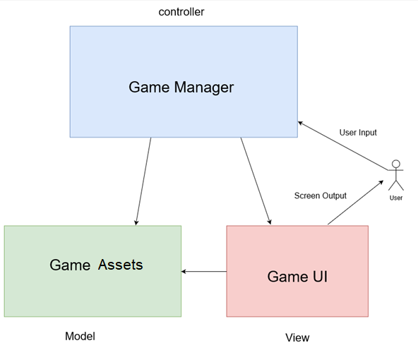
Block Diagram

Slide 5
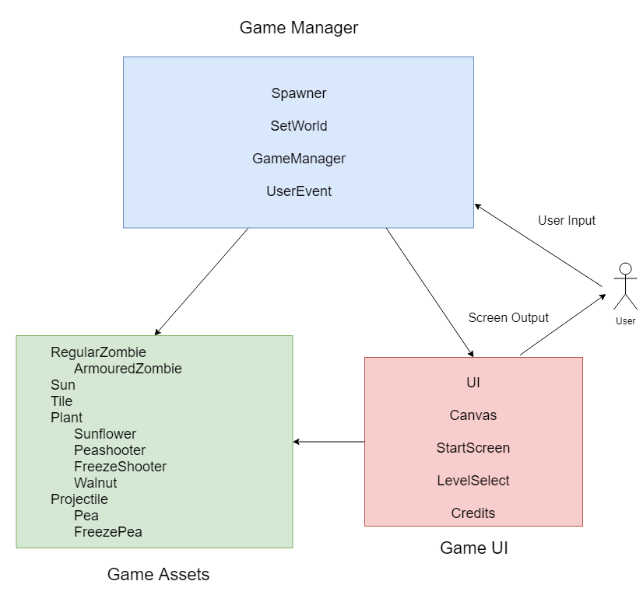
Introduction

Slide 6
Problem Statement
USABLE SPACE
For text, tables, charts, etc. place all your content within these boundaries.
PLACEMENT
Vertical:
1.57 in - 3.98 cm
Horizontal:
.69 in - 1.75 cm
TIP
Turn on the guides (View > guides). The orange guides show the usable space.
The crop marks right outside the slide also show the usable space.
Copy/paste this rectangle in your slides

Slide 7
Headline, Arial bold, 22 pt. Content page – highlighted text
Subhead, Arial Bold, 18 pt
Body text, Arial Regular, 18 pt, line spacing 1.1 lines: Dolor situs cum habilitarum itum alus causticus imanenter Status ex landum it causticus imanenter Status ex landum it exus rius.
Dolor situs cum habilitarum itum alus causticus imanenter Status ex landum it Lorem exit itum alus causticus.
Dolor situs cum habilitarum itum alus causticus imanenter Status ex landum it Lorem exit itum.
Highlighted text, Arial Bold, 18 pt, line spacing 1.1 lines. Dolor cumatia habilitarum itum alus.

Slide 8
Presenter
Title Group / Region / Department XY name.lastname@siemens.com

Slide 9
Thank you.

Slide 10
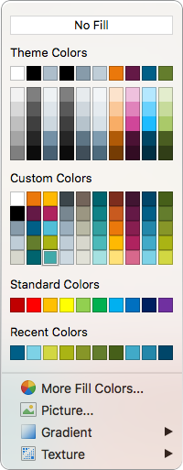
Siemens PowerPoint color palette
What colors can you use?
YES
NO
YES
NO
MAYBE
Only if you used Siemens colors

Slide 11
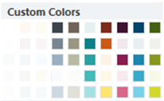
Siemens color palette Preferred colors have a white dot
Siemens Stone dark 60 70 75
Siemens Sand dark 115 100 90
Siemens Accent Teal dark 0 100 110
Siemens Accent Yellow 125 45 30
Siemens Accent Red 65 20 50
Siemens Accent Blue 0 70 105
Siemens Accent Green 70 95 25
Siemens Stone 120 135 145
Siemens Sand 155 150 130
Siemens Accent Teal 15 130 135
Siemens Accent Yellow 200 90 30
Siemens Accent Red dark 100 25 70
Siemens Accent Blue dark 0 95 135
Siemens Accent Green dark 100 125 45
Siemens Stone 155 175 190
Siemens Sand 185 185 165
Siemens Accent Teal 50 160 160
Siemens Accent Yellow dark 235 120 10
Siemens Accent Red 135 30 80
Siemens Accent Blue 35 135 170
Siemens Accent Green 135 150 40
Siemens Stone light (35%) 190 205 215
Siemens Sand light (35%) 215 215 205
Siemens Accent Teal 75 185 185
Siemens Accent Yellow Light 255 185 0
Siemens Accent Red light 175 35 95
Siemens Accent Blue 65 170 200
Siemens Accent Green light 170 180 20
Siemens Stone 205 217 225
Siemens Sand 225 225 215
Siemens Accent Teal 165 225 225
Siemens Accent Yellow 255 225 120
Siemens Accent Red 215 105 140
Siemens Accent Blue 125 210 230
Siemens Accent Green 210 215 65
Where to find them:
GUI colors can be found under Shape Fill/Contour Fill/Font Color – Custom Colors as shown:

