Slide 1
Plants vs Zombies Team 10: Critical Hit Studios
Restricted © Siemens AG 2019
Realize innovation.

Slide 2
Agenda: Problem Statement Short Live Demo Pre-recorded Highlights Demo Architecture Diagram Module Description Challenges About the Team

Slide 3
Problem Statement
Creating a clone of Plant vs Zombies game, which is a desktop application. The aim of the game is to protect user’s house from zombies, using magical plants.

Slide 4
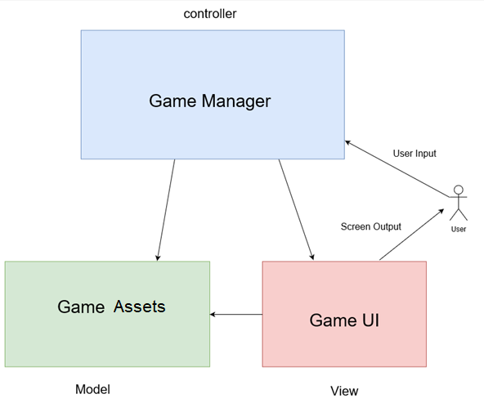
Architecture Diagram :

Slide 5
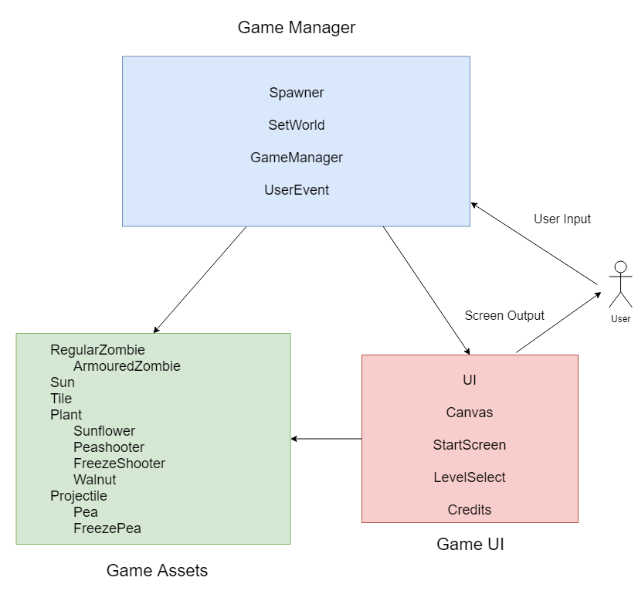
Module description

Slide 6
Key challenges of the problem statement
Class diagram
No cyclic dependency
Game layout (UI)
Interaction between various game assets
Scalability
Maintaining fair economy

Slide 7
Code statistics
TOTAL NO. OF CODE LINES
1605
TOTAL NO. OF CODE FILES
22
TOTAL NO. OF COMMITS IN GIT REPOSITORY
150
AVG. NO. OF COMMITS PER DAY
Approximately 12

Slide 8
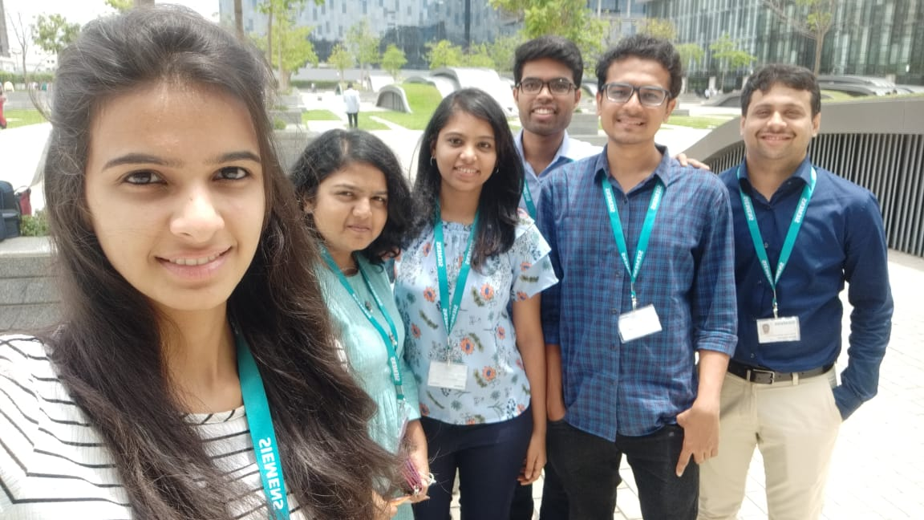
Team ‘Critical Hit Studios’ & Tasks List
Aman : Assets making, UI of start screen, level select screen, functionality of sun count, code review & bug fixes
Apurva : Audio background, audio source managing, sound effects, Help screen
Avanti : Functionalities of pea shooter, freeze plant, pea, freeze pea, pea-zombie collision and death
Mayank : Functionalities of grid, sun, horde, user event, check path, save, smoke, game manager
Purva : Functionalities of regular & armoured zombies, game lose, spawning zombies, game balancing, progress bar
Shivkumar : Functionalities of tile, panel, dialog box, game win, walnut, user event, game manager

Slide 9
Presenters
Team 10 : Critical Hit Studios .
Mentor : Nilesh Gupta
Aman Garg
Apurva Surve
Avanti Dorle
Mayank Nagpurkar
Purva Ekatpure
Shivkumar Patil

Slide 10
Thank you.

