Slide 1
Plants vs Zombies Team: Critical Hit Studios
Restricted © Siemens AG 2019
Realize innovation.

Slide 2
Agenda: Topic 1 Topic 2 Topic 3 Topic 4 Please note that there a no bullets

Slide 3
Problem Statement
Creating a clone of Plant vs Zombies game, which is a desktop application. The aim of the game is to protect user’s house from zombies, using magical plants.

Slide 4
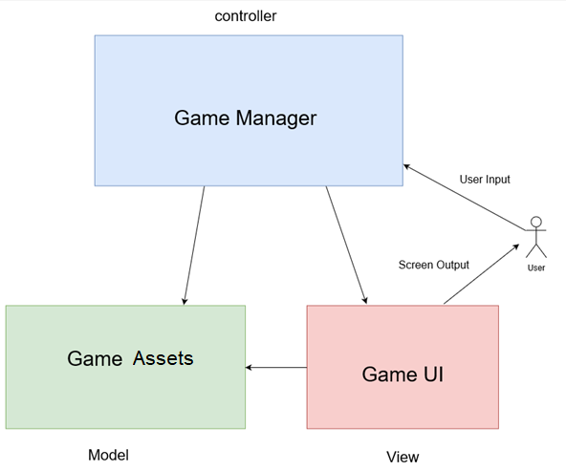
Block Diagram

Slide 5
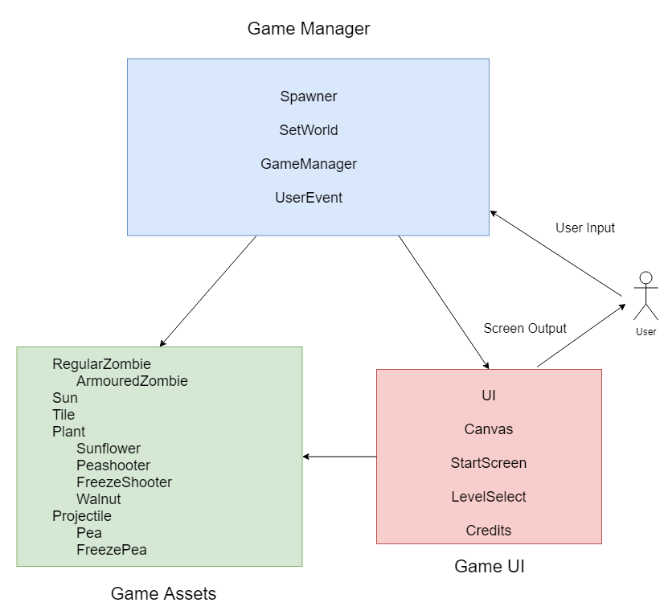
Introduction

Slide 6
Problem Statement
USABLE SPACE
For text, tables, charts, etc. place all your content within these boundaries.
PLACEMENT
Vertical:
1.57 in - 3.98 cm
Horizontal:
.69 in - 1.75 cm
TIP
Turn on the guides (View > guides). The orange guides show the usable space.
The crop marks right outside the slide also show the usable space.
Copy/paste this rectangle in your slides

Slide 7
Code statistics
TOTAL NO. OF CODE LINES
1599
TOTAL NO. OF CODE FILES
22
TOTAL NO. OF COMMITS IN GIT REPOSITORY
140
AVG. NO. OF COMMITS PER DAY
11.6

Slide 8
Headline, Arial bold, 22 pt. Content page – highlighted text
Subhead, Arial Bold, 18 pt
Body text, Arial Regular, 18 pt, line spacing 1.1 lines: Dolor situs cum habilitarum itum alus causticus imanenter Status ex landum it causticus imanenter Status ex landum it exus rius.
Dolor situs cum habilitarum itum alus causticus imanenter Status ex landum it Lorem exit itum alus causticus.
Dolor situs cum habilitarum itum alus causticus imanenter Status ex landum it Lorem exit itum.
Highlighted text, Arial Bold, 18 pt, line spacing 1.1 lines. Dolor cumatia habilitarum itum alus.

Slide 9
Presenter
Team 10 : Critical Hit Studios .
Mentor : Nilesh Gupta
Aman Garg
Apurva Surve
Avanti Dorle
Mayank Nagpurkar
Purva Ekatpure
Shivkumar Patil

Slide 10
Thank you.

