Slide 1
Critical Hit Studios
Presents
Plant vs Zombies

Slide 2
Contents
Problem Statement
Introduction
Element Specification
Purpose
Requirements
Functional Requirement
Non-Functional Requirement
External Interface Specification
Technical specification
Use Case Diagram

Slide 3
Problem Statement
Creating a Clone of Plants vs Zombies game. It is a tower defense game, where user needs to protect his house from zombies using magical plants.

Slide 4
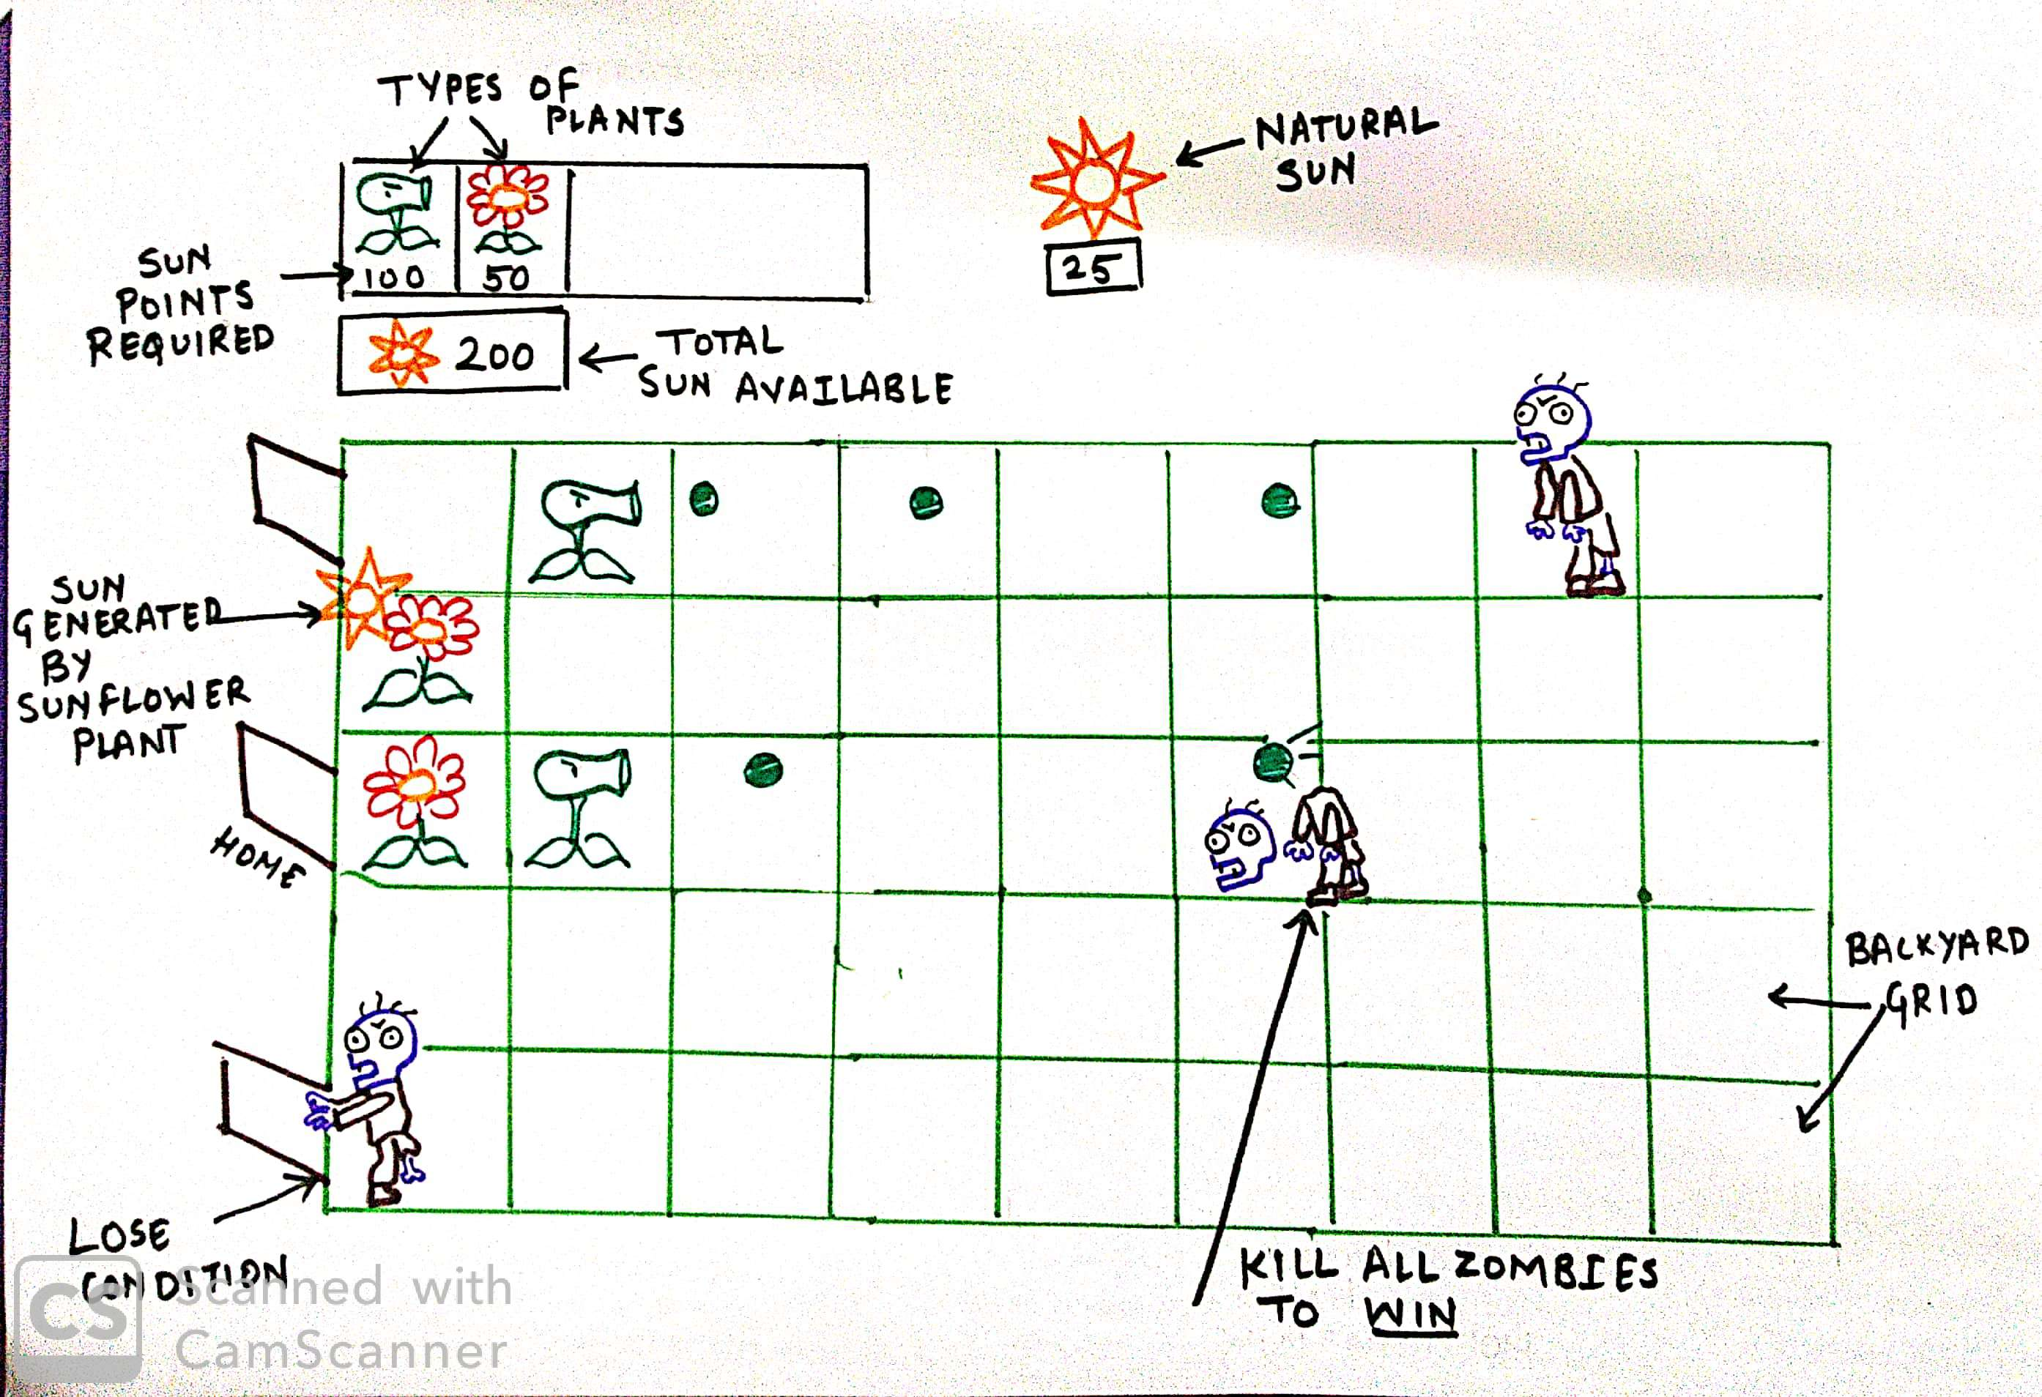
Introduction

Slide 5
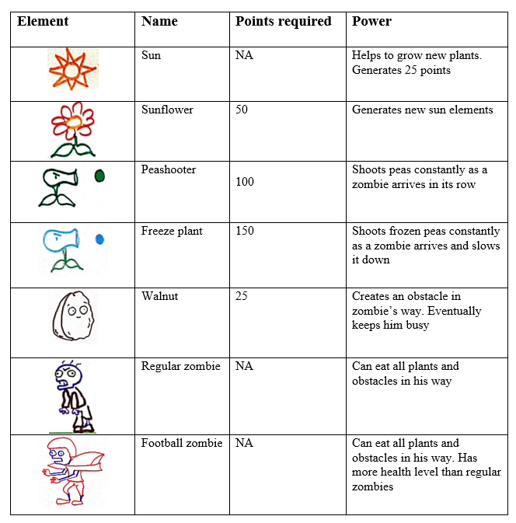
Element Specification

Slide 6
Purpose
Fair
Rewarding
Entertaining

Slide 7
Functional Requirements
Sr. No. | Requirement | Required/Desired
1 | Start UI Screen will have Play Button | Required
2 | Start UI Screen will have Quit Button | Required
3 | 5 x 9 layout grid | Required
4 | Panel to select different plant seeds | Required
5 | Panel to display sun count | Required
6 | Placing Plants on grid | Required
7 | Zombies should enter from one side of layout | Required
8 | Sun should drop | Required
9 | User uses sun to place plant in grid | Required

Slide 8
Functional Requirements
Sr. No. | Requirement | Required/Desired
10 | Sunflower plant should generate sun regularly | Required
11 | Different types of plant should attack zombies | Required
12 | Zombies take damage on projectile impact | Required
13 | Zombies die when health is zero | Required
14 | Zombies will destroy everything in their path including plants | Required
15 | Level completion Bar | Required
16 | Win condition is when all zombies are killed | Required
17 | Lose condition is when a zombie reaches the home line | Required
18 | Background music | Required

Slide 9
Functional Requirements
Sr. No. | Requirement | Required/Desired
19 | Minimum 1 level: Elements included (Refer table 3.1) - Peashooter plant Sunflower plant Sun 15 Regular zombies Win condition- Kill all zombies | Required
20 | Level 2: Elements included (Refer table 3.1)- Peashooter plant Sunflower plant Sun Freeze plant Walnut 20 Regular zombies 5 Football zombies Win condition- Kill all 25 zombies | Desired

Slide 10
Functional Requirements
Sr. No. | Requirement | Required/Desired
21 | Playing Screen will have Pause Button | Desired
22 | Playing Screen will have Resume Button | Desired
23 | Start Screen will have Credits Button | Desired
24 | Info Tooltip | Desired

Slide 11
Non-Functional Requirements
Sr. No. | Parameter | Requirement | Required/Desired
1 | Reliability | Should not hang/crash | Required
2 | Availability | Should be available offline | Required
3 | Usability | User friendly Interactive | Required

Slide 12
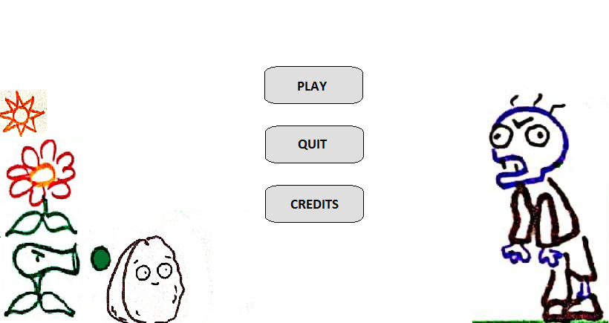
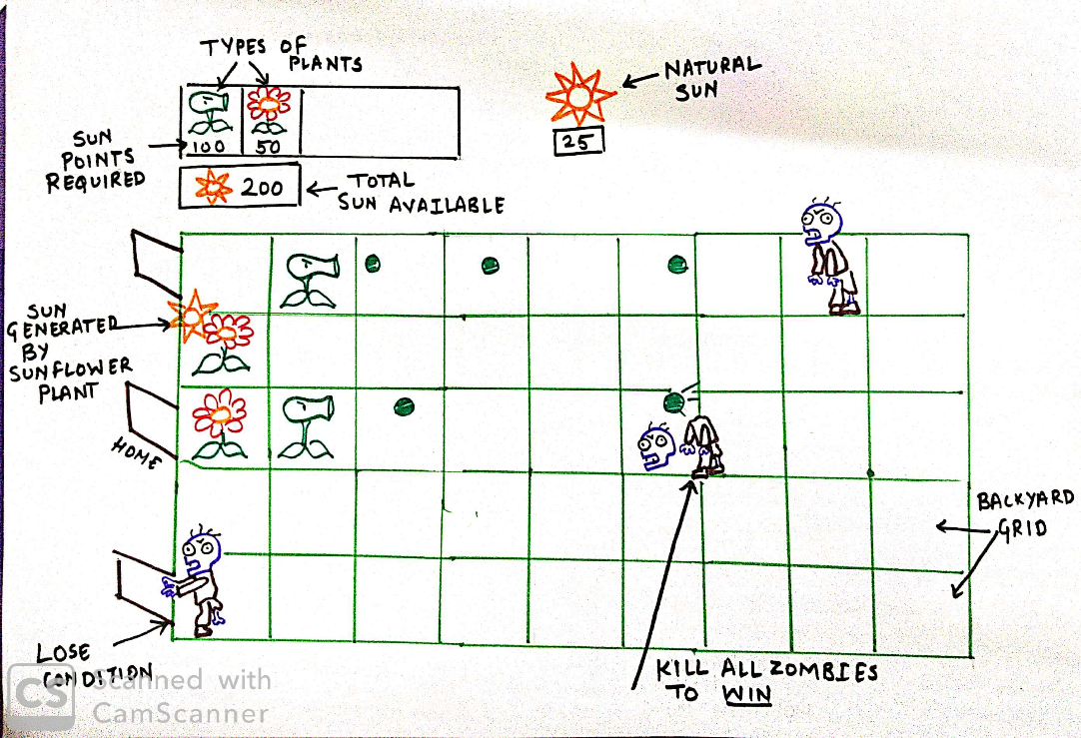
External Interface Specification
Start Screen
Playing Screen

Slide 13
Technical Specification
Hardware Details
Operating System
Sr. No. | Requirement | Required/Desired
1 | Efficient space utilization. Approximately 500mb HDD | Required
2 | 2GB RAM | Required
3 | Graphics card with DX10 (shader model 4.0) capabilities | Required
Sr. No. | Requirement | Required/Desired
1 | Desktop application should support Windows 7 and above | Required

Slide 14
Technical Specification
Performance
Sr. No. | Requirement | Required/Desired
1 | Should not lag, Give quick responses. Less than 0.25 sec for each event. | Required

Slide 15
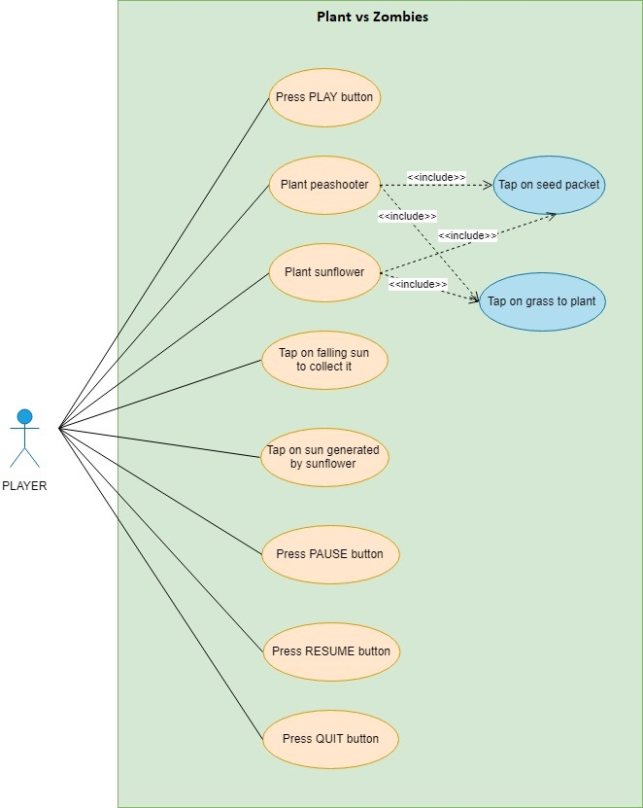
Use Case Diagram

