Slide 1
Critical Hit Studios Presents Plants vs Zombies Game

Slide 2
Index
Architecture Diagram
Wireframe
Use Case Diagram
Class Diagram
Activity Diagram
Communication Diagram
Spcifications

Slide 3
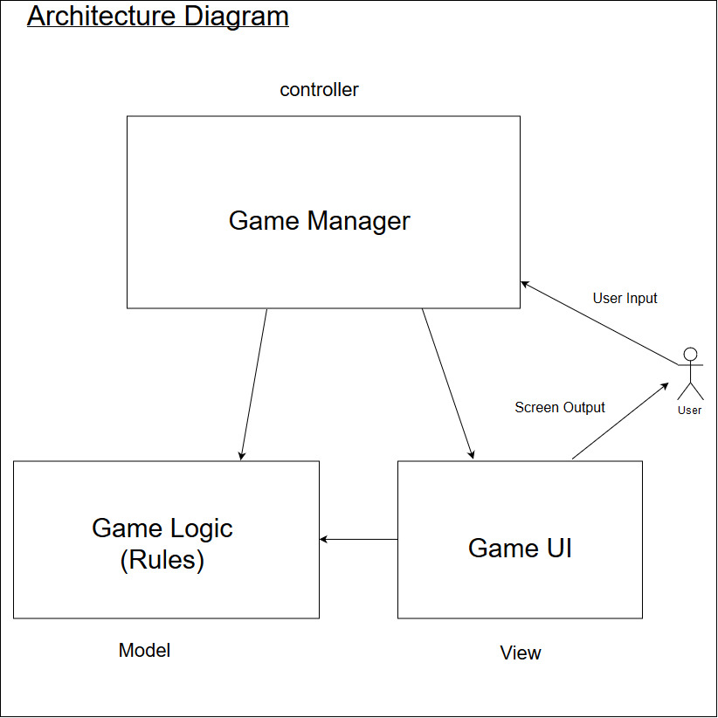
Architecture Diagram

Slide 4
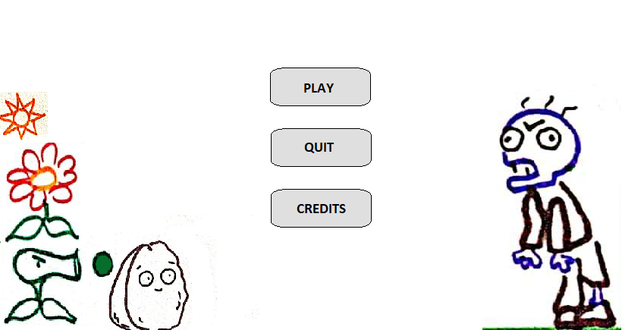
Wireframe

Slide 5
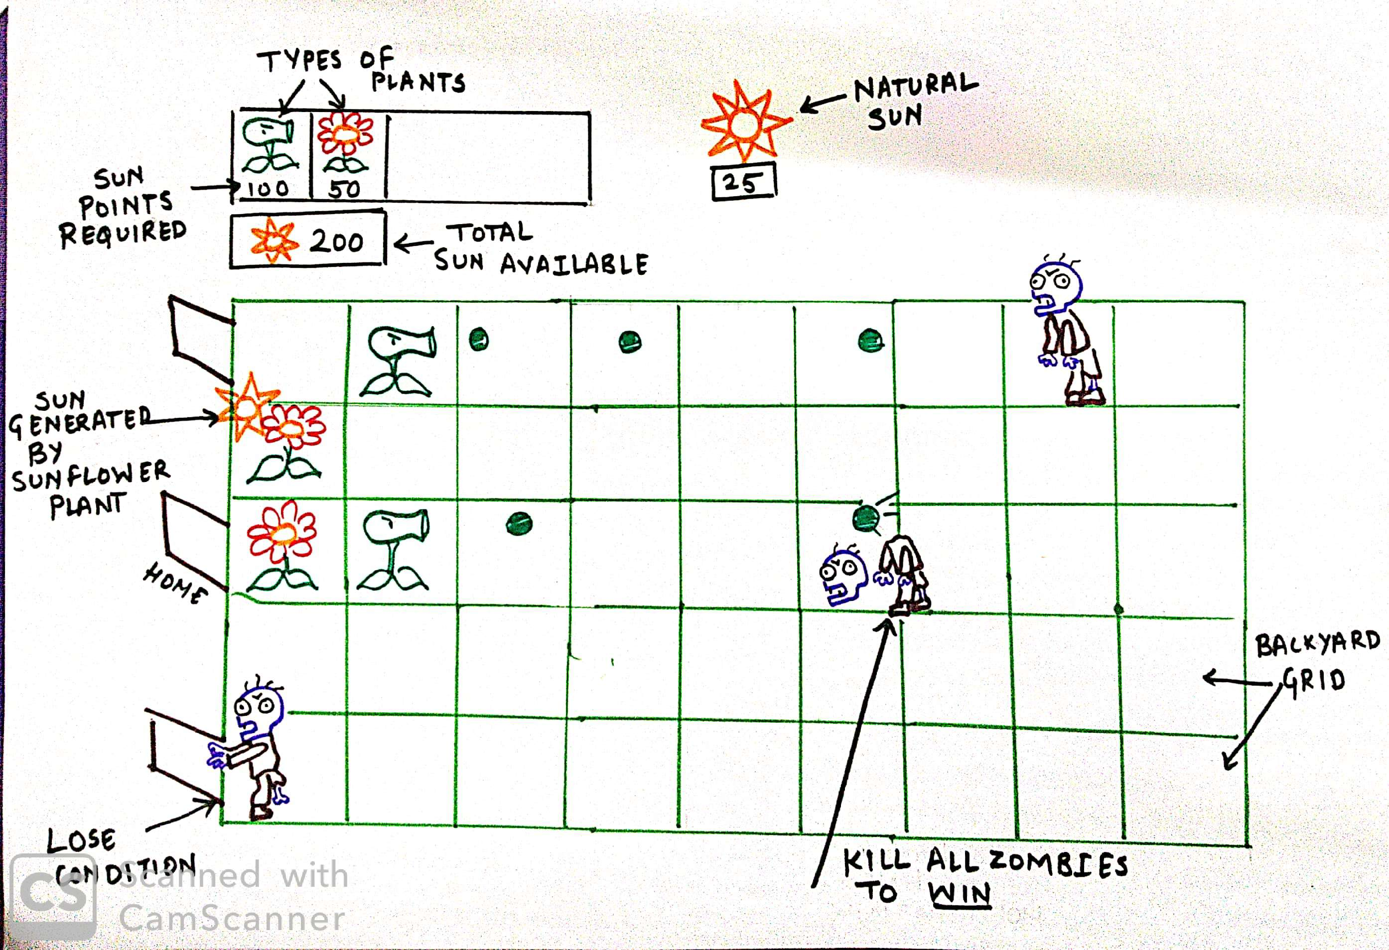
Wireframe

Slide 6
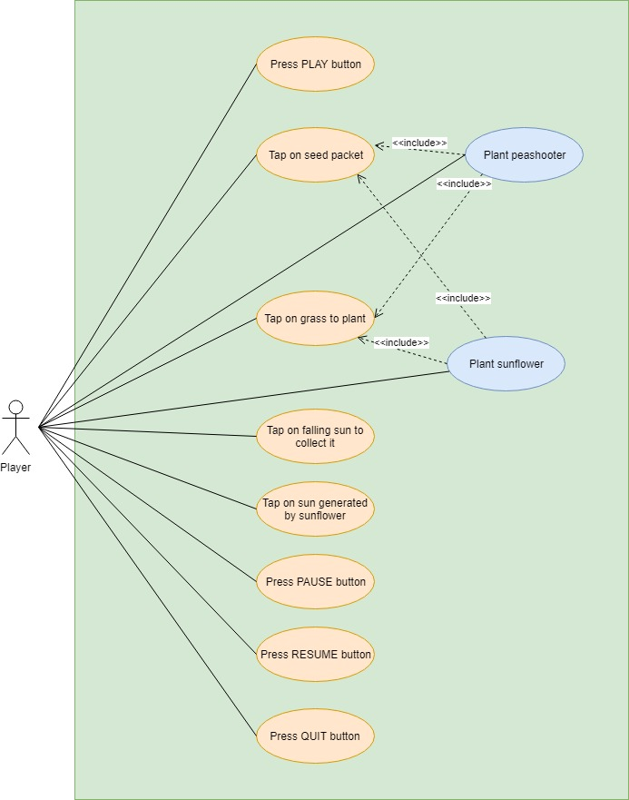
Use Case Diagram

Slide 7
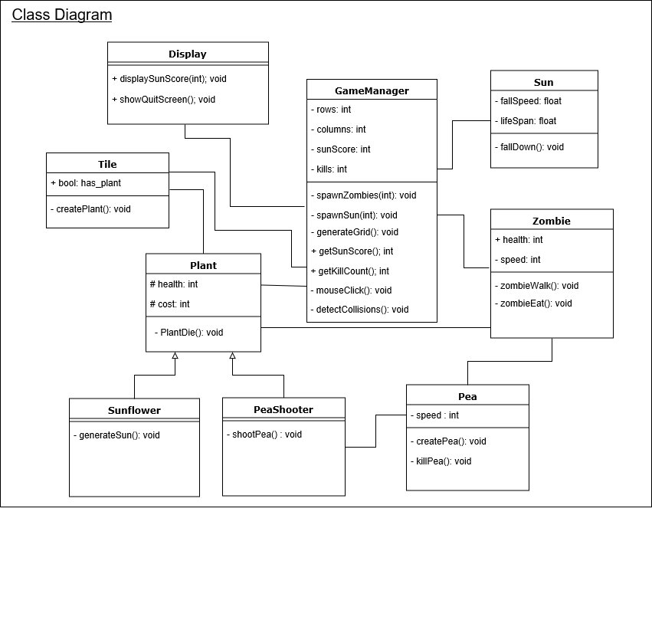
Class Diagram

Slide 8
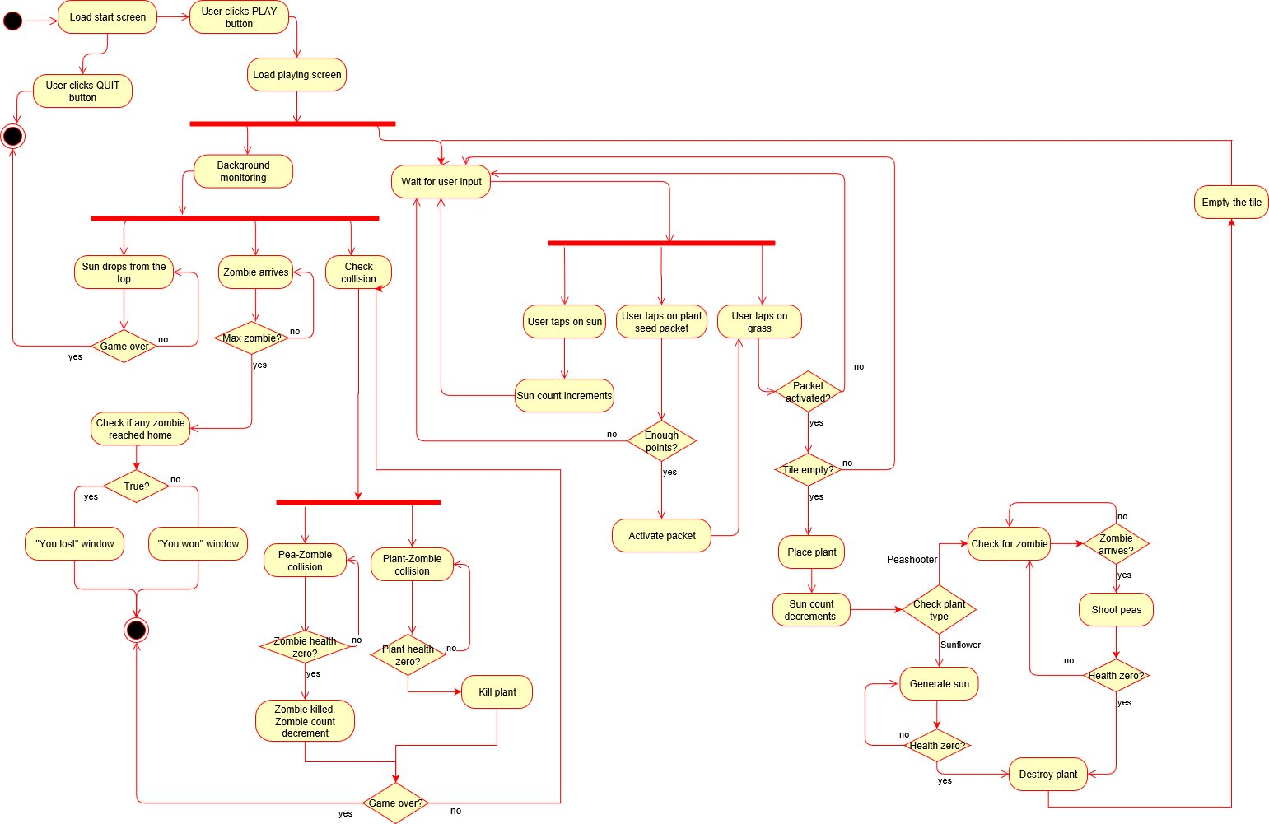
Activity Diagram

Slide 9
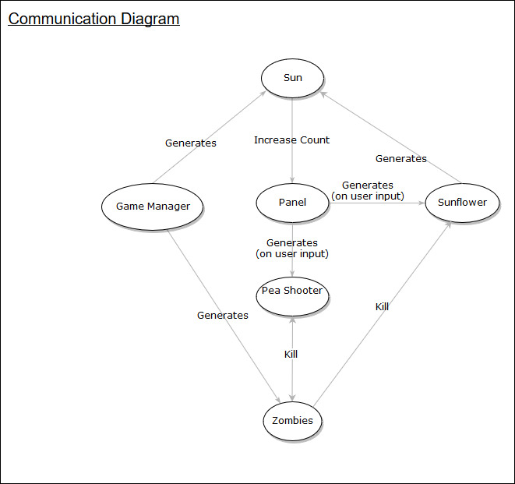
Communication Diagram

Slide 10
Specifications
Framework – Unity
Programming Language – C Sharp

Slide 11
Thank You !

