Slide 1
Plants vs Zombies Team: Critical Hit Studios
Restricted © Siemens AG 2019
Realize innovation.

Slide 2
Agenda: Topic 1 Topic 2 Topic 3 Topic 4 Please note that there a no bullets

Slide 3
Problem Statement
Creating a clone of Plant vs Zombies game, which is a desktop application. The aim of the game is to protect user’s house from zombies, using magical plants.

Slide 4
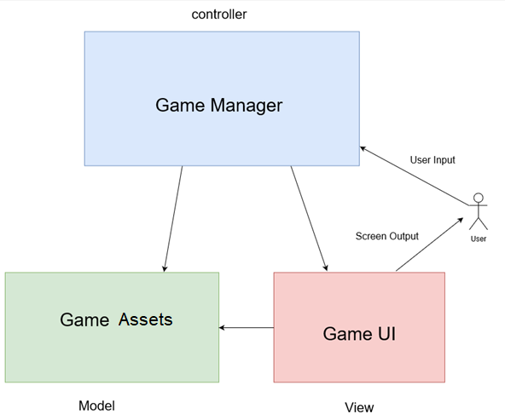
Block Diagram

Slide 5
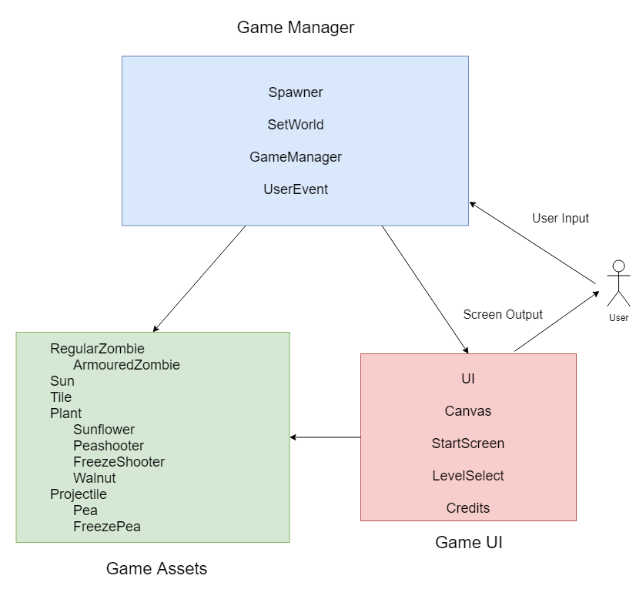
Introduction

Slide 6
Problem Statement
USABLE SPACE
For text, tables, charts, etc. place all your content within these boundaries.
PLACEMENT
Vertical:
1.57 in - 3.98 cm
Horizontal:
.69 in - 1.75 cm
TIP
Turn on the guides (View > guides). The orange guides show the usable space.
The crop marks right outside the slide also show the usable space.
Copy/paste this rectangle in your slides

Slide 7
Code statistics
TOTAL NO. OF CODE LINES
1599
TOTAL NO. OF CODE FILES
22
TOTAL NO. OF COMMITS IN GIT REPOSITORY
140
AVG. NO. OF COMMITS PER DAY
11.6

Slide 8
Key challenges of the problem statement
1 .Class diagram
2.No cyclic dependency
3. Game layout (UI)
4. Interaction between various game assets
5. Scalability
6. Maintaining fair economy

Slide 9
Presenter
Team 10 : Critical Hit Studios .
Mentor : Nilesh Gupta
Aman Garg
Apurva Surve
Avanti Dorle
Mayank Nagpurkar
Purva Ekatpure
Shivkumar Patil

Slide 10
Thank you.

