Slide 1
Critical Hit Studios Presents Plants vs Zombies Game

Slide 2
Index
Wireframe
Use Case Diagram
Architecture Diagram
Class Diagram
Communication Diagram
Activity Diagram
Specifications

Slide 3
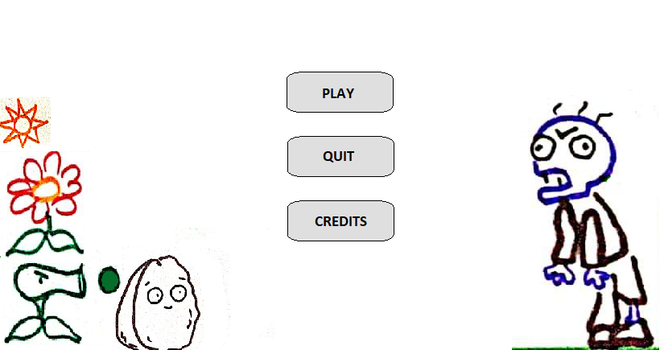
Wireframe

Slide 4
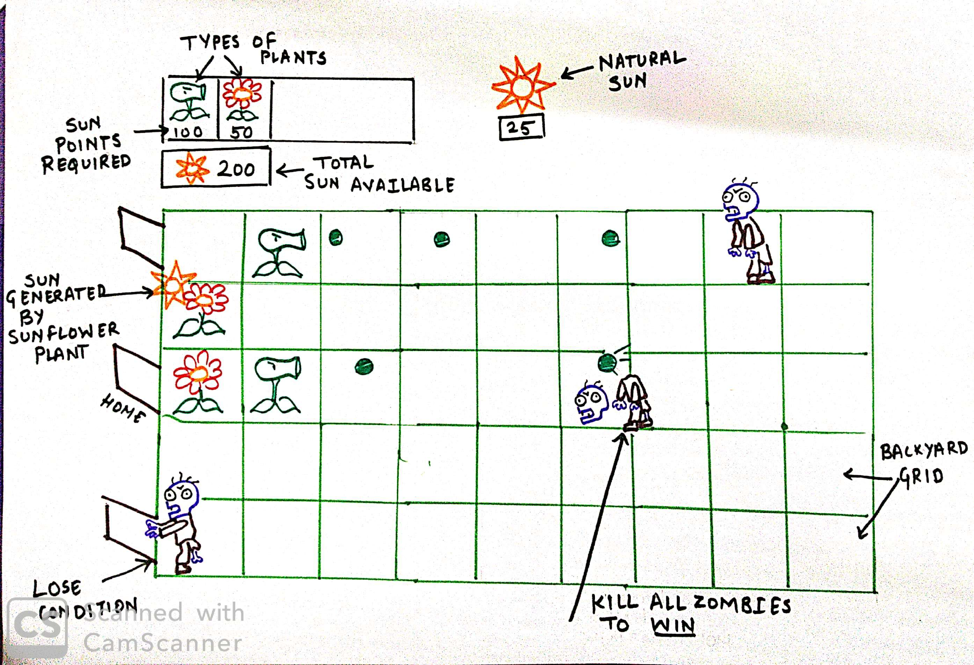
Wireframe

Slide 5
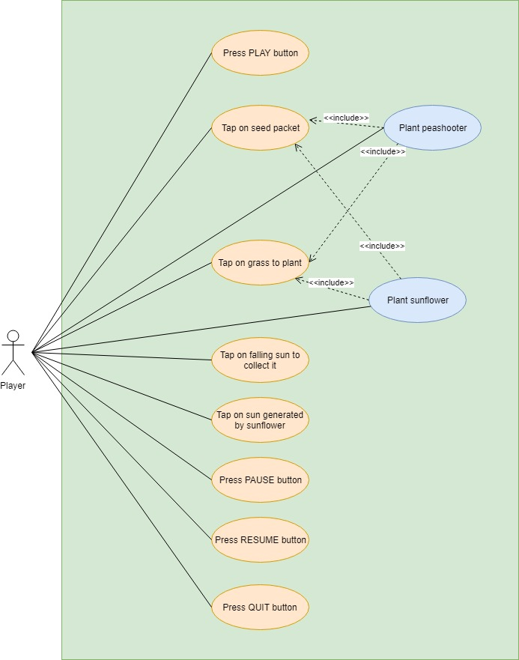
Use Case Diagram

Slide 6
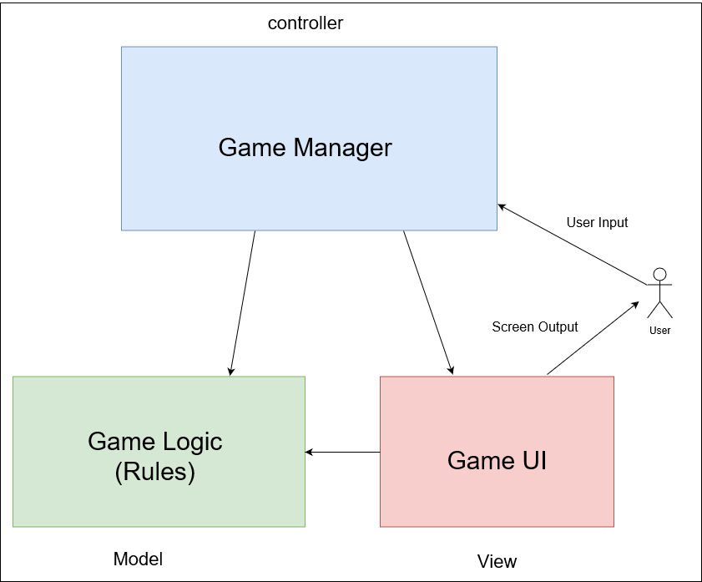
Architecture Diagram

Slide 7
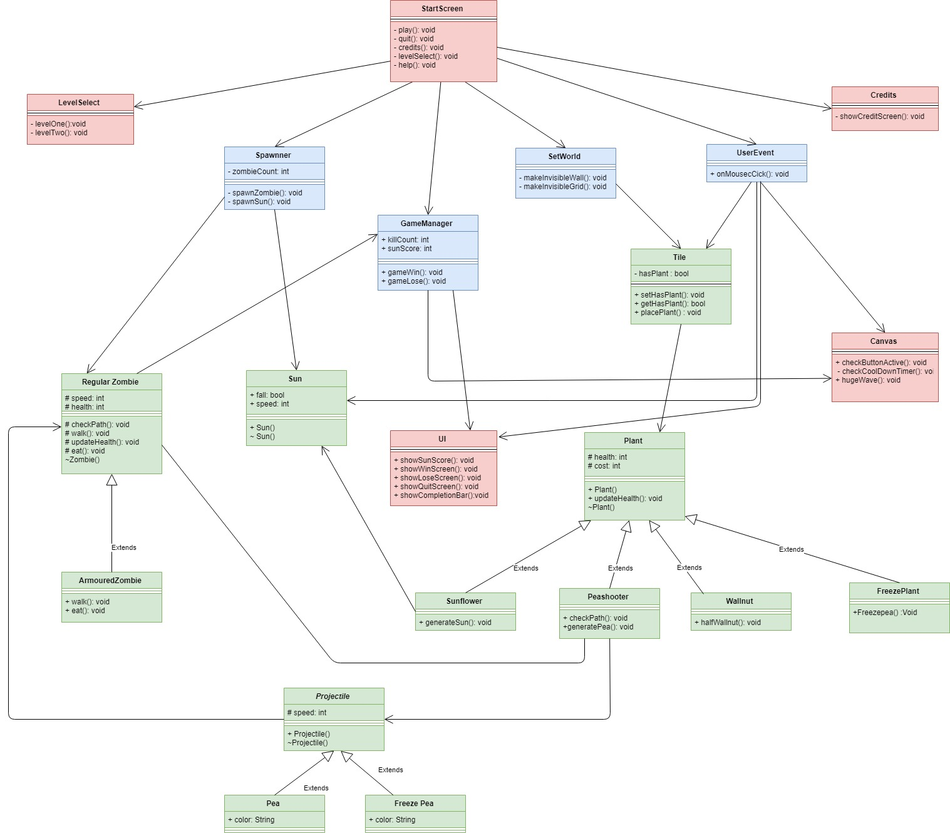
Class Diagram

Slide 8
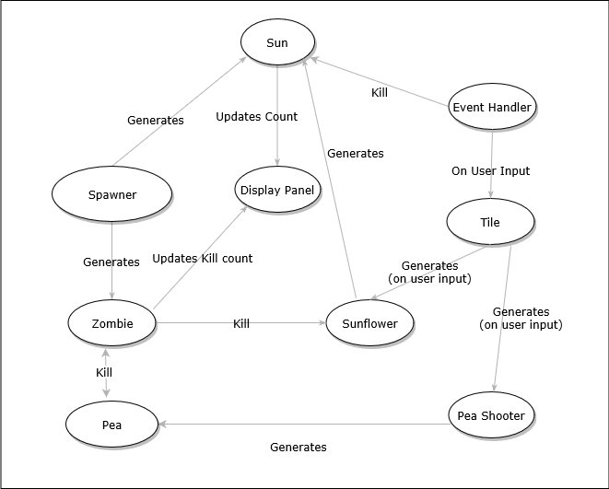
Communication Diagram

Slide 9
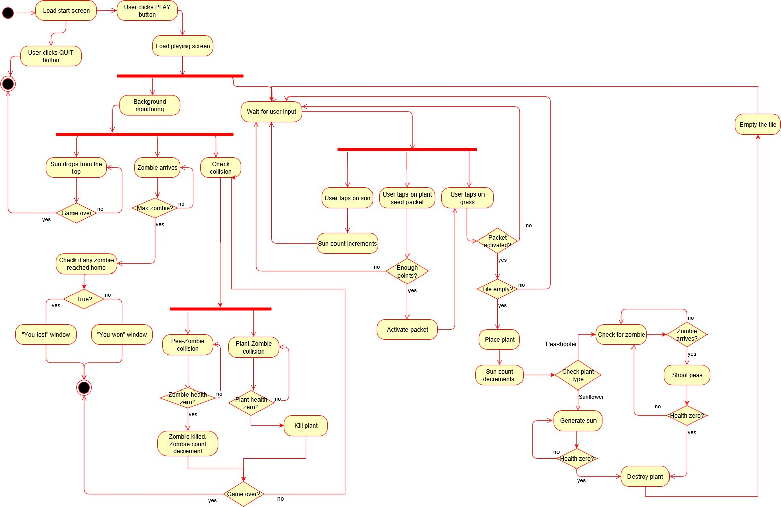
Activity Diagram

Slide 10
Specifications
Framework – Unity
Programming Language – C Sharp

Slide 11
Thank You !

