Slide 1
URBAN CRUISE INDIA
PINAAK Driver App
A screen-by-screen walkthrough — from duty status to trip completion
PINAAK — Driver App Walkthrough
1

Slide 2
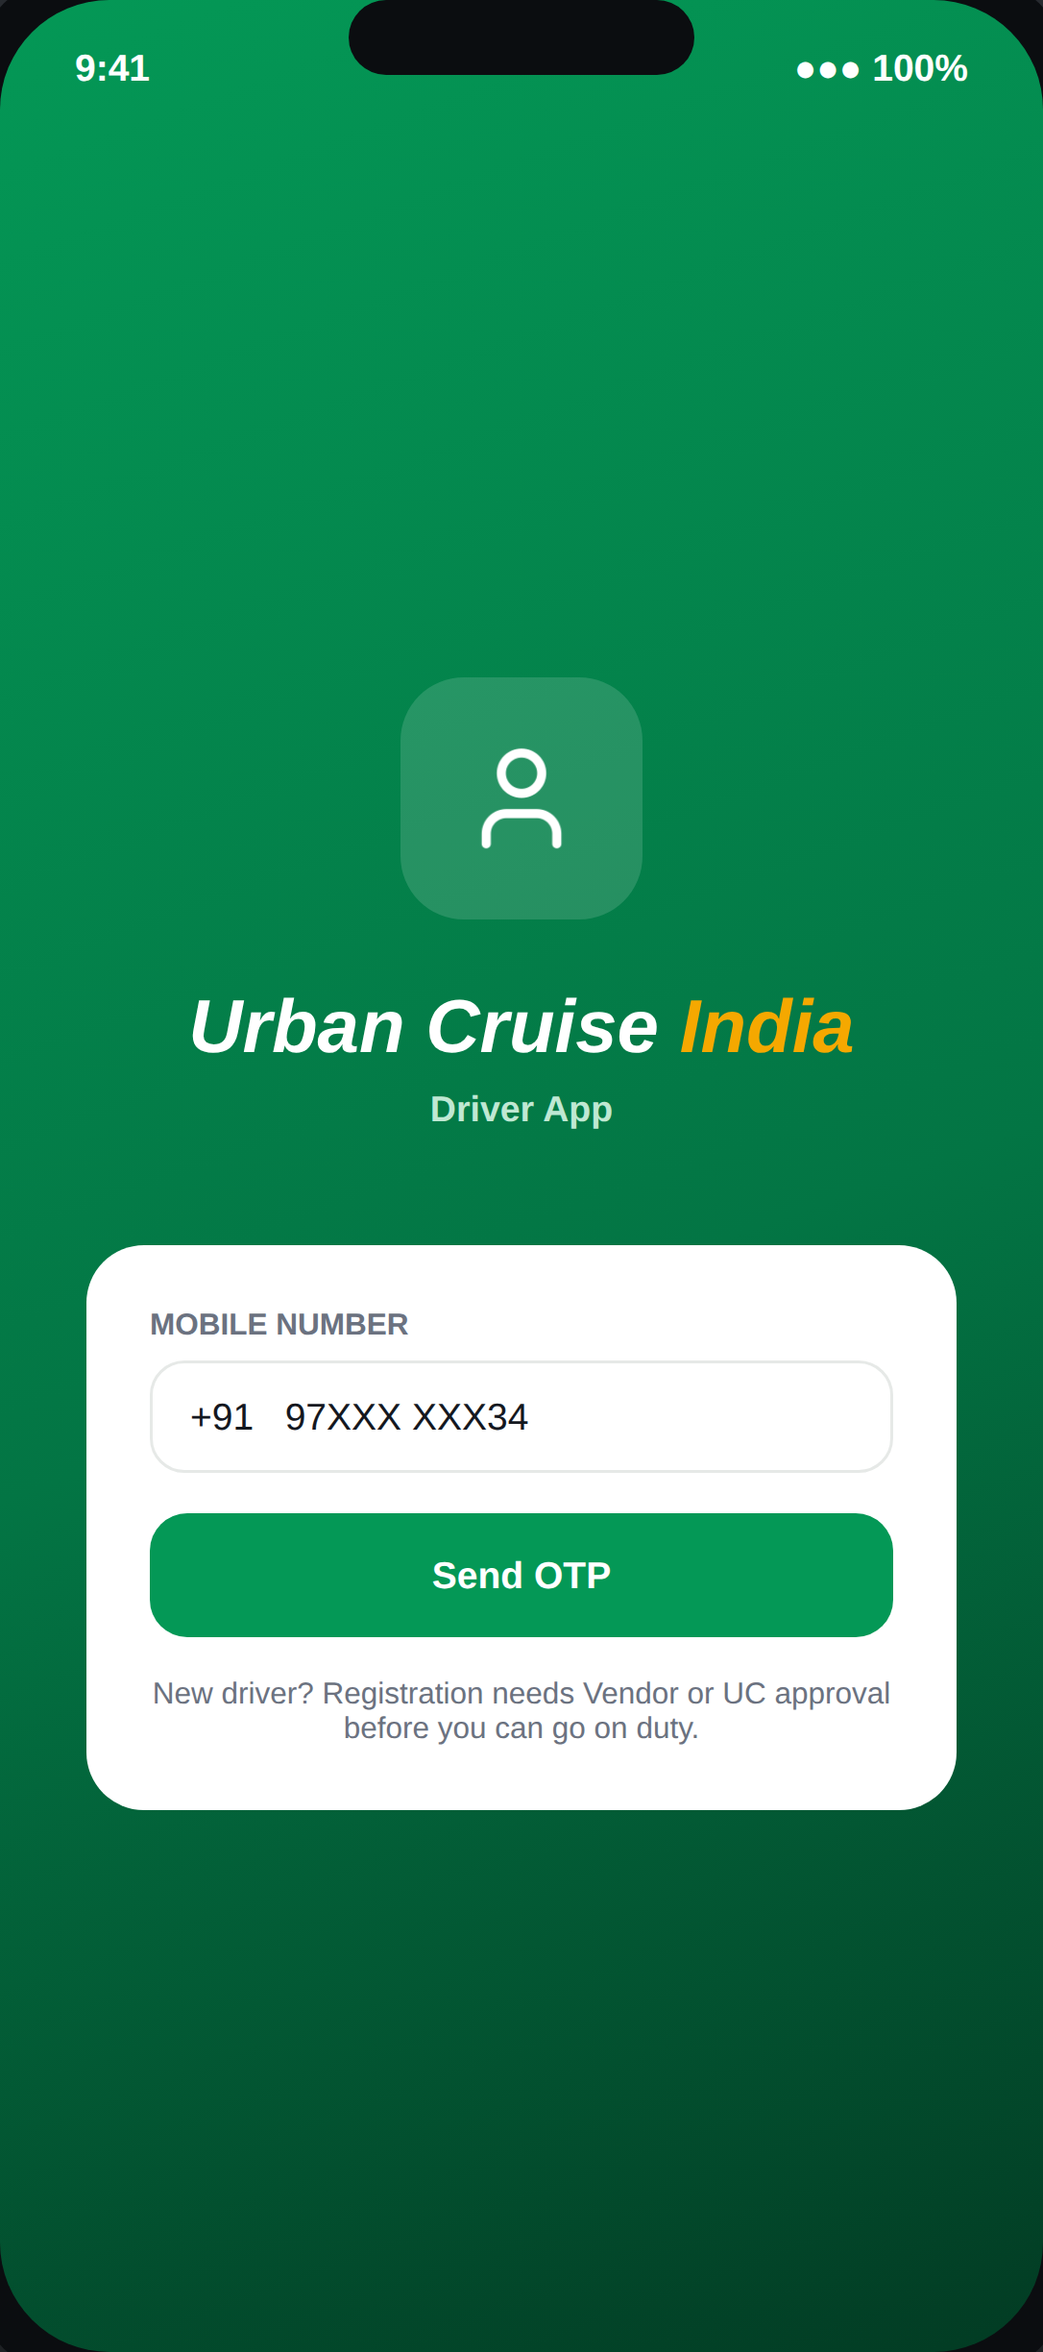
01
ENTRY POINT
Login & Onboarding
Phone + OTP self-registration. A new driver's profile sits in Pending Approval until either the Vendor or UC approves it — whichever acts first.
PINAAK — Driver App Walkthrough
2

Slide 3
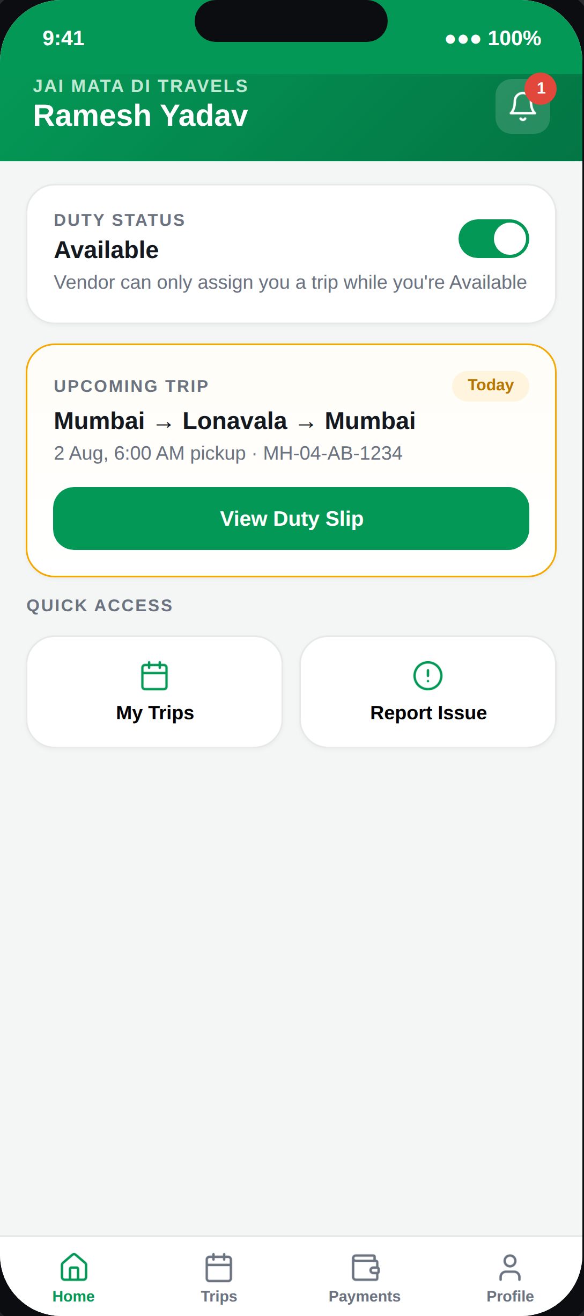
02
AVAILABILITY
Duty Status
The missing link that makes vendor-side assignment meaningful: a Vendor can only assign a trip to a driver who is marked Available.
PINAAK — Driver App Walkthrough
3

Slide 4
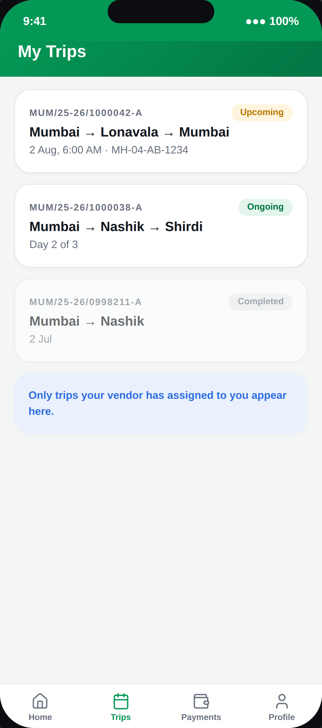
03
OVERVIEW
My Trips
A trip only appears here once the vendor has assigned this specific driver — never trips belonging to other drivers at the same vendor.
PINAAK — Driver App Walkthrough
4

Slide 5
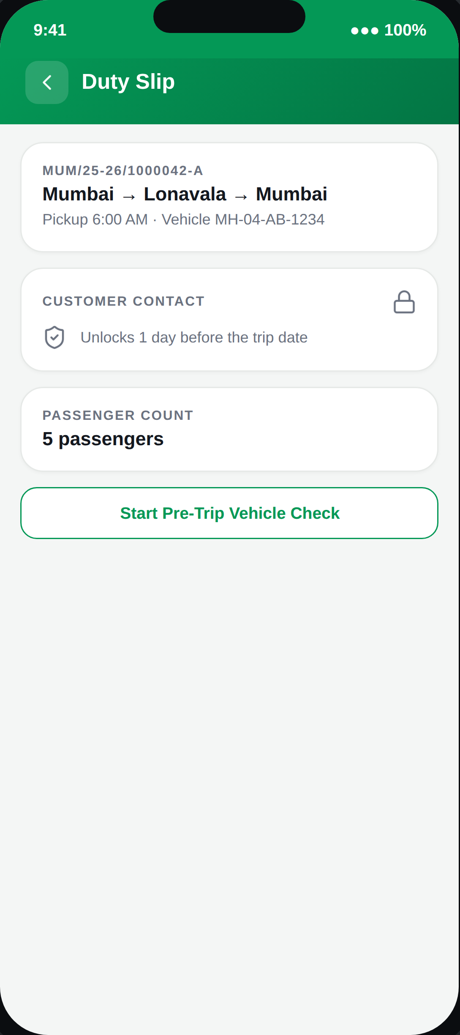
04
TRIP PREP
Duty Slip
Customer name and phone stay hidden until exactly 1 day before the trip date — an exact timing rule taken straight from the Masters access matrix.
PINAAK — Driver App Walkthrough
5

Slide 6
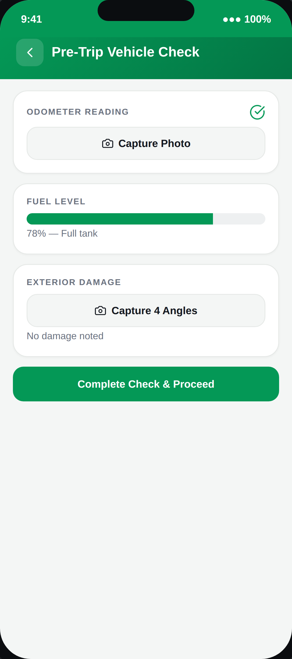
05
TRIP PREP
Pre-Trip Vehicle Check
A driver-owned record — odometer, fuel, damage photos — separate from the Vendor's own pre-dispatch checklist, since the driver is the one physically with the vehicle at departure.
PINAAK — Driver App Walkthrough
6

Slide 7
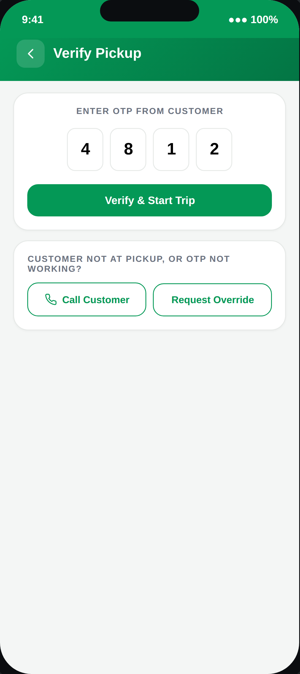
06
PICKUP
OTP Verification
If the OTP fails or the customer isn't there, the driver isn't stuck — Call Customer or Request Override routes to the Vendor/UC for a manual trip-start decision.
PINAAK — Driver App Walkthrough
7

Slide 8
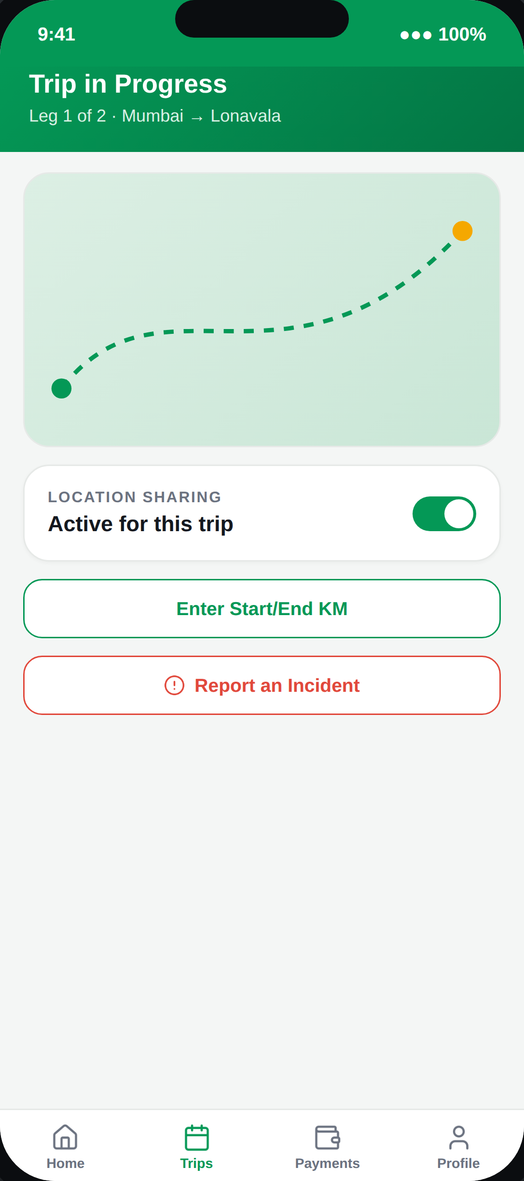
07
IN TRANSIT
Live Trip
Location sharing is scoped to the trip only — not always-on background tracking. Incident reporting is one tap away, right where a driver would need it.
PINAAK — Driver App Walkthrough
8

Slide 9
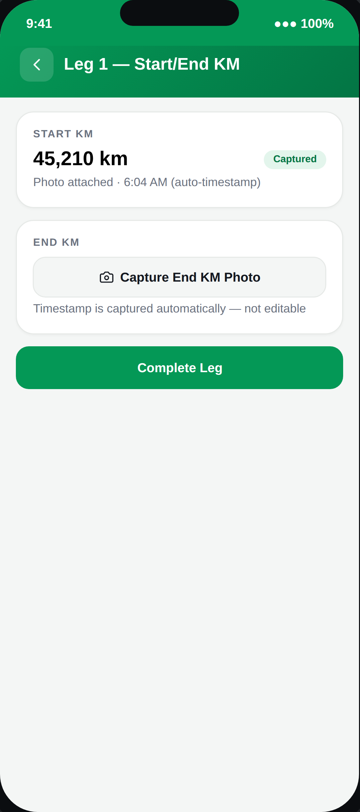
08
BILLING RECORD
Start/End KM Capture
One KM pair per itinerary leg, not one for the whole journey. The timestamp is system-generated at the moment of the photo — never typed in — which is what makes this record trustworthy for billing disputes.
PINAAK — Driver App Walkthrough
9

Slide 10
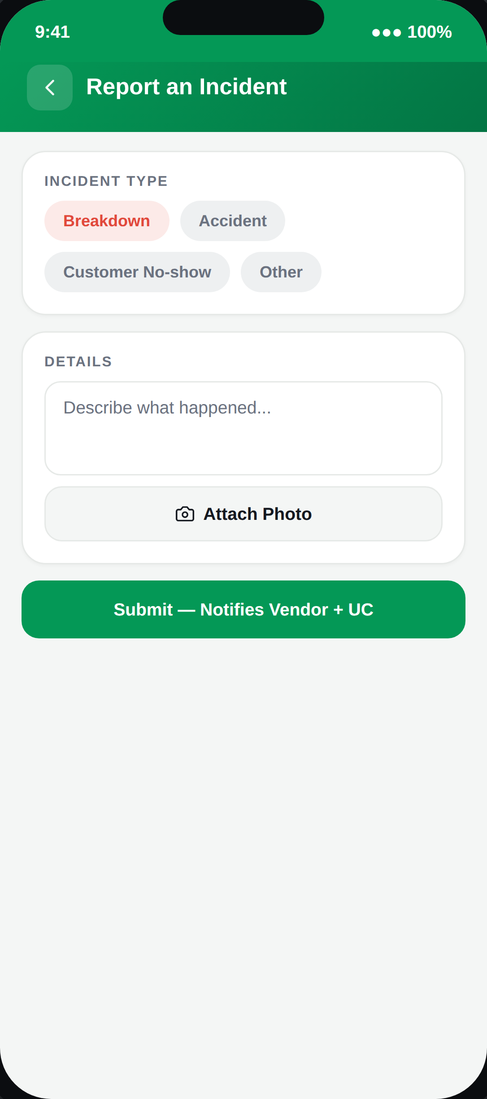
09
SAFETY
Incident Report
Breakdown, accident, or a customer no-show — submission notifies the Vendor and UC at the same time, not one waiting to notice after the other.
PINAAK — Driver App Walkthrough
10

Slide 11
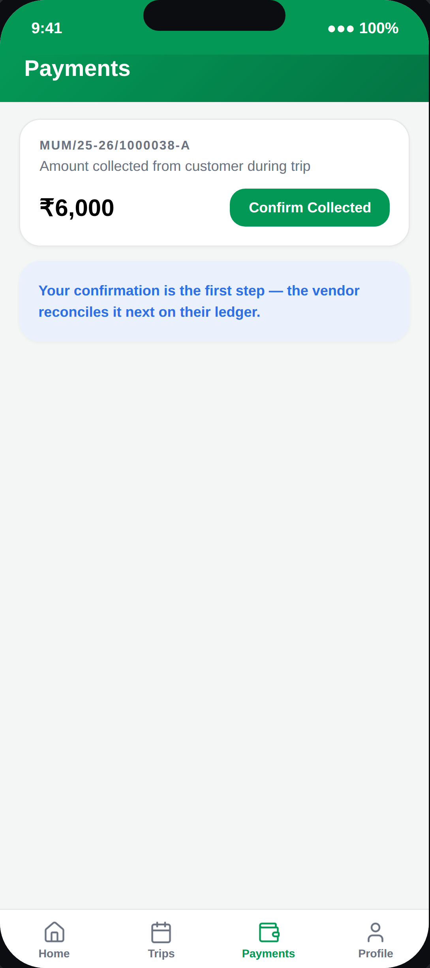
10
MONEY
Payments
The driver's confirmation is the first link in the reconciliation chain — the Vendor's own ledger then reconciles the same transaction on their side.
PINAAK — Driver App Walkthrough
11

Slide 12
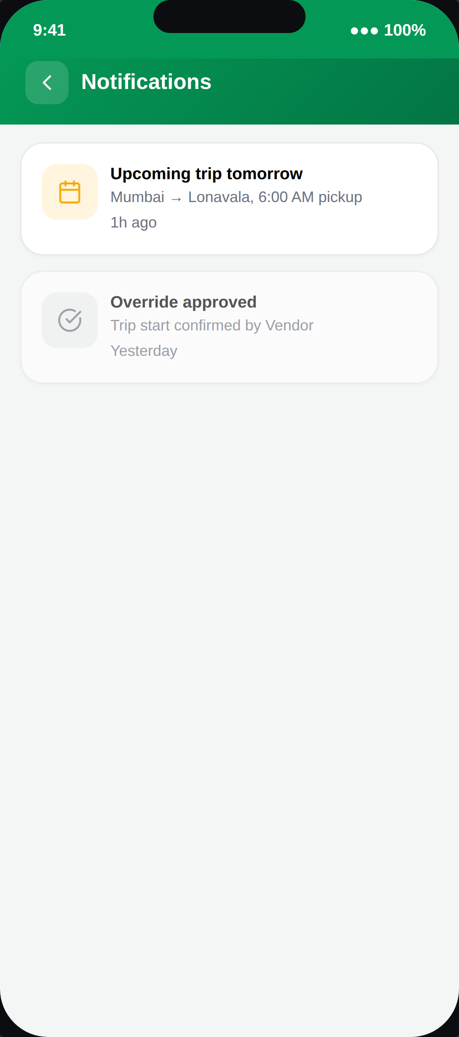
11
ALERTS
Notifications
Upcoming-trip reminders plus status updates on anything the driver has flagged — an override request, an incident report.
PINAAK — Driver App Walkthrough
12

Slide 13
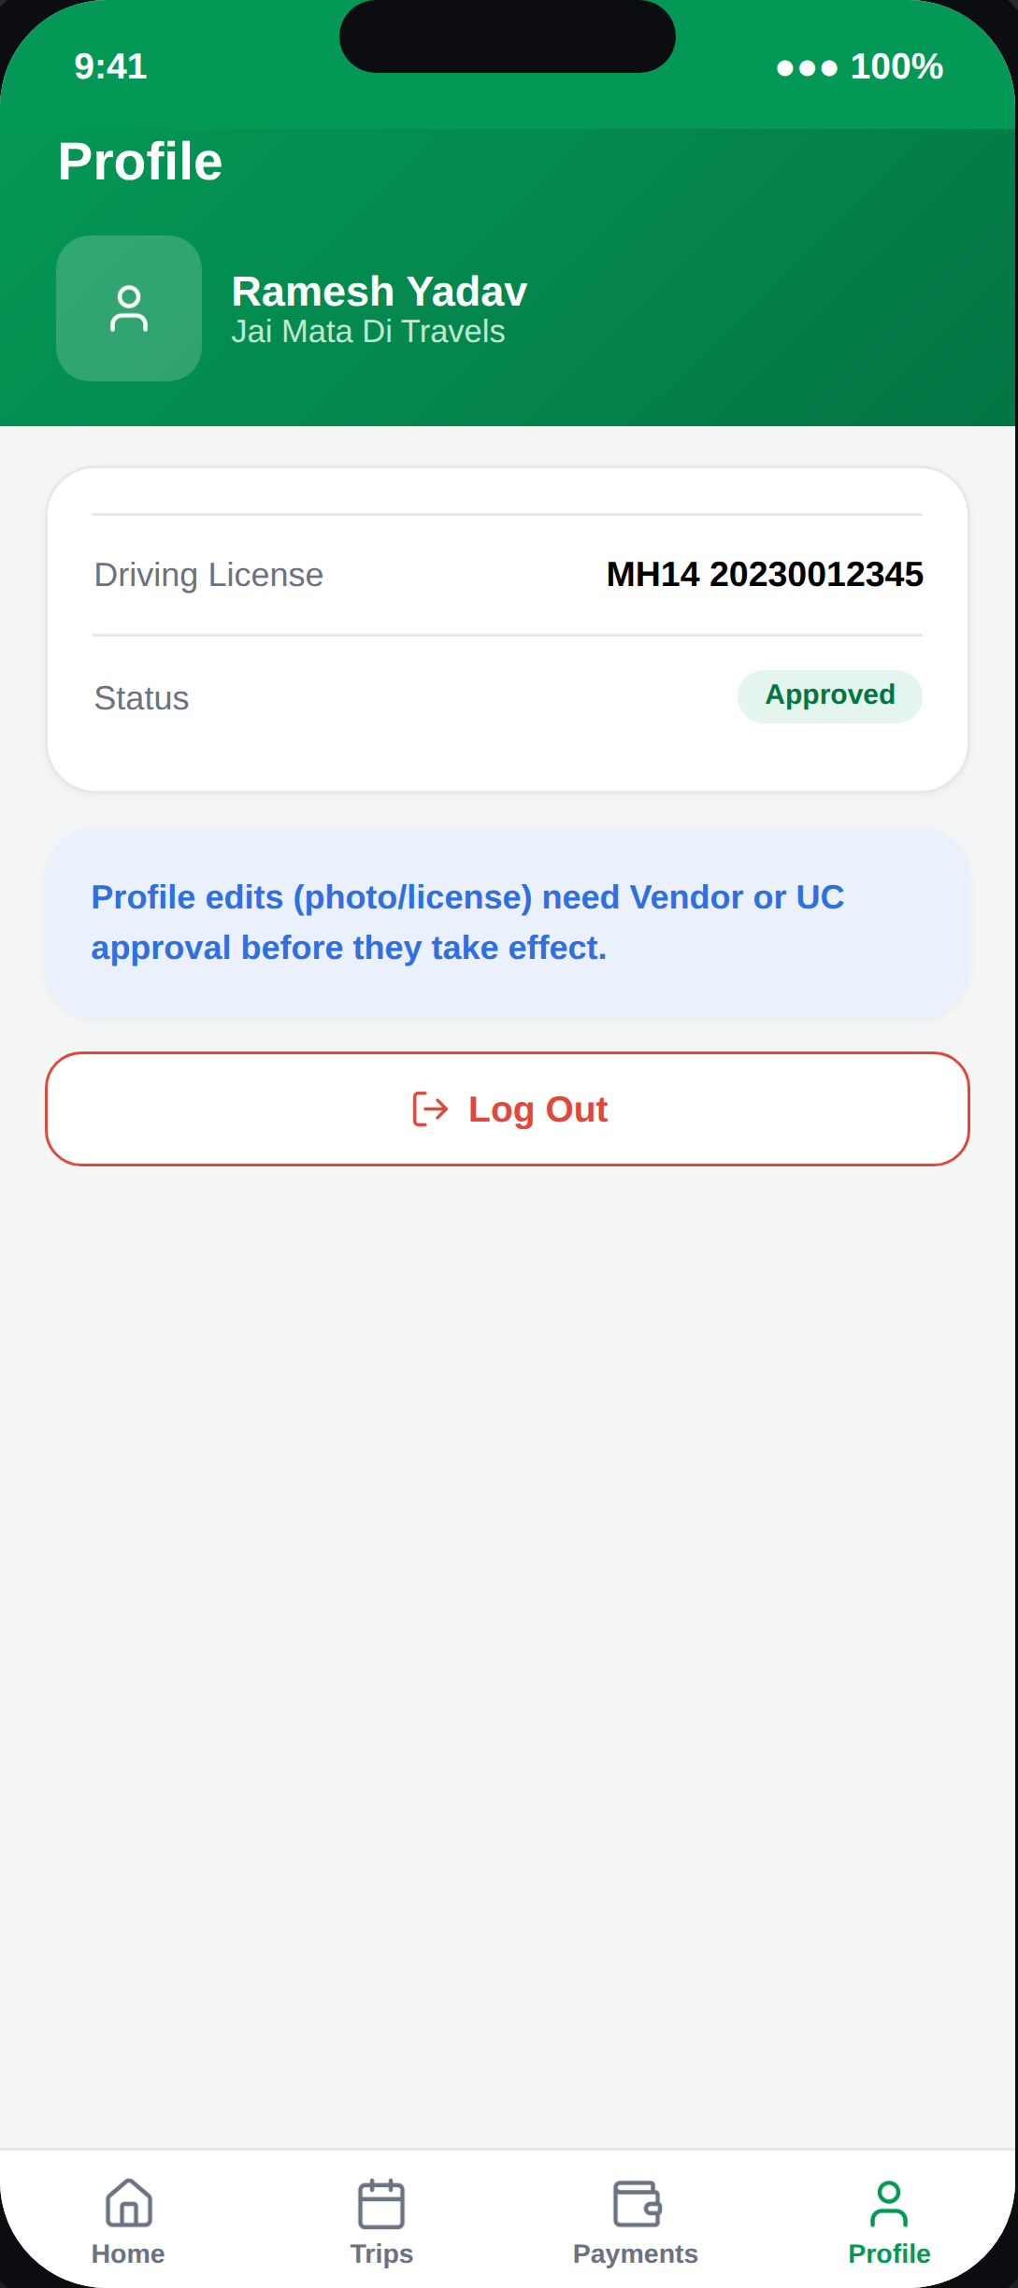
12
ACCOUNT
Profile
View-only for most fields — a driver can propose a photo or license update, but it needs Vendor or UC approval before it takes effect.
PINAAK — Driver App Walkthrough
13

Slide 14
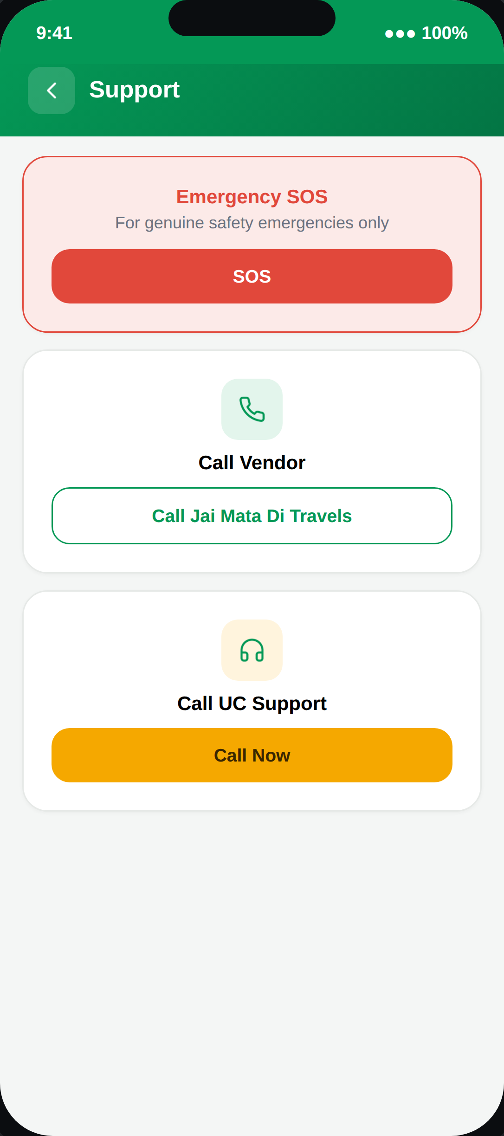
13
HELP & SAFETY
Support
A dedicated SOS sits above routine support — proposed now since it's cheap to build up front and standard in any fleet app, even though it wasn't in the original requirement.
PINAAK — Driver App Walkthrough
14

