Slide 1
URBAN CRUISE INDIA
PINAAK Customer App
A screen-by-screen walkthrough — from quotation to feedback
PINAAK — Customer App Walkthrough
1

Slide 2
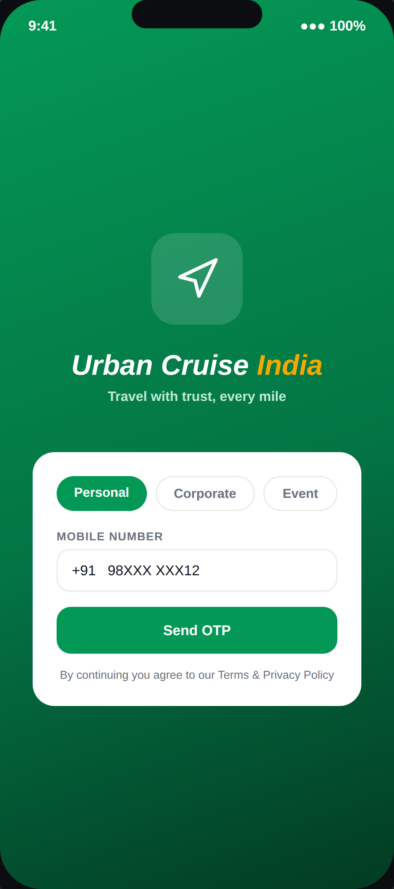
01
ENTRY POINT
Login & Account Type
Personal, Corporate, and Event customers share one login screen — the account type determines what they see next. Corporate/Event accounts have 3 logins (Booking Person, Admin, A/C) sharing one profile.
PINAAK — Customer App Walkthrough
2

Slide 3
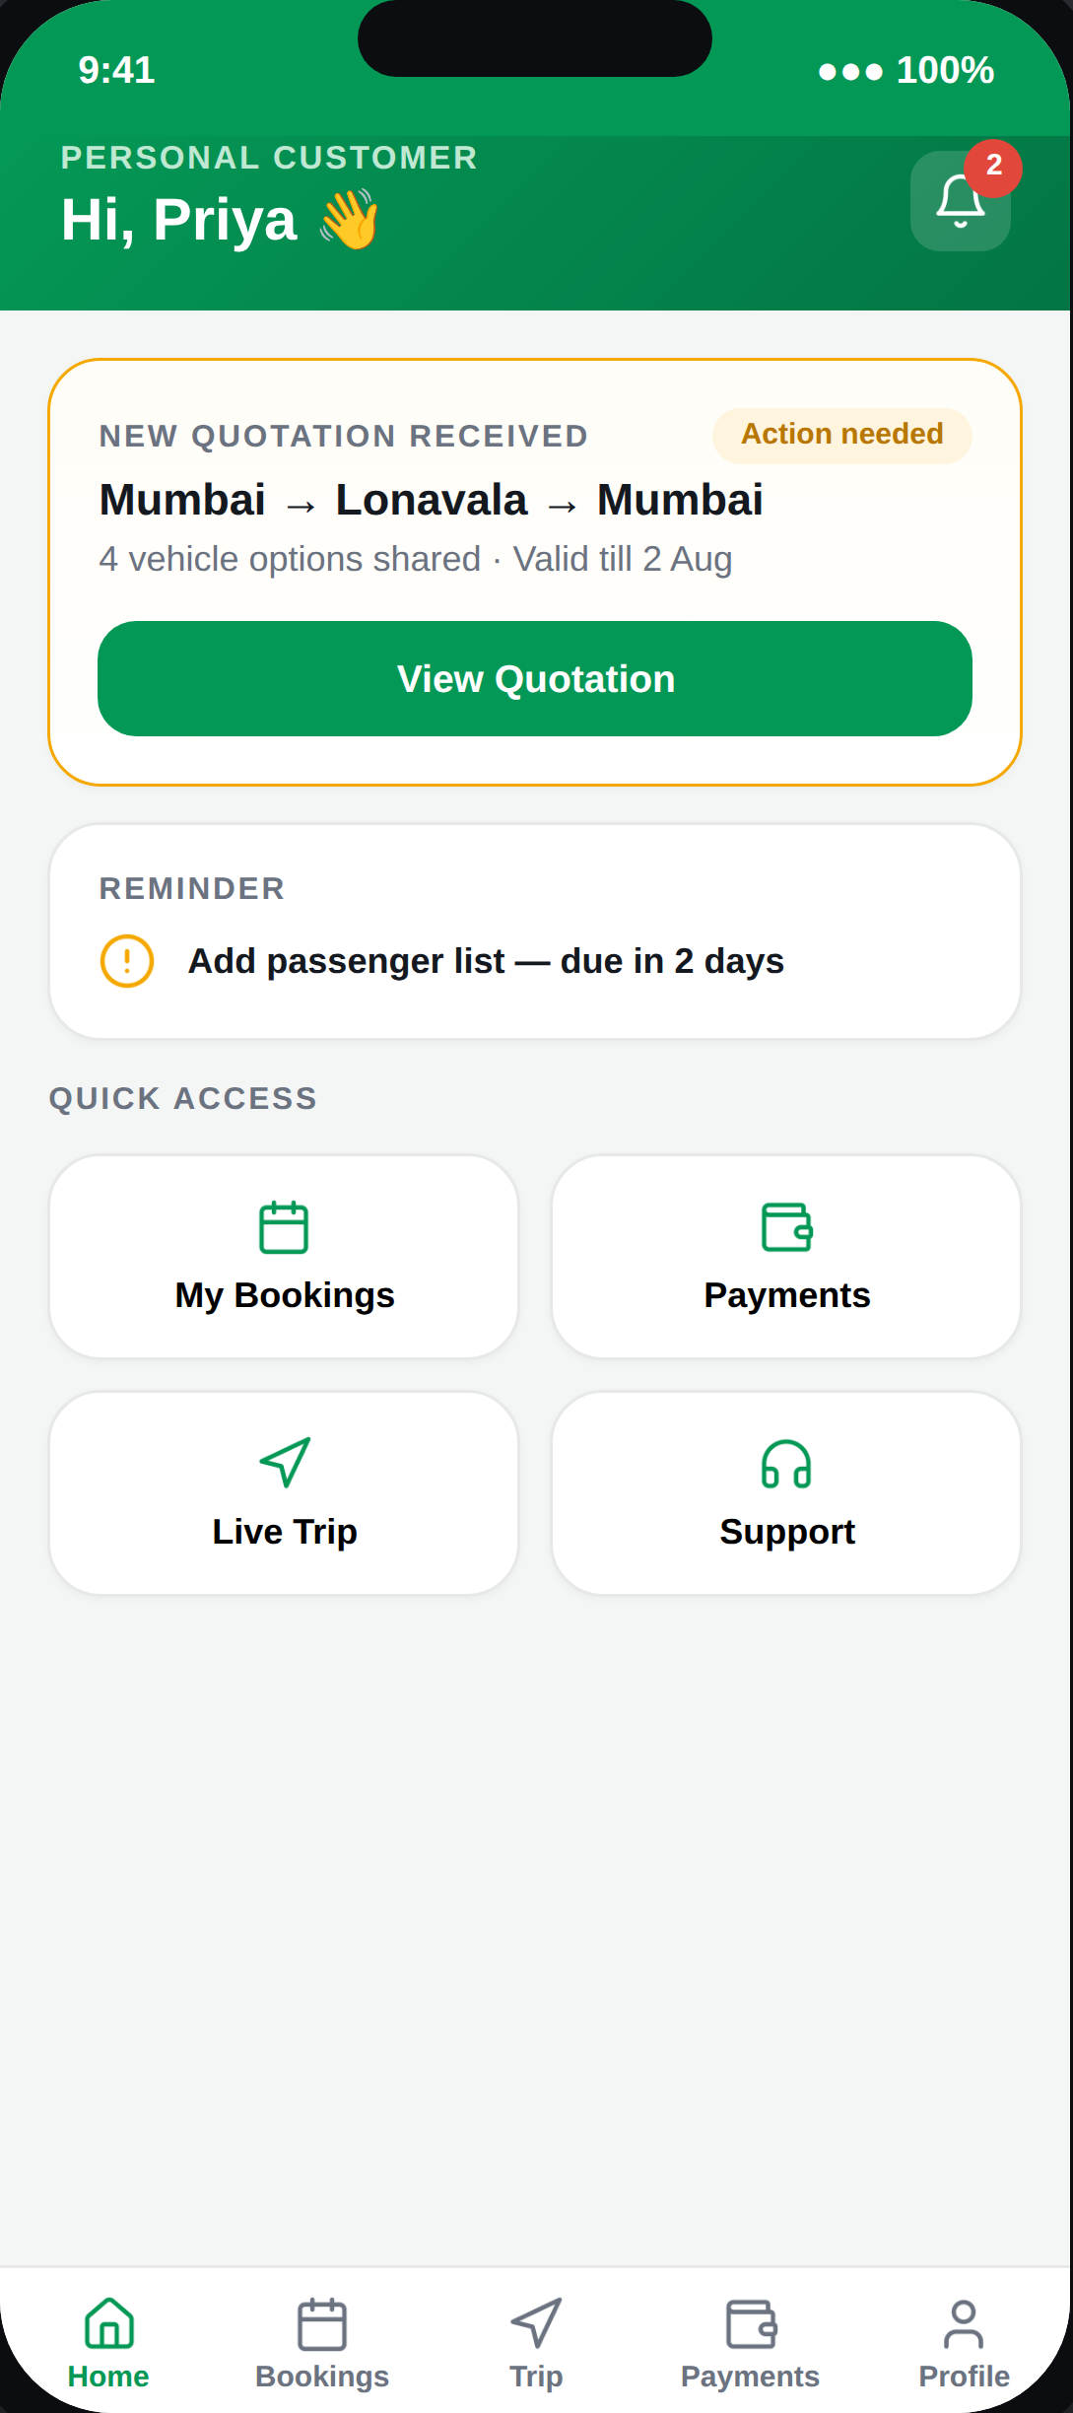
02
DASHBOARD
Home
Always surfaces exactly one “next action” card — never more than one — so a customer with multiple bookings in flight isn't overwhelmed with competing prompts.
PINAAK — Customer App Walkthrough
3

Slide 4
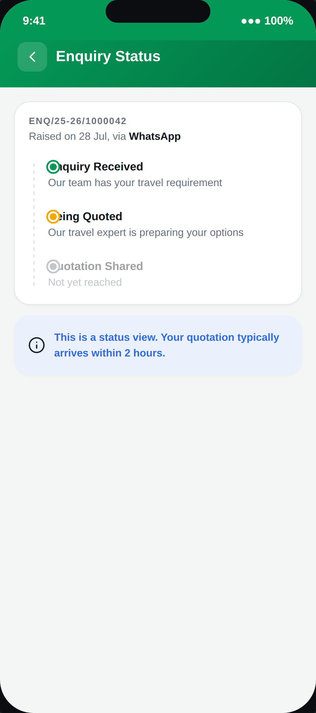
03
PRE-QUOTATION
Enquiry Status
A read-only status mirror — the enquiry itself is raised and managed by our team via the Admin Portal, not created inside this app.
PINAAK — Customer App Walkthrough
4

Slide 5
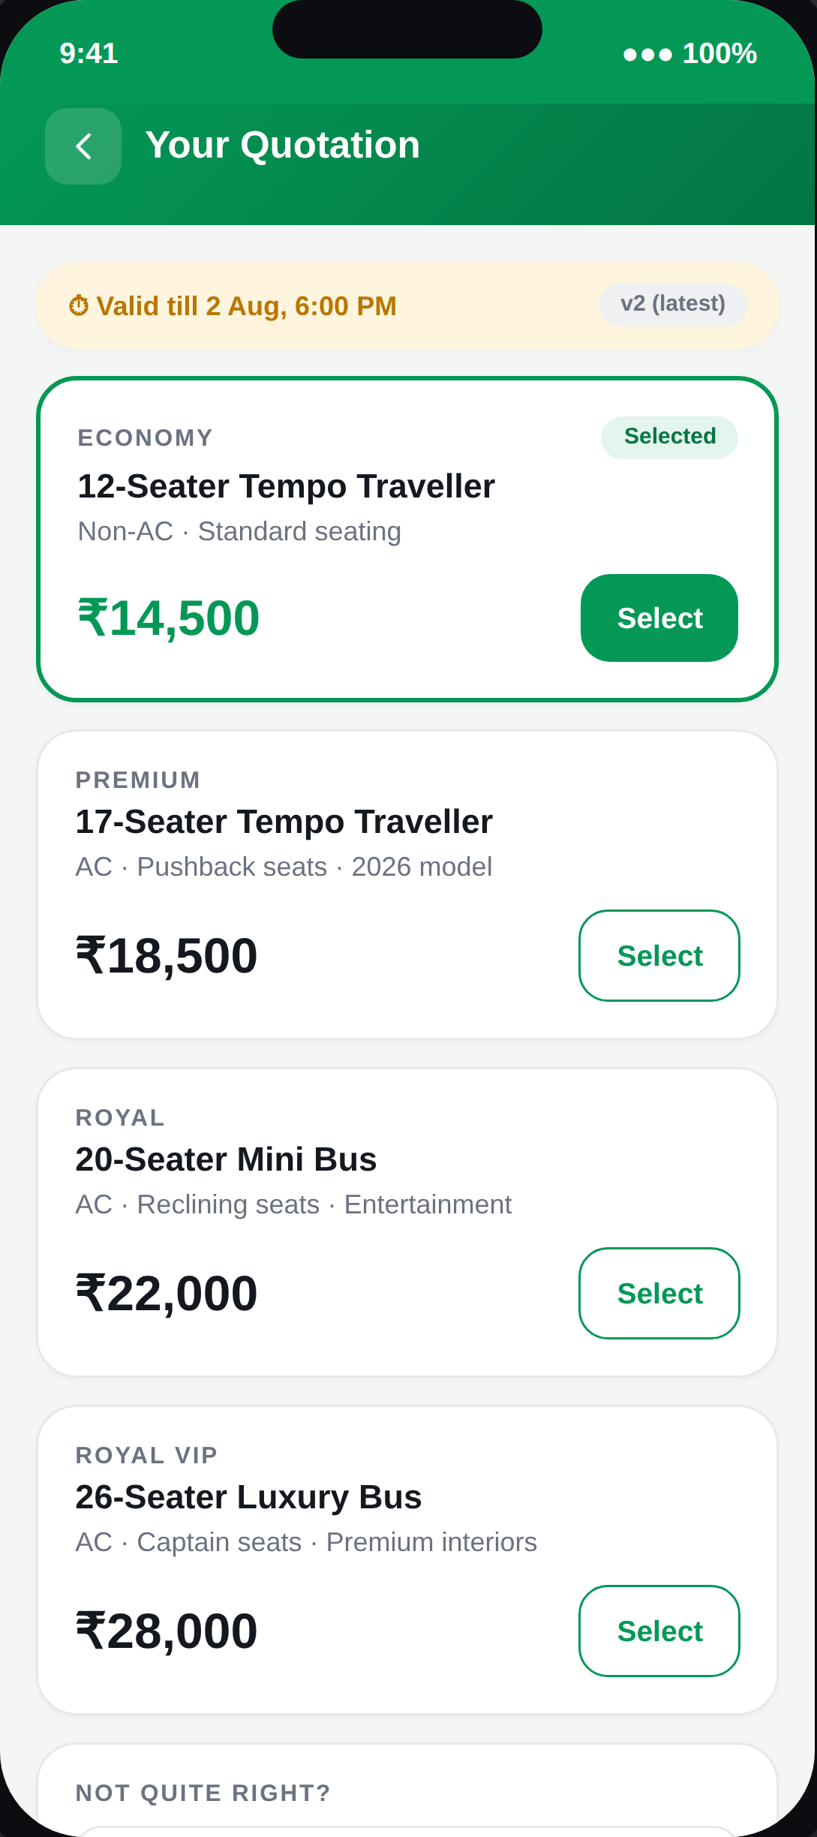
04
DECISION POINT
Quotation — Tiered Comparison
All vehicle tiers shown side by side. A customer can select a tier immediately, or leave a remark — which starts a new quotation version rather than a dead end.
PINAAK — Customer App Walkthrough
5

Slide 6
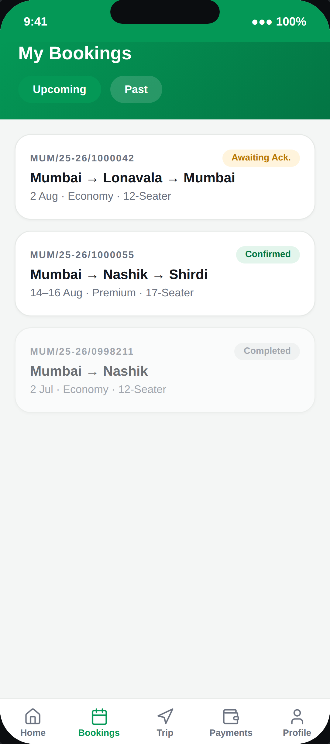
05
OVERVIEW
My Bookings
Upcoming and Past, at a glance. Booking ID always equals the Quotation ID — the same identifier is used by our Vendor and Driver apps downstream.
PINAAK — Customer App Walkthrough
6

Slide 7
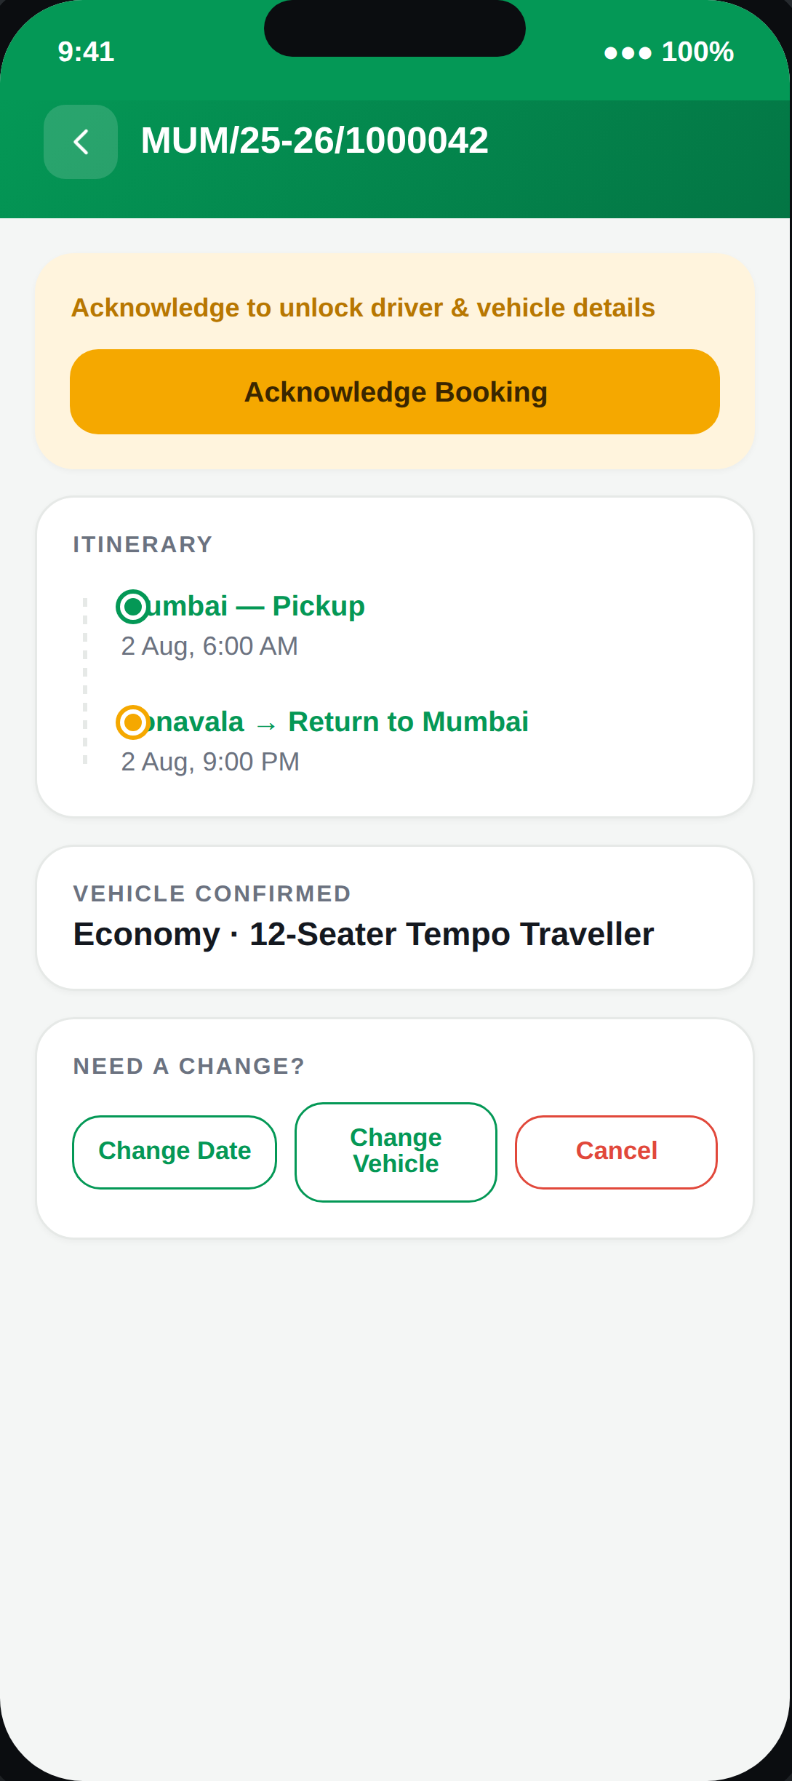
06
CONFIRMATION
Booking Detail
Driver and vehicle details stay locked until the customer acknowledges the booking. Modification requests (date, vehicle, cancellation) all route through one consistent tracker.
PINAAK — Customer App Walkthrough
7

Slide 8
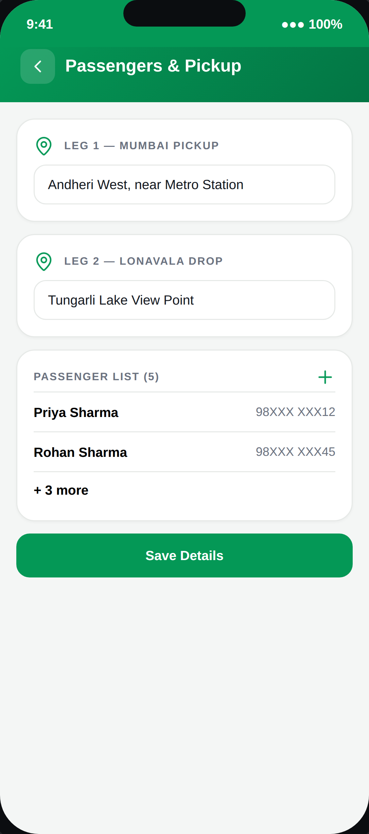
07
TRIP PREP
Passengers & Pickup
Multi-city itineraries get a pickup address per leg, not one address for the whole trip — matching how our real itineraries actually run.
PINAAK — Customer App Walkthrough
8

Slide 9
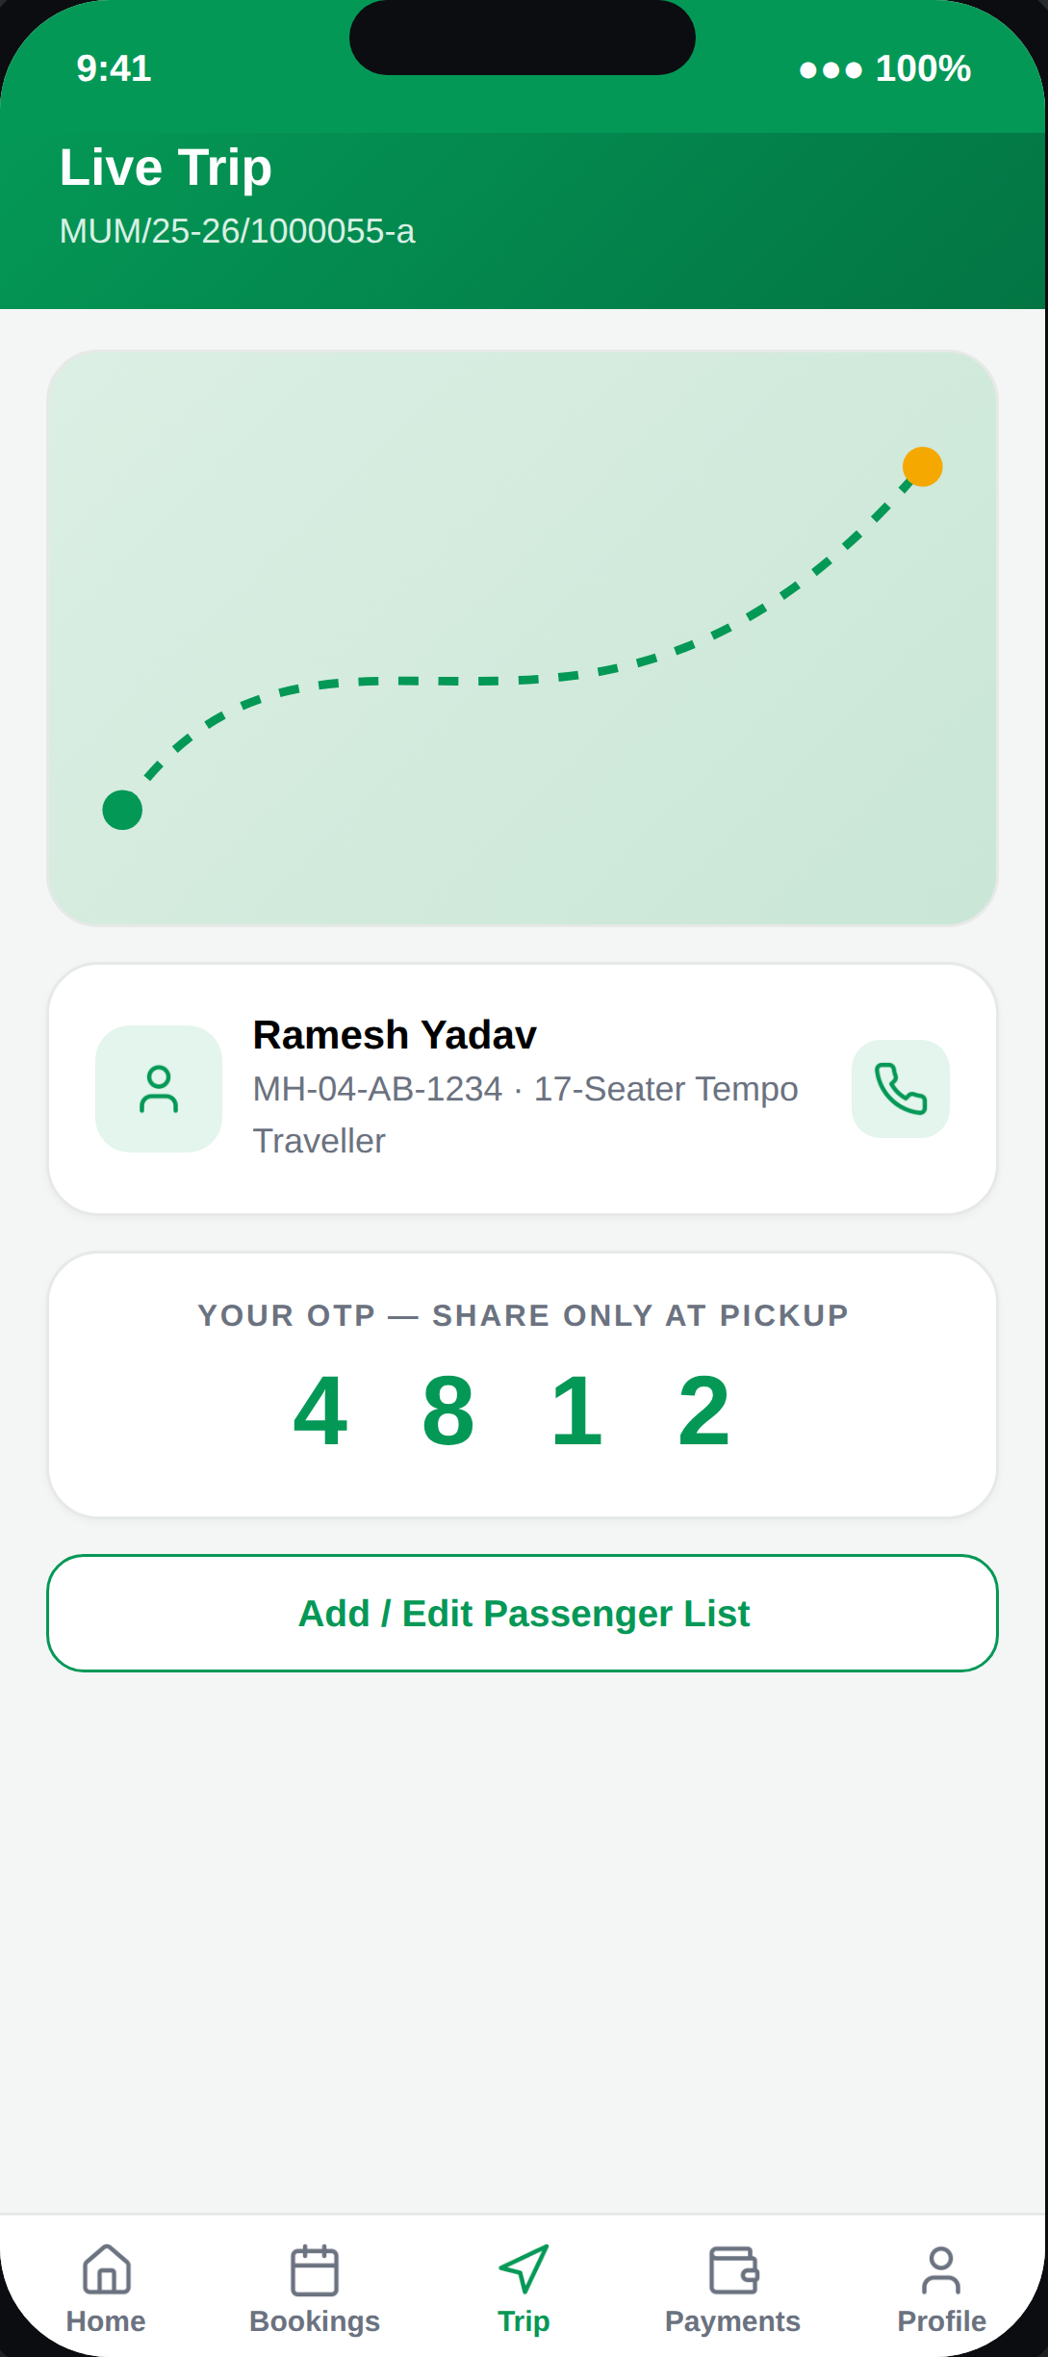
08
IN TRANSIT
Live Trip
Live location, driver contact, and a one-time OTP the customer hands to the driver at pickup — the final check before the trip begins.
PINAAK — Customer App Walkthrough
9

Slide 10
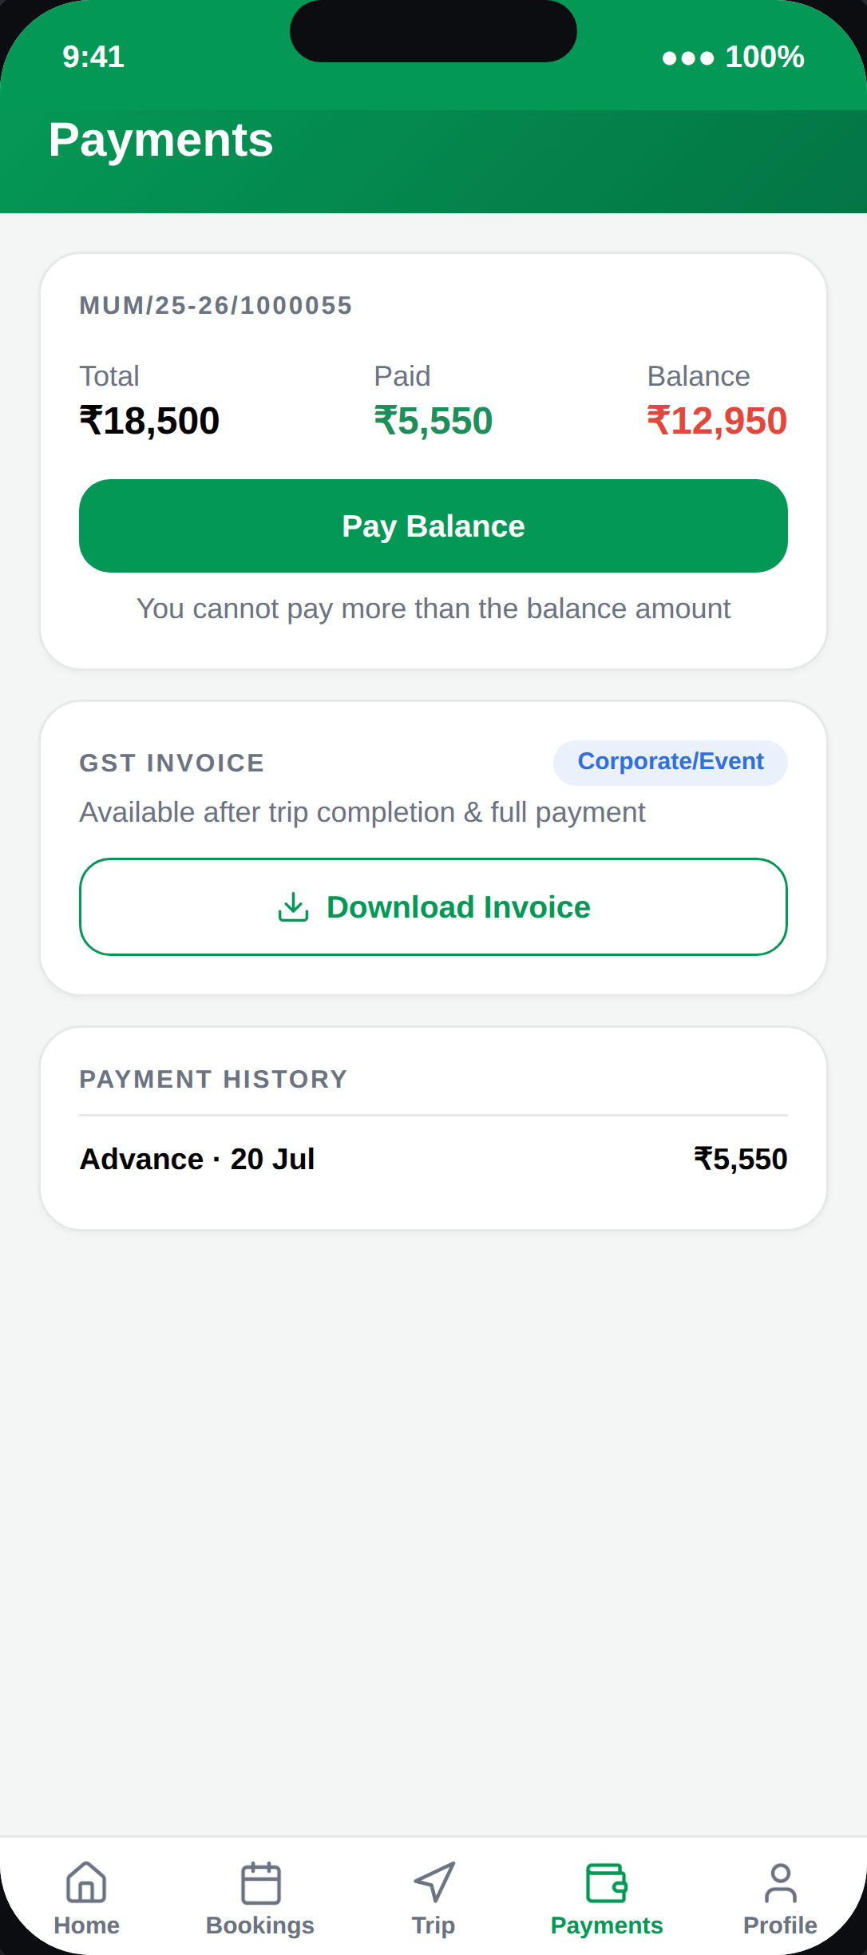
09
MONEY
Payments
Total, paid, and balance are always visible. Payment can never exceed the balance due. Corporate/Event bookings get a downloadable GST invoice once the trip is complete.
PINAAK — Customer App Walkthrough
10

Slide 11
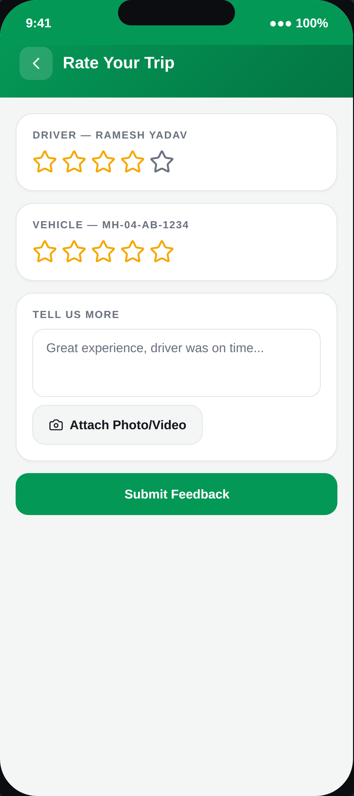
10
POST-TRIP
Feedback
Separate ratings for driver and vehicle, plus optional photo/video — unlocked only once a trip is marked complete.
PINAAK — Customer App Walkthrough
11

Slide 12
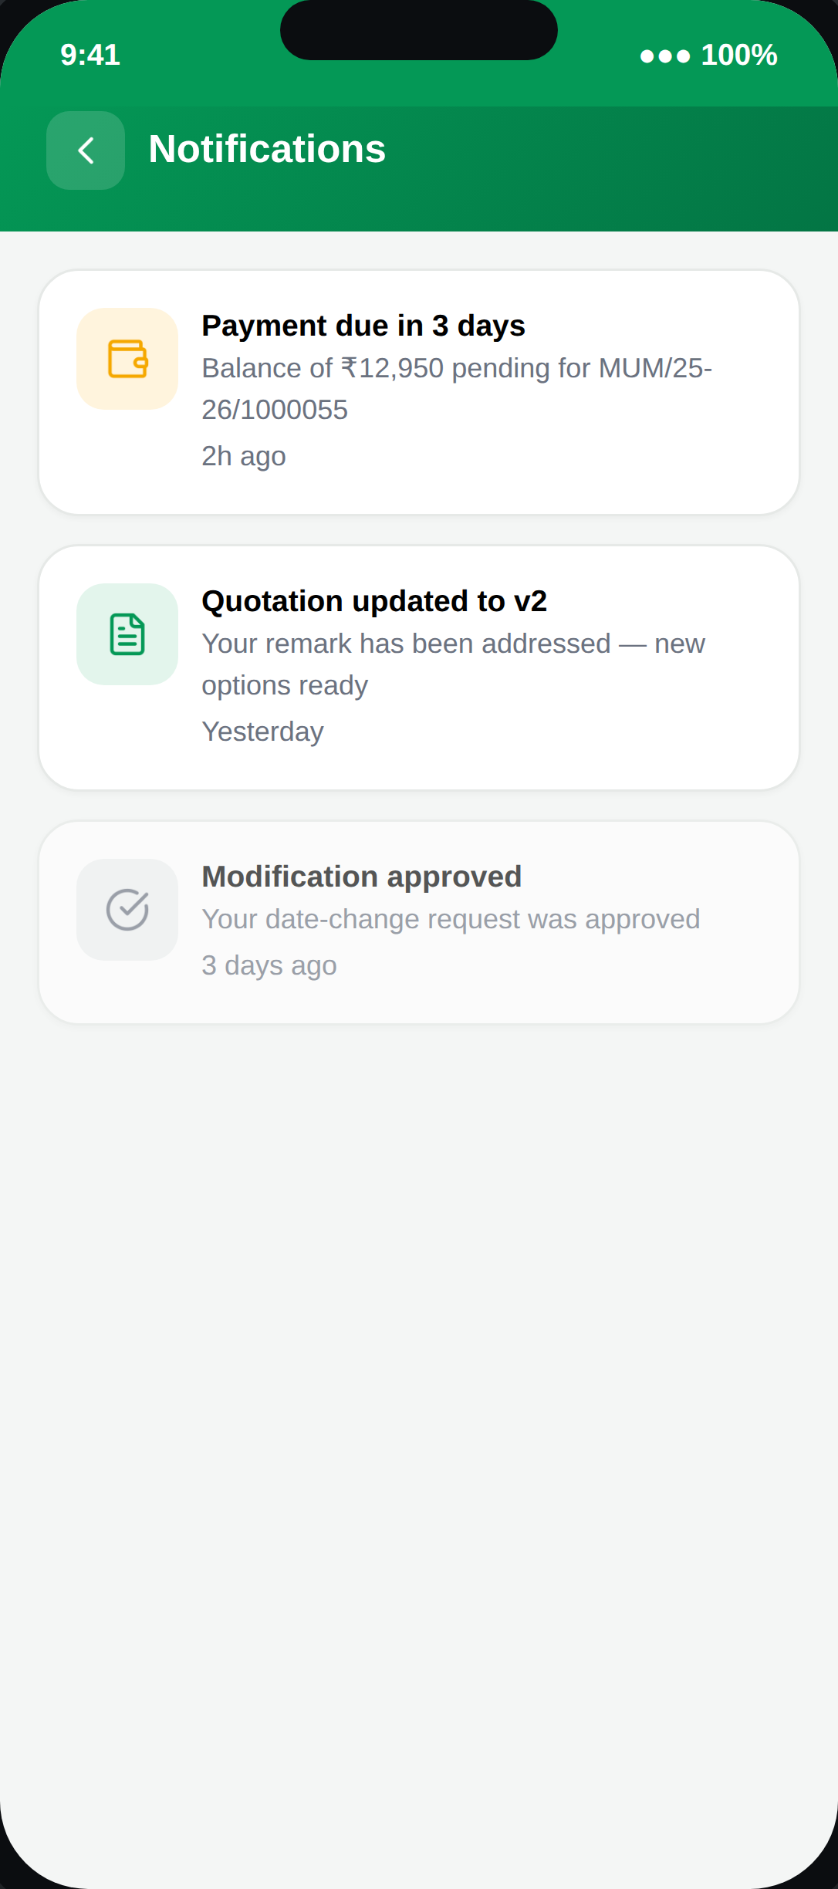
11
ALERTS
Notification Centre
Every reminder here is triggered by a backend event — payment due, quotation revised, request approved — never a client-side timer, so nothing is missed on a new device.
PINAAK — Customer App Walkthrough
12

Slide 13
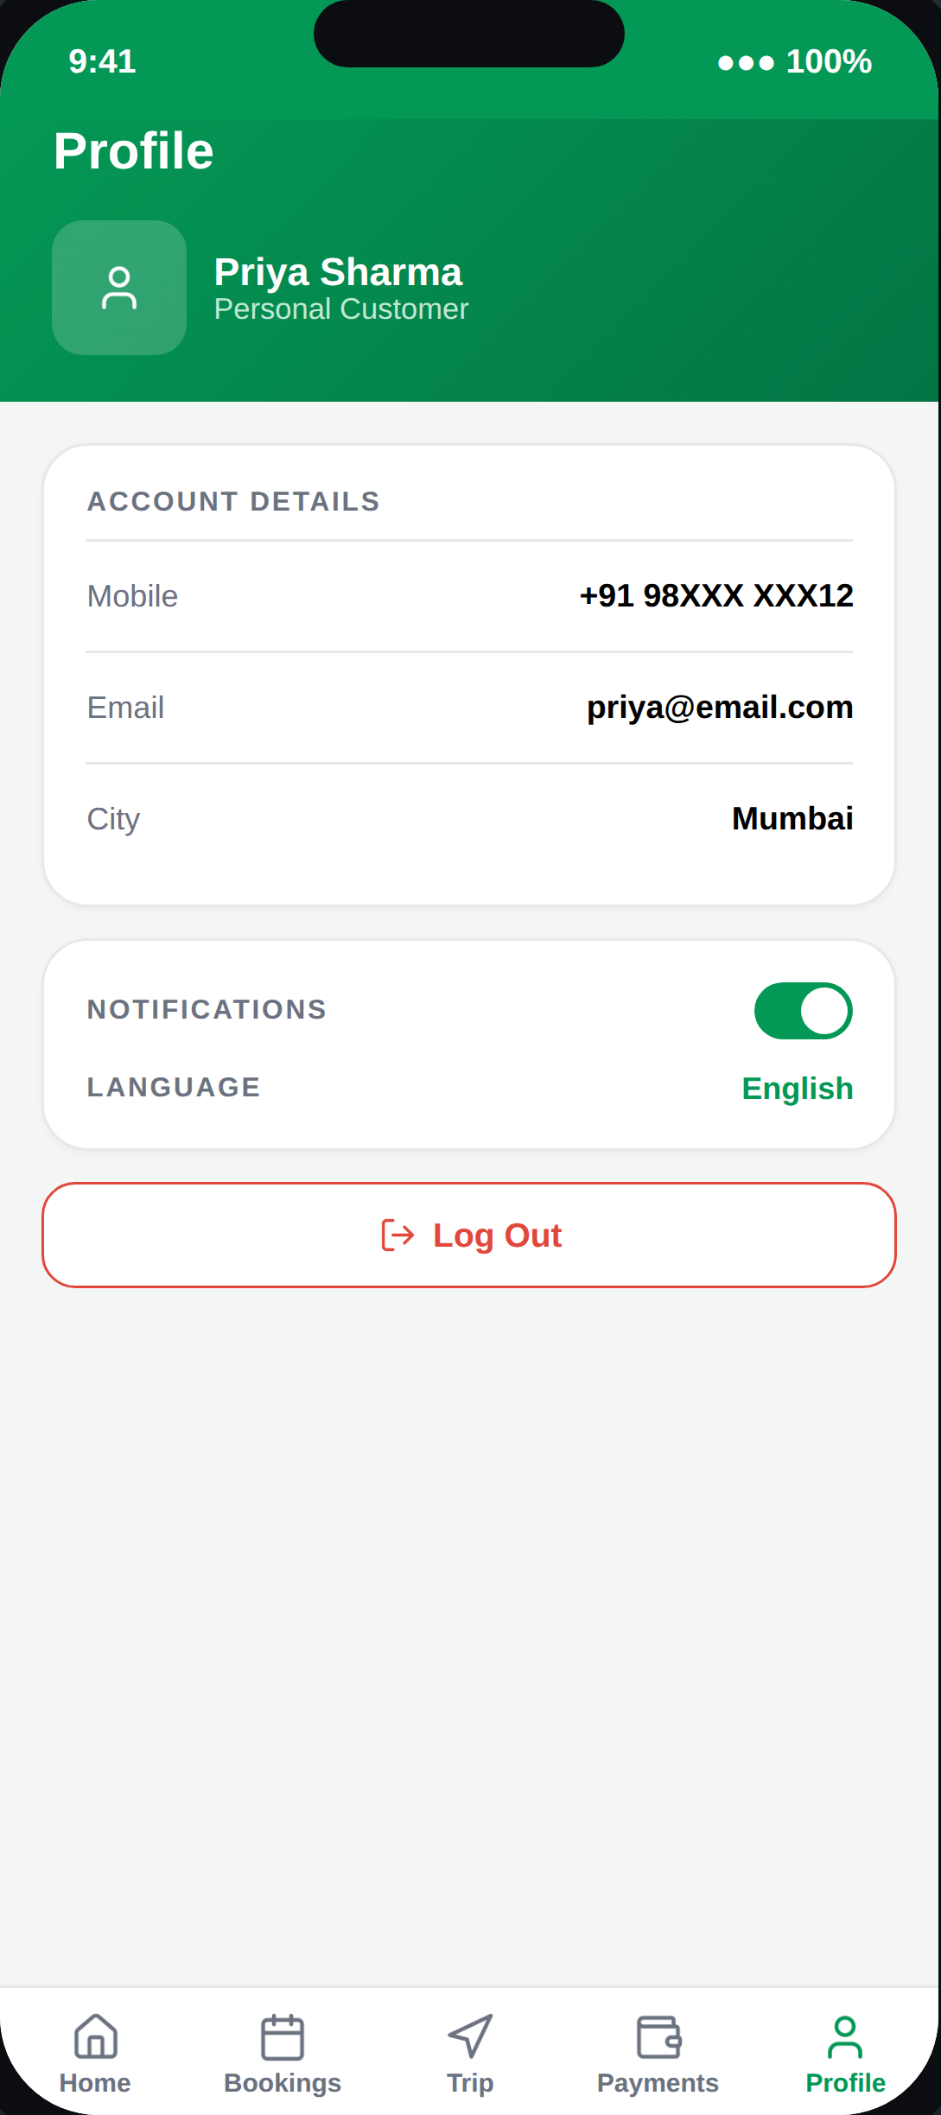
12
ACCOUNT
Profile
For Corporate/Event accounts, only the Admin login can edit account-level details — Booking Person and A/C logins are scoped to bookings and payments respectively.
PINAAK — Customer App Walkthrough
13

Slide 14
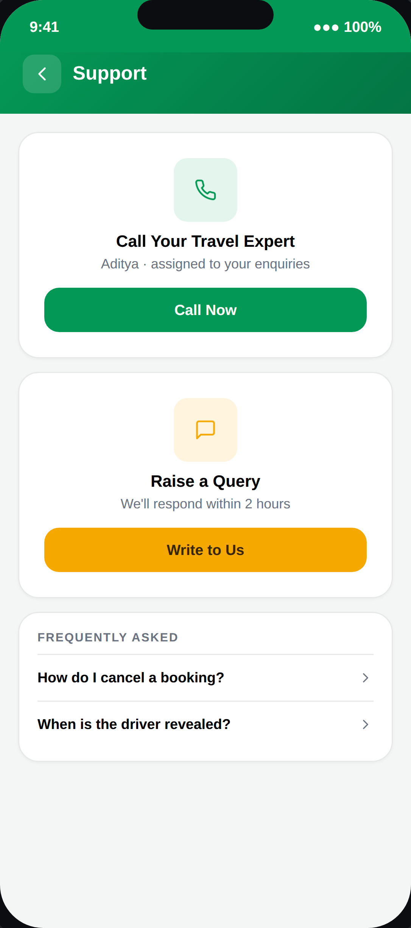
13
HELP
Support
A routing screen, not a chatbot — it hands the customer to a human, either by call or a logged query, within a committed response window.
PINAAK — Customer App Walkthrough
14

