Slide 1
URBAN CRUISE INDIA
PINAAK Vendor App
A screen-by-screen walkthrough — from assignment to payout
PINAAK — Vendor App Walkthrough
1

Slide 2
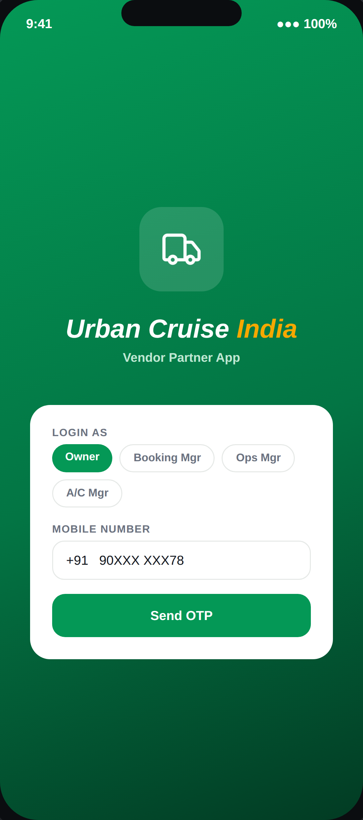
01
ENTRY POINT
Login & Sub-Role
One Vendor ID, up to 4 logins — Owner, Booking Manager, Ops Manager, A/C Manager. Permission is bound to which login was used, enforced on the backend.
PINAAK — Vendor App Walkthrough
2

Slide 3
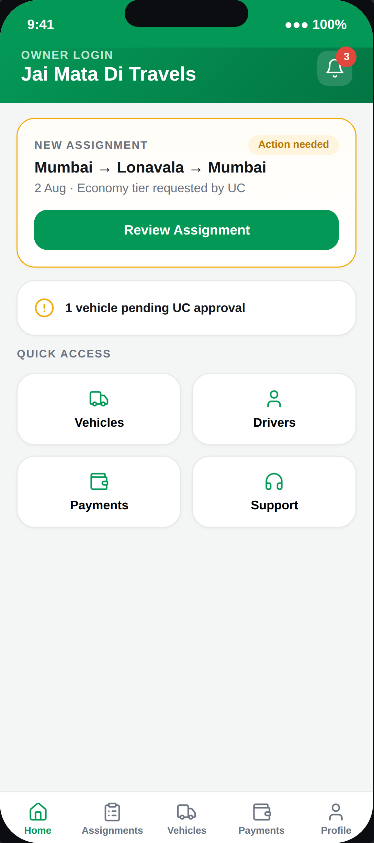
02
DASHBOARD
Home
Each sub-role's home screen surfaces only what that role can act on — no dead-end cards pointing at actions the logged-in role can't perform.
PINAAK — Vendor App Walkthrough
3

Slide 4
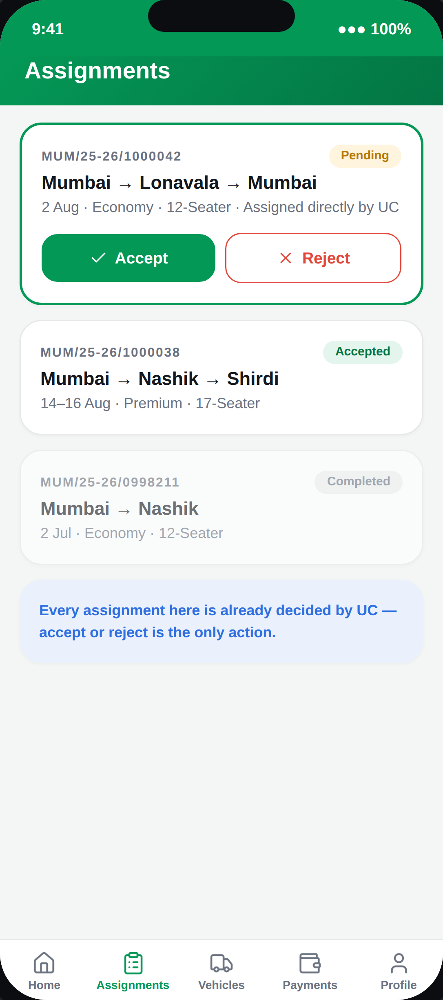
03
BOOKING INTAKE
Assignments
Every booking here is already decided by UC — usually over a phone call checking availability and rate. The vendor's only in-app action is Accept or Reject; there's no bidding or competing with other vendors.
PINAAK — Vendor App Walkthrough
4

Slide 5
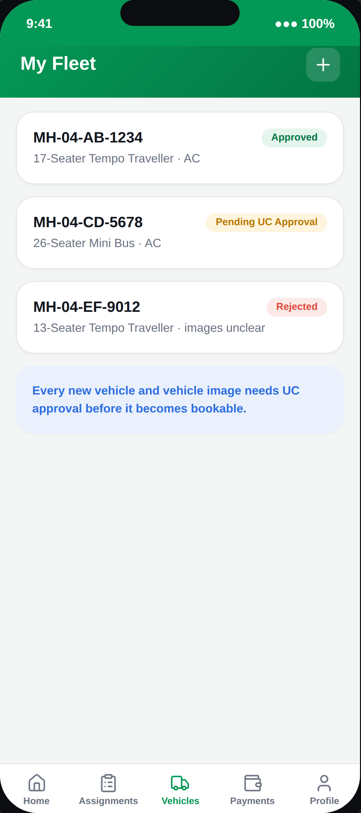
04
FLEET
Vehicle Master
Vendors can add and edit vehicles, but every vehicle and every vehicle image needs UC approval before it becomes bookable.
PINAAK — Vendor App Walkthrough
5

Slide 6
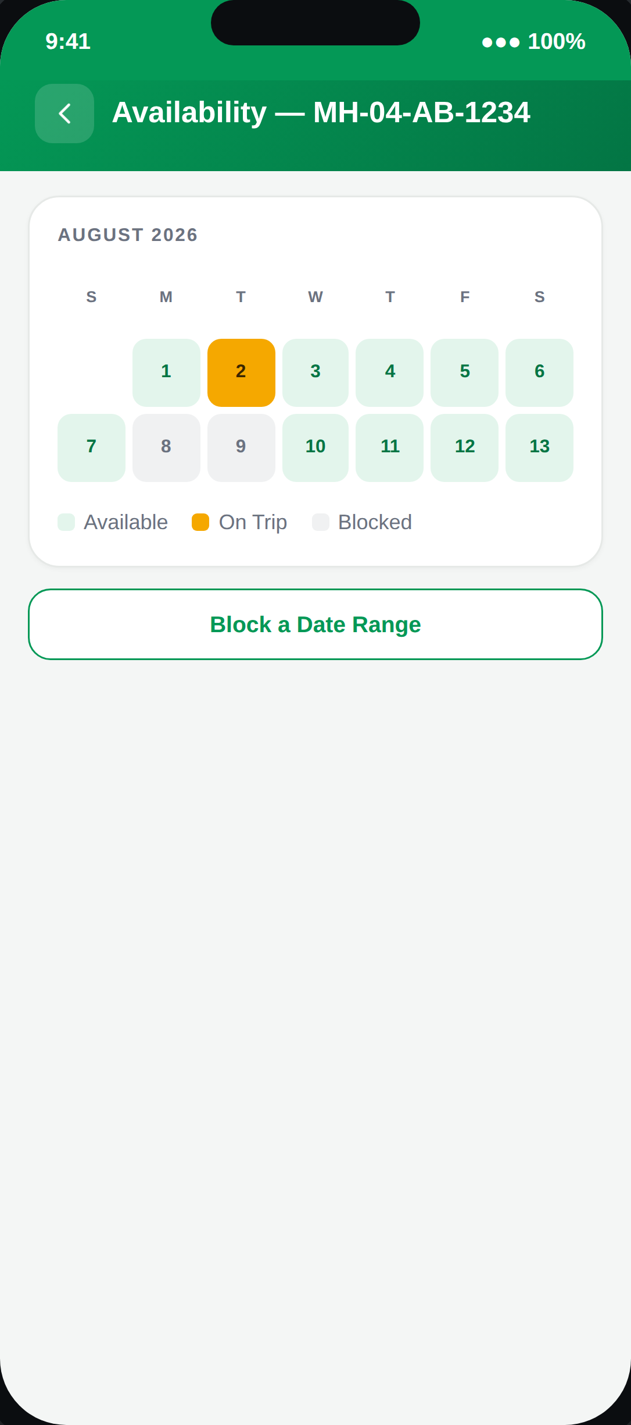
05
FLEET
Vehicle Availability Calendar
A vendor can block a vehicle for personal use or maintenance — this tells UC the vehicle can't be offered for those dates during their manual availability check.
PINAAK — Vendor App Walkthrough
6

Slide 7
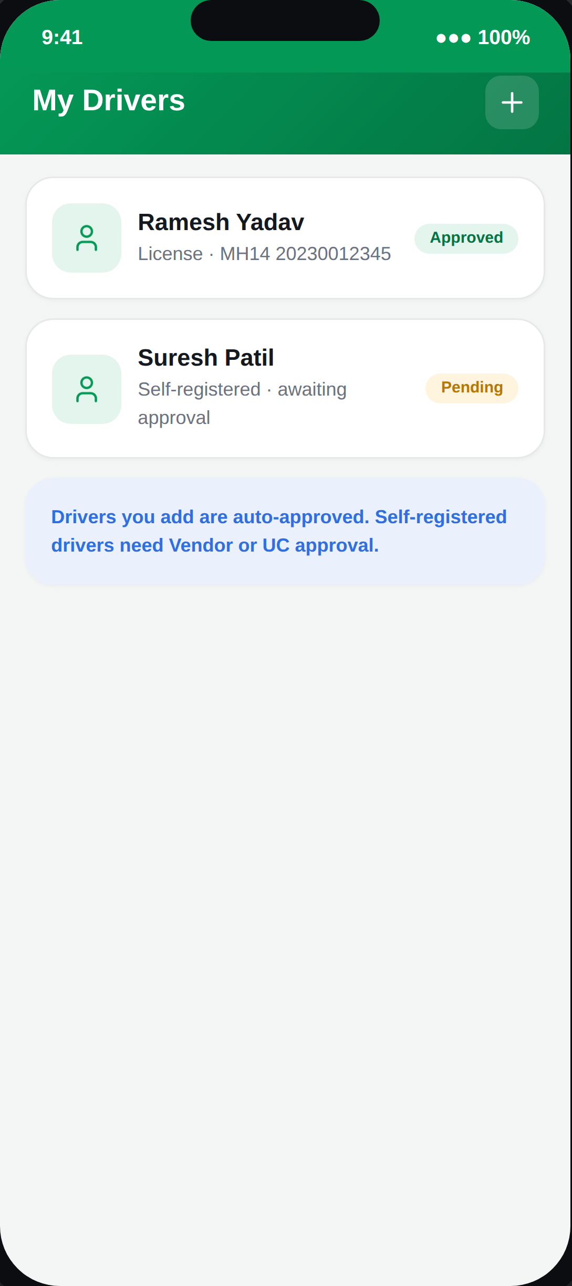
06
FLEET
Driver Master
Drivers a vendor adds directly are auto-approved. A driver who self-registers via the Driver app needs approval from either the Vendor or UC.
PINAAK — Vendor App Walkthrough
7

Slide 8
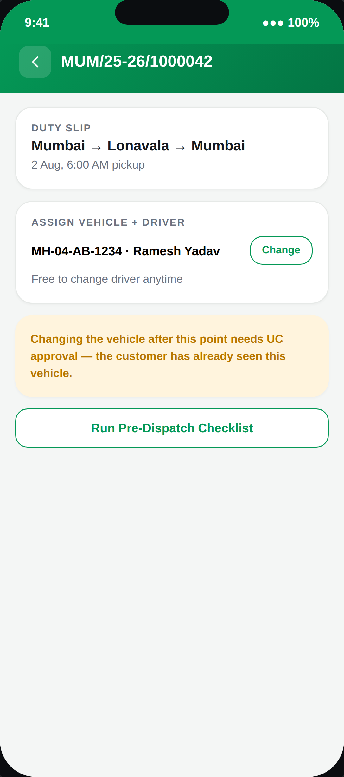
07
DISPATCH
Trip & Duty Slip
Assigning or changing the driver is free at any time. Changing the vehicle after it's been assigned needs UC's sign-off, since the customer may have already seen that vehicle's details.
PINAAK — Vendor App Walkthrough
8

Slide 9
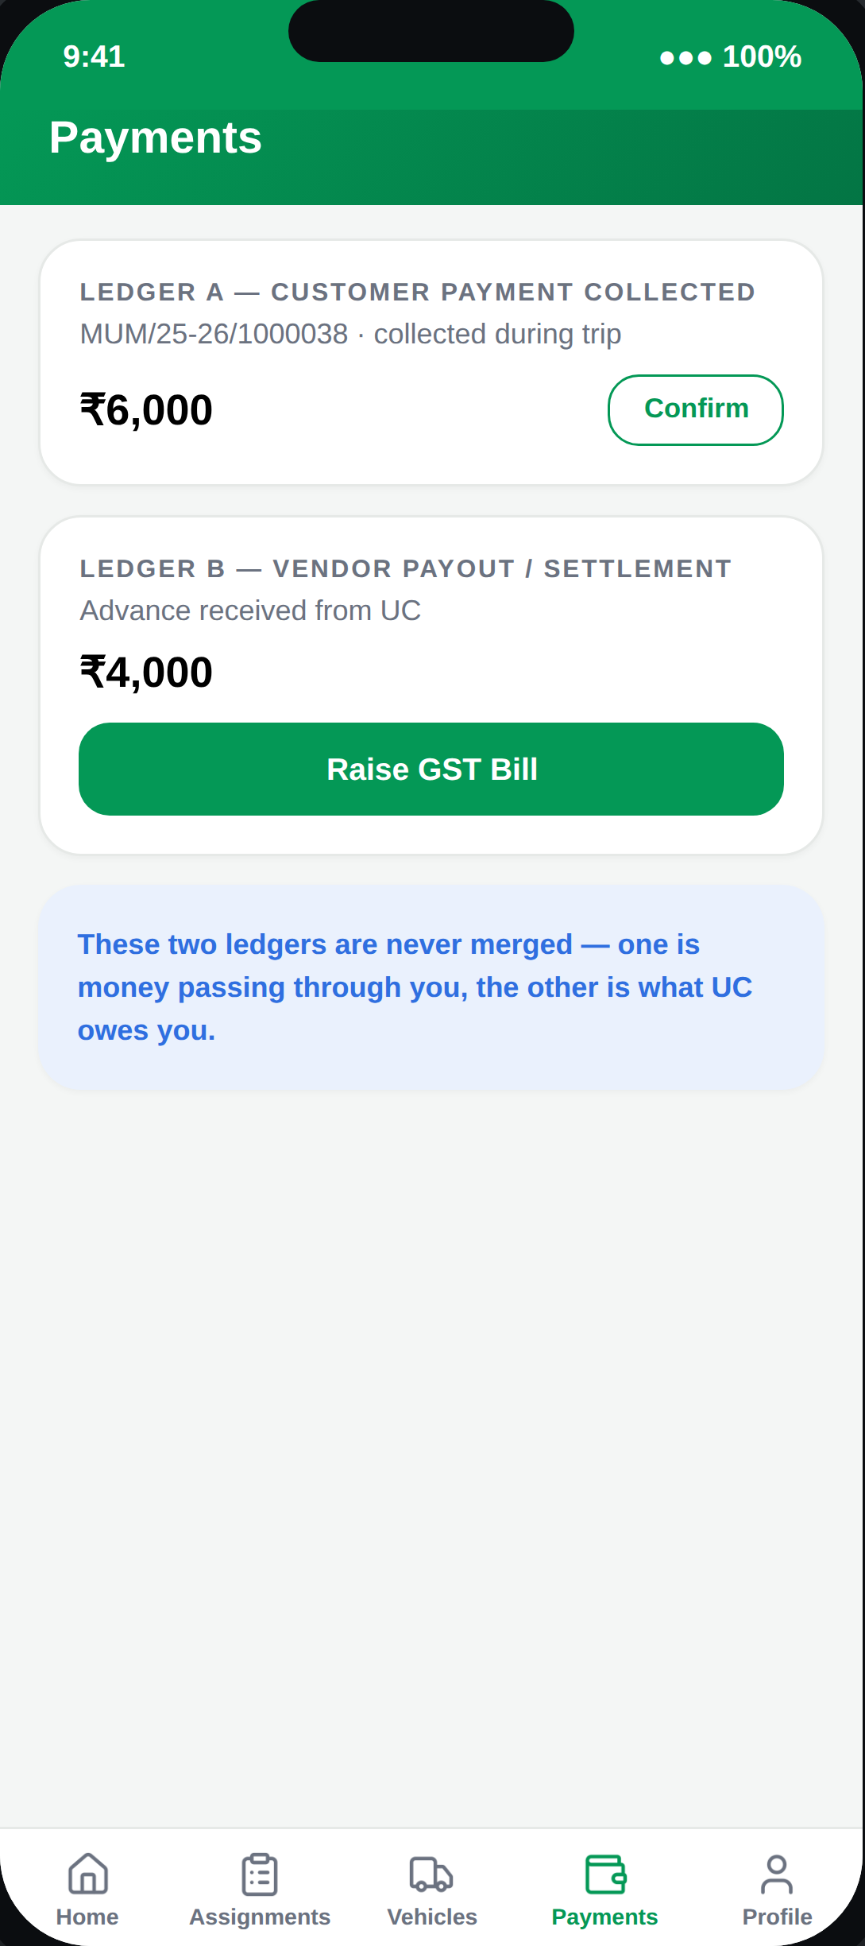
08
MONEY
Payments — Two Ledgers
Customer payment collected during the trip and the vendor's own payout from UC are tracked as two separate ledgers — never merged into one number.
PINAAK — Vendor App Walkthrough
9

Slide 10
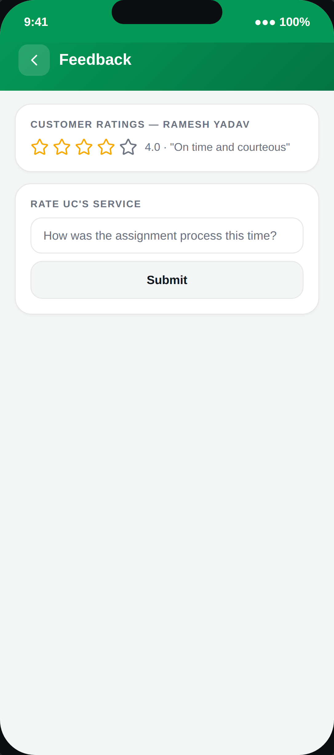
09
QUALITY
Feedback
Vendors see the ratings customers left about their drivers and vehicles, and can submit their own feedback on UC's assignment process.
PINAAK — Vendor App Walkthrough
10

Slide 11
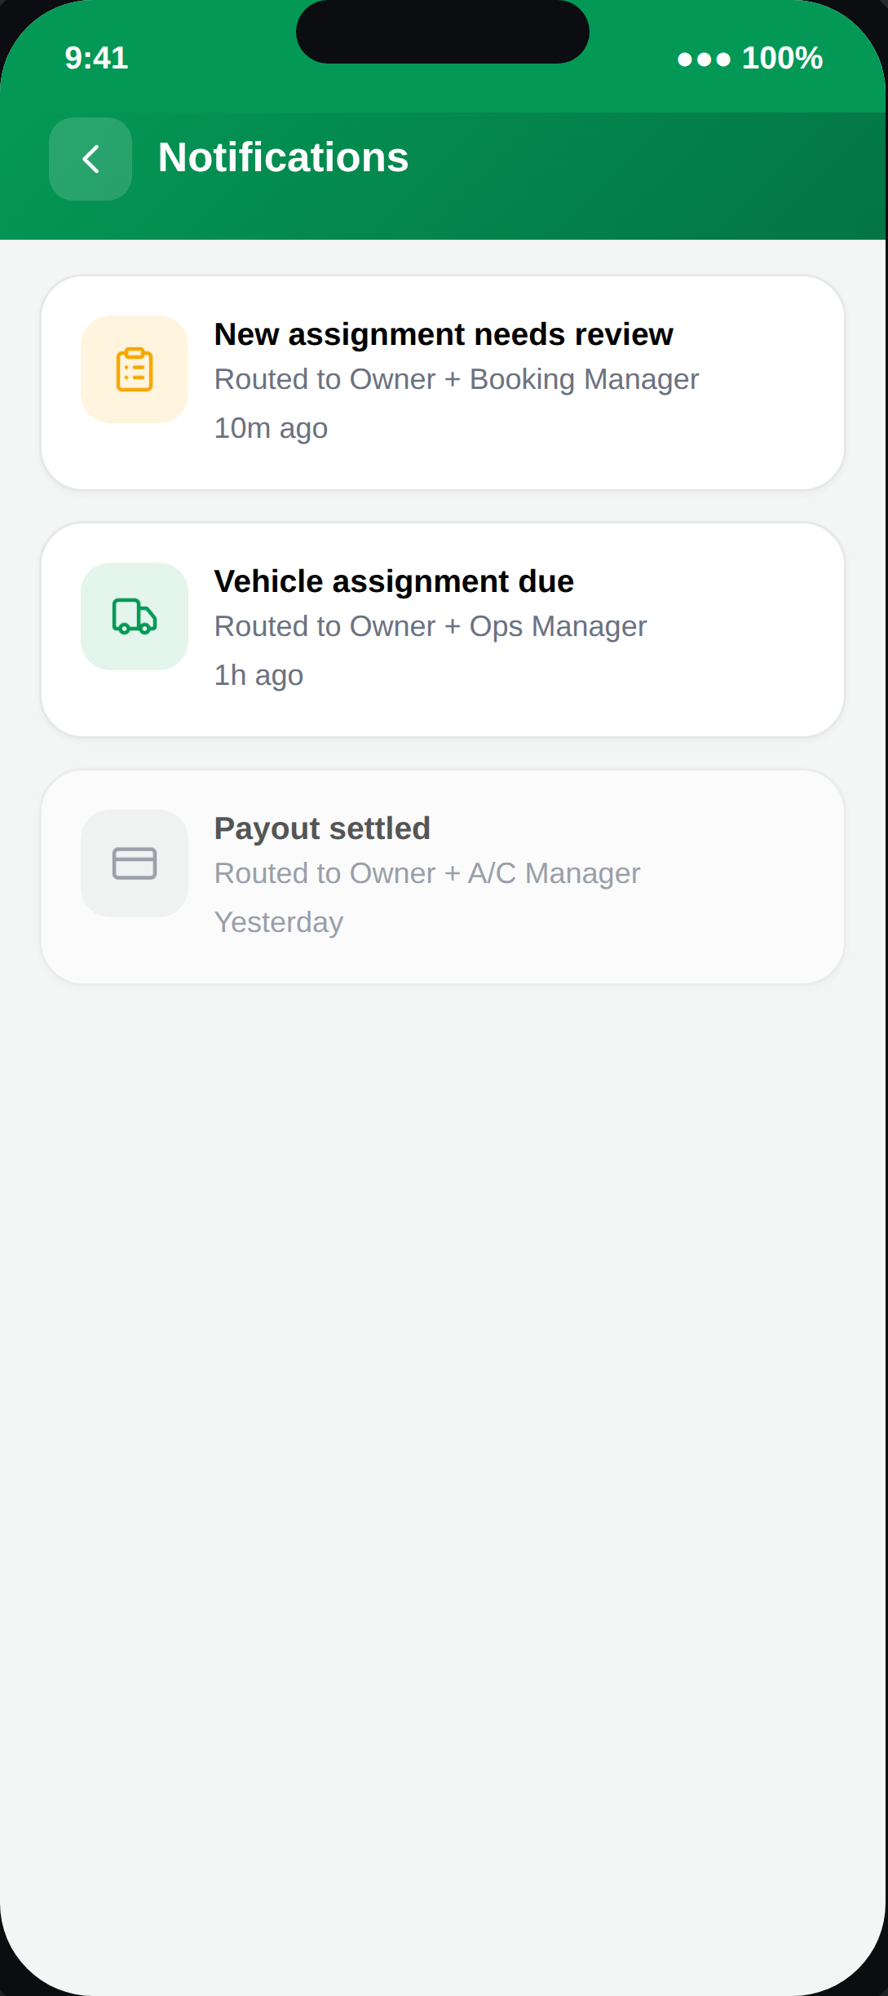
10
ALERTS
Notification Centre
Routed by sub-role — Owner sees everything; Booking Manager, Ops Manager, and A/C Manager only see what's relevant to their function.
PINAAK — Vendor App Walkthrough
11

Slide 12
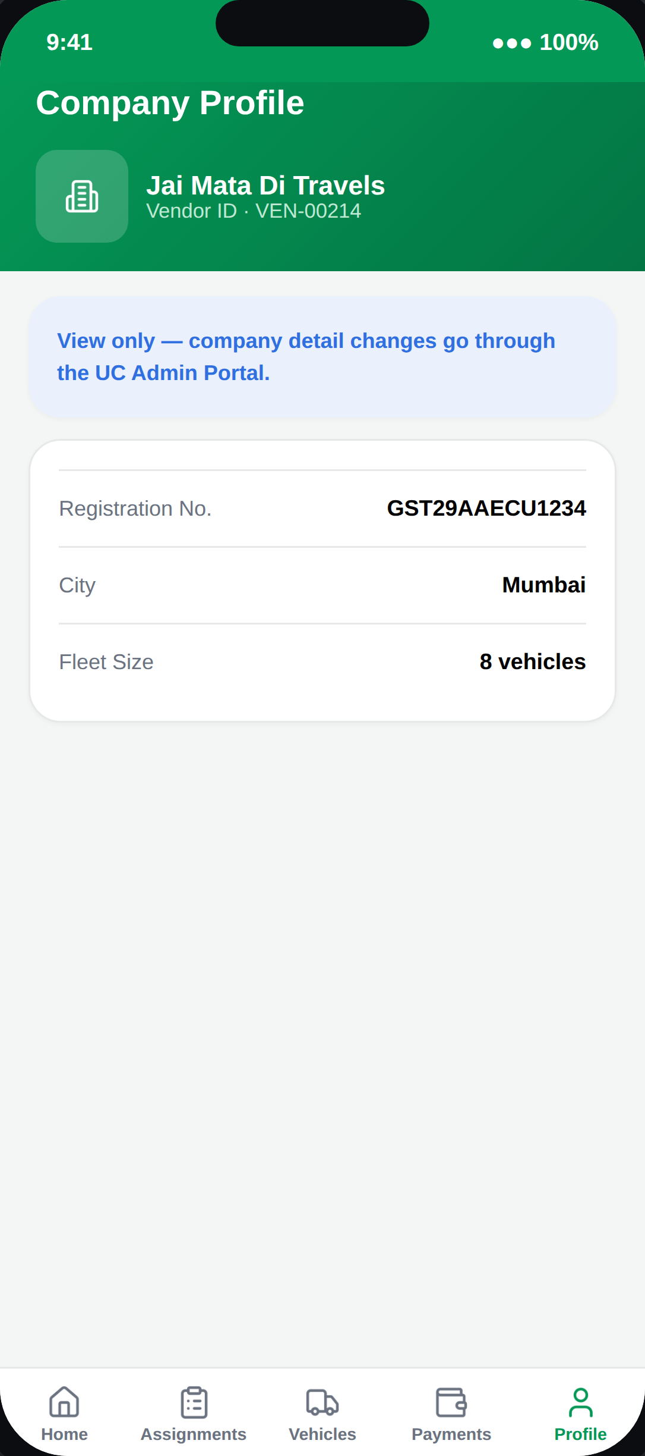
11
ACCOUNT
Company Profile
View only inside the app — company-level detail changes go through the UC Admin Portal, the same boundary used for onboarding.
PINAAK — Vendor App Walkthrough
12

Slide 13
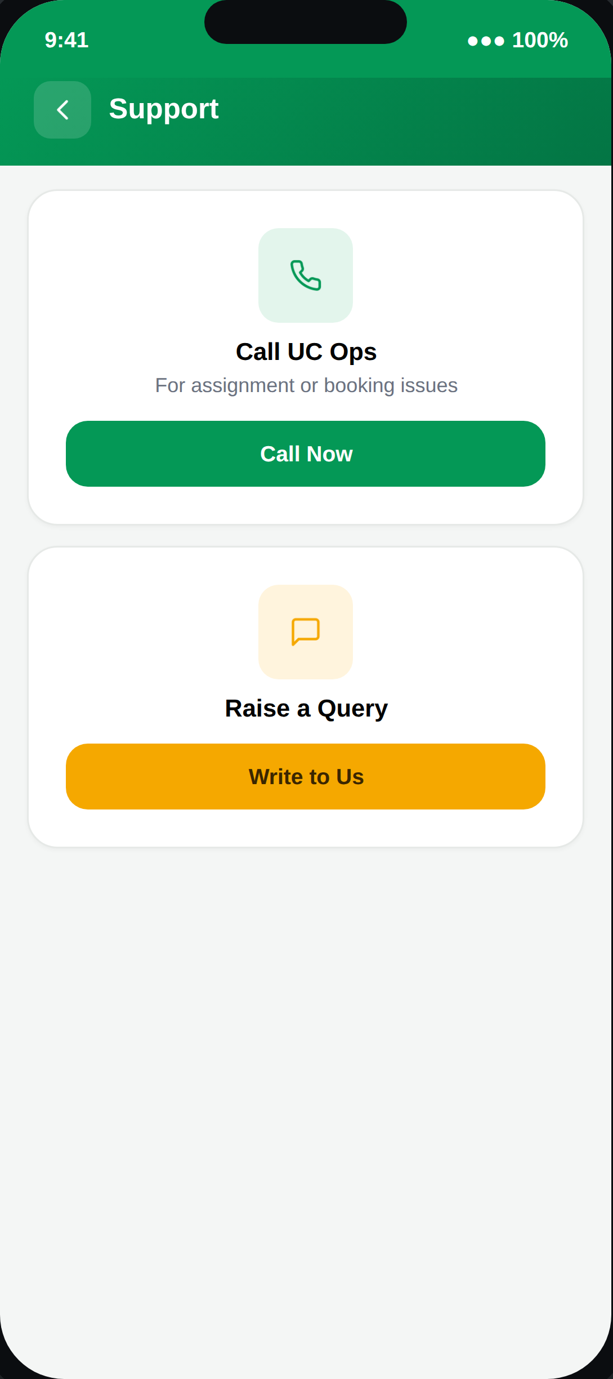
12
HELP
Support
A direct line to UC Ops — for assignment issues, payment queries, or anything the app itself can't resolve.
PINAAK — Vendor App Walkthrough
13

