Slide 1
Thyroid Disease Classification
Guidance By: Prof. Somanath Tripathy
Name: Aman Gupta
Roll No: 1801CS05

Slide 2
Introduction
The thyroid is a butterfly shaped gland consisting of two lobes, the right lobe and the left lobe is located on the lower front neck.
Malfunctioning of the thyroid results in a disease such as hyperthyroidism when too much hormones are produced, hypothyroidism when not enough hormones are produced.

Slide 3
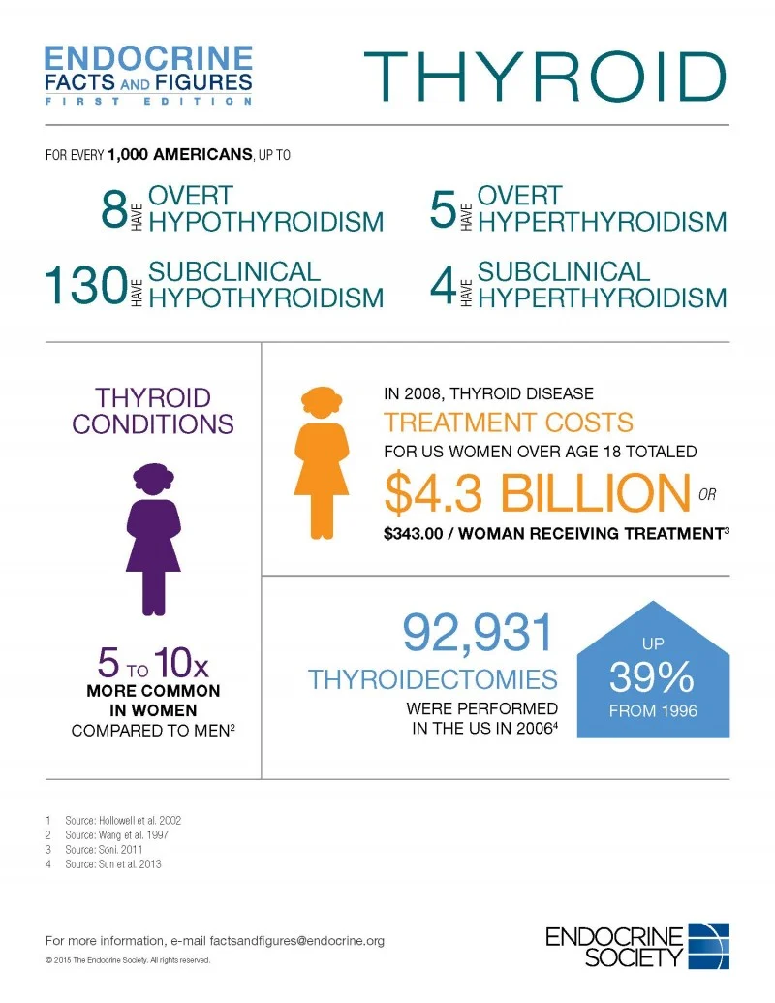
Motivation
Early and correct diagnosis play a major role in curing a disease.
In India around 42 million suffers from Thyroid disease.

Slide 4
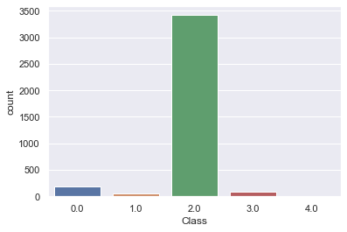
Dataset
Description of dataset:
5 classes are there in our dataset.
Compensated Hypothyroid
Hyperthyroid
Negative
Primary Hypothyroid
Secondary Hypothroid

Slide 5
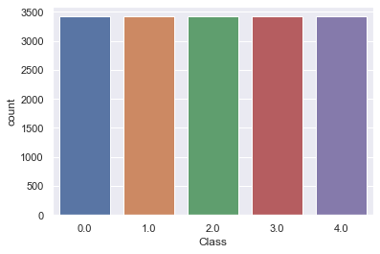
Balancing Dataset
We have used Random oversampling to balance dataset.
I have also use SMOTENC, but is was not giving us the good results.

Slide 6
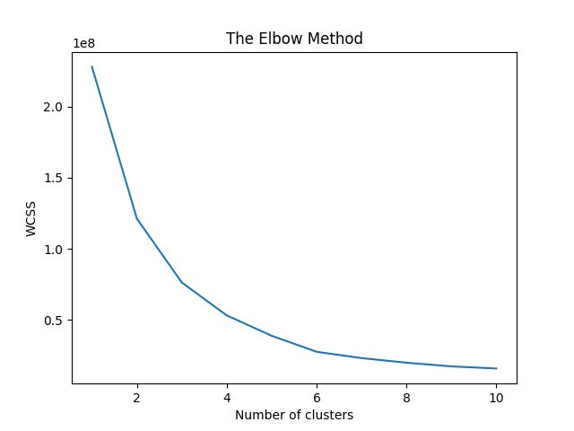
Clustering
Unsupervised learning so that we can put same type of data points together.
To find optimal number of clusters I have plotted the graph between (Within-Cluster-Sum-of-Squares) WCSS and number of clusters. I have used elbow method to find the optimal clusters.

Slide 7
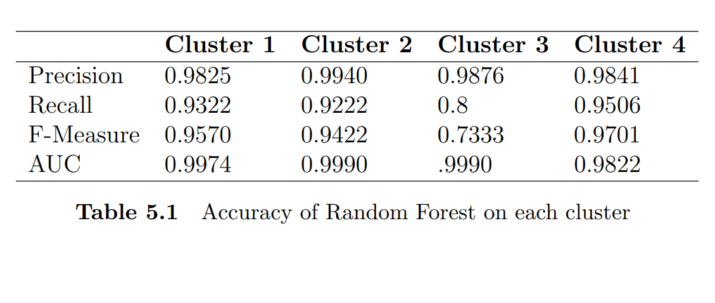
Random Forest
For each cluster I have calculated the optimal parameters.
Results for each clusters can be seen in the table.

Slide 8
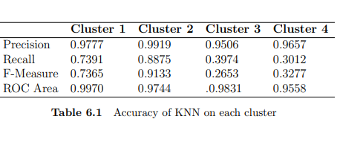
KNN - K Nearest Neighbors
For each cluster I have calculated the optimal parameters.
Results for each clusters can be seen in the table.

Slide 9
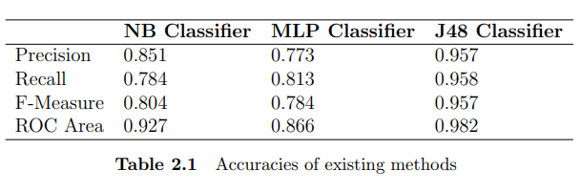
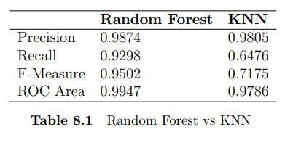
Results comparison.

Slide 10
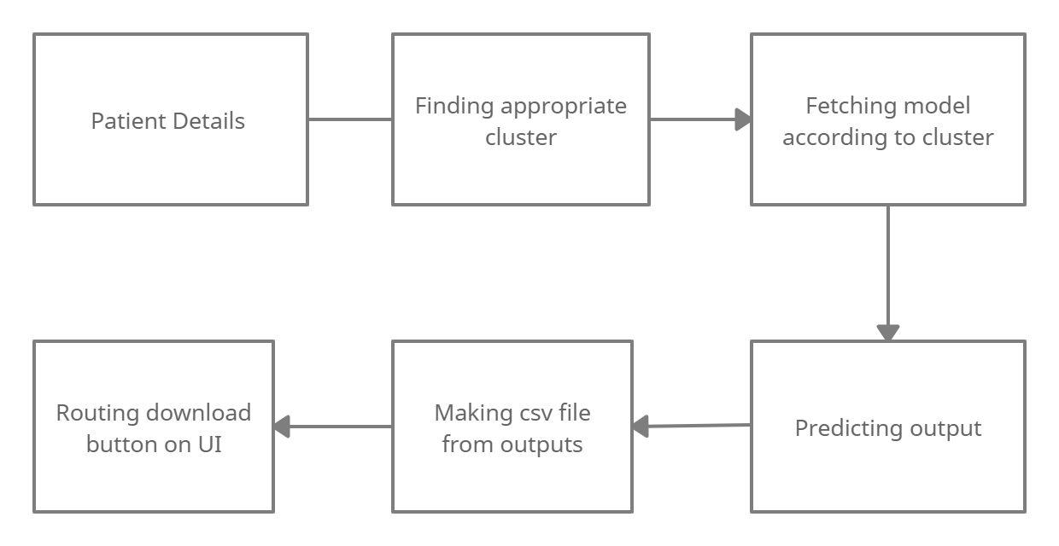
User Interface

Slide 11
Links for deployed Apps
https://thyroid-one-prediction.herokuapp.com/
https://thyroid-lab-prediction.herokuapp.com/

Slide 12
Thank You.

