Slide 1
What is the Difference Between Internet and World Wide Web?
Although many people confuse it to be the same, there is a distinct difference between the Internet and World Wide Web.
Internet refers to hardware, while the World Wide Web refers to software.
In short, World Wide Web is an application that runs on the Internet
Web is NOT internet

Slide 2


Slide 3
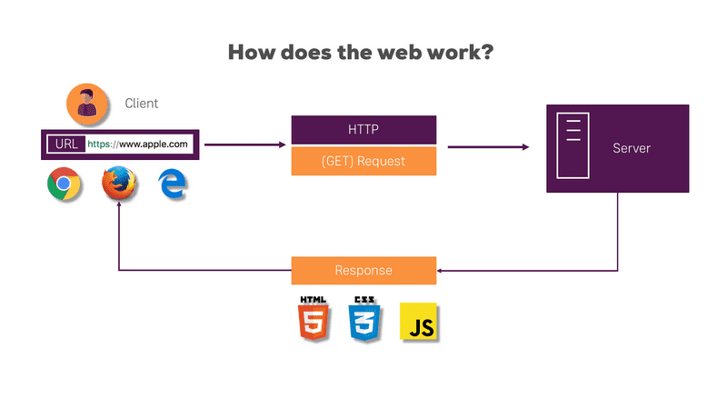
A client (using web browser) send a HTTP request to web server for specific file
A web server contains web pages and files
The web server send the requested file back to the client
The file (mostly web page) is rended /displayed via the browsers
The web browsers display the information, based on the HTML code in the file

Slide 4


What does a web developer do?
PICK THE SKILLS YOU NEED TO WORK IN WEB DEVELOPMENT
GET AN EDUCATION
PRACTICE YOUR CODING SKILLS
DEVELOP TECHNICAL SKILLS

Slide 5

What is the role of a web developer?
A web developer is responsible for programming the code that “tells” a website how to function. A developer builds a website from the bottom up, which means designing it in such a way that end users have no difficulty navigating the site.

Slide 6

Web developers have distinct personalities. They tend to be artistic individuals, which means they’re creative, intuitive, sensitive, articulate, and expressive. They are unstructured, original, nonconforming, and innovative. Some of them are also conventional, meaning they’re conscientious and conservative.

