Slide 2
Python Text to Speech Project with Git and GitHub
Aman India

Slide 3
Text to Speech Project with hand on Git and GitHub
Learn to empower by building creative

Slide 4

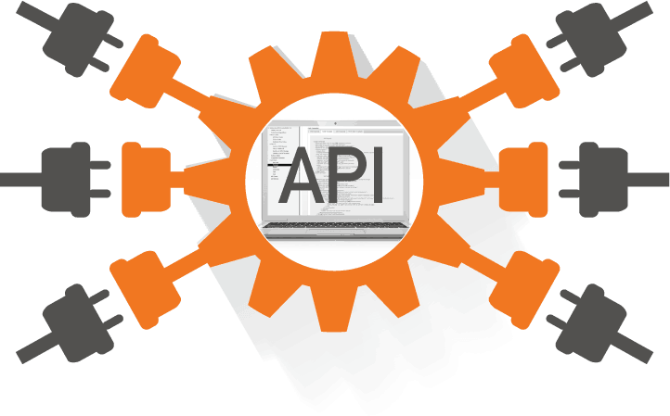
Ready to grasp these items:
A deep introduction to APIS
Small Intro to Python
Hands on project
Introduction to Git and GitHub
Making GitHub profile and uploading project
My Introduction (If still space left to digest)

Slide 5
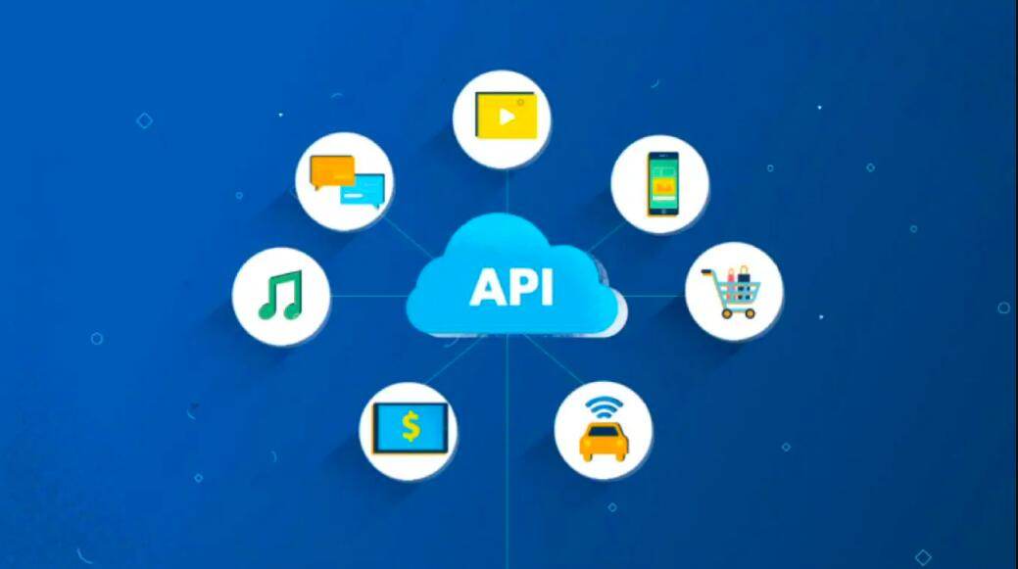
What is Mr. API?
Application Programming Interface
In layman term
API is a guard that build connection between two applications and enables to share data with some rules.
Formal Definition
An API (Application Programming Interface) is a set of functions that allows applications to access data and interact with external software components, operating systems, or microservices.
To simplify, an API delivers a user response to a system and sends the system's response back to a user.

Slide 6



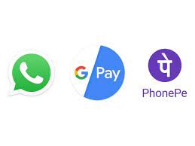
Its uses in daily life:
Google Pay
Flight Booking
Movie ticket booking
Using any third party application is done by API!

Slide 7
Hands on project
We are building a python project with the use of simple google Text to Speech API.
(gTTS)
The project we are going to build is a personalized book reader with support of different languages.
For details of gtts refer:
https://gtts.readthedocs.io/en/latest/module.html

Slide 8
Introduction to Git and GitHub
Mr smart code vault and version control

Slide 9
GitHub
GitHub is a repository where anyone can store there files and works which can be accessible through the globe.

