Slide 1



PaisaTrack: Student Expense Tracker
A simple web app to track spending against a monthly budget.
Track
Budget
Log every expense as it happens.
Set a monthly limit and stay on target.
Team Gully Coders · Hacktoberfest by MLH · NIAT · Sushant University
Team members: Aman Kumar, Akshat Kumar, Aashish Mishra

Slide 2
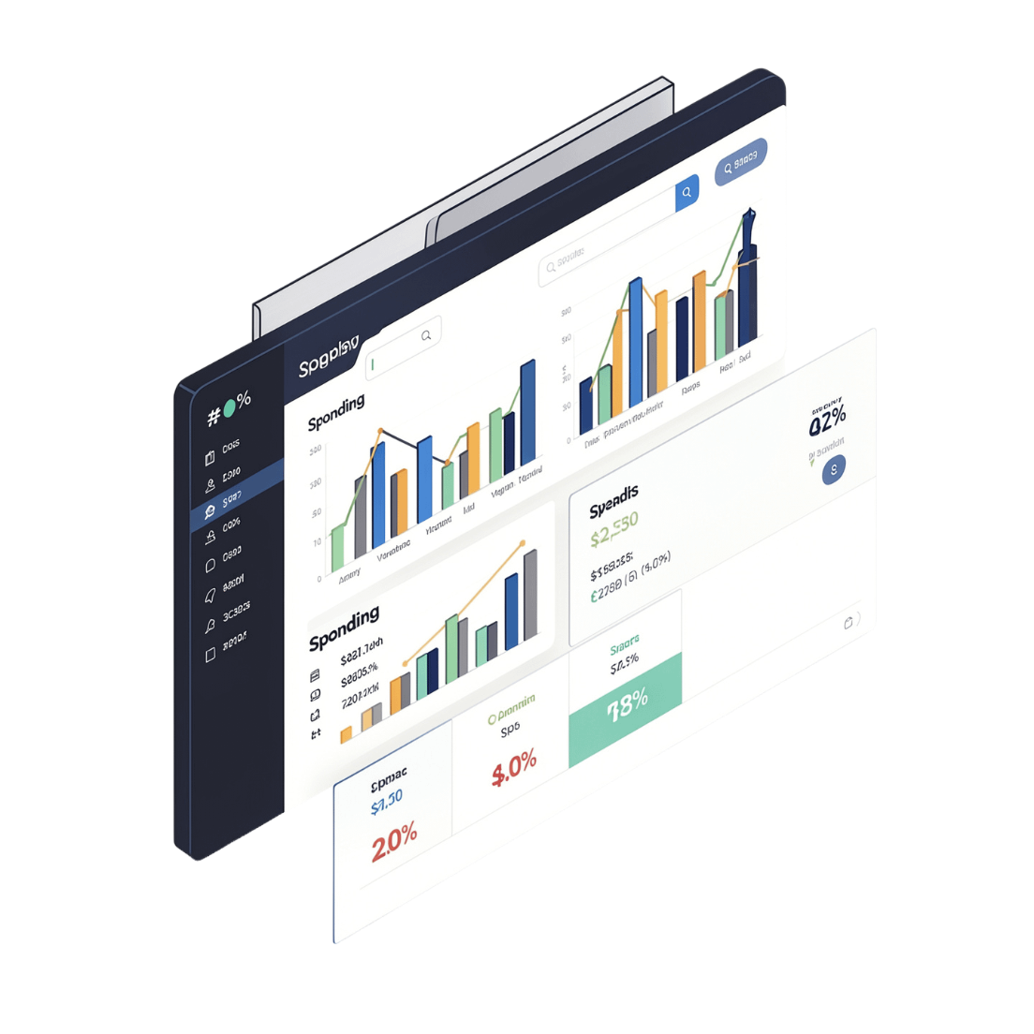






Overview Dashboard
At a glance, your finances
Monthly spending total
Remaining budget
Average daily spending
Top spending category
Category breakdown chart
Quick spending summary

Slide 3



Add & Manage Expenses
Manual Entry
Auto-Suggest
Transaction List
Enter description, amount, date, category, and payment method for each transaction.
Category suggestions appear automatically from merchant names — e.g. Zomato, DMRC.
Filter by category, choose visible columns, and delete selected rows anytime.

Slide 4
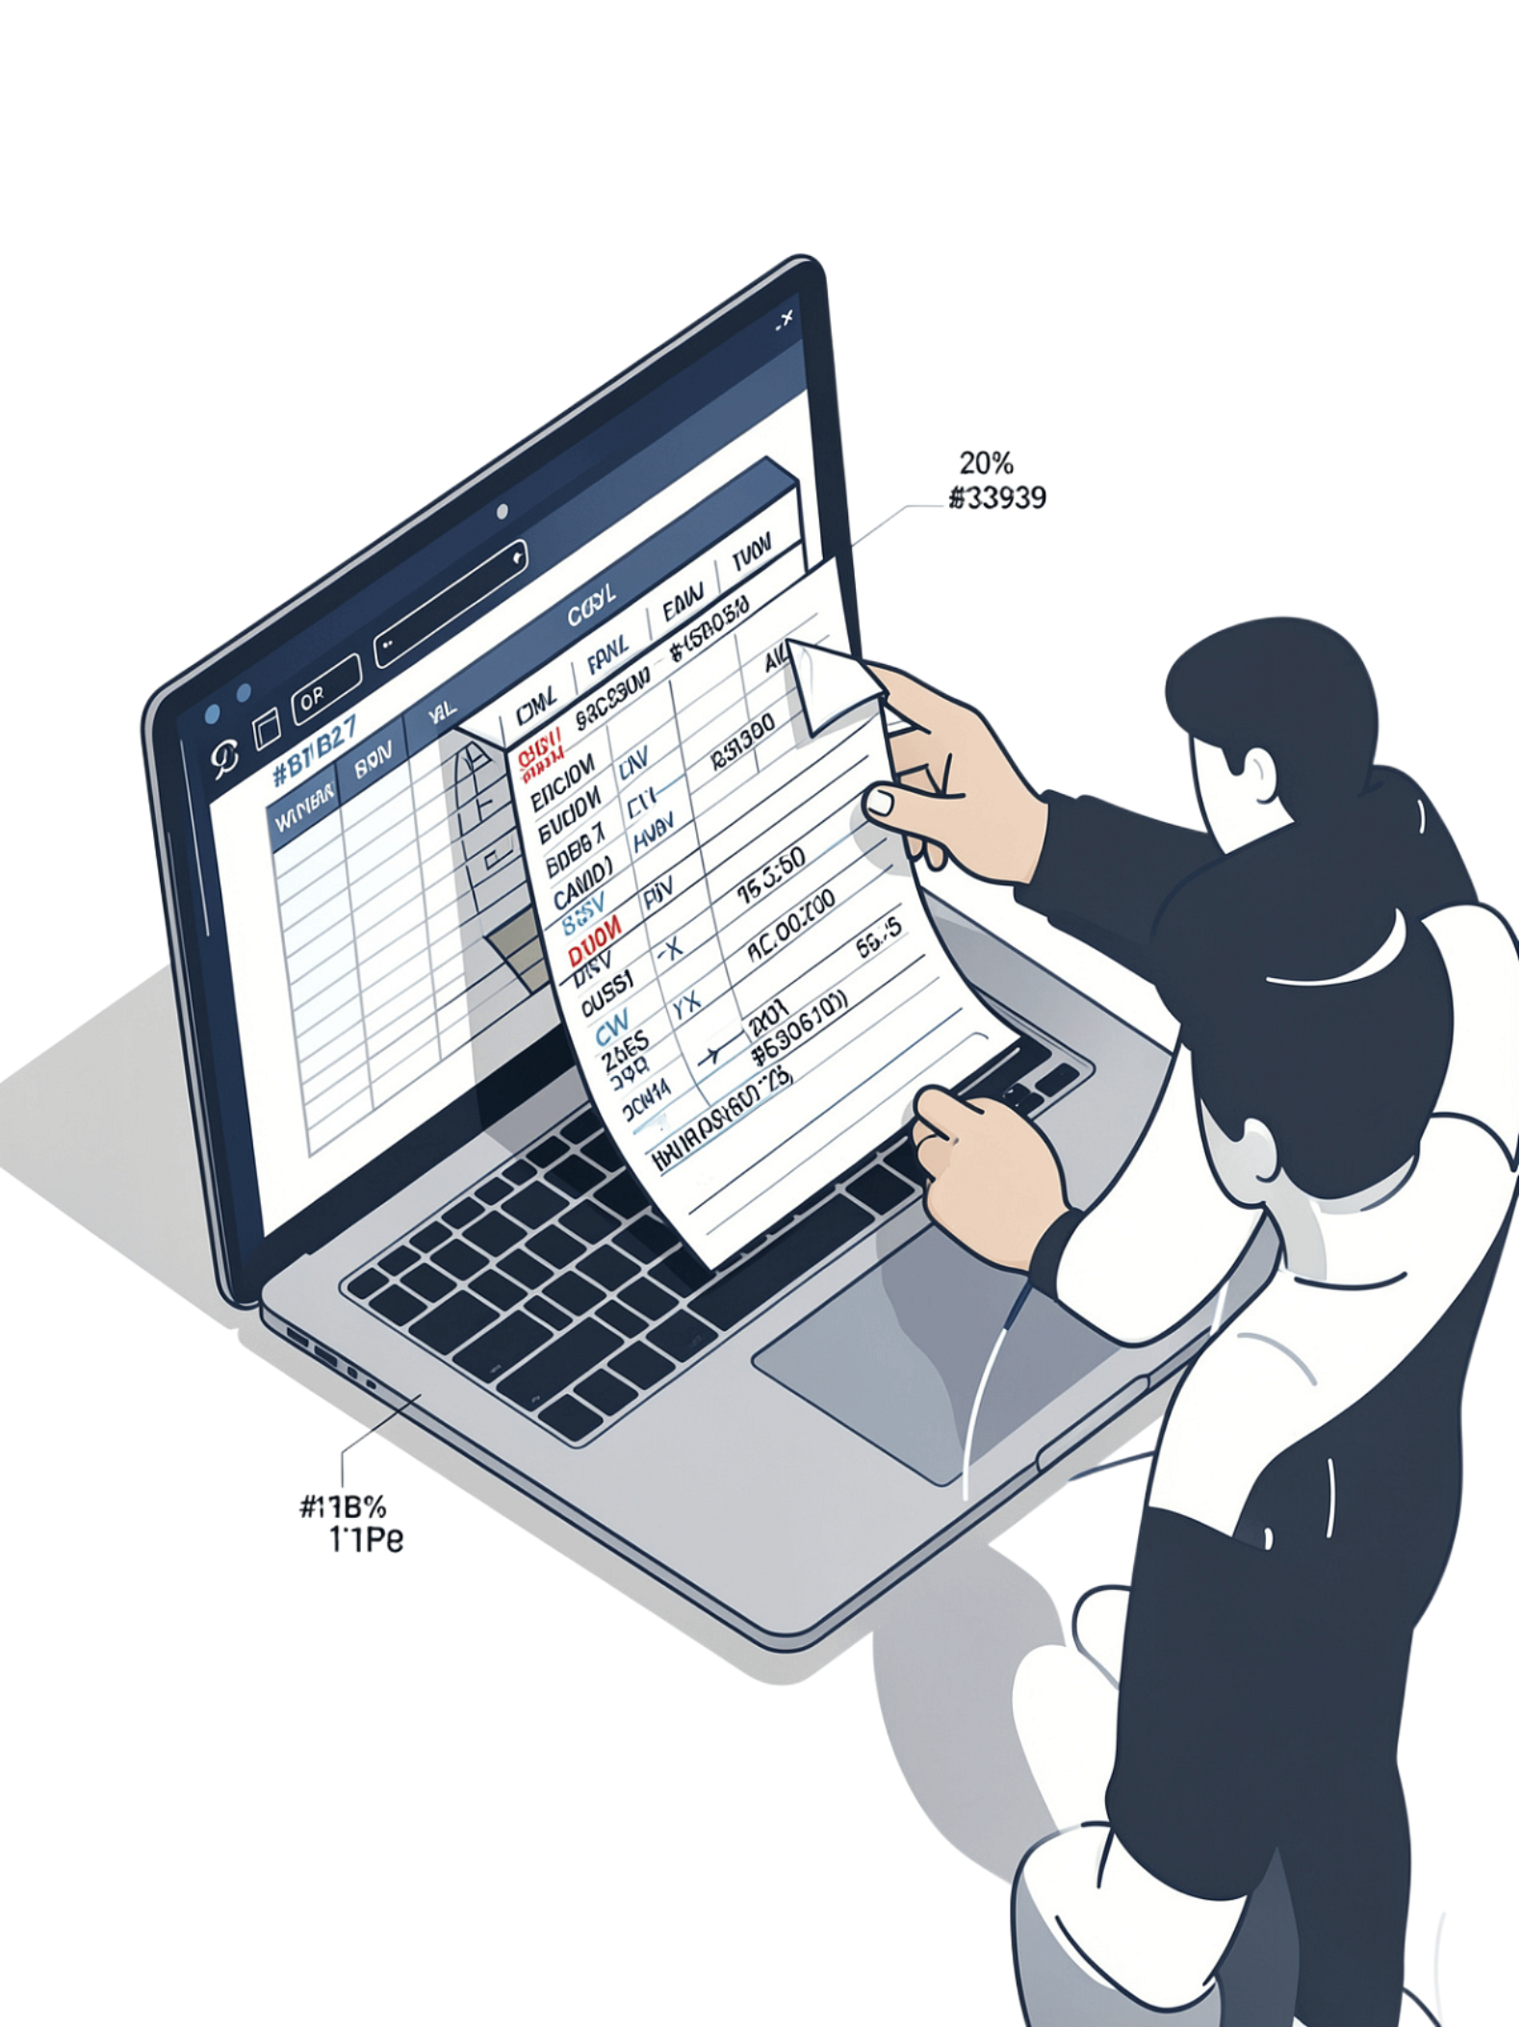





Upload Bank Statement (CSV)
Map Columns
Select File
Assign date, description, amount; optional fields
Choose your CSV bank statement
Import
Preview
Import transactions to PaisaTrack
Review valid transactions; invalid rows excluded
Invalid rows — missing a date, amount, or description — are excluded automatically before import.

Slide 5
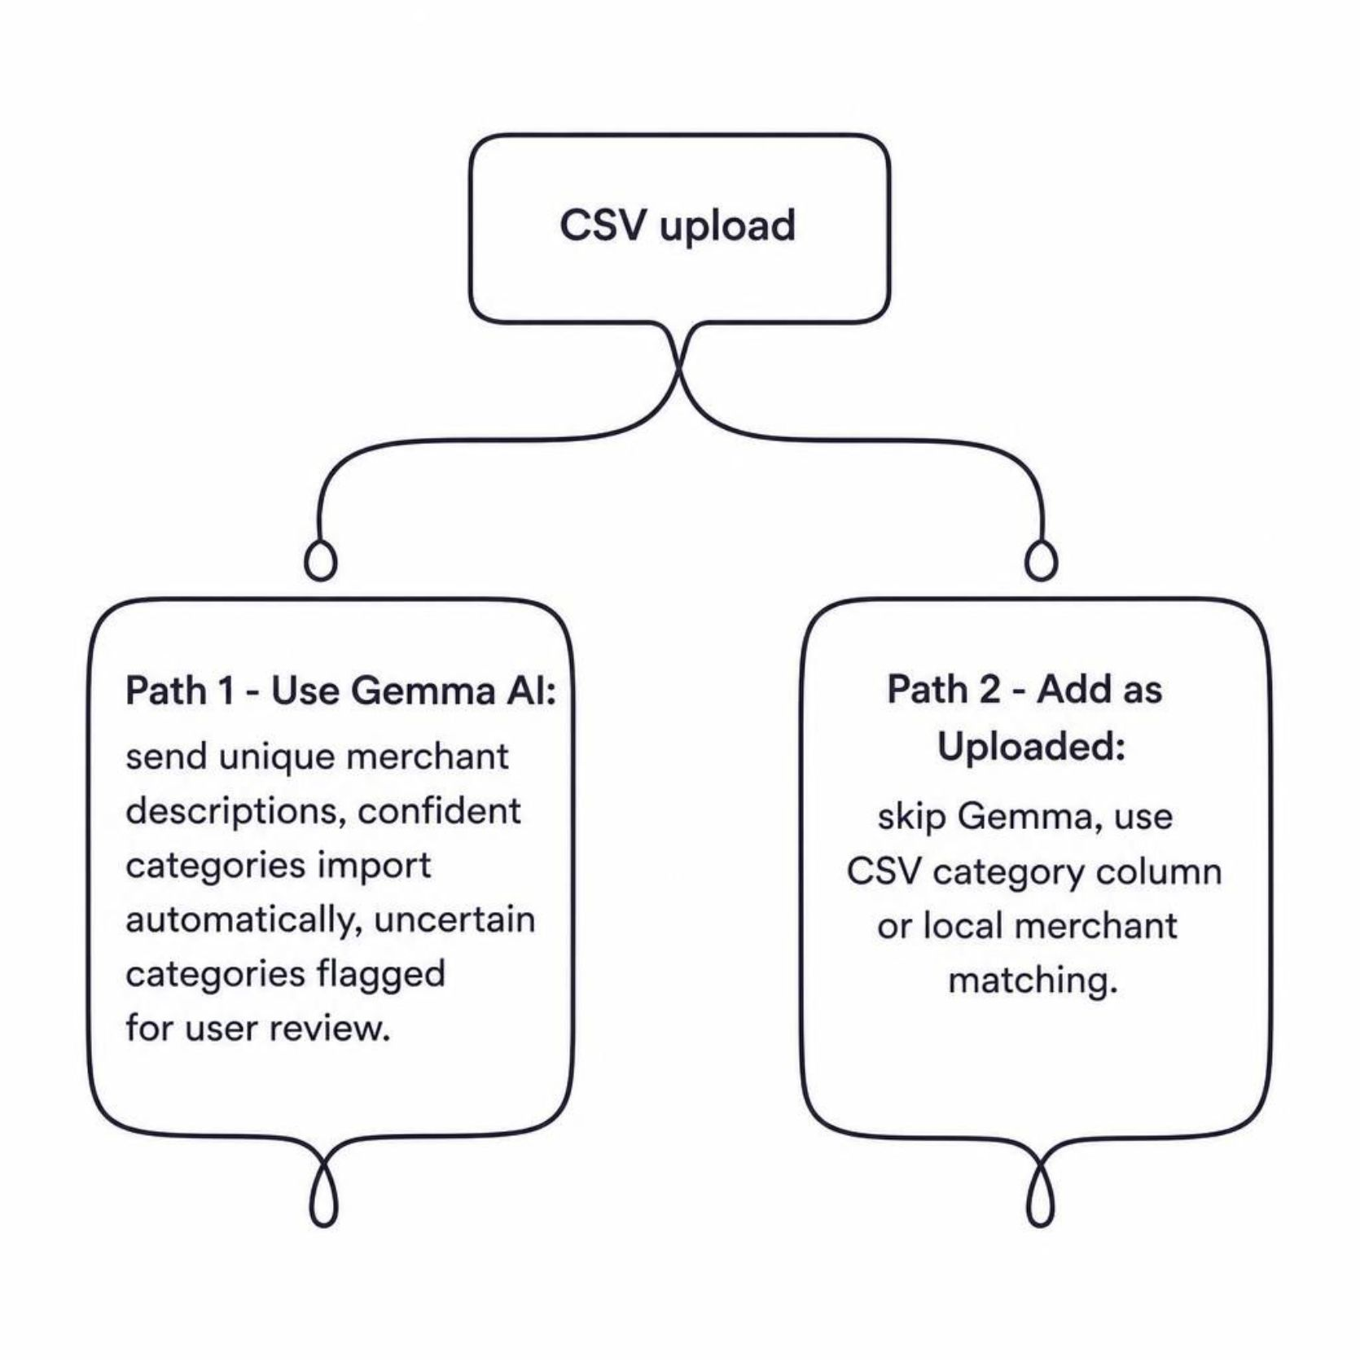



Gemma Categorization
Two ways to categorize
Auto-categorize with Gemma
Add as Uploaded
Opt in to send unique merchant descriptions. Confident matches import automatically; uncertain ones are flagged for review.
Skip Gemma entirely. PaisaTrack uses your CSV's category column or local merchant matching instead.
Only merchant descriptions are sent to Gemma — no amounts, dates, or personal data.

Slide 6




Manage Imports & Workflow
Switch CSV Files
Remove Last Import
Delete Transactions
Gemma Spending Insight
Clear the selected file at any time to choose a different bank statement.
Undo an entire import and all its transactions in one action.
Remove individual transaction rows from the list at any point during your session.
Ask Gemma for a personalized spending insight — based on your budget and category totals only.

Slide 7




Get Started with PaisaTrack
Set your monthly budget
Add expenses
Enter transactions manually or import a bank statement via CSV.
Enter your budget in the sidebar to establish your spending goal.
Review by category
Adjust & track
See where your money is going with the category breakdown chart.
Refine your spending habits and stay on track toward your budget goal.

