Slide 1
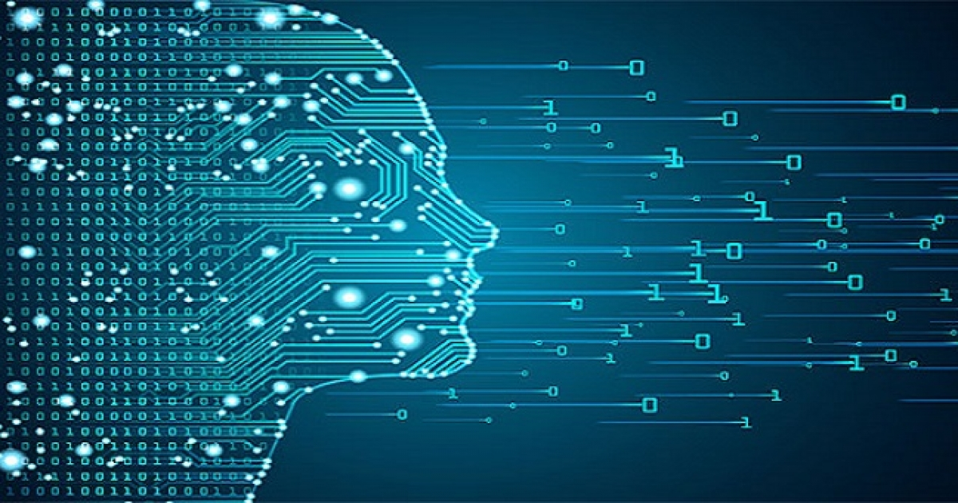
Domain Generalization
Team : Applied AI
Aman Izardar-2021201028
Diksha Daryani-2021201045
Maturi Sai Shushma- 2021201012
This Photo by Unknown author is licensed under CC BY.

Slide 2
Importance of Domain Generalization
It is difficult for models to predict correct results if the testing data distribution is different from training data distribution .
Example: It would be easy for the model to classify correctly if the training and testing have images from different cameras , but it would be a difficult task if the images belong to different domains.
Need for models that perform well without retraining or quick adaptation when there is domain shift.
Domain Generalization works well in these situations. In Domain Generalization, model is not updated after training.

Slide 3
Domain Generalization:
The key idea of domain generalization is to combine multiple source domains into a single model.
The combined model should be able to work well with the unseen target domain.
Consider A,B,C,D are different domains. If model is trained on A,B and C then, model should perform well on domain D also.
In domain generalization model does not have access to test domain.

Slide 4
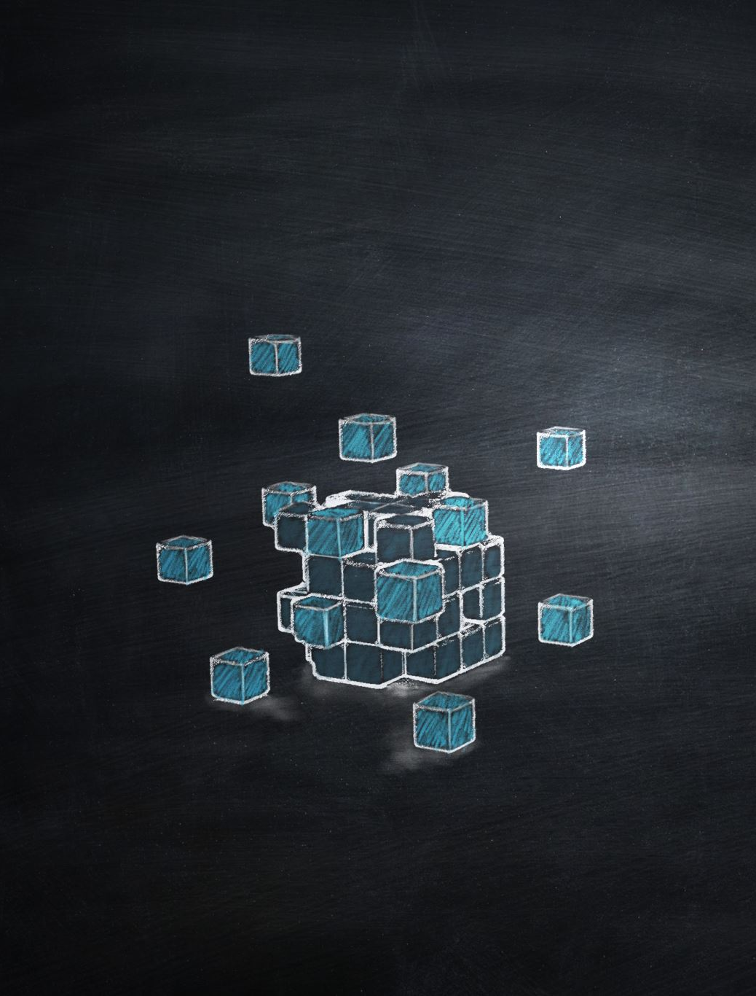
Dataset:
Dataset we are using is PACS dataset.
P- Pictures
A- Art
C- Cartoon
S- sketch
Here among these four domains we can pick any three as train domains and other as test domain.
Example : If PAC is taken as train domains, then S will be the test domain.

Slide 5
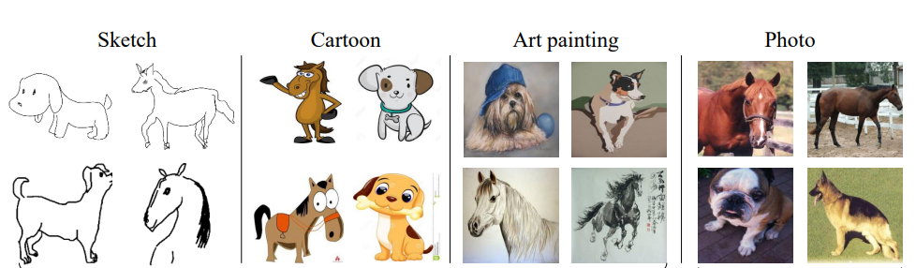
Sample Images

Slide 6
Dataset information
classes | Art painting | cartoon | photo | sketch
Dog | 379 | 389 | 189 | 772
Elephant | 255 | 457 | 202 | 740
Giraffe | 285 | 346 | 182 | 753
Guitar | 184 | 135 | 186 | 608
Horse | 201 | 324 | 199 | 816
house | 295 | 288 | 280 | 80
Person | 449 | 405 | 432 | 160

Slide 7
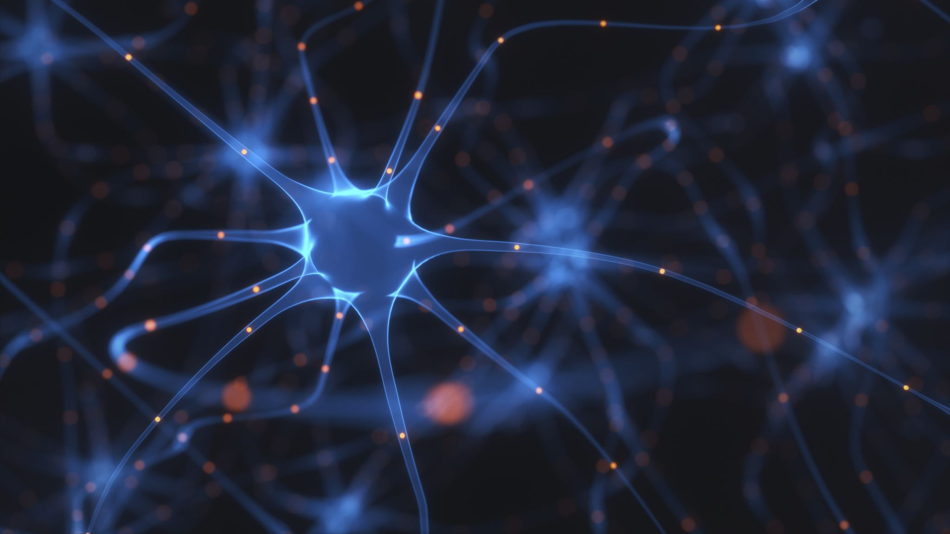
Resnet 18
ResNet-18 is a convolutional neural network that is 18 layers deep.
01
Pretrained version of the network trained on more than one million images from the ImageNet database.
02
The pretrained network can classify images into 1000 object categories.(ex: pen, keyboard, animals)
03
We changed the last fully connected layer to classify images into 7 classes.
04

Slide 8
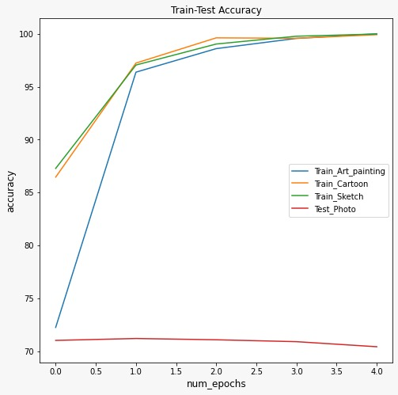
Resnet Results (Photo as test)

Slide 9
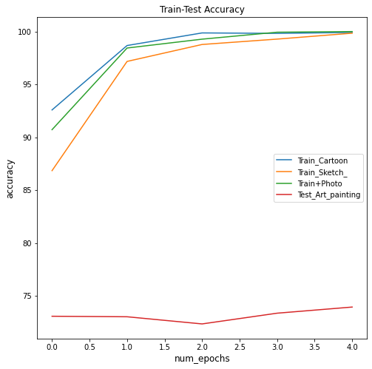
Resnet Results (Art paintings as test)

Slide 10
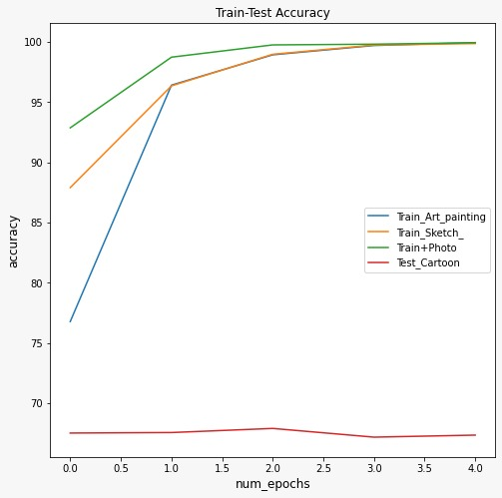
Resnet Results (Cartoon as test)

Slide 11
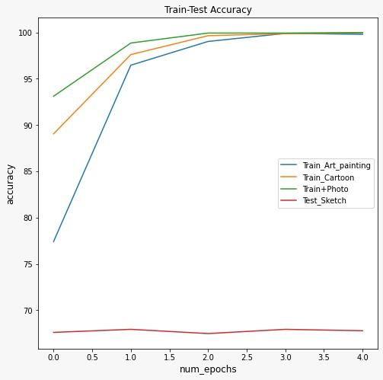
Resnet Results (Sketch as test)

Slide 12
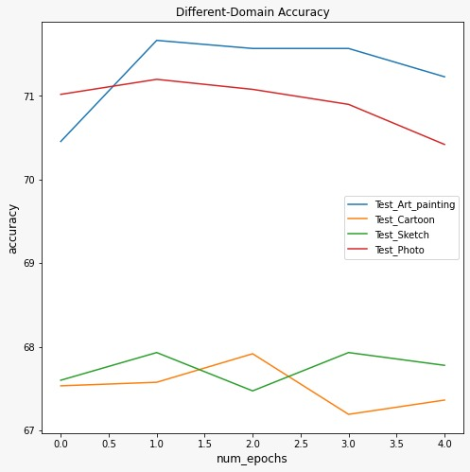
Accuracy with Renet 18

Slide 13
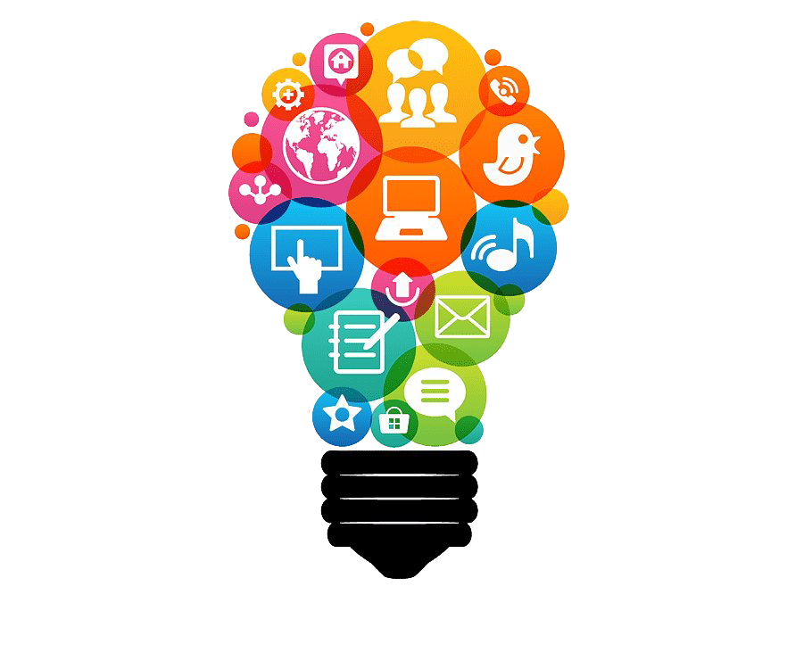
Meta learning
Learning algorithms that learn from other learning algorithms.(refers to learning about learning.)
Learning Algorithms: Learn from historical data and make predictions given new examples of data.

Slide 14
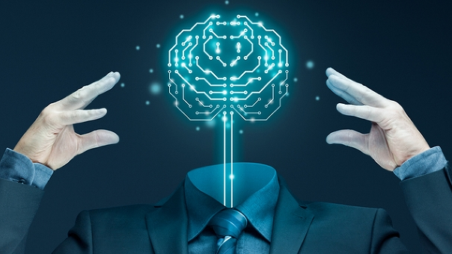
Meta Learning tasks are a category of machine learning problems that include supervised learning, reinforcement learning, and so on. Task Examples : A classifier trained on non-cat images can tell whether a given image contains a cat after seeing a handful of cat pictures. A game bot is able to quickly master a new game. A mini robot completes the desired task on an uphill surface during test even through it was only trained in a flat surface environment.
Meta Learning
This Photo by Unknown author is licensed under CC BY.

Slide 15
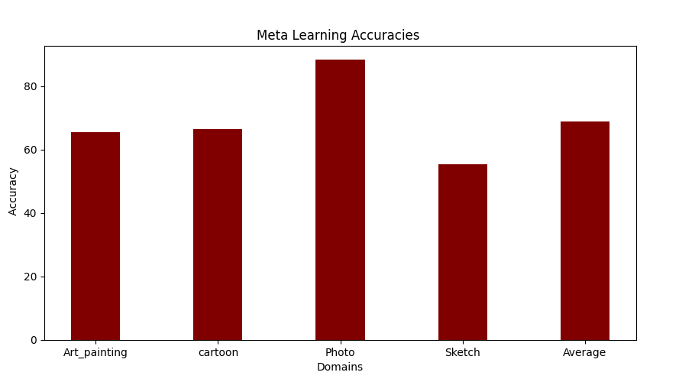
Results

Slide 16
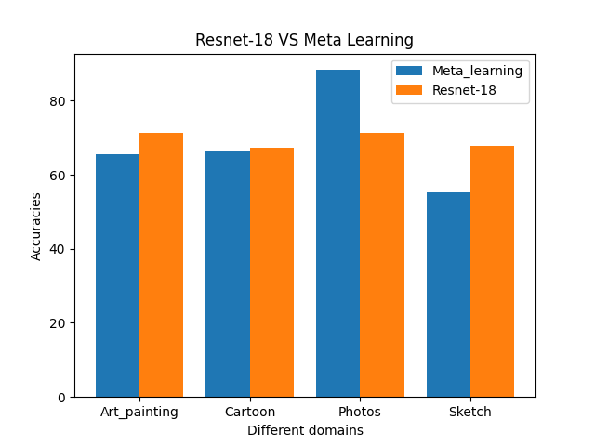
Resnet-18 VS Meta Learning

Slide 17
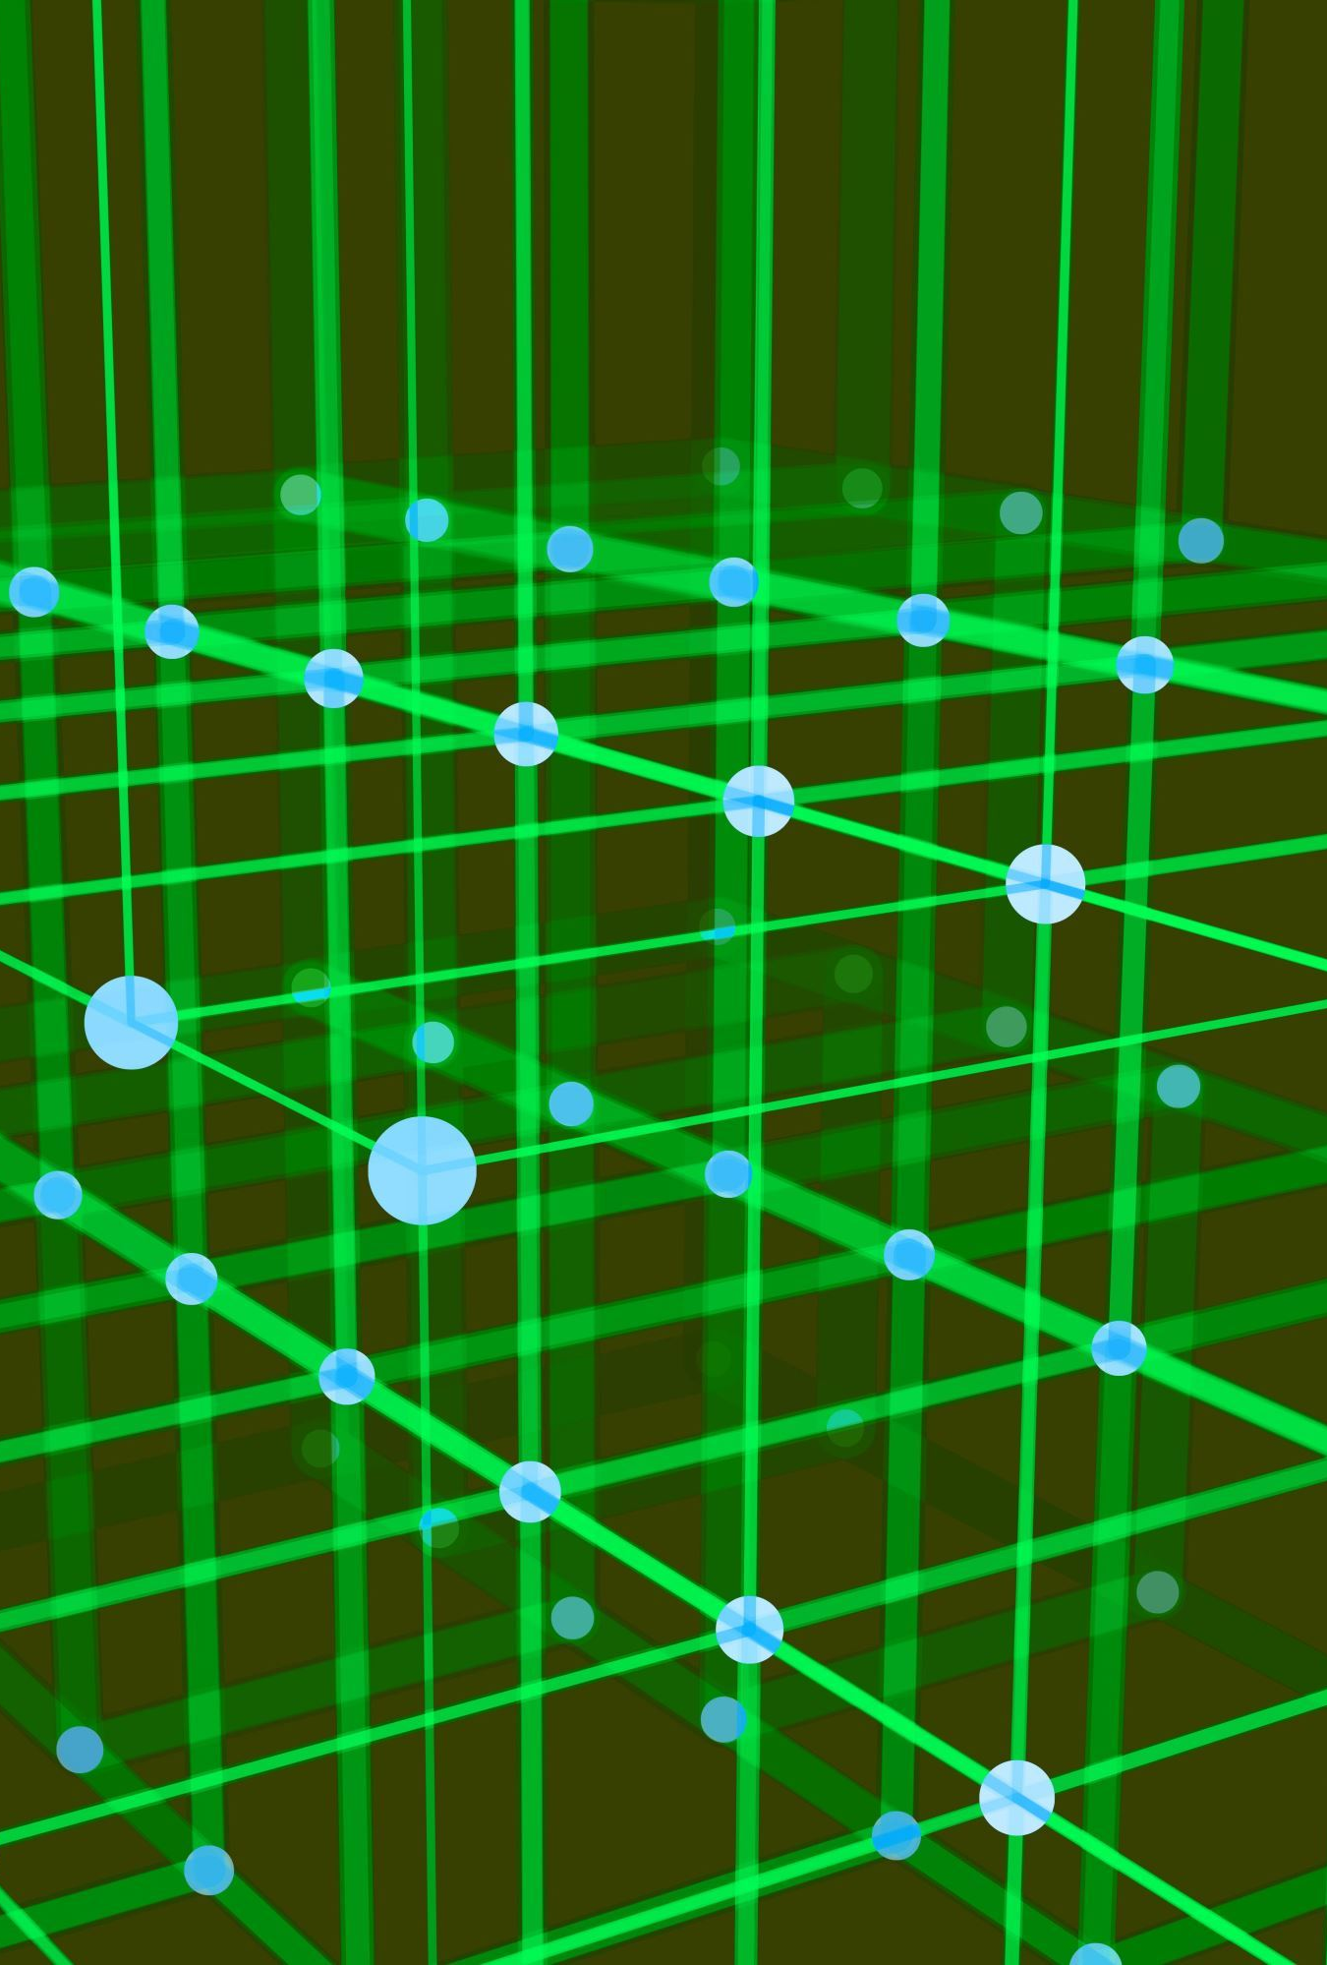
Code link
https://drive.google.com/drive/folders/1jurGvBkKW-Xgy00vY7NQlC6Xdp3LlRNd?usp=sharing

Slide 18

Thank You

