Slide 1
TRAINING REVIEW
Anomaly Detection
Deep Isolation Forest (DIF)
Using projections via random neural network to make non-linear splits

Slide 2
What is Anomaly Detection?
Core Task
Applications
Train a model to assign an abnormality score to every datapoint
→ no labels required for training (unsupervised learning).
Purpose: Identify points that deviate structurally from the majority (anomalies).
⚡ Electricity Theft
Detect abnormal consumption patterns
✔ Fraud Detection
Flag irregular financial transactions
⚙ Fault Diagnosis
Identify sensor anomalies in industrial machinery

Slide 3
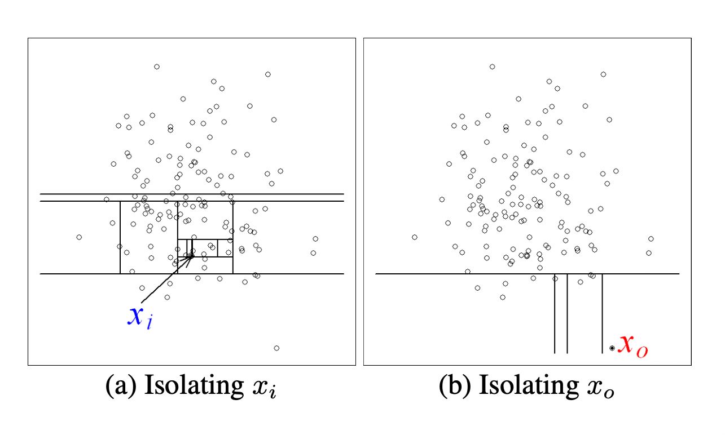
The Foundation — Standard Isolation Forest
Core Intuition
Anomalies are the minority and have attribute values that are very different from the normal instances — they require fewer random splits to isolate than normal points.
Shorter path through the tree → more anomalous.
iForest Construction
① Initialize forest
Set height limit l = ceiling(log₂ ψ)
For i = 1 to t:
X’ <-- sample(X, ψ)
Forest ← Forest U iTree(X’, 0, l)
iTree Construction
① Random subsample ψ initialises root node
② Select random feature j and random split threshold η
③ Split: o⁽ʲ⁾ ≤ η vs o⁽ʲ⁾ > η -> (internal node)
Recurse until leaf size = 1 or max depth -> (external node)

Slide 4
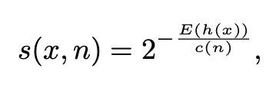
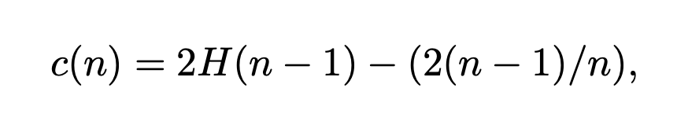
The Foundation — Standard Isolation Forest
Anomaly Score
E(h(x)) = Average path length across all trees in iForest
C(n) = normalising constant
Shorter path → higher score → more anomalous
H(i) = harmonic number = ln(i) + 0.5772156649 (Euler’s constant).
c(n) is the average of h(x) given n, we use it to normalise h(x)

Slide 5
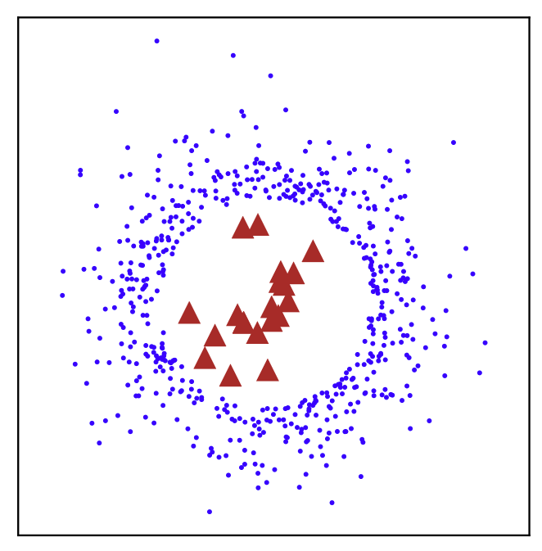
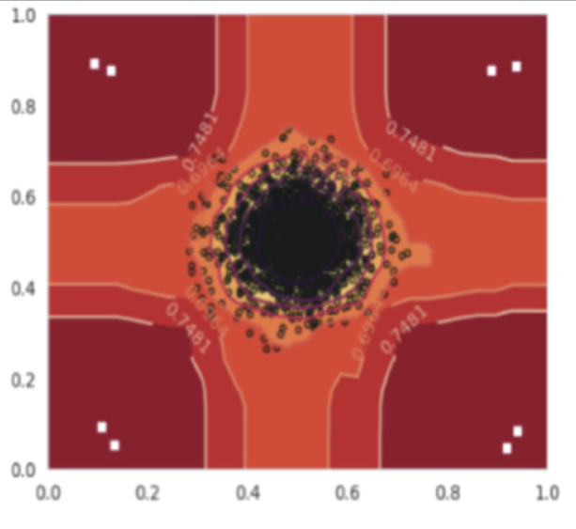
Two Core Problems with iForest
Problem 1 — False Negatives (for Hard Anomalies)
Problem 2 — Ghost Regions / Algorithmic Bias
iForest’s splits are ONLY axis-parallel + ONLY one random feature per split. However, anomalies that are only detectable through feature combinations cannot be isolated by horizontal or vertical cuts alone.
Axis-parallel splits create artefact regions in empty areas of the data space. Rectangular zones near clusters receive unexpectedly low anomaly scores — despite containing no samples. The partitioning treats them as ‘normal’.
⊗ surrounded by ○○○ → axis-parallel cuts cannot isolate it
Rectangular partitions → dead zones → false sense of normality

Slide 6
DIF — Key Insights
If you cannot separate anomalies with linear cuts in the original space,
project the data into new spaces where you can.
Original Space
Random NN Projection
Projected Space
Anomalies inseparable
with any linear cut
▶
Randomly-initialized neural net
maps data non-linearly
▶
Axis-parallel iForest
now works cleanly
Linear cut in projected space = Non-linear cut in original space

Slide 7
The DIF Algorithm — Three Main Steps
1
2
3
Random Representation
Ensemble
Build iTrees in
Projected Spaces
DEAS Scoring
(Deviation-Enhanced)
r randomly initialised NNs φ₁…φᵣ
t isolation trees per representation
Extends depth score with split deviation
Each NN maps all data into a new projected space
Standard axis-parallel splits
Small deviation → dense region → not amplified
Different weights → diverse views of data
Total trees T = r × t
Large deviation → sparse region → amplified
Linear cut in transformed space ≡ non-linear in original
Score = path length × deviation

Slide 8
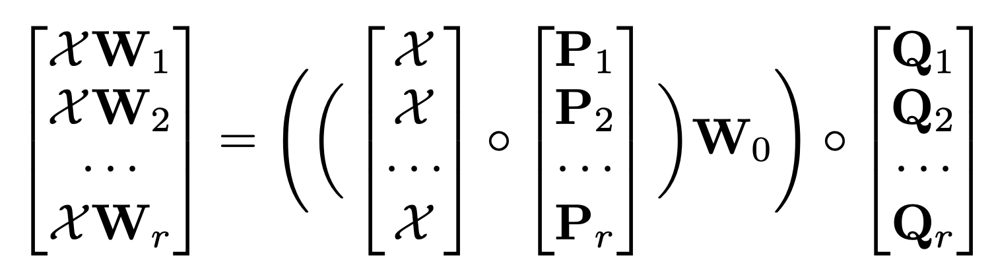
CERE — Computation-Efficient Representation Ensemble
NOTE: r separate networks run sequentially → cost scales linearly with r. CERE computes all r representations in a single batched operation.
How CERE Works
Each ensemble member shares a base matrix W₀, further diversified by two small random vectors pᵢ and qᵢ: Wᵢ = W₀ ∘ (pᵢ qᵢᵀ) ∘ = element-wise Hadamard product All r representations are computed as a single parallel batch — cost ≈ one forward pass regardless of r.
NOTE: Each layer has its own independent W₀
r representations ≈ cost of 1 forward pass

Slide 9
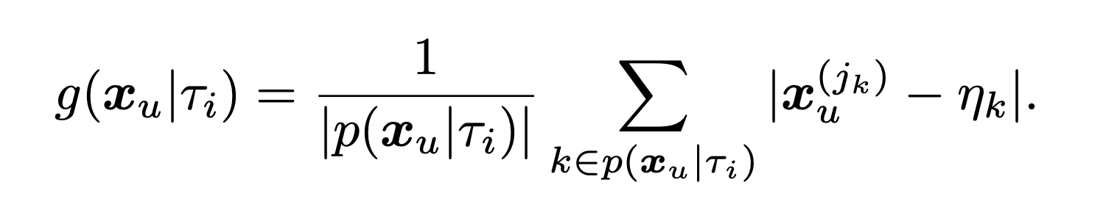
DEAS — Deviation-Enhanced Anomaly Scoring
Averaged Deviation Degree
Combined DEAS Score
For each split k along the path, measures how far the data point deviates from the split threshold ηₖ. Averaged across all splits encountered.
Path length term × Deviation term
Small g(x)
Large g(x)
What this achieves
Standard iForest path length does not account for density context. DEAS does: points consistently near split boundaries live in crowded regions and its anomaly score gets suppressed; points far from boundaries inhabit sparse, genuinely anomalous space and its anomaly score gets amplified.
Close to threshold
→ Dense region
→ Score suppressed
Far from threshold
→ Sparse / isolated
→ Score amplified

Slide 10
TRAINING REVIEW
Optimised Deep Isolation Forest
ODIF
Detection logic · DEAS scoring · CERE — all unchanged. Only the training phase is restructured.

Slide 11
The Problem with DIF’s Training Phase
What DIF does
The waste
1
Transform all N samples
Total training samples
N
Full dataset passes through CERE into r representations
(e.g. 100,000)
2
Store all representations
Samples used per tree
n
(default: 256)
3
Subsample at tree time
Total samples needed
t × n
Each of r×t trees draws n samples from the already-stored data
(e.g. 100 × 256 = 25,600)
Wasted transformations
N − tn
⚠ Each tree uses only n = 256 samples. The other N − n transforms are computed and stored for nothing.
~74,400 in this example

Slide 12
ODIF — Sample First, Transform Second
1
2
3
4
Pre-sample
▶
Remove duplicates
▶
Transform
▶
Build Trees
Subsample trees’ training dataset upfront
t × n total indexes selected
Extract unique indices
Each sample transformed at most once
Apply CERE to reduced subset only
Not to the full N dataset
Assign pre-sampled data to each tree
No re-sampling at construction time

Slide 13
TRAINING REVIEW
ODIF Applied
Anomaly Detection on NPDCL
Electricity Consumption Data
Northern Power Distribution Company of Telangana
Goal: identify meter tampering, illegal connections, and faulty equipment via unsupervised anomaly scoring

Slide 14
The Dataset — NPDCL Electricity Consumption
Column Group
Columns
Notes
Geographic mapping
Circle, Division, SubDivision,
Section, Area
5 levels of location — high mutual association
Billing metrics
TotServices, BilledServices,
Units, Load
Core signal columns
Time-based
year, month, month_name,
timestamp
Redundant encodings — collapsed to time_index
Identifiers
CatCode, CatDesc, resource_id,
resource_title
Zero variance / pure ID columns — dropped
Jan 2019 used as representative EDA sample. Extended to 3 sampled files (Jan 2019, May 2022, Dec 2025) before committing to the full dataset.

Slide 15
Exploratory Data Analysis — Three Key Findings
1
Zero-Variance Columns
CatCode (always 7), year, month, CatDesc, month_name, timestamp, resource_id, resource_title showed zero variance within and across all sampled files.
No discriminating signal — flagged for immediate removal.
2
Correlation |r| > 0.85
TotServices ↔ BilledServices: highly correlated — feature engineering.
Units ↔ Load: highly correlated — feature engineering.
VIF analysis confirmed severe multicollinearity across all flagged columns.
3
Cramér’s V — Geographic Columns
Circle, Division, SubDivision, Section, Area showed strong mutual association.
Highly correlated — feature engineering — encoded into 1 composite location-frequency feature.

Slide 16
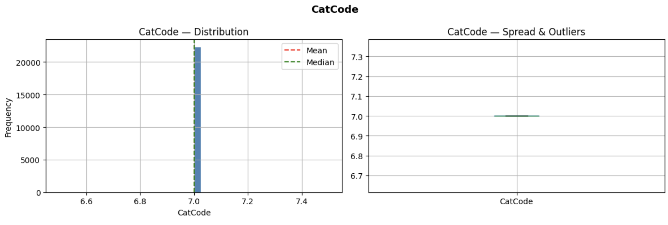
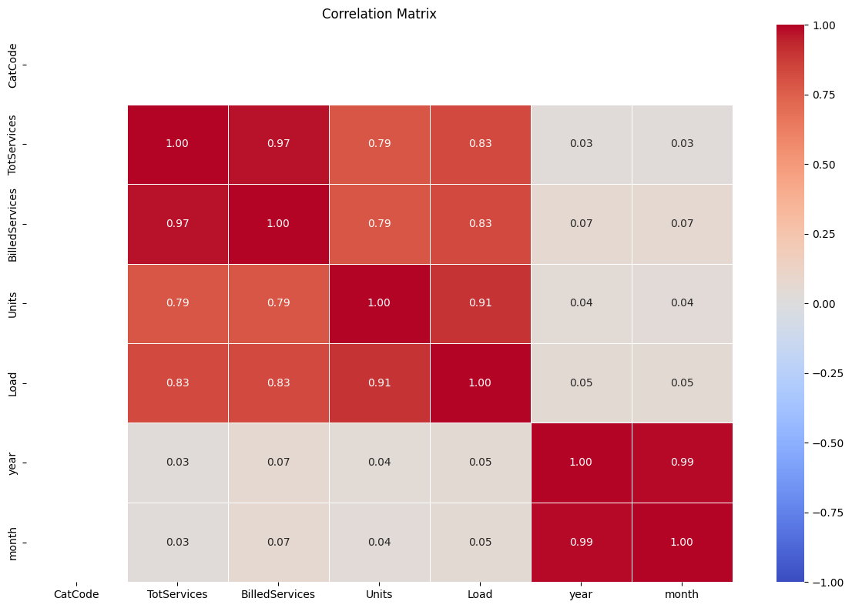
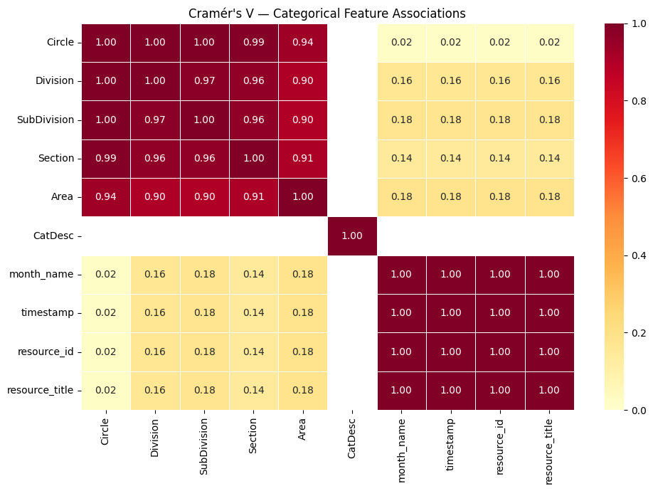
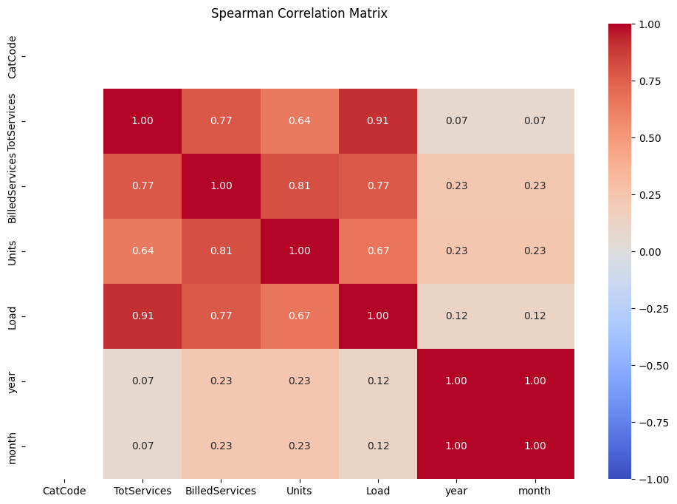
Exploratory Data Analysis — Three Key Findings

Slide 17
Feature Engineering — 4 Constructed Features
time_index
billing_rate
Theft signal
df["time_index"] = (df["year"] - df["year"].min()) * 12 + df["month"]
df["billing_rate"] =
df["BilledServices"] / df["TotServices"]
Collapses year/month into a single signal.
Proportion of services actually billed.
Close to 0 → consumption without billing — direct theft signal. Encodes the billing anomaly explicitly.
areas
df["billing_rate"] =
df["BilledServices"] / df["TotServices"]
Encodes all 5 geographic columns into relative location frequency. Rare location combinations receive low weights, flagging unusual areas.

Slide 18
Feature Engineering — 4 Constructed Features
efficiency
Tampering signal
df["loc"] = (
df["Circle"].astype(str) + "," +
df["Division"].astype(str) + "," +
df["SubDivision"].astype(str) + "," +
df["Section"].astype(str) + "," +
df["Area"].astype(str)
)
freq = df["loc"].value_counts(normalize=True)
df["areas"] = df["loc"].map(freq)
Units consumed per unit of load.
Abnormally high ratio → meter under-reporting true consumption.
Captures stuck/tampered/bypassed meters.
Final input: X = df[["time_index", "billing_rate", "efficiency", "areas"]]

Slide 19
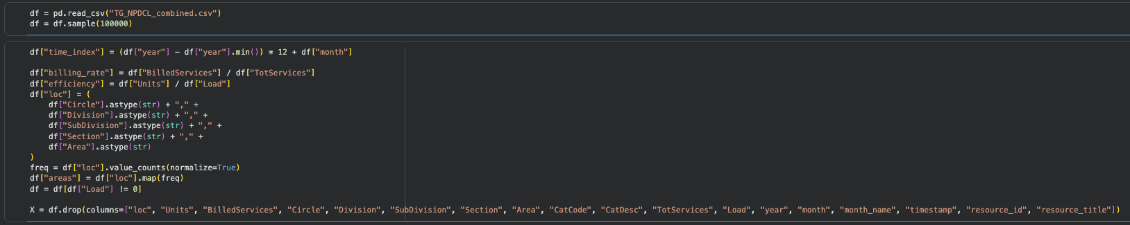
Coding the updated database

Slide 20
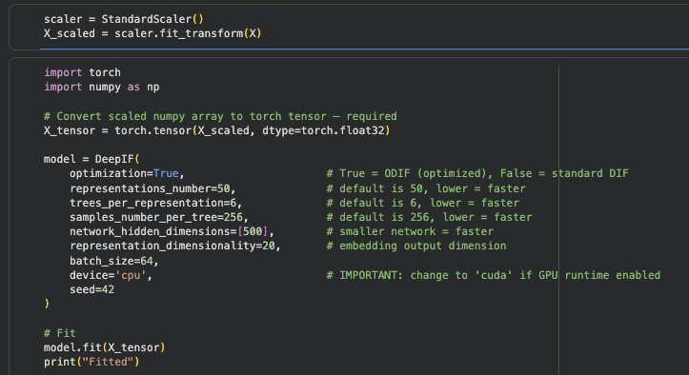
Training the ODIF model
Codebase used: optimised-deep-isolation-forest by Łukasz Gałka
https://github.com/lukasz-galka-algorithms/optimized-deep-isolation-forest.git

Slide 21
Model Configuration — ODIF on NPDCL
ODIF Configuration
optimization
True
ODIF mode
representations_number
50
r = 50 projection spaces
trees_per_representation
6
t = 6 trees each
samples_number_per_tree
256
n = 256 per tree
network_hidden_dimensions
[500]
single hidden layer MLP
representation_dimensionality
20
projects to ℝ²⁰
seed
42
reproducibility

Slide 22

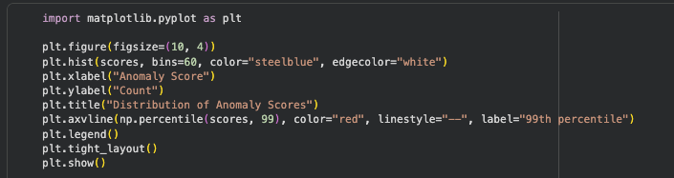
Calculating and plotting the anomaly scores
Threshold: np.percentile(scores, 99) — top 1% flagged as anomalous
Score distribution: dense low-score normal mass with a sparse anomalous high-score tail

Slide 23
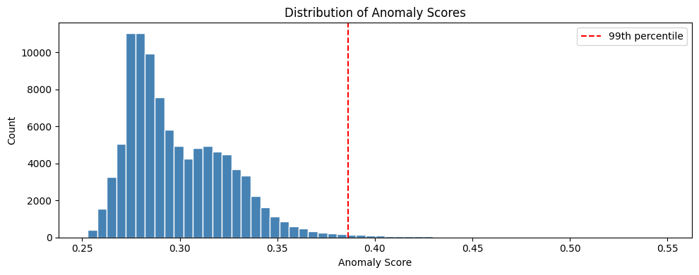
Results

Slide 24
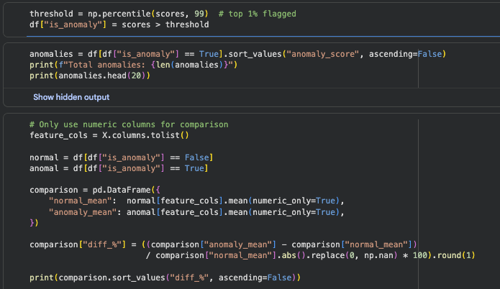
Calculating and plotting the anomaly scores
Threshold: np.percentile(scores, 99) — top 1% flagged as anomalous
Score distribution: dense low-score normal mass with a sparse anomalous high-score tail

Slide 25
Anomaly Profile — What the Model Found
Normal vs Anomalous Mean Comparison
Interpretation
Feature
Normal mean
Anomaly mean
Signal
Meter Tampering
or Bypass
billing_rate
~0.74
~0.80
— no pattern
Extreme efficiency spike — anomalies show ~29x higher units-per-load than normal records (efficiency ↑ 2805%) No separation in billing_rate, areas, or time_index — under-billing is not a contributing signal in this run Meter is reporting load far too low relative to actual consumption — consistent with a stuck, bypassed, or under-reporting load sensor
efficiency
~41
~1183
↑ High — tampering
time_index
variable
variable
— no pattern
areas
~0.03
~0.02
— no pattern

Slide 26
Use Cases — ODIF Pipeline Generalisability
⚡
⚙
🔧
PRIMARY USE CASE
Faulty Equipment
Predictive Maintenance
Electricity Theft
Machines consuming abnormal power relative to rated load.
Anomalous patterns often precede equipment failures: overheating, motor wear, bearing failures.
Flags meter tampering.
High consumption · Low billing rate · High efficiency ratio
Distinguishable from theft via geographic context (industrial vs residential)
Early detection reduces downtime and repair cost before failure occurs

