Slide 1

BLOCKCHAIN:
The blockchain is an incorruptible digital ledger of economic transactions that can be programmed to record not just financial transactions but virtually everything of value.

Slide 2
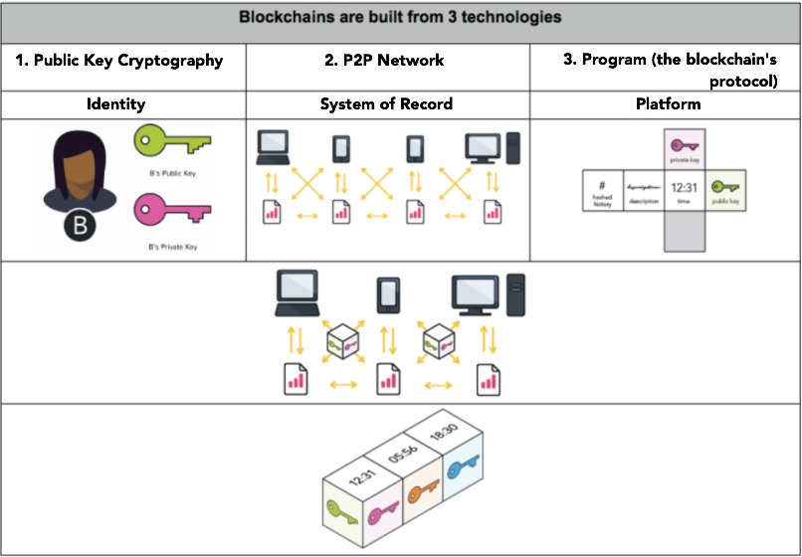

Slide 3
BLOCKCHAIN TERMS:
A blockchain is a type of distributed ledger, comprised of unchangeable, digitally recorded data in packages called blocks. Each block is then ‘chained’ to the next block, using a cryptographic signature. This allows block chains to be used like a ledger, which can be shared and accessed by anyone with the appropriate permissions.
Blocks hold batches of valid transactions that are hashed and encoded into a Hash tree. Each block includes the cryptographic hash of the prior block in the blockchain, linking the two. The linked blocks form a chain. This iterative process confirms the integrity o f the previous block, all the way back to the original genesis block.
Consensus Process is a group of peers responsible for maintaining a distributed ledger use to reach consensus on the ledger’s contents.
Mining is the process by which transactions are verified and added to a blockchain. This process of solving cryptographic problems using computing hardware also triggers the release of crypto currencies.
Smart contracts are contracts whose terms are recorded in a computer language instead of legal language. Smart contracts can be automatically executed by a computing system, such as a suitable distributed ledger system.

Slide 4
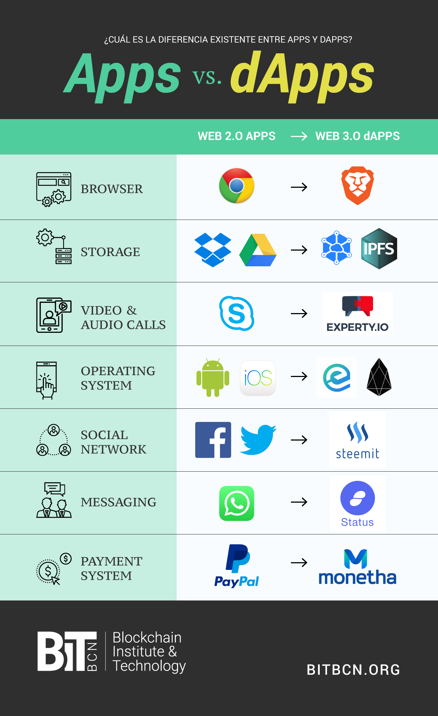
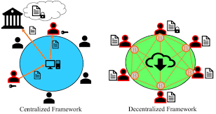
Differences between an App and a dApp :
Decentralized:
Computation is done at each node , no node is instructing the other. Works on P2P networking
Centralized:
Control of individual units from single center.
*Note: Apps are Centralized , Dapp Decentralized , there are third kind of apps which are based on Distributed Network

Slide 5
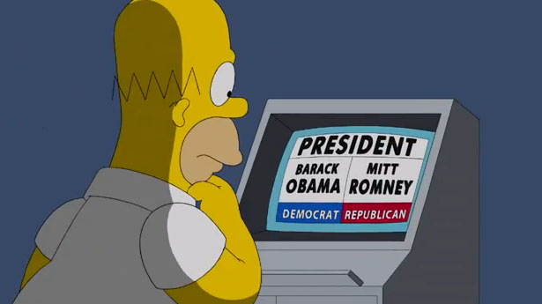
Problem Statement:
In a Country like India , we have seen various corrupt practices during government election. These Corrupt Practices Include:
Manipulating the voter list
Raiding and seizing polling booths.
Our Solution:
A Decentralized App on Public Blockchain :
Which would allow one vote per address , user verified by Aadhar
Which will have an open source ledger visible to all people on Blockchain.

Slide 6
Technologies Used:
We are using a testRPC environment of Ethereum for our POC.
Ethereum is a blockchain that allows you to run programs in its trusted environment. To this end, it has a virtual machine, called the Ethereum Virtual Machine (EVM). The EVM allows code to be verified and executed on the blockchain, providing guarantees it will be run the same way on everyone's machine. This code is contained in "smart contracts“ . Beyond just tracking account balances, it maintains the state of the EVM on the blockchain. All nodes process smart contracts to verify the integrity of the contracts and their outputs.
Ganache :
A Local test network which quickly fires up a personal Ethereum blockchain which you can use to run tests, execute commands, and inspect state while controlling how the chain operates.
MetaMask :
It is a Chrome plugin that allows users to make Ethereum transactions through regular websites. It is a wallet for our Dapp

Slide 7
Truffle:
It is a development environment, testing framework and asset pipeline for Ethereum. With Truffle, you get:
Built-in smart contract compilation, linking, deployment and binary management.
Automated contract testing with Mocha and Chai.
Scriptable deployment & migrations framework.
Interactive console for direct contract communication.
Instant rebuilding of assets during development.
Web3:
is a collection of libraries which allow you to interact with a local or remote ethereum node, using a HTTP or IPC connection.
Gas:
Gas is the execution fee for every operation made on ethereum. Its price is expressed in ether and it's decided by the miners, which can refuse to process transaction with less than a certain gas price.
https://ethereum.stackexchange.com/questions/3/what-is-meant-by-the-term-gas

Slide 8
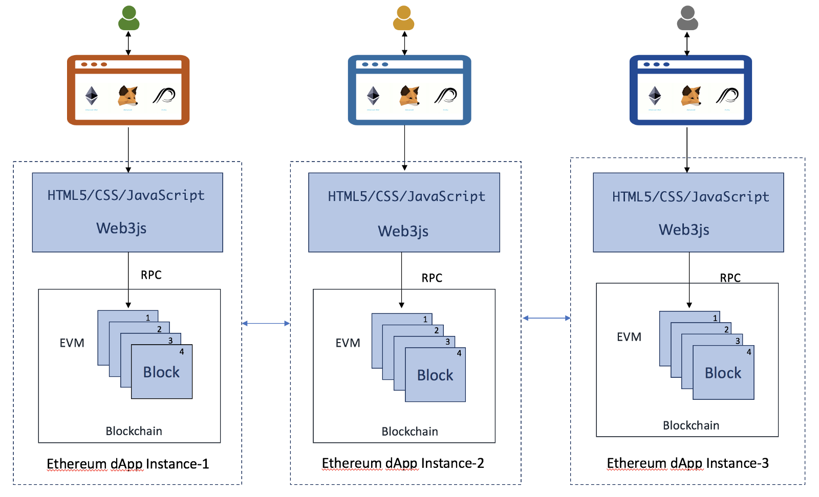
Programming Language:
Solidity : Solidity is a programming language for writing smart contracts which run on Ethereum Virtual Machine on Blockchain. It is a contract-oriented, high-level language whose syntax is similar to that of JavaScript and it is designed to target the Ethereum Virtual Machine.

Slide 9
