Slide 1
Managing Your Files

Slide 2
Objectives
Explore the differences between Windows 7 and Windows 8
Plan the organization of files and folders
Use File Explorer to view and manage libraries, folders and files
Open and save files
Create folders
Copy and move files and folders
Compress and extract files

Slide 3
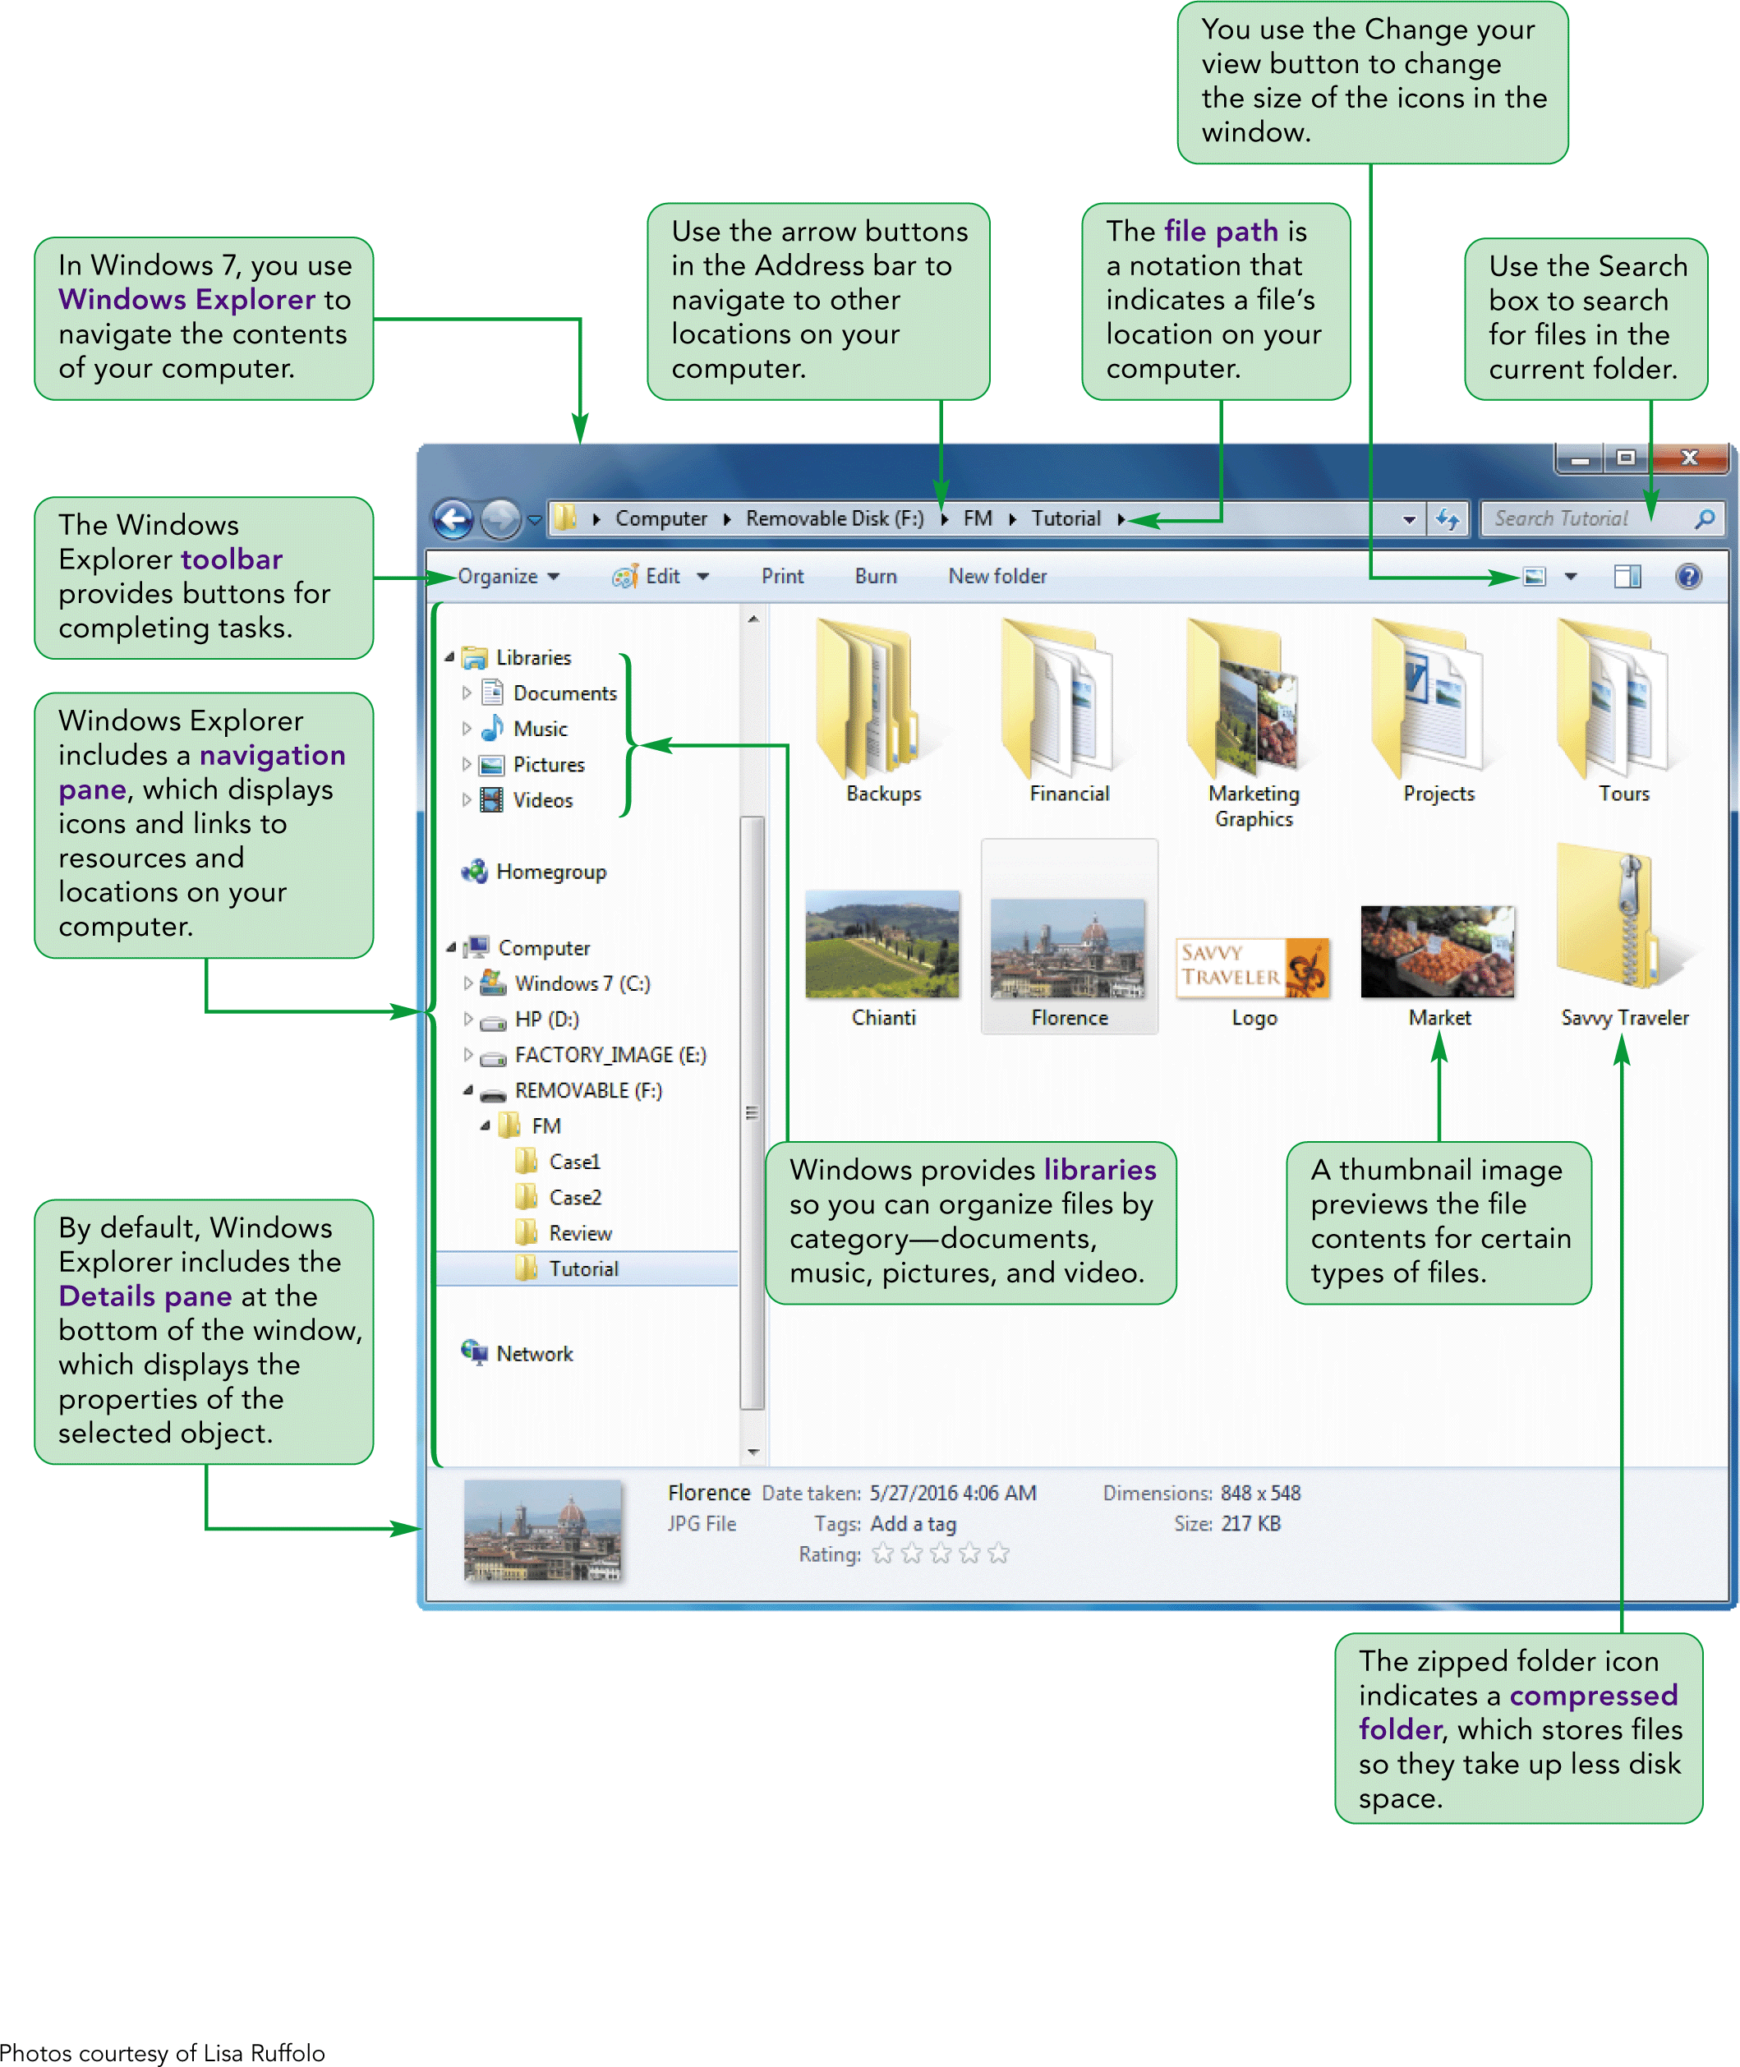
Comparing Windows 7 & Windows 8 – Visual Overview

Slide 4
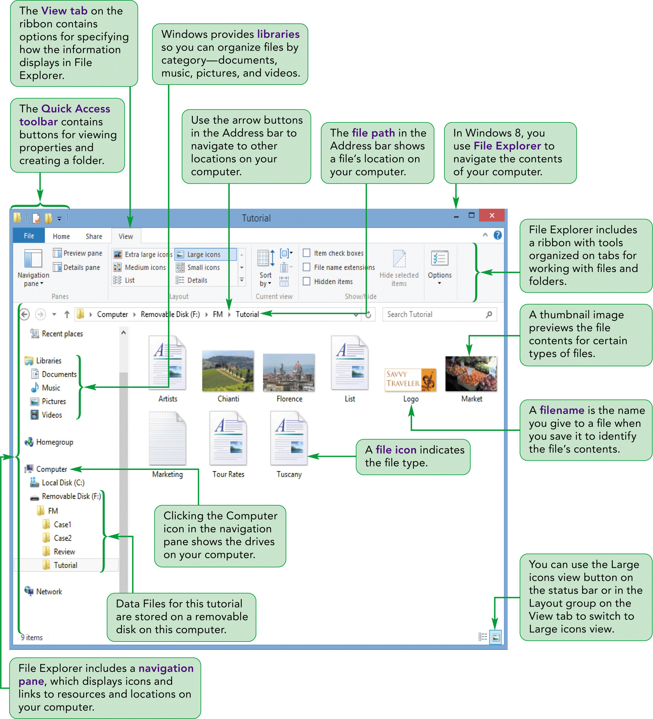
Comparing Windows 7 & Windows 8 – Visual Overview cont.

Slide 5
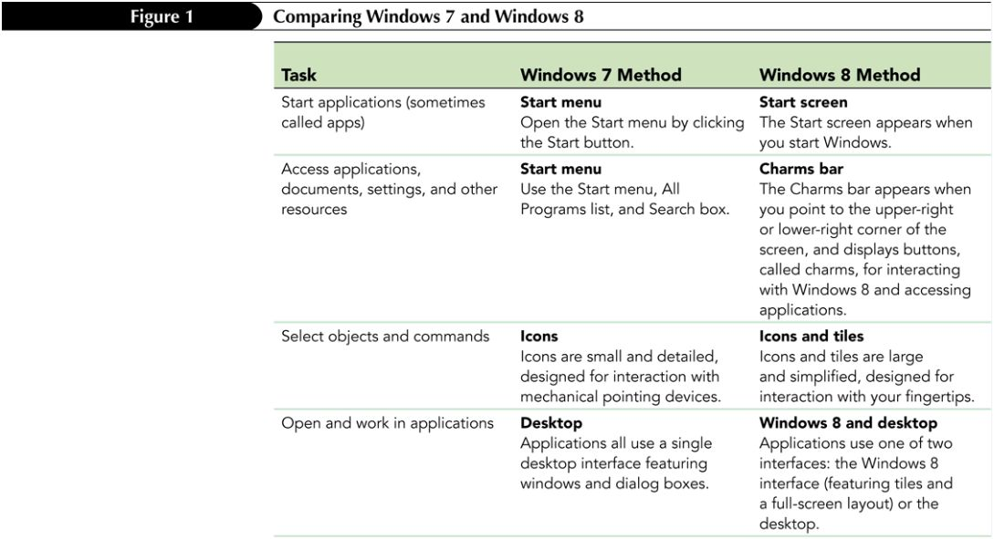
Comparing Windows 7 & Windows 8 by Task

Slide 6
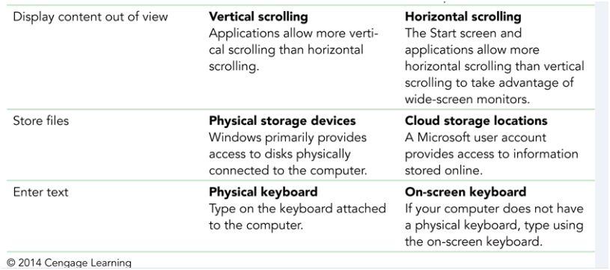
Comparing Windows 7 & Windows 8 by Task cont.

Slide 7
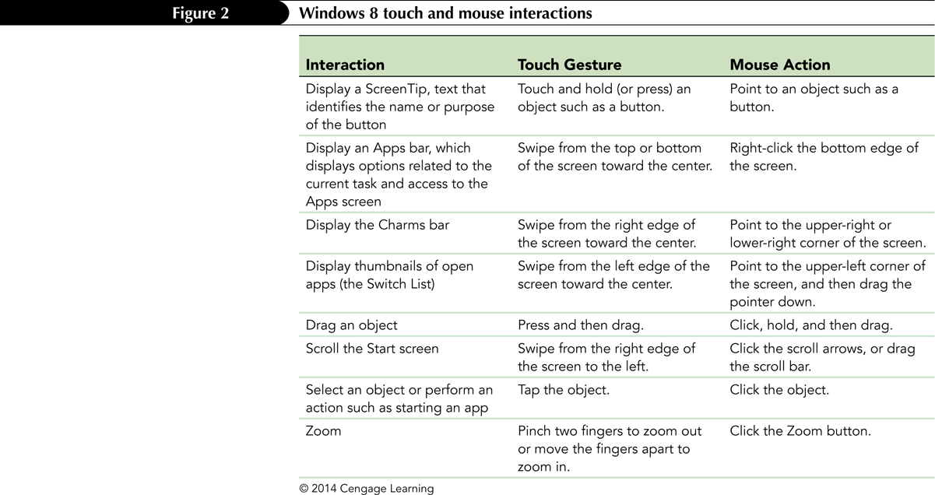
Windows 8 touch and mouse interaction

Slide 8
Organizing Files and Folders
A file, or document, is a collection of data that has a name and is stored in a computer
Disks contain folders that hold documents, or files
USB drives
Digital Video discs (DVDs)
Hard disks
Each drive is assigned a letter

Slide 9
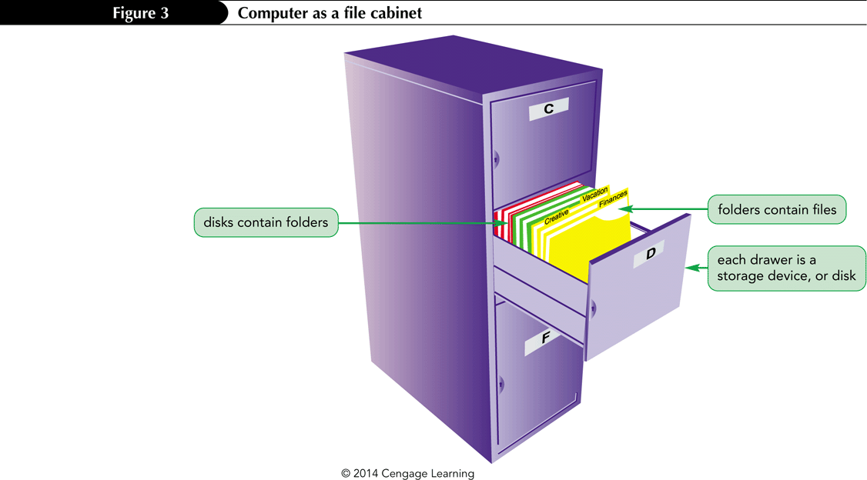
The Computer is like a file cabinet

Slide 10
Understanding How to Organize Files and Folders
Windows organizes folders and files in a hierarchy file system
Windows stores the important folders and files it needs to turn on the computer it its root directory (usually on drive C; the hard disk)
Folders stored within other folders are called subfolders

Slide 11
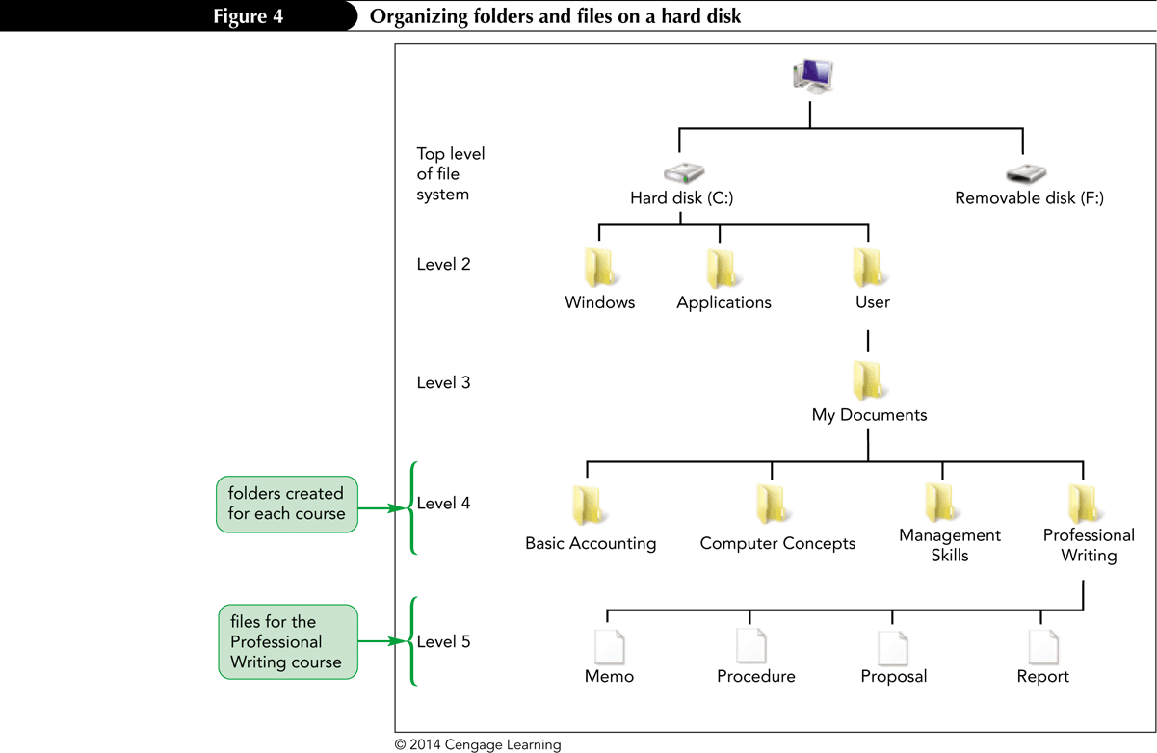
Organizing folders and files on a hard disk

Slide 12
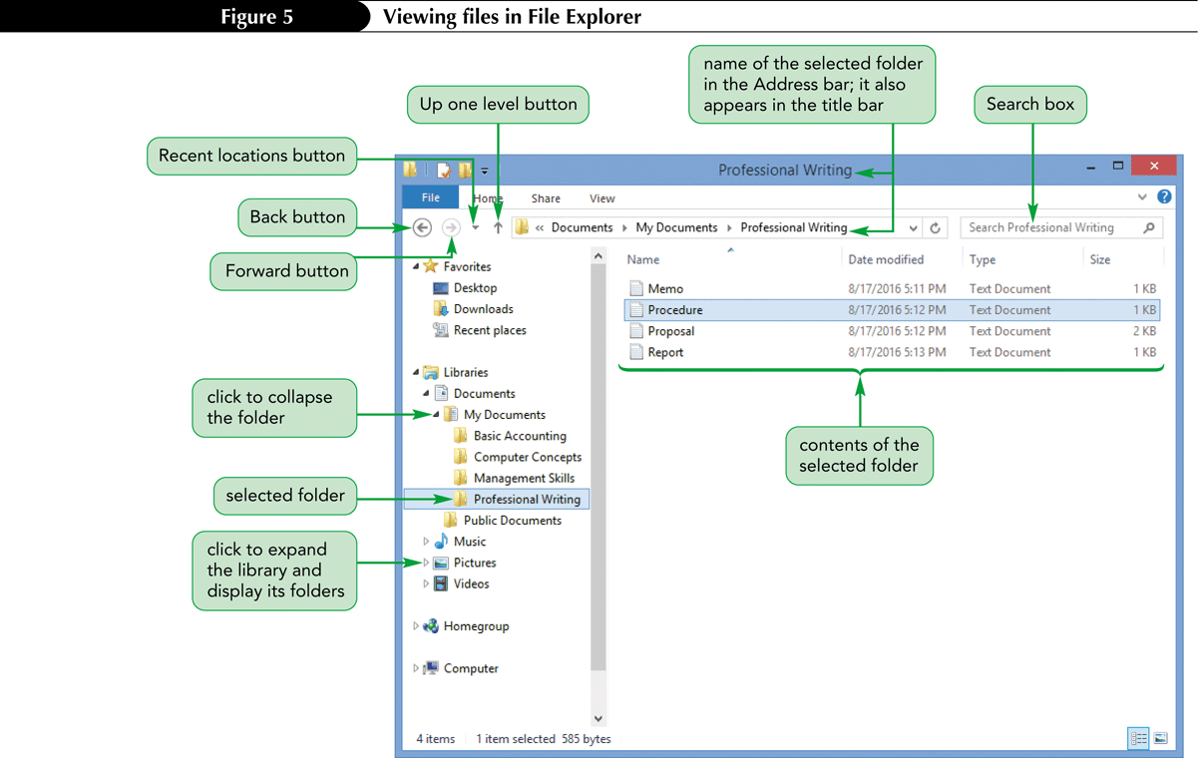
Exploring Files and Folders

Slide 13
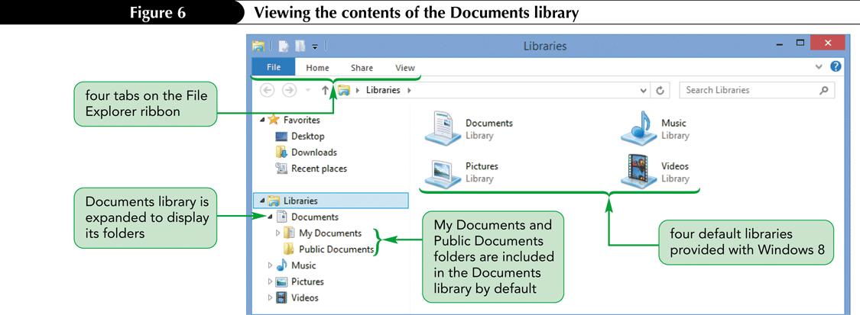
Using Libraries and Folders
When you open Windows Explorer, it shows the contents of the Windows built-in libraries by default
Libraries display similar types of files together, such as documents or pictures

Slide 14
Navigating to Your Data Files
The file path is a notation that indicates a file’s location on your computer
This path has five parts, with each part separated by an arrow button
F: is the removable disk (drive) name
Savvy Traveler is the top-level folder
Marketing is a subfolder
Logo.png is the name of the file

Slide 15
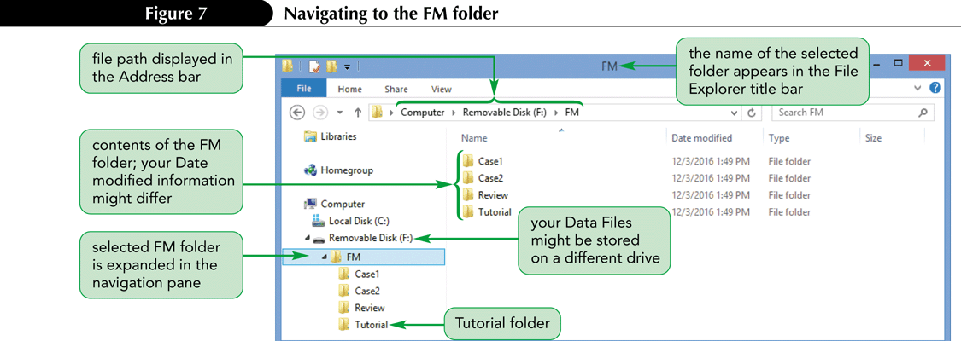
Navigating to the FM folder

Slide 16
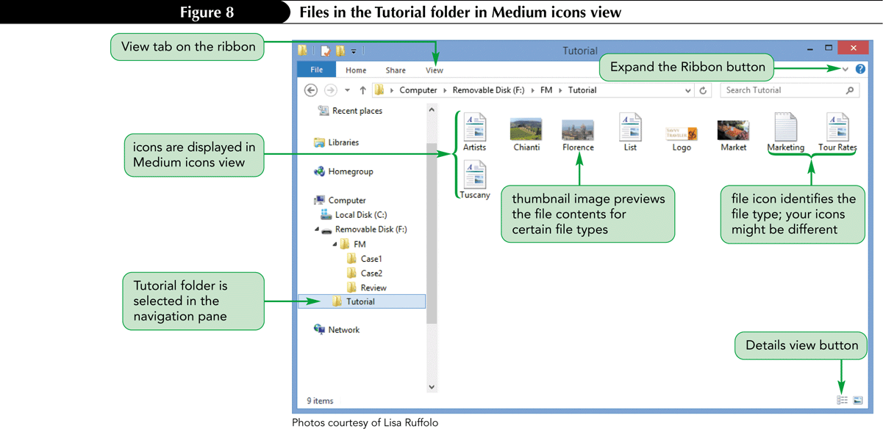
Changing the View in File Explorer

Slide 17
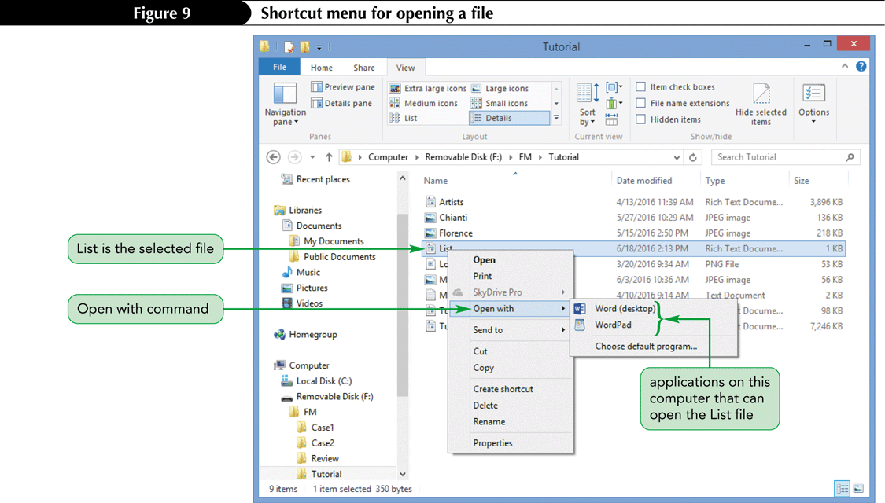
Opening a File
Right-click the file you want to open then point to open with on the shortcut menu
Click on the appropriate application

Slide 18
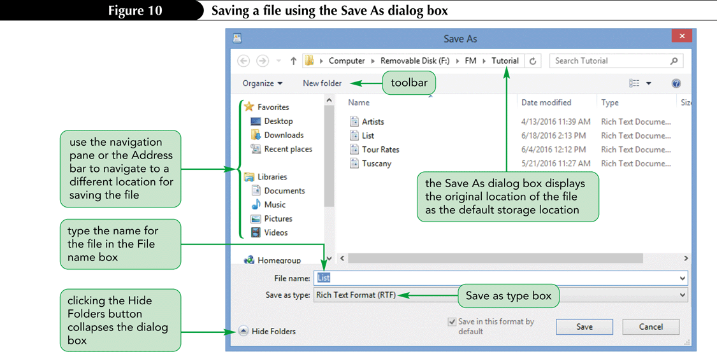
Saving a file with Save as
Click the File tab then click Save as to open the Save as dialog box.
Click in the file name box, type the file name, and then click the Save button

Slide 19
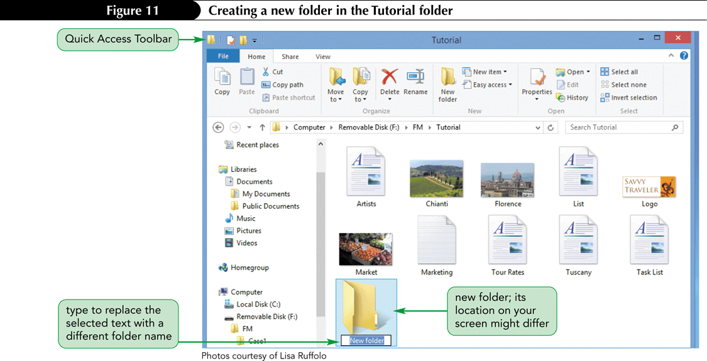
Creating a Folder
Click the Home tab
In the New group, click the New folder button
Type the folder name, and the press the Enter key

Slide 20
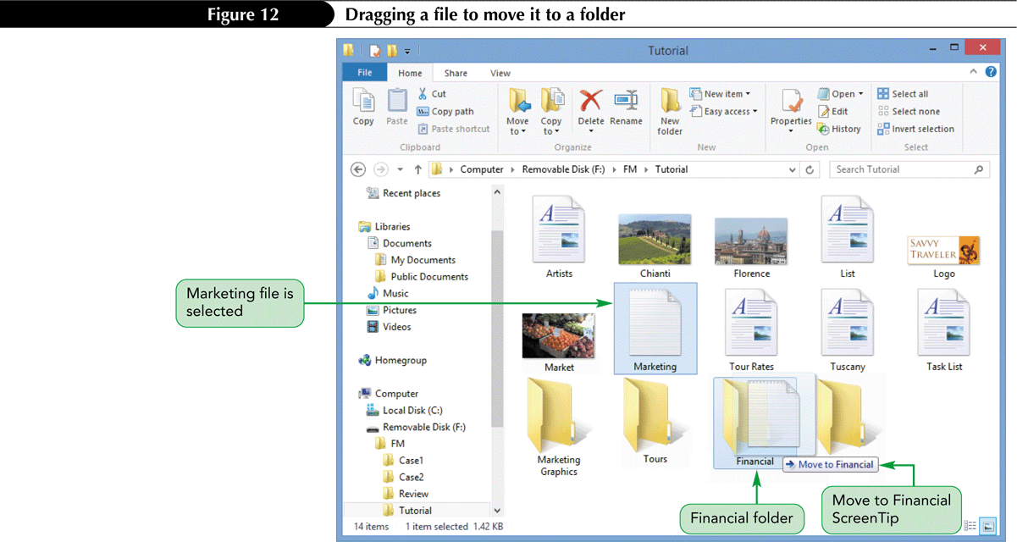
Moving a file by dragging it
Point to the file in the right pane, and then press and hold the mouse button
Drag the file to the new folder, and then release the mouse button

Slide 21
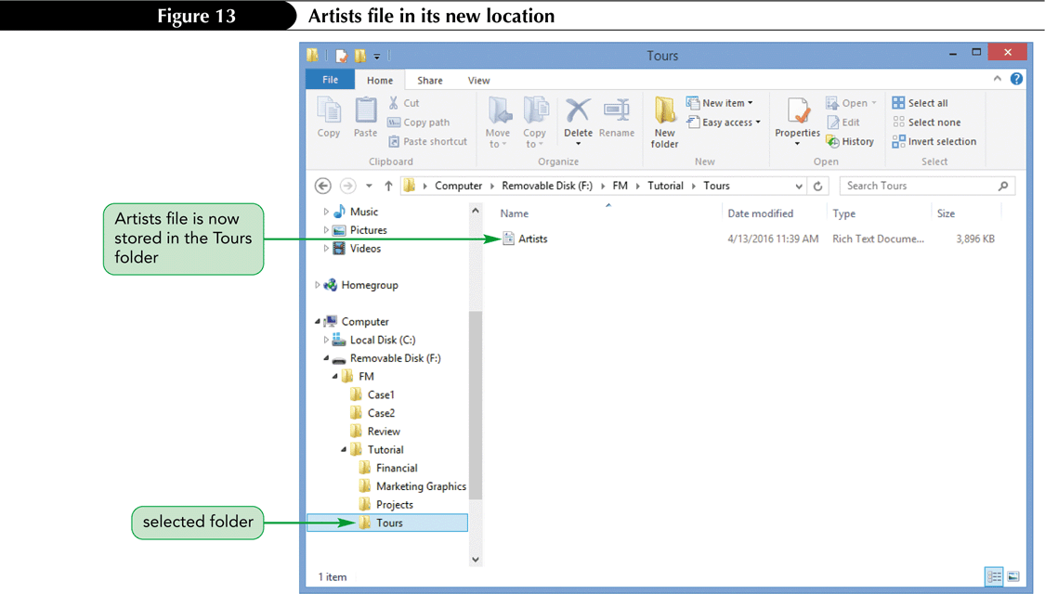
Moving a file using the Clipboard
Right-click on the file, and then click Cut on the shortcut menu
Right-click on the destination file, and then click paste on the shortcut menu

Slide 22
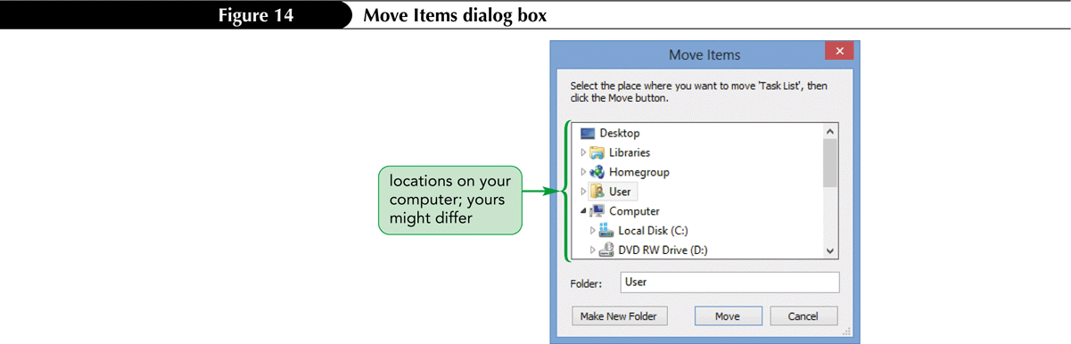
Moving a file using the Move to button
Click the file name
On the Home tab, in the Organize group, click the Move to button, and then click Choose location to open the Move items dialog box
Click the destination folder, and then click the Move button

Slide 23
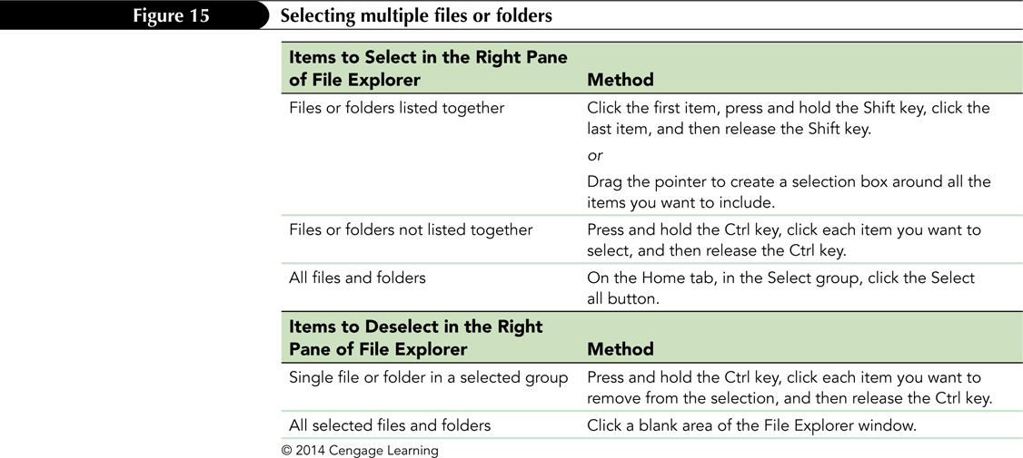
Selecting multiple files or folders

Slide 24
Using the short cut menu to delete or rename a file or folder
To delete a file or folder
Right-click on the file or folder name, and then select delete on the short cut menu
Click the Yes button to confirm you want to delete the file
To rename a file or folder
Right-click on the file or folder name, and then select rename on the short cut menu
Type the new name, and then press the Enter key

Slide 25
Working with Compressed Files
You compress a file or folder of files so it occupies less space on the disk
If you or your email contacts can send and receive files only up to a certain size, compressing large files might make them small enough to send and receive
When you extract a file, you create an uncompressed copy of the file in a folder you specify

Slide 26
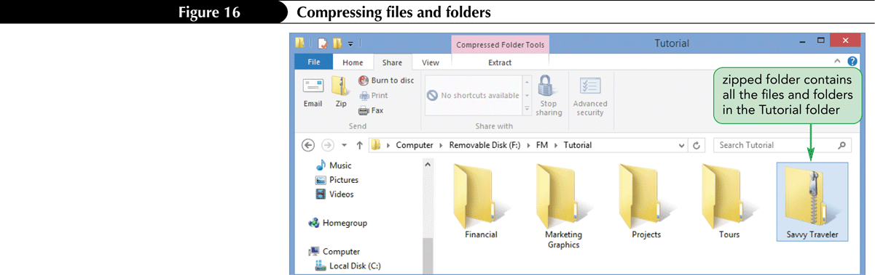
To compress folders and files
Select the folders or files you want to compress, and then click the Share tab on the ribbon
In the Send group, click the Zip button
Type the name for the compressed folder, and then press the Enter key

Slide 27
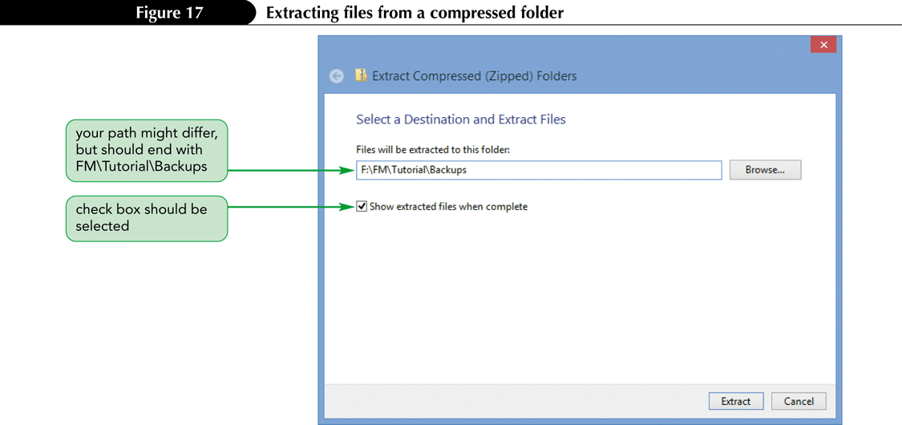
To extract the compressed files
Click on the compressed folder, and then click the Compressed Folder Tools Extract tab on the ribbon
Click the Extract all button, type or select a file path, and then click the Extract button

