Slide 1
Data Structures and Algorithms CS 213- Lecture 1
RK Shyamasundar

Slide 2
Broad Topics
Introduction to data structures,
Abstract data types, analysis of algorithms.
Creation and manipulation of data structures: arrays, matrices, sparse matrices, lists, stacks, queues, trees, heaps, hash tables, balanced trees, tries, graphs.
Algorithms for sorting and searching,
Depth-first and breadth-first search,
Paradigms:
The greedy method.
Divide-and-conquer.
Dynamic programming.
Backtracking.
Branch-and-bound.

Slide 3
Text Books
S. Sahni, Data Structures, Algorithms and Applications in C++,2nd edition, Universities Press,2005
T. Cormen, C. Leiserson, R. Rivest, C. Stein, Introduction to Algorithms, 2nd edition, Prentice-Hall India, 2001.

Slide 4
Organization
Lectures – Tuesday, Friday: 330-500PM
Quizes 3-- 30%
Mid Term – 30%
Final Exam – 40%
Attendance Necessary
Academic Honesty Policy:
http://www1.iitb.ac.in/newacadhome/rules.jsp

Slide 5
TAs
BS Radhika
Amit Goel
Sundaram Gupta
MTP-1 --6 TAs??
BTP – 3 TAs??

Slide 6
Tentative Agenda
Introduction
Role of Data structures
Concerns of program Construction
Analysis of Algorithms: Notations
Complexity Analysis forms
Recurrence Relations/Recursive Programs
Merge Sort, asymptotic analysis and performance measurement of programs.
Data representation methods and linear lists
Arrays, matrices, sparse matrices
Stacks.
Queues.
Hashing
LZW compression.
Binary trees, AVL Trees
Priority queues.
Tournament trees.
Search trees.
Graphs.
The greedy method.
Divide-and-conquer.
Dynamic programming.
Backtracking.
Branch-and-bound.

Slide 7
What is it about?
Data structures: Representation and manipulation of data.
Programs manipulate data.
Programs as data
How do we manipulate Data?

Slide 8
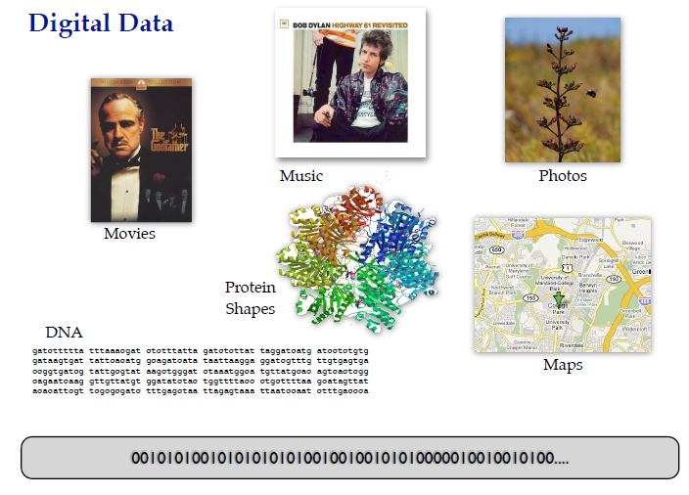

Slide 9
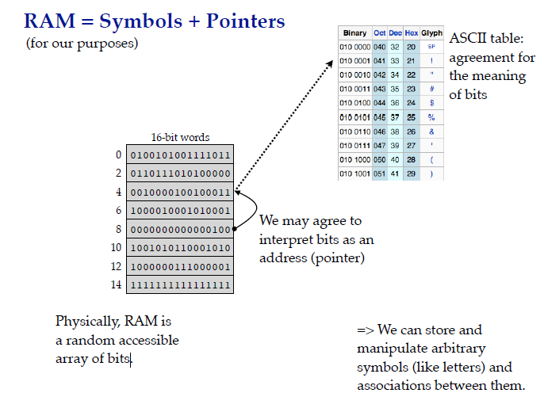

Slide 10
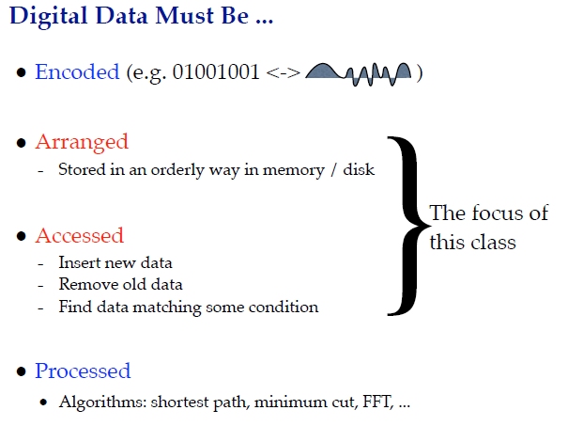

Slide 11
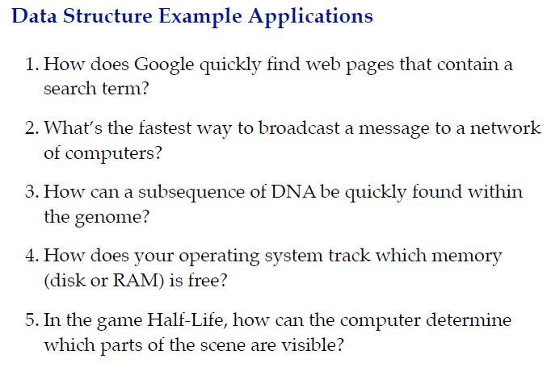

Slide 12
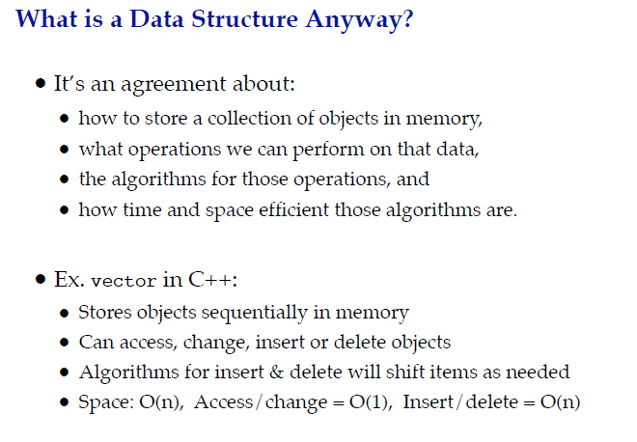

Slide 13
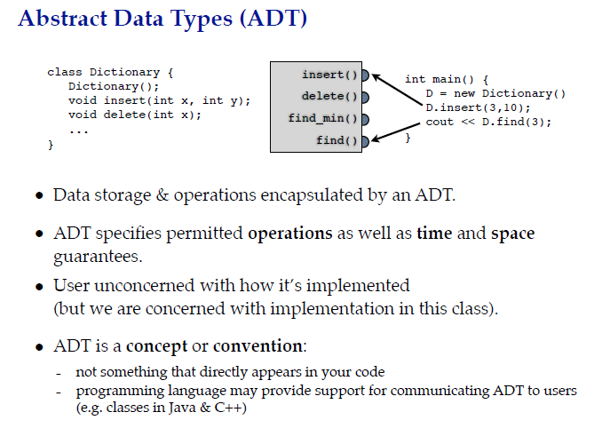

Slide 14
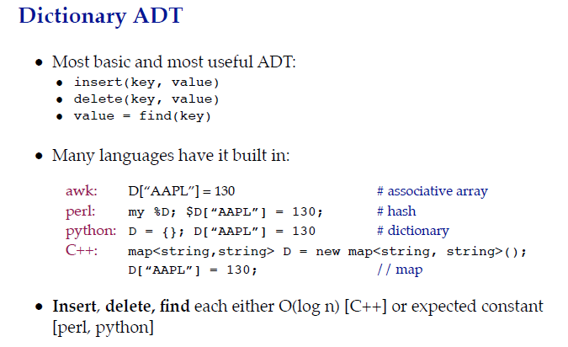

Slide 15
C++ STL
STL (Standard Template Library) is a powerful set of C++ template classes to provides general-purpose templatized classes and functions that implement many popular and commonly used algorithms and data structures like vectors, lists, queues, and stacks.

Slide 16
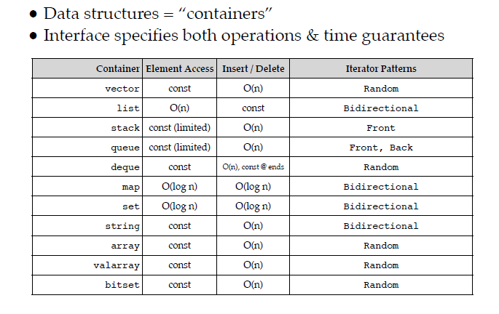
C++ STL

Slide 17
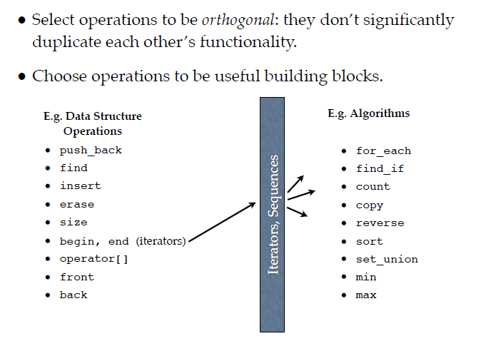
Some STL Operations

Slide 18
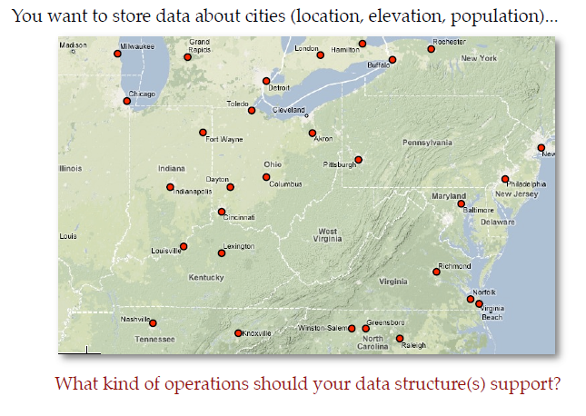
Consider Google Maps

Slide 19
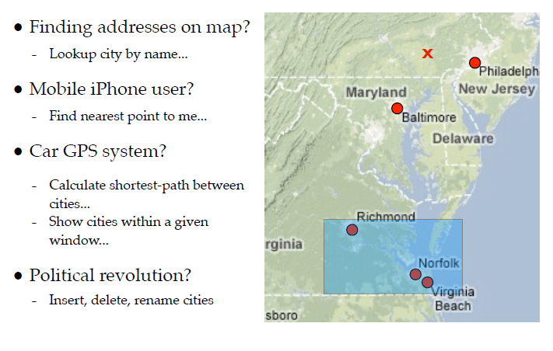
Operations to support these Operations

Slide 20
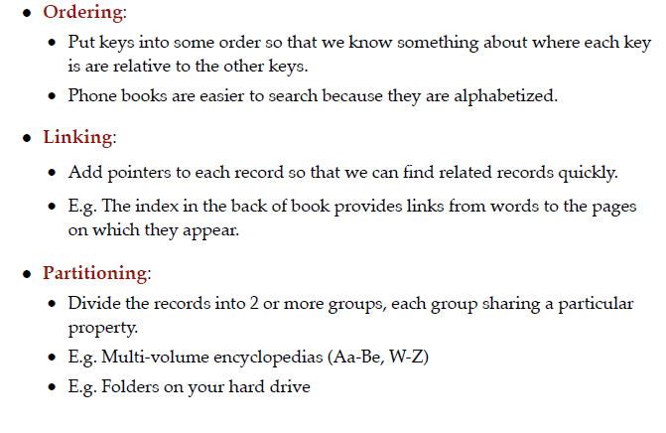
Data Organizing Principles

Slide 21
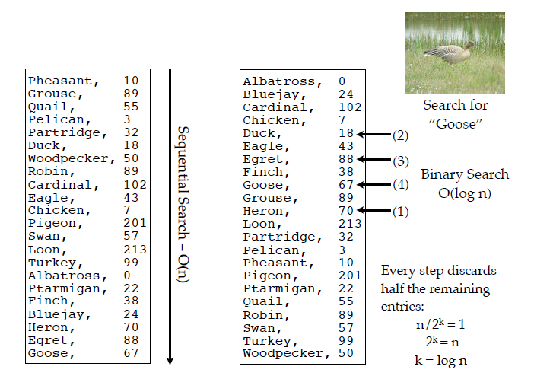
Ordering

Slide 22
Paradigms
Algorithms + Data Structures = Programs
Imperative Programs
Logics + Control = Programs
Logic Programs – Declarative Specifications
Example Finding a transitive closure of a program

Slide 23
Broad Coverage
Algorithm design methods needed to develop programs that do the data manipulation.
Study of data structures and algorithms: Crux of Computer Science.

Slide 24
Programs
Two Concerns
Correctness
Efficiency

Slide 25
Writing an convincing program
Three arrays
F[i], G[j], H[k] monotonically decreasing
Given that there exists a i,j, k such that F[i] = G[j] = H[k], write program computing the points of common intersection

Slide 26

A Simple Example

Slide 27

Permutation

Slide 28

Another Example

Slide 29

GCD

Slide 30
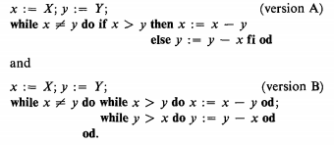
GCD (Classical versions)
What about computation of LCM?

Slide 31
Ackerman Function
A(m,n) = n+1 if m=0
= A (m-1,1), m > 0 and n=0
= A (m-1, A(m, n-1)), m > 0 n > 0

Slide 32
Tower of Hanoi

