Slide 1

Fine Tuning bert with pytorch and transformers

Slide 2
Contents
What is BERT? How BERT was trained? Special Tokens of BERT Transformers by Hugging Face Preprocessing text for BERT | BertModel Class Our Approach to Fine-tuning Dataset Class and Data loaders Building the Model Training and Validation

Slide 3
What is bert? And its architecture
The Google AI Research team defines BERT as “Bidirectional Encoder Representations from Transformers. It is designed to pre-train deep bidirectional representations from the unlabeled text by jointly conditioning on both the left and right contexts. As a result, the pre-trained BERT model can be fine-tuned with just one additional output layer to create state-of-the-art models for a wide range of NLP tasks.”
BERT’s model architecture is a multi-layer bidirectional Transformer encoder
BERT Base has: 12 Transformers Hidden Dimension Size of 768 12 Self-Attention Heads BERT Large has: | 24 Transformers Hidden Dimension Size of 1024 16 Self-Attention Heads

Slide 4
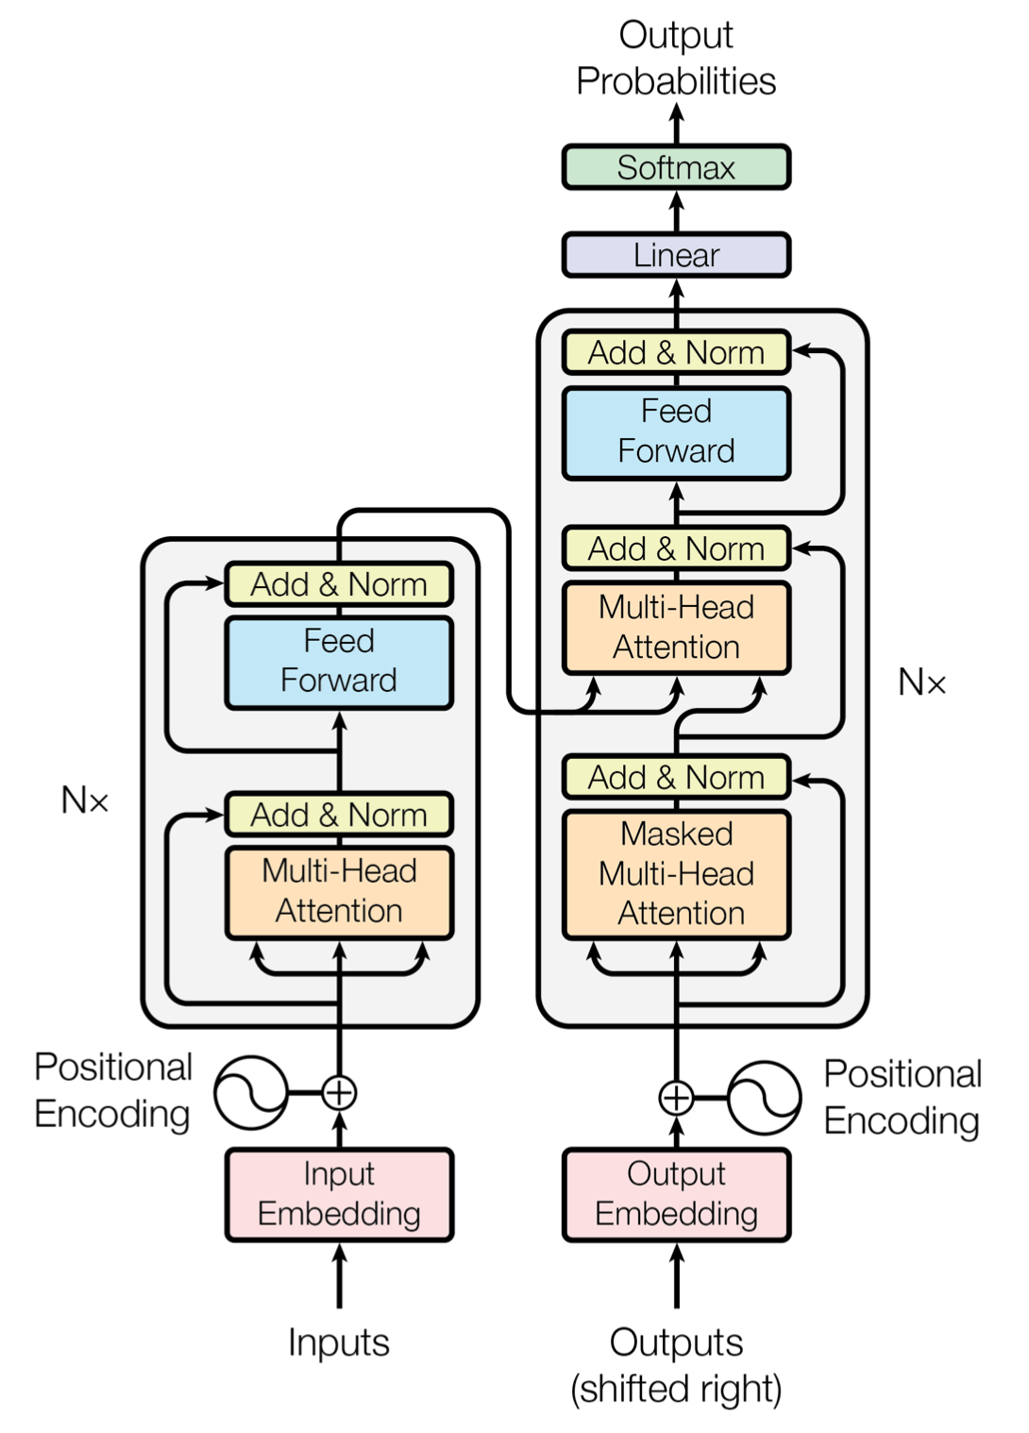
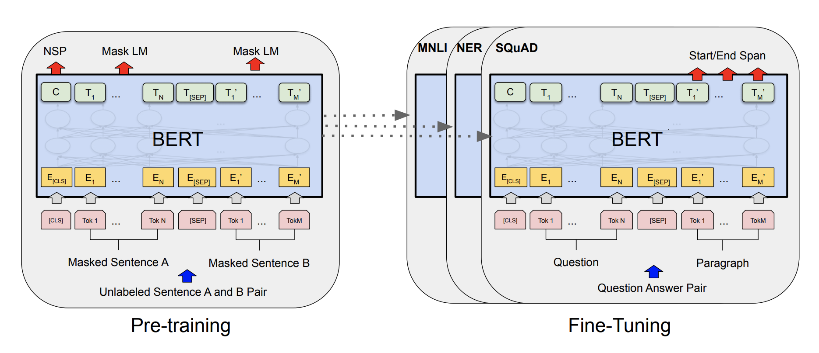
Transformer
BERT

Slide 5
How bert was trained?
Masked Language Model (MLM)
[CLS] my dog is [MASK] [SEP] he [MASK] playing [SEP]
Next Sentence Prediction (NSP)
[CLS] my dog is cute [SEP] he likes playing [SEP] YES
[CLS] my dog is cute [SEP] the river is flowing [SEP] NO

Slide 6
Special tokens of bert
[CLS] : The first token of every sequence is always a special classification token ([CLS]). The final hidden state corresponding to this token is used as the aggregate sequence representation for classification tasks. Sentence pairs are packed together into a single sequence.
[SEP] : It is basically a sequence delimiter. Must be used when sequence pair tasks are required. When a single sequence is used it is just appended at the end.
[MASK] : Token used for masked words. Only used for pre-training.
[PAD] : Token used for padding.

Slide 7
Transformers by hugging face
Transformers (formerly known as pytorch-transformers and pytorch-pretrained-bert) provides general-purpose architectures (BERT, GPT-2, RoBERTa, XLM, DistilBert, XLNet…) for Natural Language Understanding (NLU) and Natural Language Generation (NLG) with over 32+ pretrained models in 100+ languages and deep interoperability between TensorFlow 2.0 and PyTorch.
Features
As easy to use with modularity
As powerful and concise as Keras
High performance on NLU and NLG tasks
Seamlessly pick the right framework for training, evaluation, production (Pytorch/Tensorflow)

Slide 8
Preprocessing text for bert
Tokenization
Adding Special Tokens
Padding
Attention Mask
Segment IDs (for sequence pairs)
Convert sequence to integers
The dog is cute He likes to play
‘The’ ‘dog’ ‘is’ ‘cute’ ‘he’ ‘likes’ ‘to’ ‘play’
[CLS] ‘The’ ‘dog’ ‘is’ ‘cute’ [SEP] ‘he’ ‘likes’ ‘to’ ‘play’ [SEP]
[CLS] ‘The’ ‘dog’ ‘is’ ‘cute’ [SEP] ‘he’ ‘likes’ ‘to’ ‘play’ [SEP] [PAD]
1 1 1 1 1 1 1 1 1 1 1 0
0 0 0 0 0 1 1 1 1 1
[101, 1996, 3899, 2003, 10140, 102, 2002, 7777, 2000, 2377, 102, 0]

Slide 9
Bert model class
Input sequence
Attention Masks
Segment IDs (only for pairs)
BERT Model
Sequence Representations
[CLS] representation passed through linear and tanh
Hidden states (optional)
Attentions (optional)

Slide 10
Our approach to fine-tuning
Sequence Representations
Take the representation of the first token i.e. [CLS]
Linear layer
BERT Model
[CLS] representation passed through linear and tanh

Slide 11
Dataset class and data loaders
Requests data at a specific index
Data Loader
Dataset Class
Sends the data at that index

Slide 12
Training the model
Set the Model to train mode Start the epoch For every batch in the data loader Zero out gradients Get output of model | Compute loss Backpropagate gradients Optimizer step At the end of epoch validate data Finally save model

