Slide 1

PROJECT GROUP NO : 23
REAL TIME VIOLENCE DETECTION AND ALERT SYSTEM
YASHASWANI SRIVASTAVA (Roll No)
PRATEEK KUMAR RAJPUT (Roll No)
MANJIT KUMAR GAUTAM (Roll No)
Faculty Mentor: Dr. Anuranjan Kansal
DEPARTMENT OF ELECTRONICS AND COMMUNICATION ENGINEERING

Slide 2
PROBLEM STATEMENT
Design and develop a technological solution based on live CCTV feeds, that can automatically detect incidents related to street crime, violence, burglary, unauthorized access etc. and generate alerts to the concerned authority.
The solution should also be able to generate a report and maintain a database that includes the nature of incident/crime, location, time.

Slide 3
OBJECTIVES
i. Detect Incidents
Analyze live CCTV feeds & identify potential criminal activity.
Reduce the need for human monitoring & intervention.
ii. Generate Alert
When an incident is detected, the system will generate an alert.
iii. Generate Report
Generate a report which is providing details such as the nature of the incident/crime, location, time, & risk.
iv. Maintain Database
System will maintain a database of all incidents detected.
To review & analyze the data to identify patterns & trends over time.

Slide 4
USE CASES
Riots, political meets, mass protests, and any public assemblies.
Detecting security breaches in confined areas.
Road rages and accidents.
It can be used in shops for the prevention of theft.
It can be used in government offices.
Prisons which are prone to criminal activities.

Slide 5
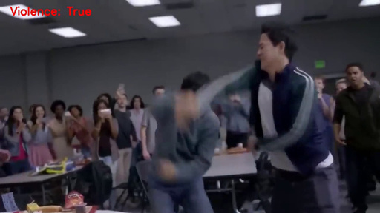




Architecture Diagram
Discard Frame
Violent Activity
Video captured by surveillence camera
Video converted to frames
COCO
Dataset
Image
Enhancement
No Violent Detected
Violent Detected
Alert via
Telegram Bot
MobileNet v2 violence recognition
MTCNN
Face
Division
CNN
PCA
3D
Detected Face
Enhanced Images are
stored in fire store DB
Using MTCNN to detect faces and then saving them in Firestore

Slide 6
Alert Module
Violence
Detected
Save Some Frame
Get Current Time
Send Image & Video Clip, Date & Time, Location to a specific group
Connect to Telegram Bot

Slide 7
Methodology
Original dataset comprises of 2000 videos, half is categorized as violence and half as non-violence.
The data taken is of 1000 videos, partitioned into train, validation, and test sets (700 for training, and 200 for validation and 100 for testing).
Trained using MobileNetV2 with dataset.
The model analyzes real-time video input to produce image frames as output.
An additional self-made dataset of 50 fight and non-fight videos in total, of 5 secs each, are also used for testing against the model, according to various local/regional conditions.

Slide 8
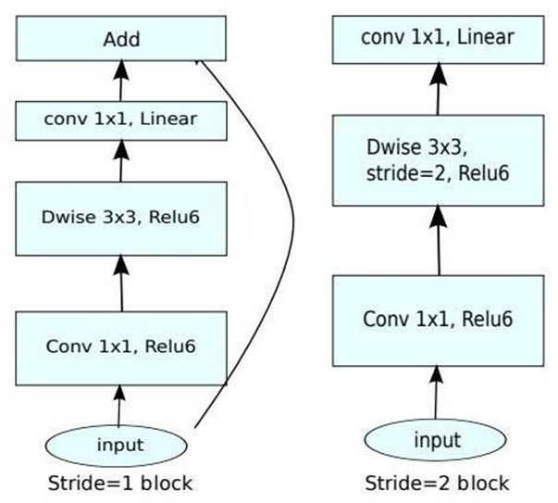
MobileNet V2
Features a 53-layer deep convolutional neural network (CNN) architecture.
Provides real-time classification capabilities under computing constraints in devices like smartphones.
Utilizes an inverted residual design, employing thin bottleneck layers at the input and output of residual blocks for enhanced performance.
Uses lightweight convolutions to filter features in the expansion layer.

Slide 9
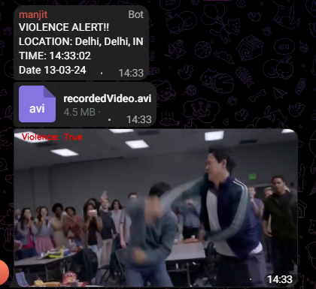
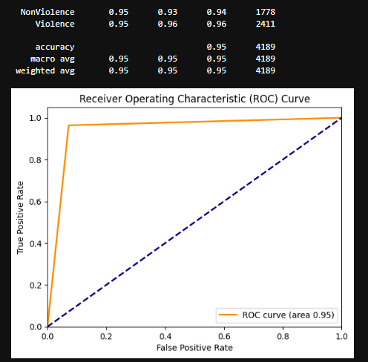
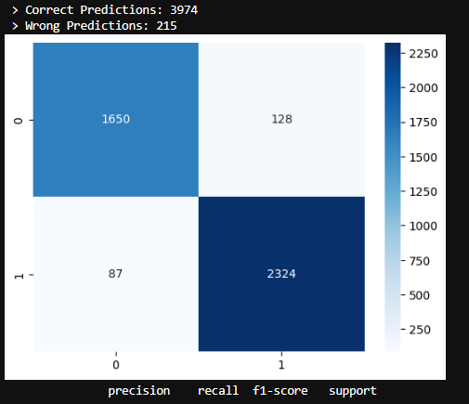
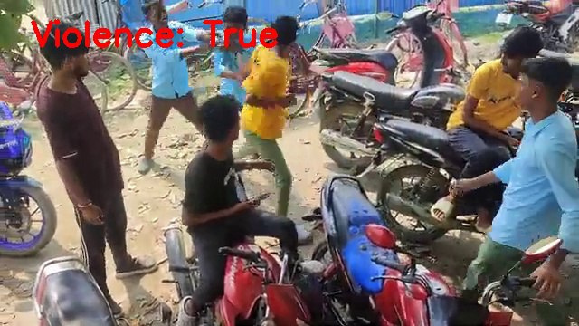
Results

Slide 10
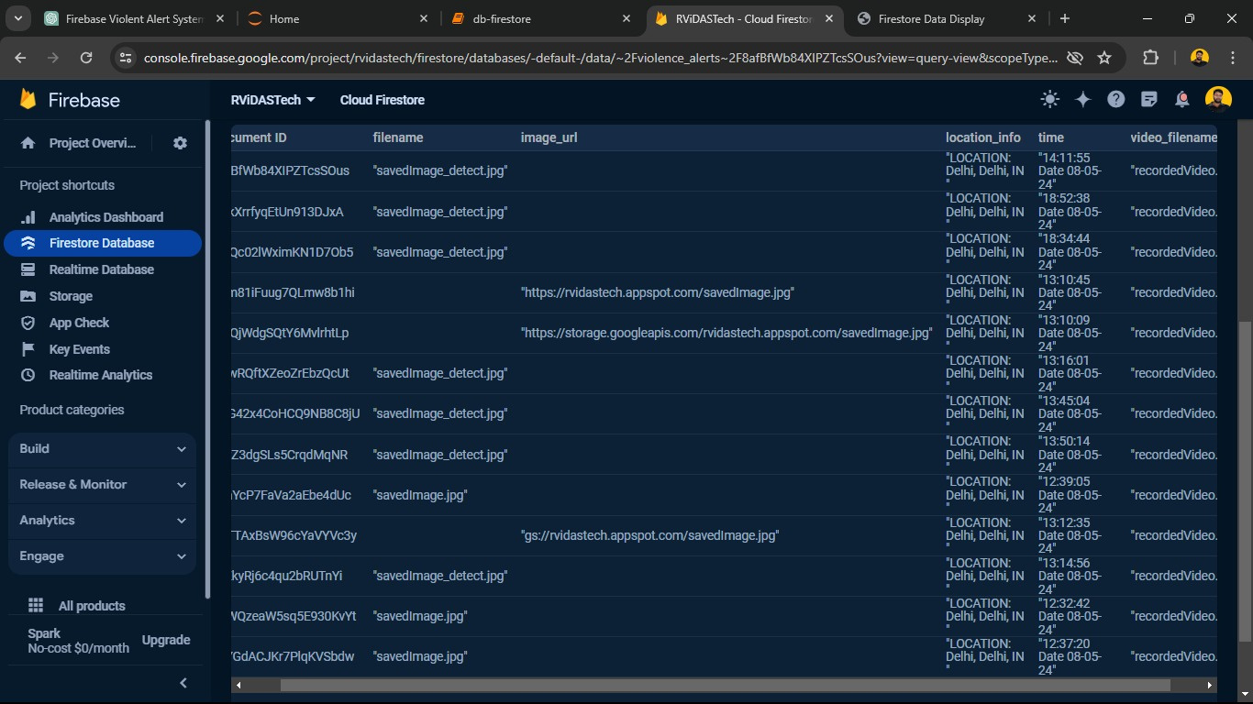
Firebase
Built by Google.
Provides services like Storage, Analysis, Machine Learning etc.
Firebase storage bucket is used to store the image
Links are obtained for the images and stored in firestore along with date and time.

Slide 11
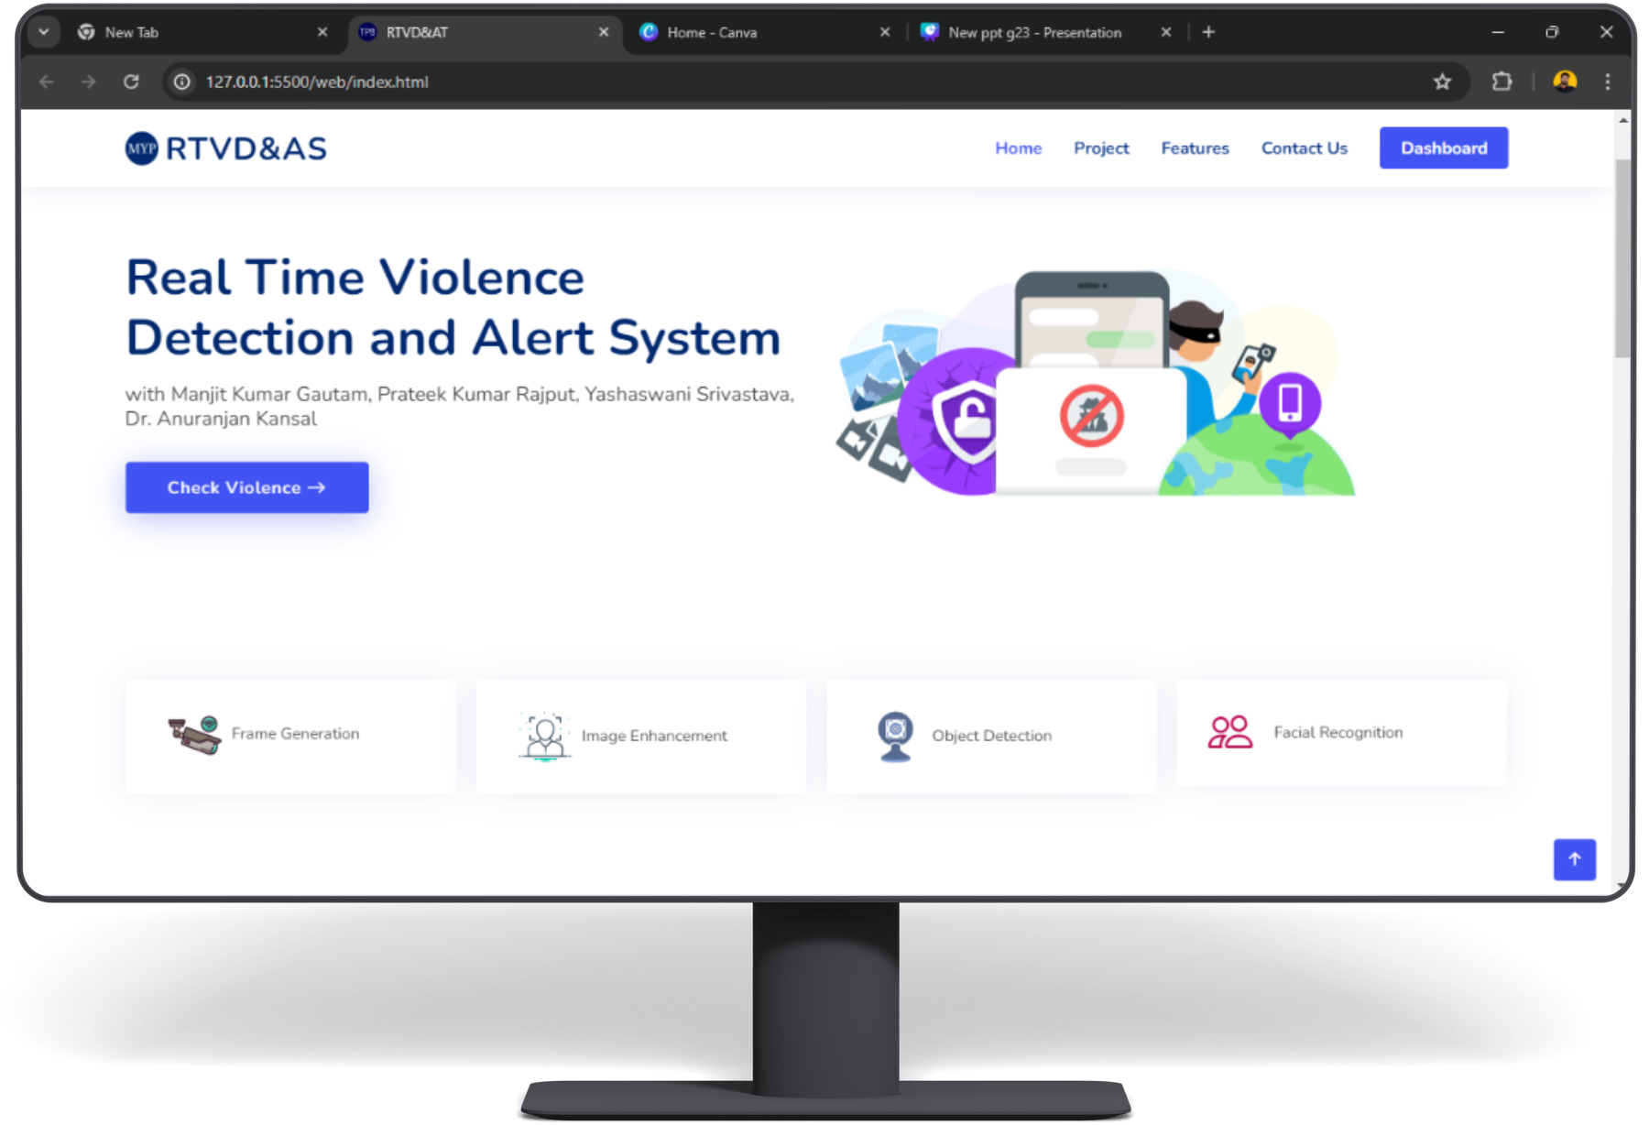
WEB DASHBOARD

Slide 12
REFERENCES
[1] M. -S. Kang, R. -H. Park and H. -M. Park, "Efficient Spatio-Temporal Model- ing Methods for Real-Time Violence Recognition," in IEEE Access, vol. 9, pp. 76270-76285, 2021, doi: 10.1109/ACCESS.2021.3083273.
[2] Zhang Y, Li Y, Guo S (2022) Lightweight mobile network for real-time violence recognition. PLoS ONE 17(10): e0276939. doi: 10.1371/journal.pone.0276939. PMID: 36315496; PMCID: PMC9621415.
[3] Ullah FUM, Ullah A, Muhammad K, Haq IU, Baik SW. Violence Detection Using Spatiotemporal Features with 3D Convolutional Neural Network. Sensors (Basel). 2019 May 30;19(11):2472. doi: 10.3390/s19112472.
[4] C. Gu, X. Wu and S. Wang, "Violent Video Detection Based on Semantic Correspondence," in IEEE Access, vol. 8,pp.85958-85967,2020,doi:10.1109/ACCESS.2020.2992617. -May 2020.

Slide 13
THANK YOU

