Slide 1
Los Angeles Environment Health Inspection
STATISTICALLY SIGNIFICANT

Slide 2
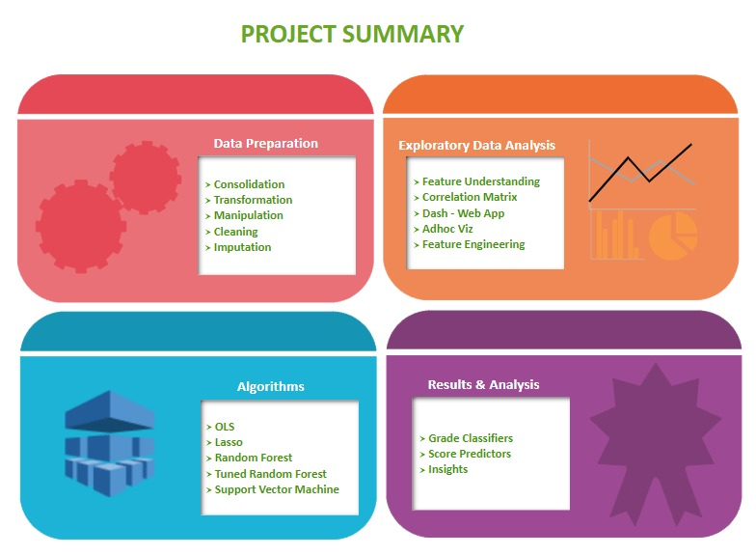
PROJECT SUMMARY

Slide 3
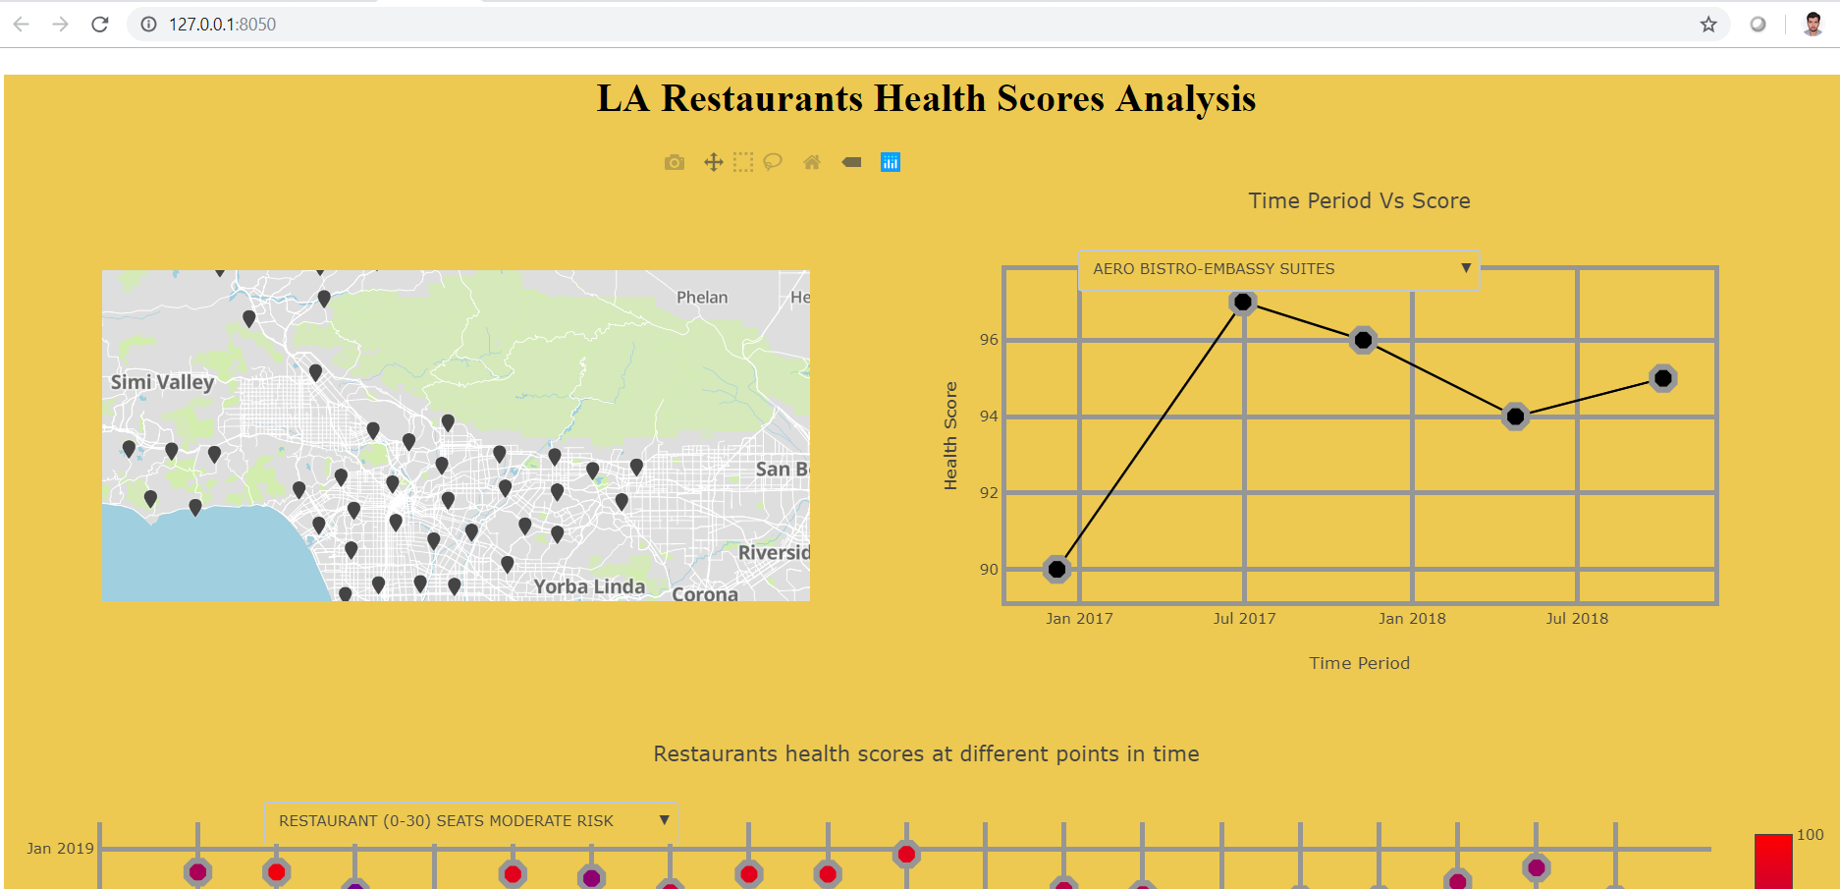
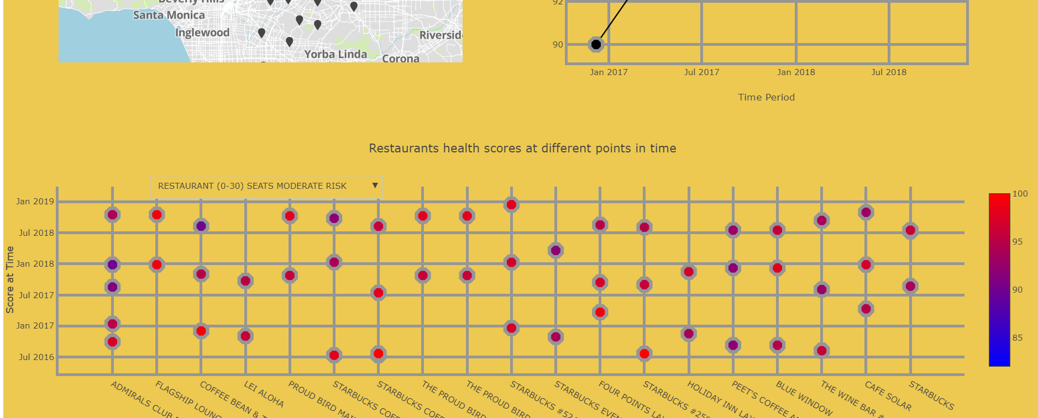
EXPLORATORY DATA ANALYSIS
For exploratory analysis we developed an interactive web app using Dash. Below are some snippets for the same.

Slide 4
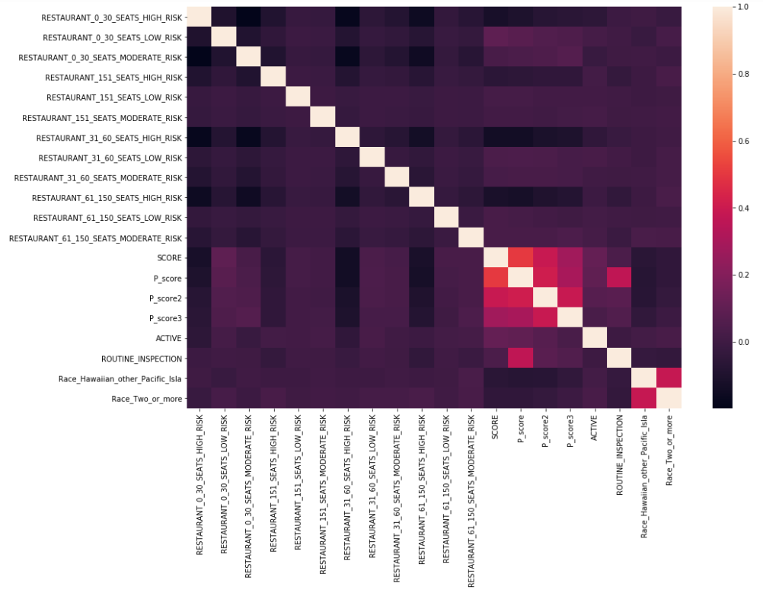
CORRELATION MATRIX

Slide 5
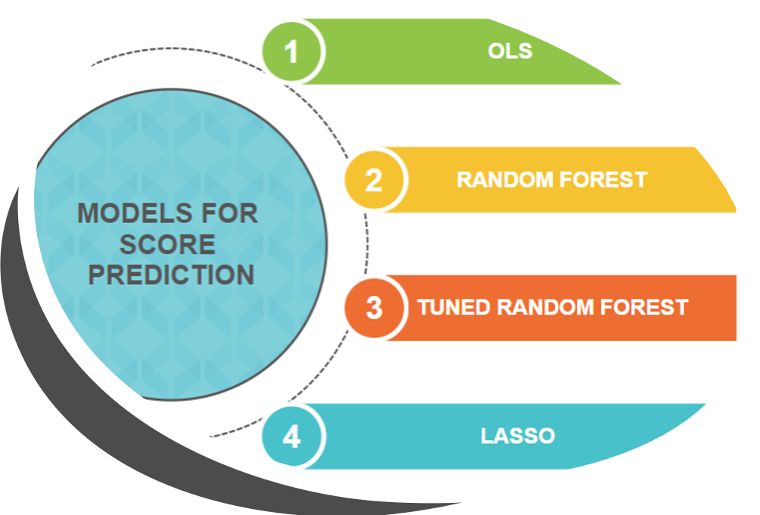

Slide 6
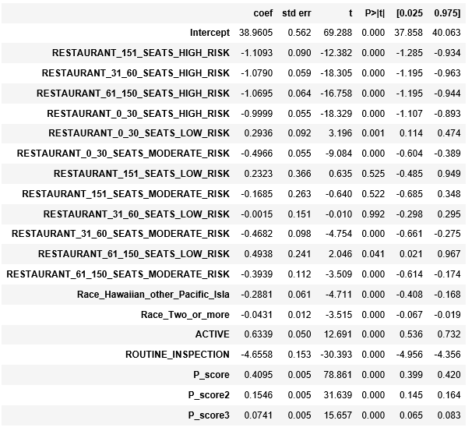
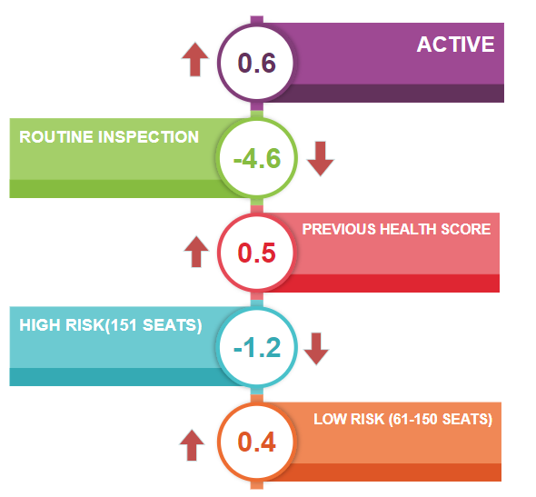
KEY FACTORS AFFECTING SCORE PREDICTION OLS RESULTS

Slide 7

Model Selection
Comparing the R2 and MSE values for above algorithms we see that Lasso gives the lowest MSE and highest R2 for the predicted values, thus we are selecting LASSO as our best model for score prediction

Slide 8
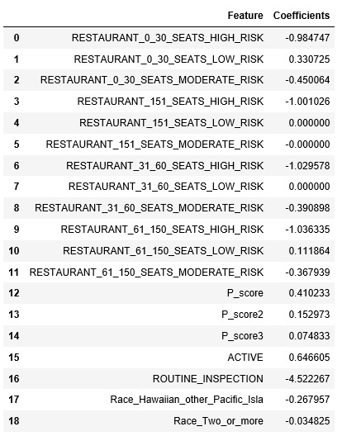
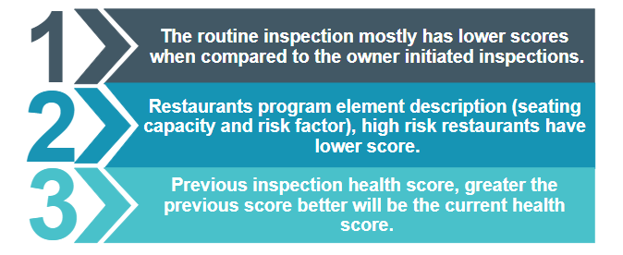
Results from best model(LASSO)

Slide 9
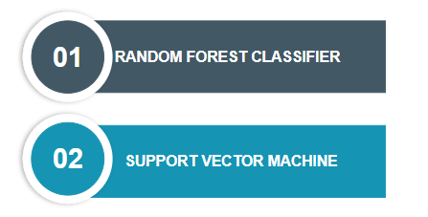
MODELS FOR CLASSIFYING RESTAURANTS INTO GRADES

Slide 10
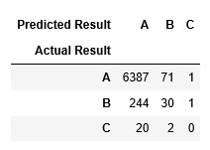

RANDOM FOREST ACCURACY
Using Random forest classifier we are able to classify restaurants into grades with 95% accuracy

Slide 11
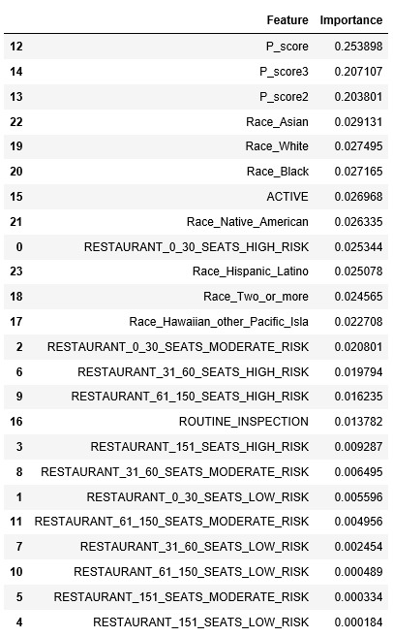
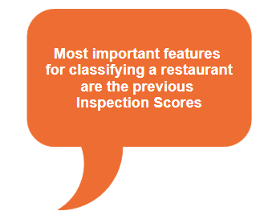
FEATURE IMPORTANCES FOR RANDOM FOREST CLASSIFIER

Slide 12
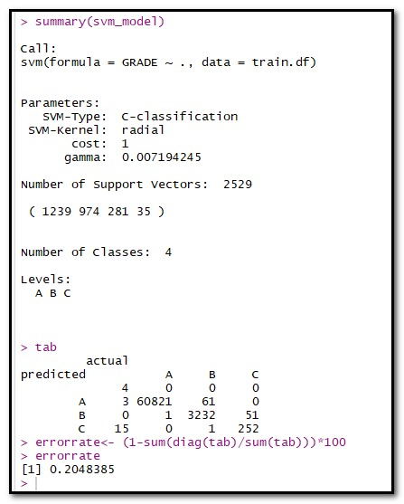
SVM RESULTS
Using SVM we are able to classify restaurants into grades with 99.8% accuracy

Slide 13
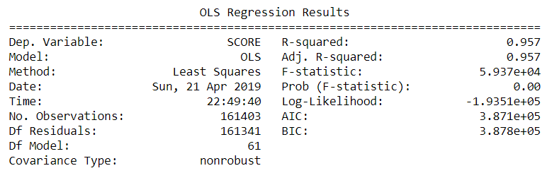
RELATIONSHIP BETWEEN HEALTH CODE VIOLATION AND SCORE OF A RESTAURANT
For finding the relationship we regressed score on all the violation code

Slide 14
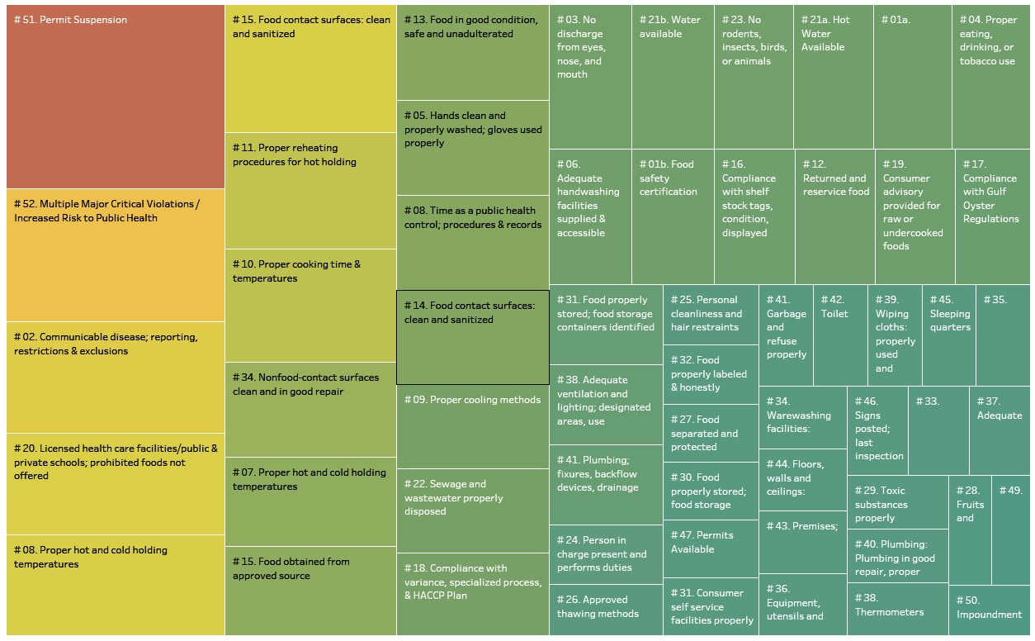
VISUALIZING THE RESULT

Slide 15
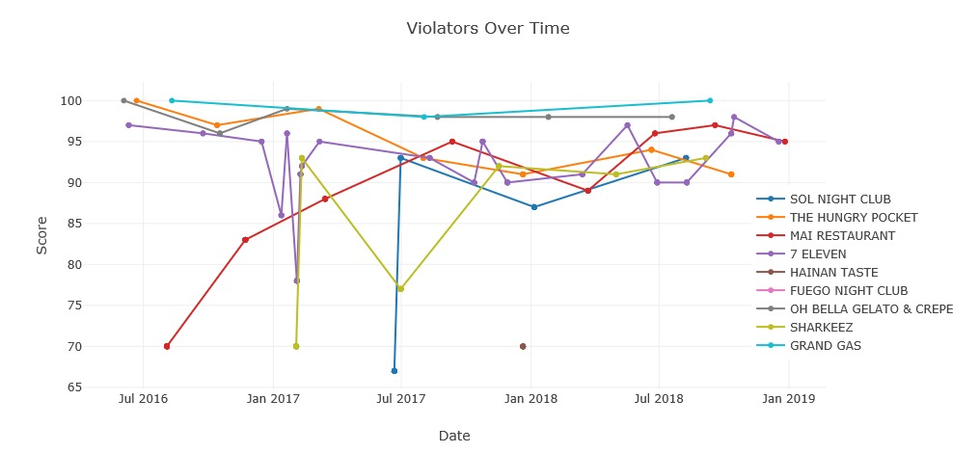
PATTERNS OF HEALTH SCORES OVER TIME
Figure shows that there is no generalized pattern for health scores over time, and that every restaurant has a different pattern for health scores over time.

Slide 16

THANK YOU!!!
We would like to take this opportunity to thank Informs Club for providing this platform to showcase our analytical skills. It was a great learning experience for us wherein we applied all our learning and realized the feasibility and practicality associated with each approach.

