Slide 1

MIS CLUB LINKVIZ 1.0
Presented by : Vizards
Members:
Sajal Singh
Amanjit Singh

Slide 2
Introduction
Many restaurants these days pride themselves on serving select natural ingredients that are second to none. Vanilla has been one such ingredient especially amongst Desserts.
In fact Vanilla ice-cream is still the favourite ice-cream flavour the United States.
Although it is grown mostly in African and Asian countries, it’s roots are actually in Mexico.

Slide 3
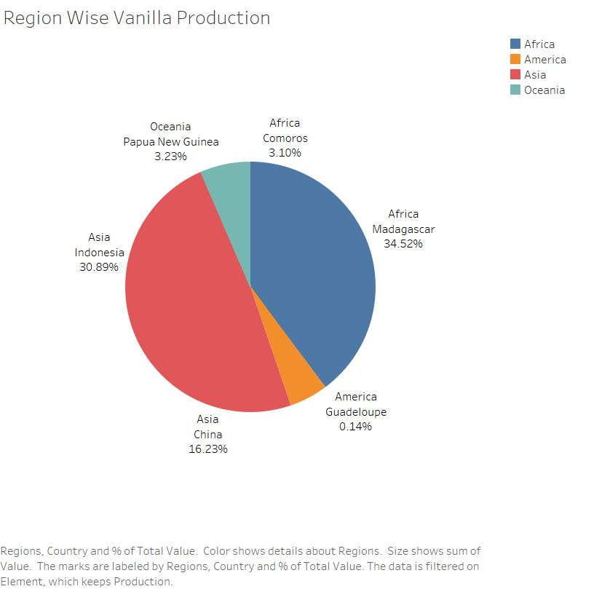
Our first viz shows us the total Vanilla in different Regions and countries since 1965.
Asia and Africa have been the top regions of vanilla production from 1965 to 2017, constituting more than 80% of the world’s produce.
Major vanilla producing countries have been Madagascar, Indonesia, China, Papua New Guinea and Mexico constituting to more than 90% of the world’s produce from 1965 to 2017.

Slide 4
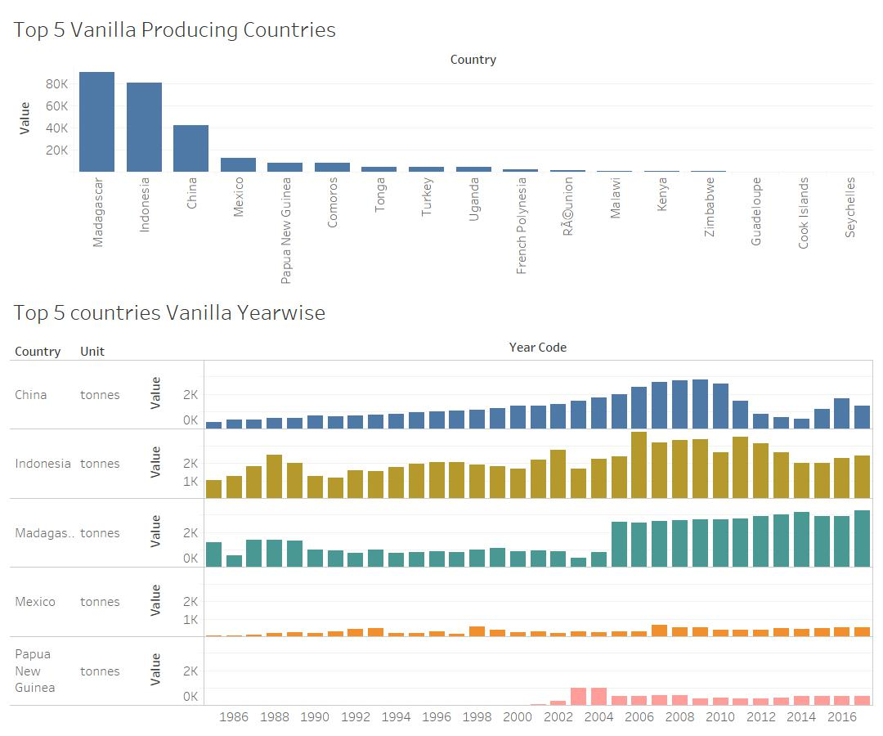
With this visualization we are able to see the overall and year wise trend of vanilla production for the top 5 vanilla producing countries.
Ever since 2005 Madagascar has been the most consistent in production, whereas China and Indonesia have seen a significant decrease in production since 2009 and 2011 respectively.
Mexico and Papua New Guinea has been more or less consistent in their respective productions since 2008.

Slide 5
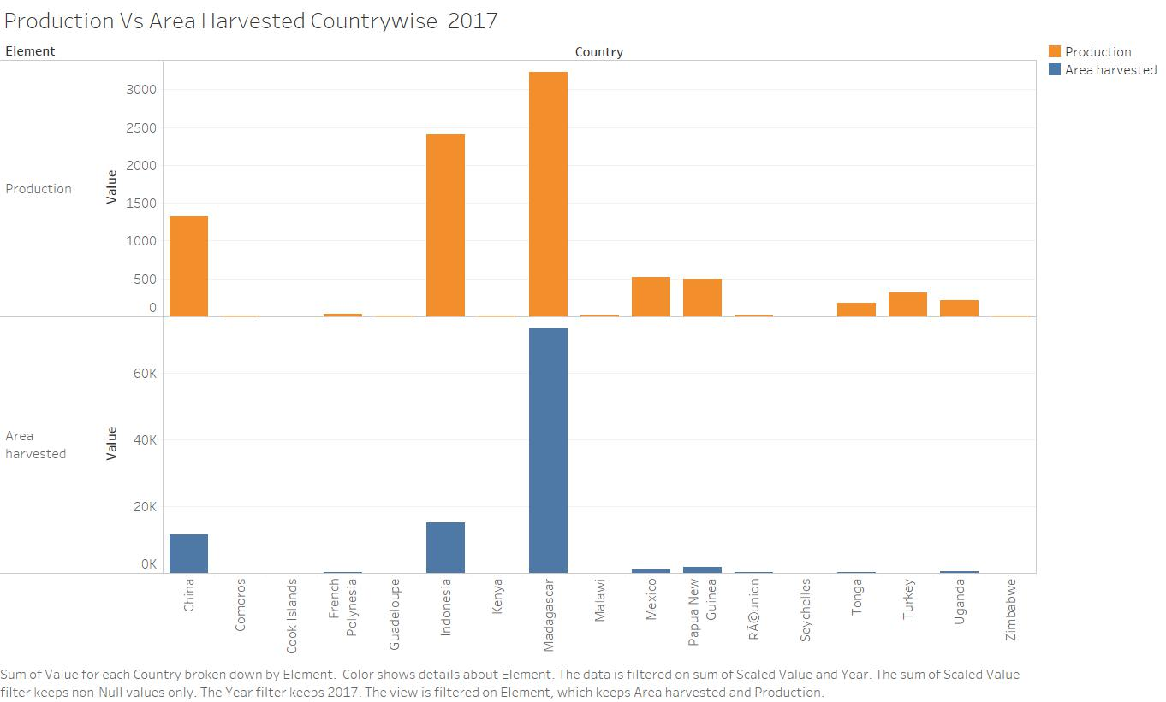
With this viz, we see the relationship between Area harvested and Production for different countries in 2017.
Although Madagascar is clearly the top producing country, Indonesia in the second place has been more efficient with its produce.
The reason for this could be due to excellent weather and soil condition in Indonesia and also its geographical location with respect to the equator.
For our production leader Madagascar, the production efficiency has been the worst in fact, which maybe due to the poor farmer conditions, frequent cyclones and the insurgence of the notorious Vanilla thieves.

Slide 6
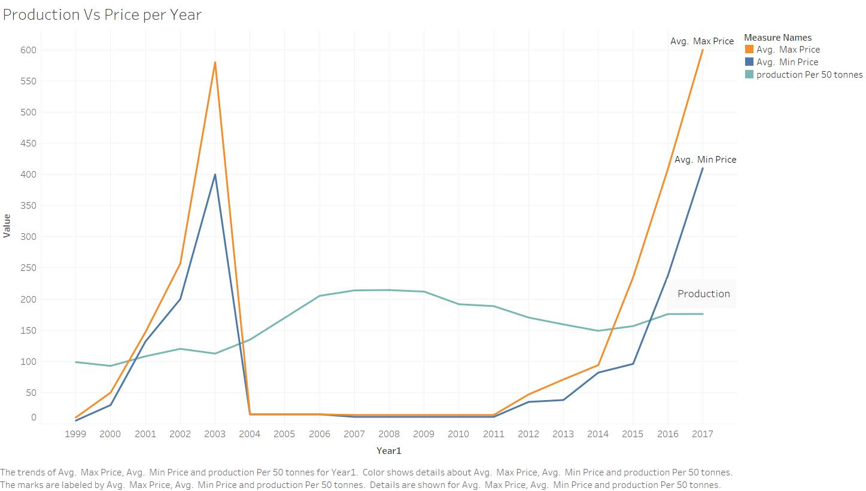
With this viz we wish to investigate the relationship between Production and Price of Vanilla over the years.
We see a steep drop in prices in 2004 which continued until 2011. This could be due to the decrease in demand of natural vanilla
After 2011, however, the vanilla prices seem to have sky rocketed especially 2015 onwards which could be due to the high demand for natural ingredients in all the products, that has been a global phenomena ever since 2015.

Slide 7
Thank You !!
We would like to take this opportunity to thank MIS Club and KPISOFT for this opportunity and providing a platform to compete with other teams. It was a great learning experience for us wherein we realised the true value of data visualization all the while learning and implementing tips and tricks of the trade.

