Slide 1
SURF detectors and descriptors
ECE 847:
Digital Image Processing
Stan Birchfield
Clemson University

Slide 2
References
SURF homepage
http://www.vision.ee.ethz.ch/~surf/
H. Bay, T. Tuytelaars, and L. V. Gool, SURF: Speeded Up Robust Features, ECCV 2006
http://www.vision.ee.ethz.ch/~surf/eccv06.pdf
H. Bay, A. Ess, T. Tuytelaars, and L. V. Gool, SURF: Speeded Up Robust Features (SURF), Computer Vision and Image Understanding (CVIU), Vol. 110, No. 3, pp. 346–359, 2008
ftp://ftp.vision.ee.ethz.ch/publications/articles/eth_biwi_00517.pdf
C. Evans, OpenSURF library
http://www.chrisevansdev.com/computer-vision-opensurf.html

Slide 3
Interest operator
Interest point detector finds distinctive locations in image (corners, blobs, T-junctions)
  should be repeatable
Interest point descriptor used for matching
  should be distinctive and robust
  Both should be fast

Slide 4
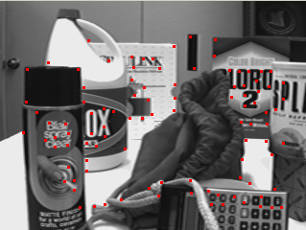
Harris features
Recall Harris features?
(Eigenvalues of gradient covariance matrix)
Dependent upon scale

Slide 5
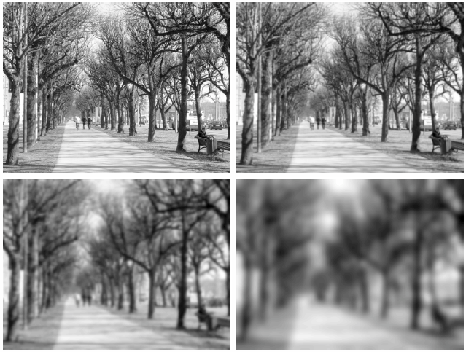
Scale space
Successively smooth an image...
ftp://ftp.nada.kth.se/CVAP/reports/Lin08-EncCompSci.pdf

Slide 6
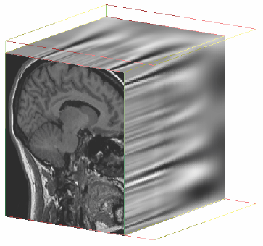
This forms a 3D space, with scale as the 3rd axis
http://citeseerx.ist.psu.edu/viewdoc/download;jsessionid=AF10AB3864DB87B4414F8169E260DC83?doi=10.1.1.95.9204&rep=rep1&type=pdf

Slide 7
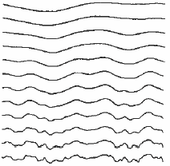
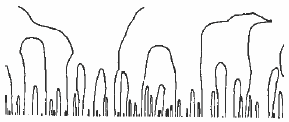
Let’s look at a slice
σ
σ
x
x
Signal F
Contours of Fxx=0
http://citeseerx.ist.psu.edu/viewdoc/download?doi=10.1.1.81.118&rep=rep1&type=pdf

Slide 8
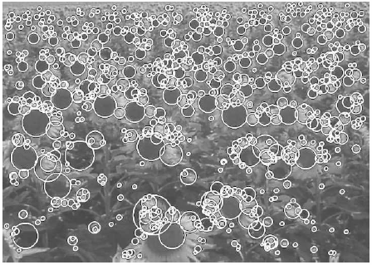
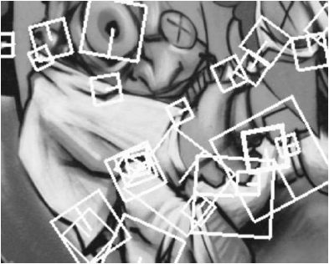
SIFT / SURF
SIFT – scale invariant feature transform (Lowe 2004)
SURF – speeded up robust features (Bay et al. 2006)

Slide 9
SURF algorithm
Interest point detector:
Compute integral image
Apply 2nd derivative (approximate) filters to image
Non-maximal suppression
(Find local maxima in (x,y,σ) space)
Quadratic interpolation

Slide 10

SURF algorithm
Interest point descriptor:
Divide window into 4x4
(16 subwindows)
Compute Haar wavelet outputs
Within each subwindow, compute
This yields a 64-element descriptor
(Only implement USURF – no rotation)

Slide 11
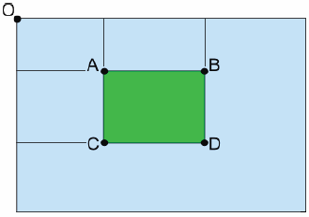
Integral image
Integral image
(a.k.a. summed area table)
is a 2D running sum
S(x,y) = ΣΣ I(x,y)
To compute,
S(x,y) = I(x,y)
- S(x-1,y-1) + S(x-1,y) + S(x,y-1)
To use,
V(l,t,r,b) = S(l,t) + S(r,b) - S(l,b) - S(r,t)
Returns sum of values inside rectangle
Note: Sum of values in any rectangle
can be computed in constant time!

Slide 12
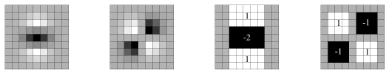

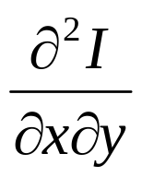
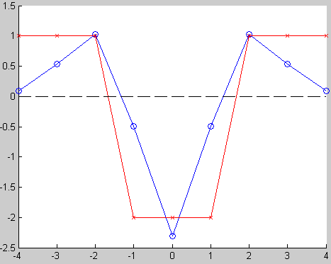
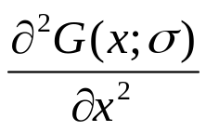
2nd derivative filters
(9x9 filters)
D_{yy}
D_{xy}
σ=1.2
scale s=1.2
σ=1.2
det(H_{approx}) = D_{xx}D_{yy} - (0.9D_{xy})²

Slide 13
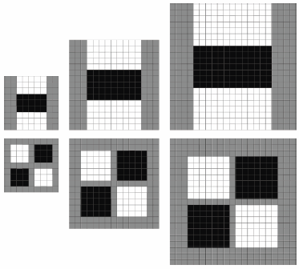
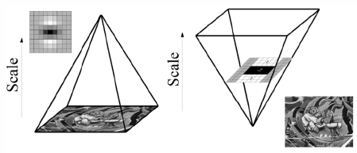
Changing scale
Integral image allows us to upsample the filter rather than downsample the image
9x9
15x15
21x21

Slide 14


Changing scale
(within an octave)
For 9x9 filter, l₀ = 3
(length of positive or negative lobe in direction of derivative)
To keep central pixel,
must increase l₀ by
minimum of 2 pixels
→ increase filter dimension by 6
Therefore, sizes of filter:
9x9, 15x15, 21x21, 27x27
l₀=3
9x9
l₀=5
15x15

Slide 15
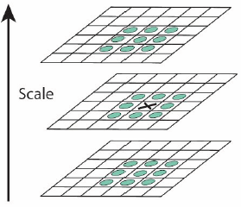
Non-maximal suppression
Retain pixel only if greater than 26 neighbors in x, y, s

Slide 16
Interpolation
We now have values at 9, 15, 21, 27:
9
15
21
27
σ=1.2
σ=1.2 * (27/9) = 3.6
Range is halfway b/w
samples
12
24
σ=1.2 * (12/9) = 1.6
σ=1.2 * (24/9) = 3.2
Range is exactly one octave!

Slide 17




Interpolation
For each local maximum, need to interpolate to get true location (to overcome discretization effects)
Hessian values:
Taylor expansion:
Solution using Newton’s method:

Slide 18
Interpolation in 1D
Newton’s method:
  Given value at x₀, and derivatives at x₀, estimate parabola
  Parabola is y = f(x) = ax²+bx+c
  Extremum of parabola (minimum if a>0, maximum if a<0) is given by x* = -b / 2a
  Repeat
f’(x) = 2ax+b
f”(x) = 2a
Newton step:
Δx = -f’(x) / f”(x)
= -(2ax₀+b) / (2a)
= -x₀ - b/2a
x₀
-b/2a
Δx
x₀

Slide 19
Interpolation in 1D
(alternative)
Successive parabolic interpolation is alternative to Newton’s method:
  Fit parabola y = f(x) = ax²+bx+c to three points
  Discard farthest of 4 points
  Repeat
y = f(x)
x

Slide 20
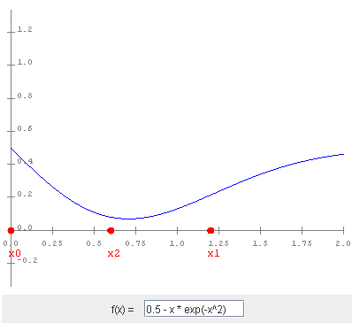
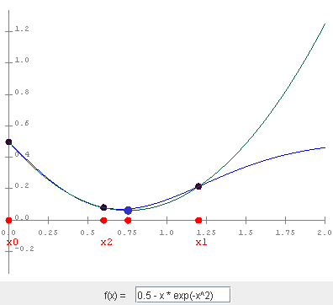
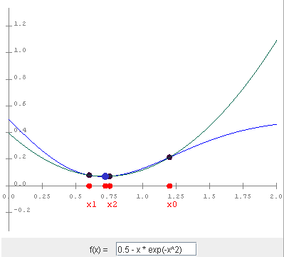
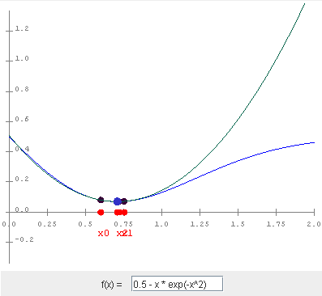
Successive parabolic interpolation example (1D)
http://www.cse.illinois.edu/iem/optimization/SuccessiveParabolic/

Slide 21
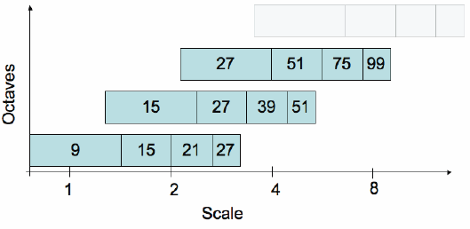
The next octaves
First octave filter sizes: 9, 15, 21, 27
Second octave sizes: 15, 27, 39, 51
  Increase by 12 each time (not 6)
  Spans from 21 (σ=1.2*21/9=2.8)
  to 45 (σ=1.2*45/9=6)
  (some overlap with first octave)
  Ok to measure at every other pixel in image
  (saves computation, like downsampling)
Third octave sizes:
27, 51, 75, 99
  Increase by 24
  each time
  Spans from
  39 (σ=1.2*39/9=5.2)
  to 87 (σ=1.2*87/9=11.6)
  Ok to measure at every
  4th pixel in image

Slide 22
SURF octave overview
9
15
21
27
33
39
45
51
57
63
69
75
81
87
93
99
5.2 ≤ σ ≤ 11.6
2.8 ≤ σ ≤ 6.0
σ=1.2 * (12/9) = 1.6
σ=1.2 * (24/9) = 3.2
σ=1.2 * (21/9) = 2.8
σ=1.2 * (45/9) = 6.0
σ=1.2 * (39/9) = 5.2
σ=1.2 * (87/9) = 11.6
1.6 ≤ σ ≤ 3.2

Slide 23
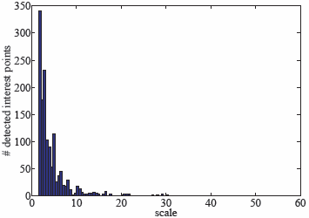
But higher octaves increasingly less useful

Slide 24
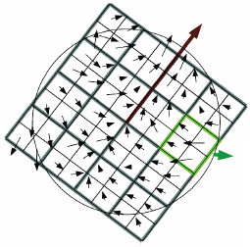


SURF descriptor
Once interest point has been found,
  Place window around point
  Divide into 4x4 subwindows
  In each subwindow,
    measure at 25 (5x5) places: dx and dy
    sum over all 25 places to get 4 values:
Note: Use Haar wavelets to measure differences (similar to gradients)

Slide 25
Details
10s
2s
2s
10s
20s
weight by Gaussian
σ = 3.3s
20s

Slide 26
with s=1.2
12
3
3
12
24
weight by Gaussian
σ = 4
sign of LoG =
sign of trace(H_{approx}) =
sgn( Dxx + Dyy )
24
→ 65 values per interest point (16 x 4 + 1)

Slide 27
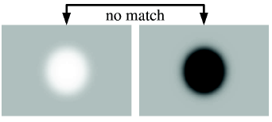
sign of LoG
speeds up matching
sgn( Dxx + Dyy )

Slide 28
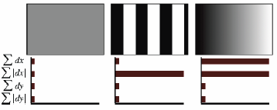
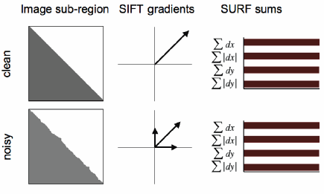
Why SURF is better than SIFT

Slide 29
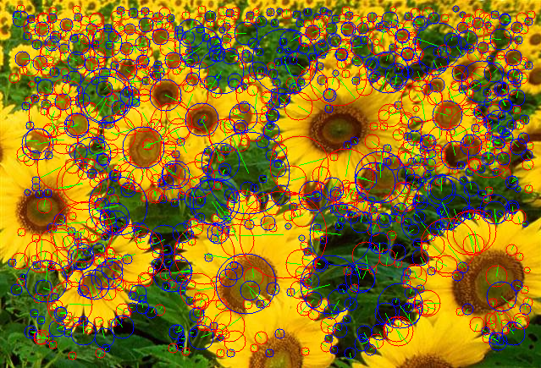
Examples: Flowers

Slide 30
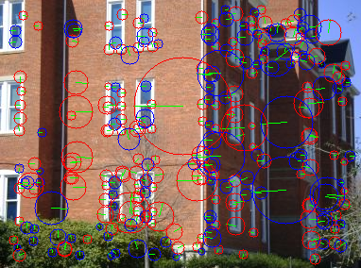
Examples: Tillman
SURF, 5 octaves, 4 scales per octave

Slide 31
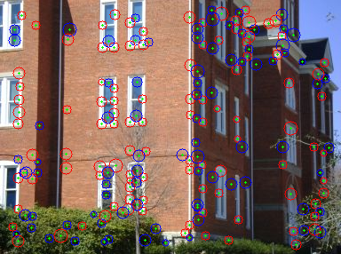
Examples: Tillman
U-SURF, 1 octave, 4 scales per octave

Slide 32
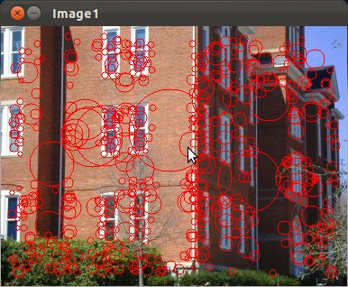
Examples: Tillman
OpenCV’s SURF

Slide 33



