Slide 1
Intuit Craft Demo
- Amanjot Singh

Slide 2
Introduction
Craft Demo / Case study Statement
Assumptions
Use Case
Architecture
Usage - Gateway / Service
Entity - Config
Class Diagram
Algorithms
Code Walkthrough
Testing
Problems
Enhancements
Q&A
AGENDA

Slide 3
INTRODUCTION
~11 years of experience working on Java, Spring, Spring Boot, REST. Mentored teammates and juniors.
Knowledge of Cloud services
Currently working with NAB as Senior Consultant
Latest Project: Internal trading application which involves Data from upstream services to our system and process it to store in Database and enable downstream clients to consume.
Tech Stack : Java, Spring Boot, REST, Kafka, Gitlab, Teamcity, Docker, AWS
Previous Experience:
Natwest Group - 6.5 years (Lead Engineer)
Publicis Sapient - 5 months (Senior Software Developer)
Raremile - ~1 year (Software Developer)
Accenture - ~3 years (Software Developer)

Slide 4
REQUIREMENT
“Web Services like AWS and Intuit impose Rate Limits on how many Requests per Second a Client can make. For example, you can only poll the AWS CloudFormation Status Service less than 30 times/second.
Design a solution for a Rate-Limiting Scheme under these conditions:
A single DataCenter/region
We have different Web Services and want to impose different rate-limits on them
Each Client has a Client Id
Each Client has a different Rate-Limit per Web Service
Be sure to explain any issues you can think of! For example, what if 1000 Clients all make simultaneous calls to the same Web Service?”

Slide 5
ASSUMPTIONS
Each Client has a client_id associated with each request.
Each Client could have different rate limit for different web service. And if client specific rate limit is not specified for a service then web service’s default limit will be applicable.
Single Data center/region in picture.
If no client or service level rate limit is specified, request will be rejected as we dont want services to be bombarded with requests.
Services implementing Rate limiting could be separate microservices or could be behind gateway.
Client_id will be passed in request headers.
Fetching service_id from request header.

Slide 6
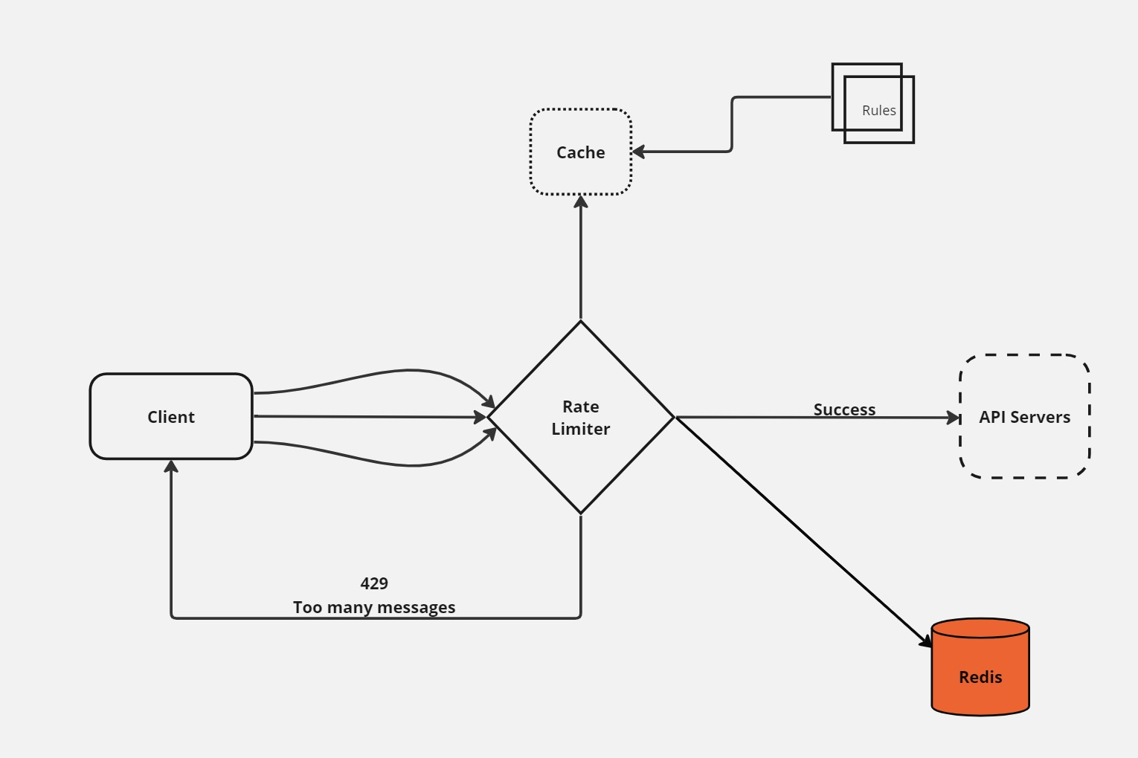
ARCHITECTURE

Slide 7
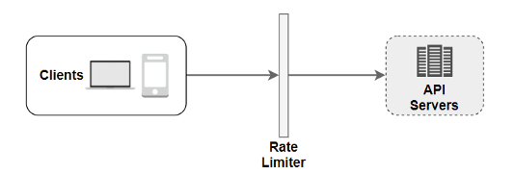
USAGE – GATEWAY / SERVICE
GATEWAY:
If all the microservices are behind a service gateway, we can have all the clients and services rate limiting
details with gateway either via DB/Cache/configs.

Slide 8
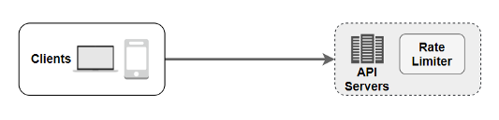
WITHIN SERVICE:
In case Gateway doesn’t provide Rate limiting feature and due to constraints we can’t put rate limiting feature in gateway or services are not behind gateway. Each service can have their own rate limiting implementation and logic.

Slide 9
ENTITY
public class RateLimiterProperties {
private boolean enabled;
private RateLimiterType algorithm;
private Map<String, Policy> service = new HashMap<>();
public static class Policy{
private int limit;
private int refreshInterval;
private Map<String, ClientPolicy> client = new HashMap<>();
}
public static class ClientPolicy{
private int clientLimit;
private int clientRefreshInterval;
}
}

Slide 10
We are getting service’s rate limit and refresh interval from a Map.
private Map<String, Policy> service = new HashMap<>();
And in case client rate specific limit and refresh interval has been put for client, we can fetch it from another Map.
private Map<String, ClientPolicy> client = new HashMap<>();
So overall time complexity comes out to be O(1) to fetch the limit and refreshInterval for client/service.
intuit: ratelimit: algorithm: SLIDING enabled: true service: serviceA: limit: 10 refreshInterval: 60 client: clientA: clientLimit: 2 clientRefreshInterval: 78 clientB: clientLimit: 21 clientRefreshInterval: 45 serviceB: limit: 1 refreshInterval: 10 client: clientA: clientLimit: 2 clientRefreshInterval: 20 clientB: clientLimit: 10 clientRefreshInterval: 45

Slide 11
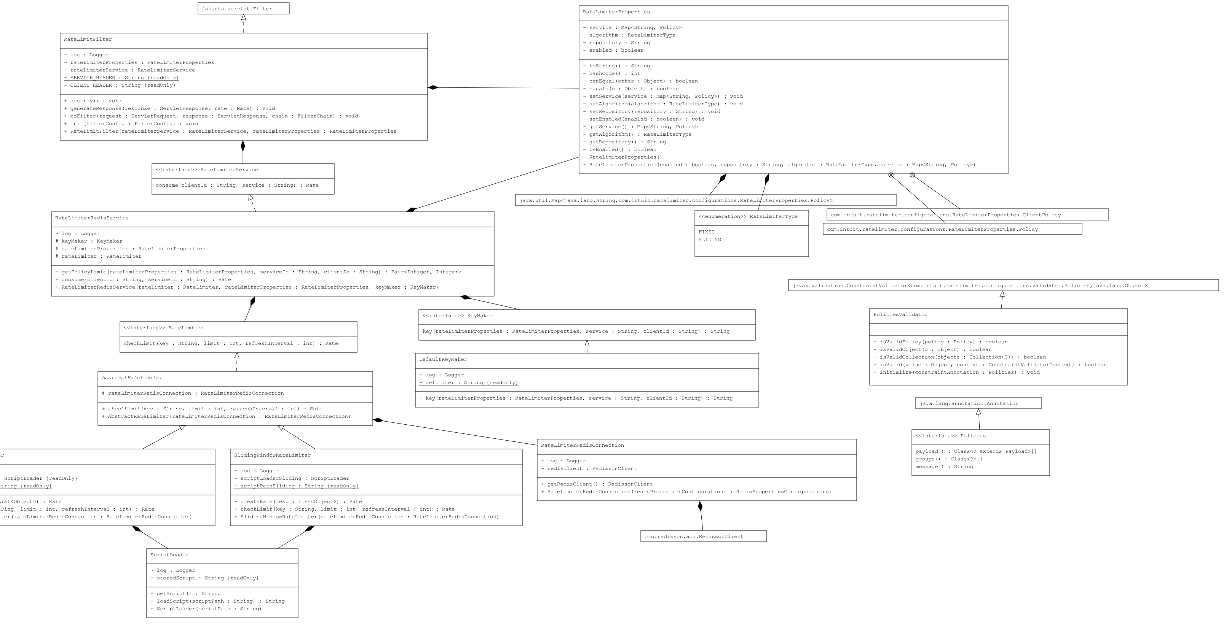

Slide 12
RATE LIMITING ALGORITHM
TOKEN BUCKET ALGORITHM
SLIDING LOG ALGORITHM
FIXED WINDOW ALGORITHM (implemented)
SLIDING WINDOW ALGORITHM (implemented)

Slide 13
FIXED WINDOW ALGORITHM:
LUA SCRIPT :
local id = KEYS[1] local limit = tonumber(ARGV[1]) local window = tonumber(ARGV[2]) local function headers(limit, window, remaining) return { tostring(limit), tostring(window), tostring(remaining) } end if redis.pcall('EXISTS', id) == 1 then local count = redis.pcall('DECR', id) local ttl = redis.pcall('TTL', id) if count >= 0 then local h = headers(limit, ttl, count) return {'allow', h} else local h = headers(limit, ttl, 0) return {'deny', h} end else local count = limit - 1 redis.pcall('SETEX', id, window, count) local h = headers(limit, window, count) return {'allow', h} end

Slide 14
SLIDING WINDOW ALGORITHM:
LUA SCRIPT:
local current_time = redis.call('TIME') local trim_time = tonumber(current_time[1]) - ARGV[2] local function headers(limit, window, remaining) return { tostring(limit), tostring(window), tostring(remaining) } end redis.call('ZREMRANGEBYSCORE', KEYS[1], 0, trim_time) ------ Uses Sorted Set local request_count = redis.call('ZCARD',KEYS[1]) local ttl = redis.pcall('TTL', KEYS[1]) if request_count < tonumber(ARGV[1]) then redis.call('ZADD', KEYS[1], current_time[1], current_time[1] .. current_time[2]) redis.call('EXPIRE', KEYS[1], ARGV[2]) local ttl = redis.pcall('TTL', KEYS[1]) local h = headers(tonumber(ARGV[1]), ttl, tonumber(ARGV[1])-request_count-1) return {'allow', h} end local h = headers(tonumber(ARGV[1]), ttl, 0) return {'deny', h}

Slide 15
DEMO AND CODE
WALK THROUGH

Slide 16
TESTING

Slide 17
CHALLENGES
Latency
Atomicity - When there is high concurrent requests, as transaction to get-inc-set is not atomic. While there is limit pending and two request can pick the counter , increment it and set it , which will result in breaching the rate limiting counter.

Slide 18
ENHANCEMENTS
Multi server redis cluster to deal with high requests.
Support for multiple Rate Limiting Algorithms.
Support for having different algorithm for different services.
Creating metrices to analyze the requests and rate limiting data. Running a separate sidecar may be, to analyze the logging and create dashboard.
Implementing separate rule engine, a cache to have all rate limiting data related to service and clients as config will be difficult to maintain once data will increase.
Ability to modify the rate limiting (limit, refreshInterval) at runtime.
Ability of rate limiting to block clients for duration.

Slide 19
Q & A

Slide 20
THANK YOU

