Slide 1
Intuit Craft Demo
- Amanjot Singh

Slide 2
Introduction
Craft Demo / Case study Statement
Assumptions
Use Case
Architecture
Usage - Gateway / Service
Entity - Config
Class Diagram
Algorithms
Code Walkthrough
Testing
Problems
Enhancements
Q&A
AGENDA

Slide 3
INTRODUCTION
~11 years of experience working in Industry.
Mentored teammates and juniors.
Knowledge of Cloud services.
Currently working with NAB as Senior Consultant
Tech Stack : Java, Spring Boot, REST, Kafka, Gitlab, Teamcity, Docker, AWS
Previous Experience:
Natwest Group - 6.5 years (Lead Engineer)
Publicis Sapient - 5 months (Senior Software Developer)
Raremile - ~1 year (Software Developer)
Accenture - ~3 years (Software Developer)
Personal Info:
Staying in Gurgaon from past 7 years with family, basically from Rohtak, Haryana.
Worked previously in Bangalore for 4 years at start of career.
Hobbies: Playing cricket on weekends.

Slide 4
Work Portfolio
Last Project:
Designed an internal trading platform which is being used by internal traders of Natwest. It sits between upstream and downstream services. Implemented new microservices to cater to consumers requirements. Built features for regulatory reporting etc.
Handled migration of legacy monolith application features/data on to new trading platform.
Architedtured Deployment pipelines for multiple archetypes.
15+ teams are using the same pipeline code supporting different branching strategy.

Slide 5
REQUIREMENT
“Web Services like AWS and Intuit impose Rate Limits on how many Requests per Second a Client can make. For example, you can only poll the AWS CloudFormation Status Service less than 30 times/second.
Design a solution for a Rate-Limiting Scheme under these conditions:
A single DataCenter/region
We have different Web Services and want to impose different rate-limits on them
Each Client has a Client Id
Each Client has a different Rate-Limit per Web Service
Be sure to explain any issues you can think of! For example, what if 1000 Clients all make simultaneous calls to the same Web Service?”

Slide 6
ASSUMPTIONS
Each Client has a client_id associated with each request.
Each Client could have different rate limit for different web service. And if client specific rate limit is not specified for a service then web service’s default limit will be applicable.
Single Data center/region in picture.
If no client or service level rate limit is specified, request will be rejected as we dont want services to be bombarded with requests.
Services implementing Rate limiting could be separate microservices or could be behind gateway.
Client_id will be passed in request headers.
Fetching service_id from request header.

Slide 7
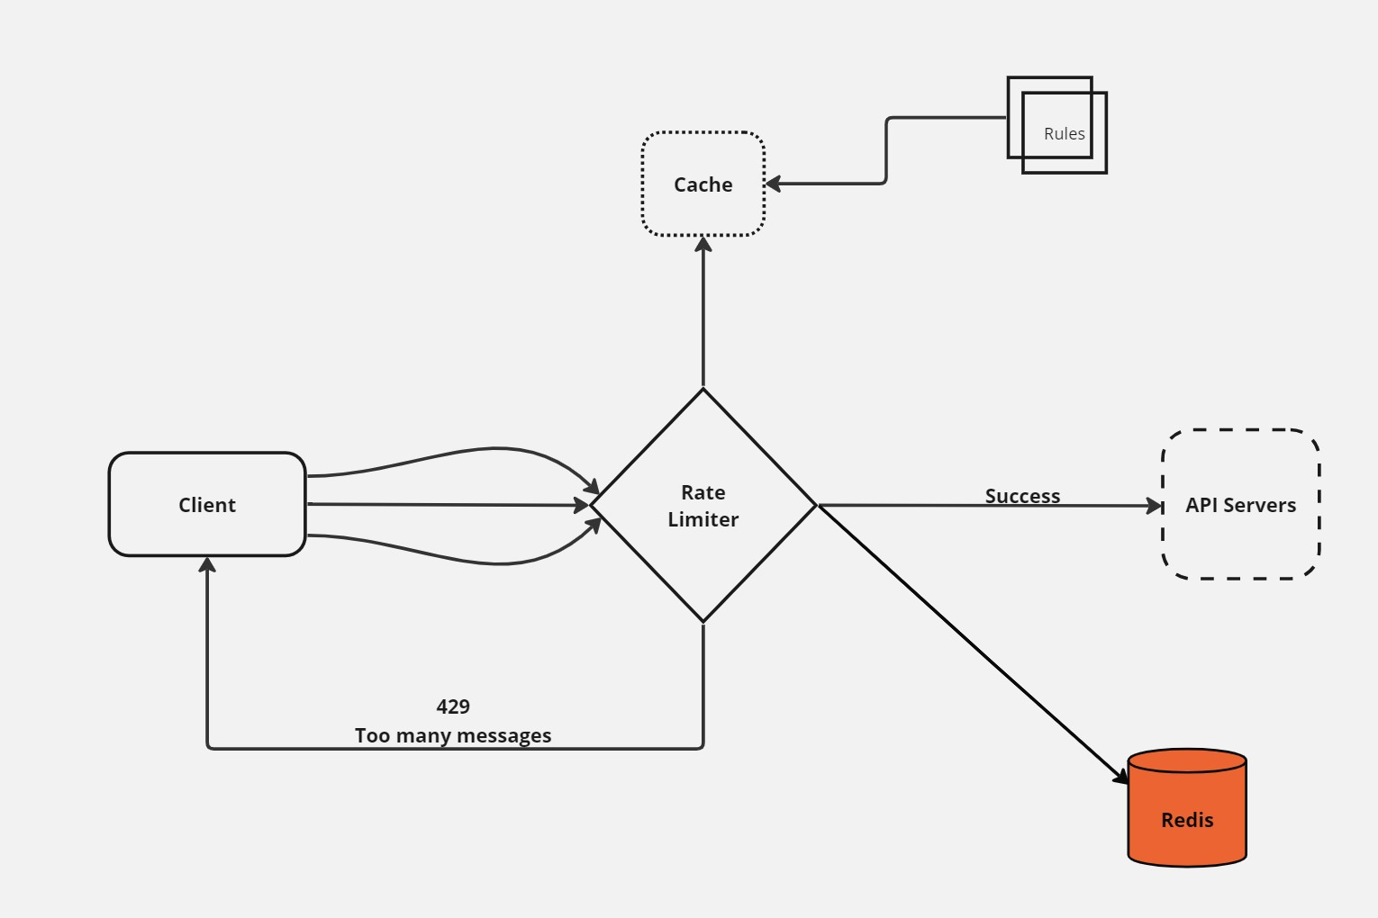
ARCHITECTURE

Slide 8
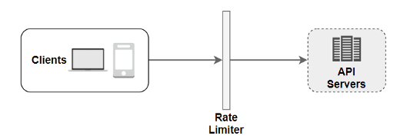
USAGE – GATEWAY / SERVICE
GATEWAY:
If all the microservices are behind a service gateway, we can have all the clients and services rate limiting
details with gateway either via DB/Cache/configs.

Slide 9
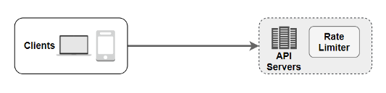
WITHIN SERVICE:
In case Gateway doesn’t provide Rate limiting feature and due to constraints we can’t put rate limiting feature in gateway or services are not behind gateway. Each service can have their own rate limiting implementation and logic.

Slide 10
ENTITY
public class RateLimiterProperties {
private boolean enabled;
private RateLimiterType algorithm;
private Map<String, Policy> service = new HashMap<>();
public static class Policy{
private int limit;
private int refreshInterval;
private Map<String, ClientPolicy> client = new HashMap<>();
}
public static class ClientPolicy{
private int clientLimit;
private int clientRefreshInterval;
}
}

Slide 11
We are getting service’s rate limit and refresh interval from a Map.
private Map<String, Policy> service = new HashMap<>();
And in case client rate specific limit and refresh interval has been put for client, we can fetch it from another Map.
private Map<String, ClientPolicy> client = new HashMap<>();
So overall time complexity comes out to be O(1) to fetch the limit and refreshInterval for client/service.
intuit: ratelimit: algorithm: SLIDING enabled: true service: serviceA: limit: 10 refreshInterval: 60 client: clientA: clientLimit: 2 clientRefreshInterval: 78 clientB: clientLimit: 21 clientRefreshInterval: 45 serviceB: limit: 1 refreshInterval: 10 client: clientA: clientLimit: 2 clientRefreshInterval: 20 clientB: clientLimit: 10 clientRefreshInterval: 45

Slide 12
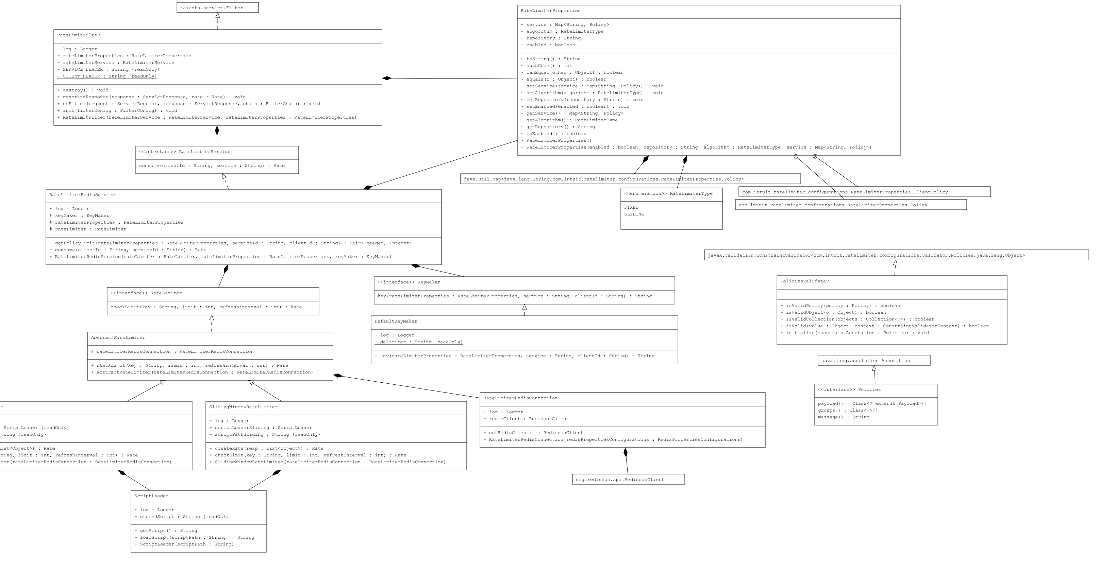

Slide 13
RATE LIMITING ALGORITHM
TOKEN BUCKET ALGORITHM
SLIDING LOG ALGORITHM
FIXED WINDOW ALGORITHM (implemented)
SLIDING WINDOW ALGORITHM (implemented)

Slide 14
FIXED WINDOW ALGORITHM:
LUA SCRIPT :
local id = KEYS[1] local limit = tonumber(ARGV[1]) local window = tonumber(ARGV[2]) local function headers(limit, window, remaining) return { tostring(limit), tostring(window), tostring(remaining) } end if redis.pcall('EXISTS', id) == 1 then local count = redis.pcall('DECR', id) local ttl = redis.pcall('TTL', id) if count >= 0 then local h = headers(limit, ttl, count) return {'allow', h} else local h = headers(limit, ttl, 0) return {'deny', h} end else local count = limit - 1 redis.pcall('SETEX', id, window, count) local h = headers(limit, window, count) return {'allow', h} end

Slide 15
SLIDING WINDOW ALGORITHM:
LUA SCRIPT:
local current_time = redis.call('TIME') local trim_time = tonumber(current_time[1]) - ARGV[2] local function headers(limit, window, remaining) return { tostring(limit), tostring(window), tostring(remaining) } end redis.call('ZREMRANGEBYSCORE', KEYS[1], 0, trim_time) ------ Uses Sorted Set local request_count = redis.call('ZCARD',KEYS[1]) local ttl = redis.pcall('TTL', KEYS[1]) if request_count < tonumber(ARGV[1]) then redis.call('ZADD', KEYS[1], current_time[1], current_time[1] .. current_time[2]) redis.call('EXPIRE', KEYS[1], ARGV[2]) local ttl = redis.pcall('TTL', KEYS[1]) local h = headers(tonumber(ARGV[1]), ttl, tonumber(ARGV[1])-request_count-1) return {'allow', h} end local h = headers(tonumber(ARGV[1]), ttl, 0) return {'deny', h}

Slide 16
DEMO AND CODE
WALK THROUGH

Slide 17
TESTING

Slide 18
CHALLENGES
Latency
Atomicity - When there is high concurrent requests, as transaction to get-inc-set is not atomic. While there is limit pending and two request can pick the counter , increment it and set it , which will result in breaching the rate limiting counter.

Slide 19
ENHANCEMENTS
Multi server redis cluster to deal with high requests.
Support for multiple Rate Limiting Algorithms.
Support for having different algorithm for different services.
Creating metrices to analyze the requests and rate limiting data. Running a separate sidecar may be, to analyze the logging and create dashboard.
Implementing separate rule engine, a cache to have all rate limiting data related to service and clients as config will be difficult to maintain once data will increase.
Ability to modify the rate limiting (limit, refreshInterval) at runtime.
Ability of rate limiting to block clients for duration.

Slide 20
Q & A

Slide 21
THANK YOU

