Slide 1
Dashboard Design - Task 3
Data Analyst Internship | Power BI Project Summary

Slide 2
Objective
Design an interactive dashboard using Power BI that helps business stakeholders analyze key metrics like Sales, Profit, and Growth over time with visualizations and filters.

Slide 3
Dataset Used
Used a Sales/Financial dataset from Kaggle.
Dataset includes fields such as Order Date, Sales, Profit, Category, Region, etc.

Slide 4
Key KPIs and Features
- Total Sales, Profit, Orders
- Monthly Sales/Profit trends
- Top Categories & Regions
- Interactive Filters (Date, Category, Region)
- Clean layout with consistent color themes

Slide 5
Step 6: Time-Series Analysis
• Created line and bar charts to show trends over time
• Used 'Order Date' as X-axis, and 'Sales'/'Profit' as Y-axis
• Grouped data by Month, Quarter, Year using drill-down
• Enhanced visuals with colors, data labels, and legends

Slide 6
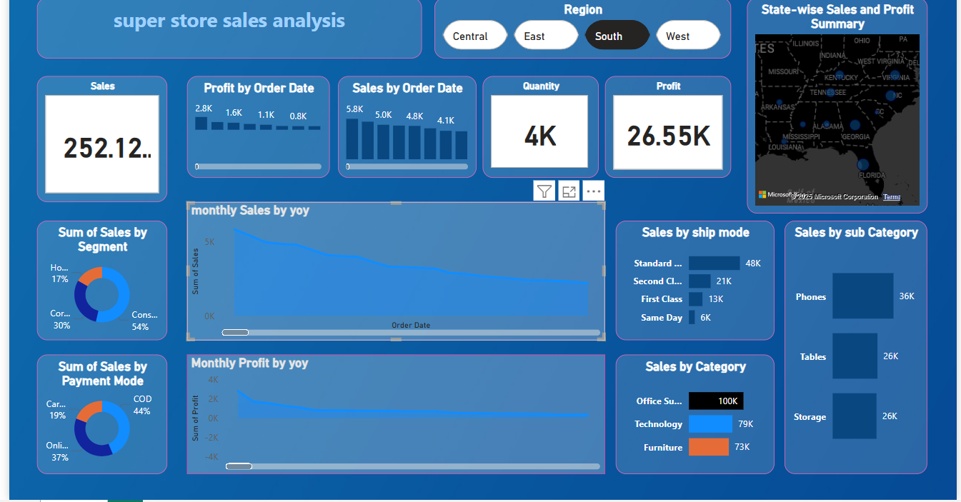
Dashboard Screenshots
Insert screenshots of your dashboard here:
- Overall Dashboard
- Filtered View
- KPI Cards and Trends

Slide 7
Tools
Tools Used:
- Power BI
- Kaggle Dataset

