Slide 1
ExamHub
Online Examination System
Project Presentation • HTML, CSS & JavaScript
1

Slide 2
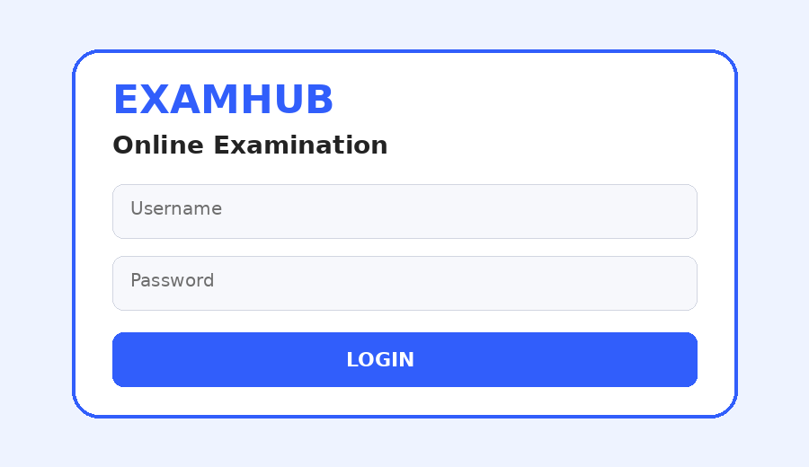
1. Project Overview
• ExamHub is a browser-based Online Examination System.
• The website starts with a student login page and opens the dashboard after successful login.
• Students can explore exams, take timed MCQ tests, submit answers and view results.
• An admin dashboard provides exam management and exam creation features.
• The implementation uses HTML, CSS and JavaScript.
ExamHub Visual
2

Slide 3
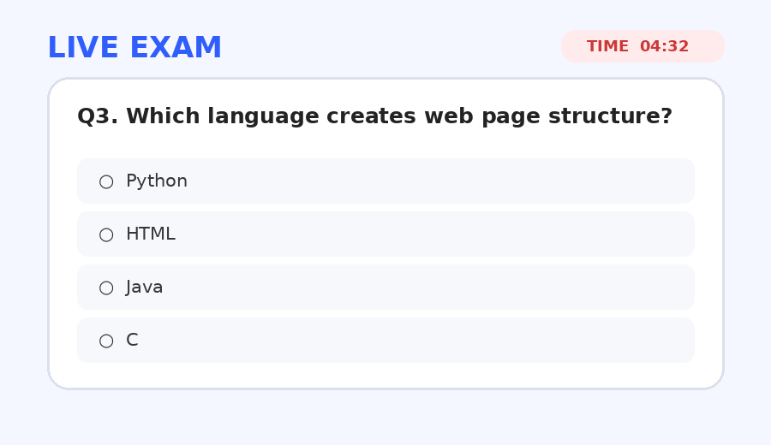
2. Project Objectives
• Provide a simple and user-friendly online examination interface.
• Allow students to enter the exam area through a login screen.
• Conduct timed multiple-choice examinations.
• Calculate scores automatically after submission.
• Store and display examination results in the browser.
• Provide basic administration features.
ExamHub Visual
3

Slide 4
3. Main Modules
• Login — username and password demo login.
• Home — overview and featured exams.
• Exams — available exams and start controls.
• Exam — MCQs, timer and question navigation.
• Results — score, date and status.
• Admin — statistics, preview and create-exam form.
ExamHub Visual
4

Slide 5
4. Login Page
• The login screen is the first page shown to the user.
• It contains Username and Password fields with a Login button.
• Demo credentials: student / 1234.
• Invalid credentials display an error message.
• Successful login opens the main application.
ExamHub Visual
5

Slide 6
5. Student Examination Workflow
• 1. Login
↓
2. Explore Exams
↓
3. Start Exam
↓
4. Answer MCQs
↓
5. Submit
↓
6. View Result.
ExamHub Visual
6

Slide 7
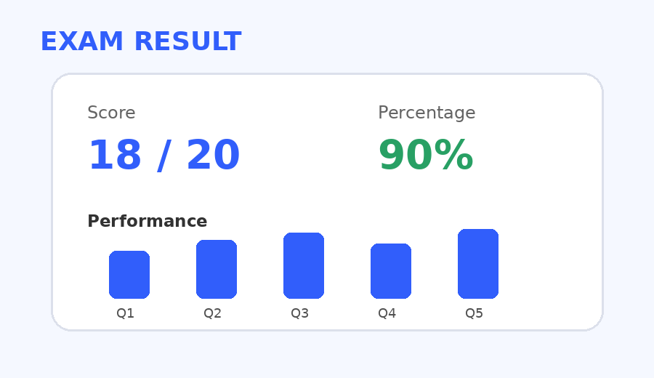
6. Examination Features
• Multiple-choice questions with four answer options.
• Previous and Next navigation between questions.
• Countdown timer based on exam duration.
• Automatic submission when the timer reaches zero.
• Automatic score and percentage calculation.
• Results are saved in browser localStorage.
ExamHub Visual
7

Slide 8
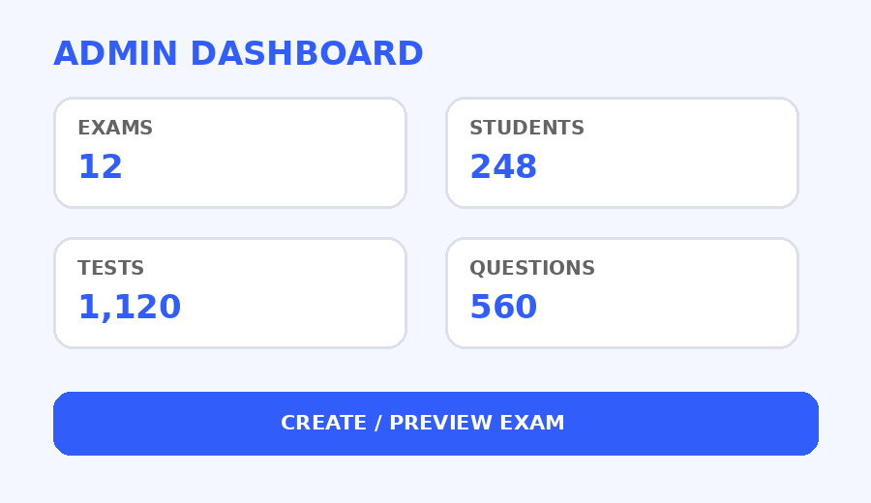
7. Admin Dashboard
• Displays total exams, students, question-bank count and completed tests.
• Lists exam title, category, number of questions and duration.
• Allows an administrator to preview an exam.
• Includes a Create Exam form with title, category, questions, duration and description.
• New exams are added dynamically to the front-end list.
ExamHub Visual
8

Slide 9
8. Technologies Used
• HTML5 — page structure and form elements.
• CSS3 — layout, cards, responsive design and styling.
• JavaScript — login, navigation, timer, scoring and dynamic rendering.
• localStorage — browser-side storage of examination results.
ExamHub Visual
9

Slide 10
9. Sample Exams Included
• Web Development — Computer Science — 5 questions — 5 minutes.
• C Programming — Programming — 5 questions — 5 minutes.
• Quantitative Aptitude — Aptitude — 5 questions — 5 minutes.
ExamHub Visual
10

Slide 11
10. Benefits of the System
• Reduces manual effort in conducting basic online tests.
• Provides instant score calculation.
• Makes exam participation convenient through a browser.
• Organizes student and admin functions.
• Responsive layout supports desktop and smaller screens.
• Can be extended into a full-stack application.
ExamHub Visual
11

Slide 12
11. Limitations and Future Scope
• Current login is a front-end demo without server-side authentication.
• Exam data is stored in JavaScript rather than a central database.
• Create Exam currently inserts sample questions.
• Future versions can add registration, real admin authentication and a database.
• Further scope includes question-bank management, randomized questions, negative marking, reports and cloud deployment.
ExamHub Visual
12

Slide 13
12. Conclusion
ExamHub demonstrates an end-to-end front-end workflow for an Online Examination
System — from login and exam selection to timed assessment, automatic scoring, results and basic administration.
Thank You
ExamHub Visual
13

