Slide 1





Team Name: Ignite
Members: Aman Kumar (21BCS3224) & Sunny Raj (22BCS10173)
Problem Statement: Slow charging with wireless charger
Solution(Title Only): Creating an external wireless technology

Slide 2

Describe Your Problem Statement:
Wireless charging is widely used in smartphone, earpods, smartwatches and other electronic devices. The average time to charge iPhone 14 pro max and Samsung S23 Ultra is more than 2 hours, which is comparatively more than wired charging technology. Also making electronic devices wirelessly chargeable requires you to include copper coil during manufacturing, which actually increase the size and width of the device and make device heavy.
Describe Your Idea Solution:
The approach followed here is to use external charger, which itself is wireless technology. The external charger works with the same principle to that of wireless charging, that is electromagnetic induction. We call it “ExtCharger”.
How is works:
- The ExtCharger will be attached to devices like phone, laptops, smartwatches, virtual reality headsets or etc., just like phone case.
- The ExtCharger will act as receiver, instead of making the electronic device the receiver.
- The ExtCharger will connect the electronic device through wire by using USB-C type port and which will itself get electromagnetic waves from the transmitter to be converted to power.
Advantages:
- The load of charging will be taken by ExtCharger, which will make the device more durable and thinner in size.
- The ExtCharger will charge faster than the current wireless charging. This means the charging time will reduce subsequently.

Slide 3
Opportunity:
- This way of charging has not been used by the people.
- This charging method is different from the current wireless charging by providing advantages like faster charging and also this type of charging method will be able to charge devices which are non-compatible with wireless charging.
- This charging can be used:
1) In our home by placing it over the table along the bed.
2) In our Car which provides the feature of wireless charging.
3) On the bike holder so that rider can charge while riding bike and using map for direction.
4) In offices where the people in office can place their device without the need of connecting with wire or waiting for long time for electronic device to get fully charged.
- The cost of implementing is comparatively similar to other wireless charger, but it gives more output than any wireless charger.

Slide 4
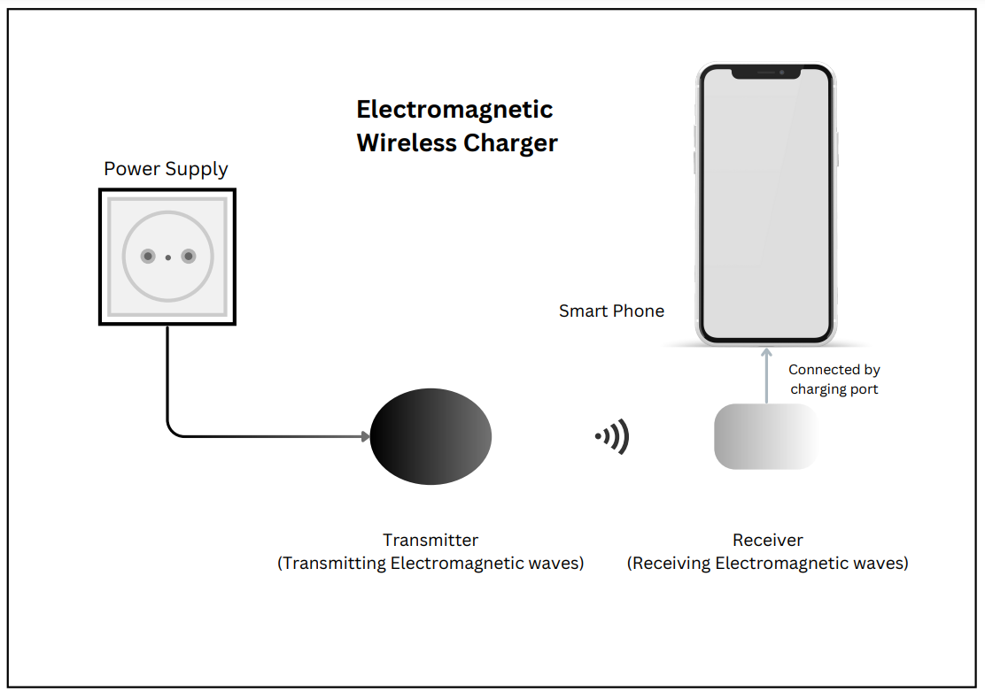
Add process Flow chart / simulated images of prototype or any relevant image related to your Idea
Prototype of ‘ExtCharger’
(Electromagnetic wireless charger)

Slide 5
FEATURES:
- Faster charging
- Also compatible for electronic devices which does not support wireless charging.
- Easy to handle than wired charging.
- Reduce the size of device by placing the copper wire outside of electronic device and building the wireless power receiver that is fully dedicated to wireless charging.
- Wireless charging also makes things nice and organized.
Describe Your Tech Stack:
- Copper wire or Primary coil
- Electromagnetic induction
- USB-C type port
- Case cover to hold device
- Electronic circuit board.

Slide 6
Business Logic Of Solution:
ExtCharger will be popular among the people who don’t carry cables to charge electronic devices every time and every where.
ExtCharger will be implemented in homes, offices, hotels and various other places where people are capable of spending their money to comfort.
Estimated Cost of Implementation:
The current model of wireless charging cost anywhere between ₹ 800 to ₹ 5000. The cost can go even higher depending upon the model and the technology used.
Our ExtCharger will cost about ₹ 3000 in Indian market, which is not too much to afford by general public.
Our ExtCharger will target people who can spend in middle range in technology.

