Slide 1

MADAN MOHAN MALAVIYA UNIVERSITY OF TECHNOLOGY, GORAKHPUR
MINI PROJECT-125 PRESENTATION
ON
QUIZZBIZZ-ONLINE QUIZ SYSTEM
UNDER GUIDANCE
OF
MR. RAJENDRA KUMAR DWIVEDI
(Associate prof. IT & CA)
Dr. JAY PRAKASH
(Assistant prof. IT & CA)
SUBMITTED BY
AMAN KUMAR GUPTA
(2019104007)
SESSION 2020-2021

Slide 2
QuizzBizz-Online Quiz System
I developed this project to organise Quiz through online mode. In present system everything is done manually, quiz organiser’s need to maintain books to store information like student details, course details, question paper, result etc. It is very difficult to maintain all data manually, also in current situation when students cannot appear in exams physically due to covid-19 pandemic, it is difficult to evaluate and organise test.
The aim of the project is to organise quiz through online mode and to evaluate student. The administrator, instructor, student who are attending quiz can connect through this project, thus facilitating effective implementation and monitoring of various activities of online examination like conducting examination as per scheduled and delivering result to that user or student.

Slide 3
Language Used
Backend-Python, Django Framework
Frontend-Angular Framework(typescript)
Database
PostgreSQL

Slide 4

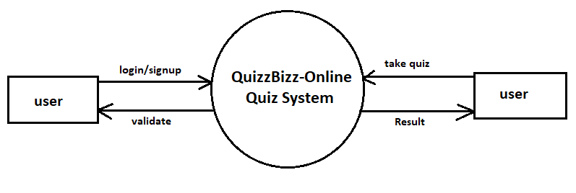



Zero-level DFD

Slide 5
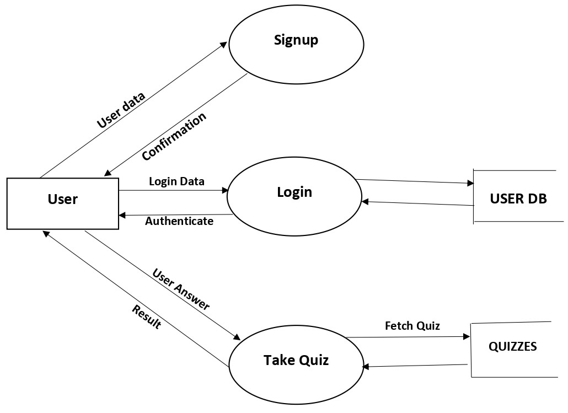
First-level DFD

Slide 6
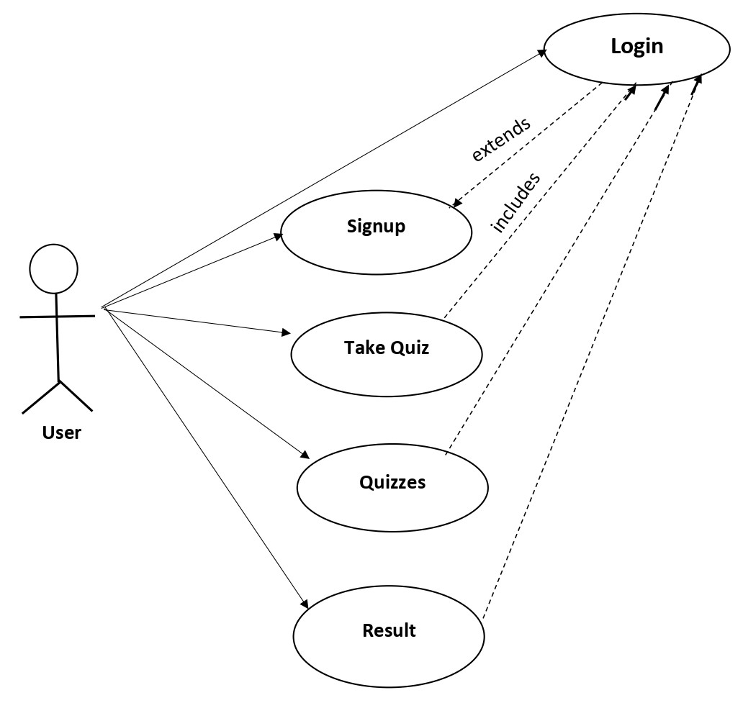
Use Case Diagram

Slide 7
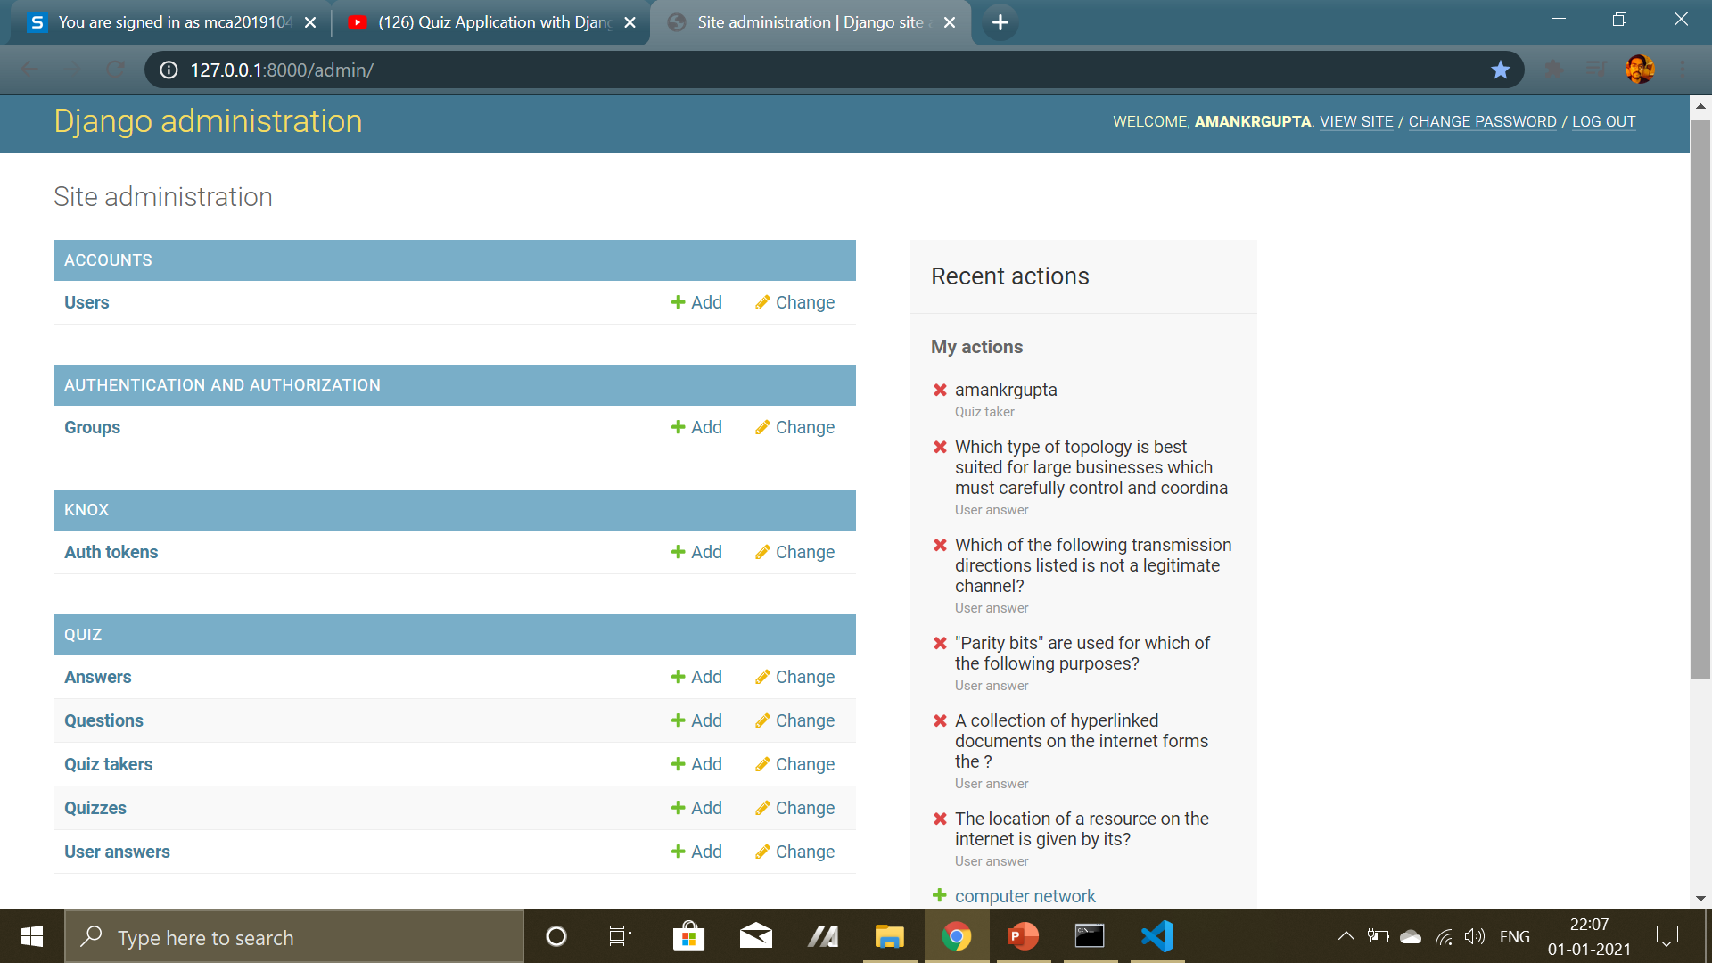
Admin Page

Slide 8
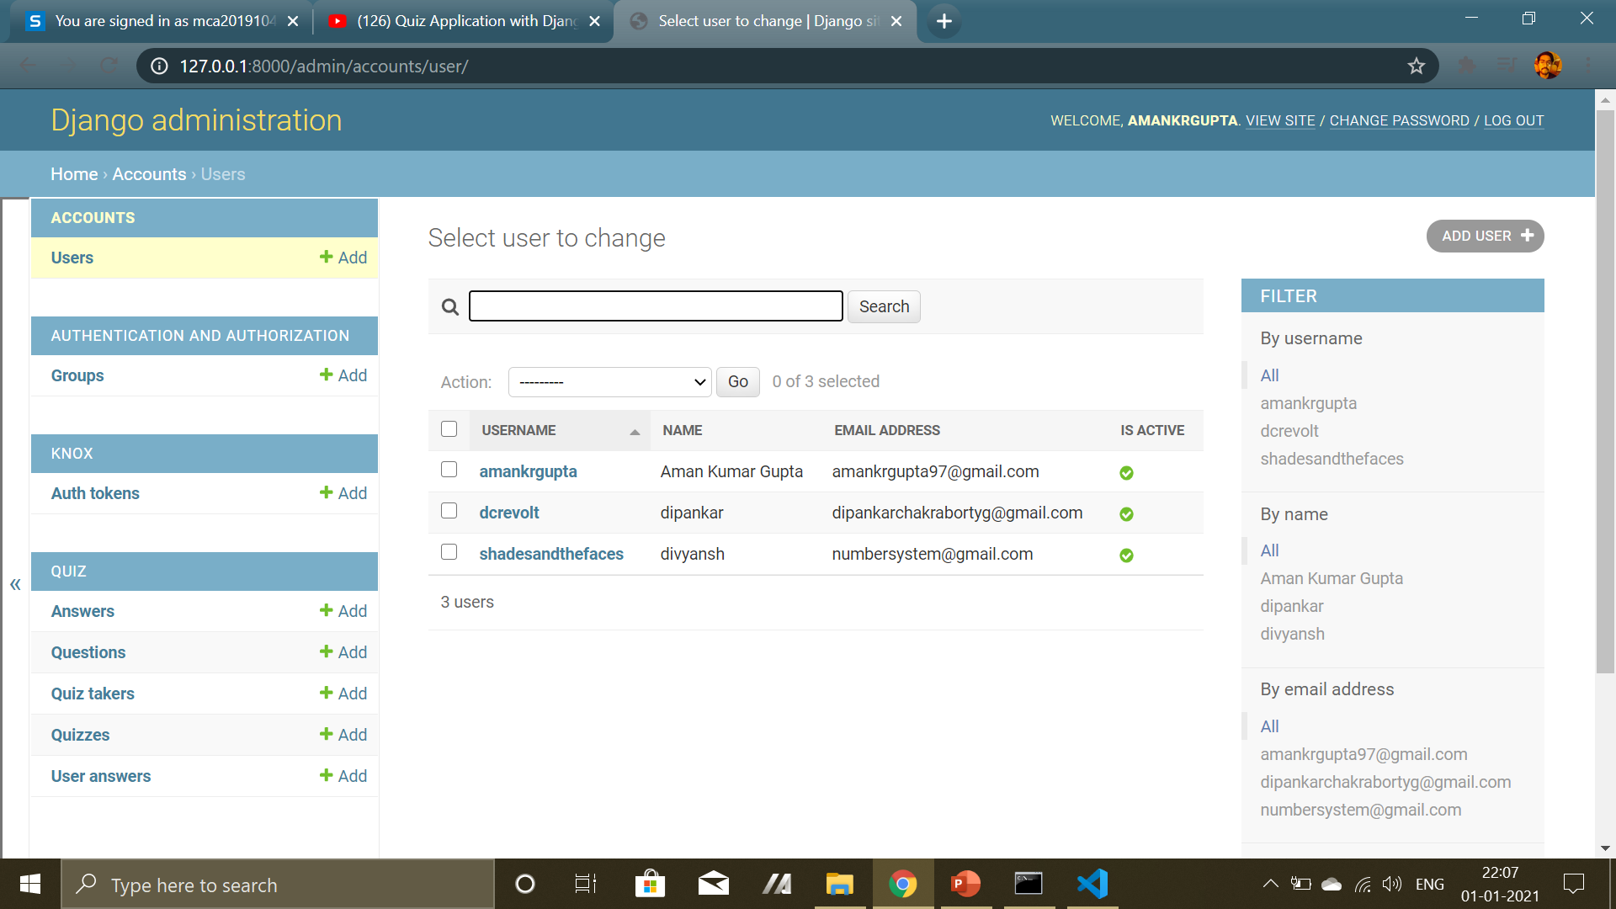
Users

Slide 9
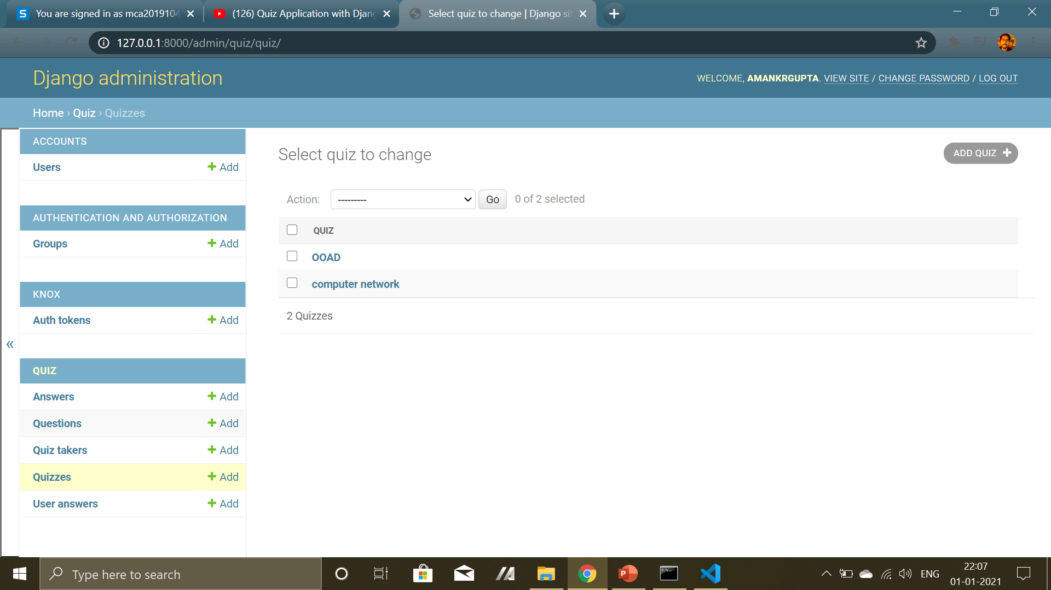
Quizzes
Admin can create Quiz by clicking on ADD QUIZ button

Slide 10
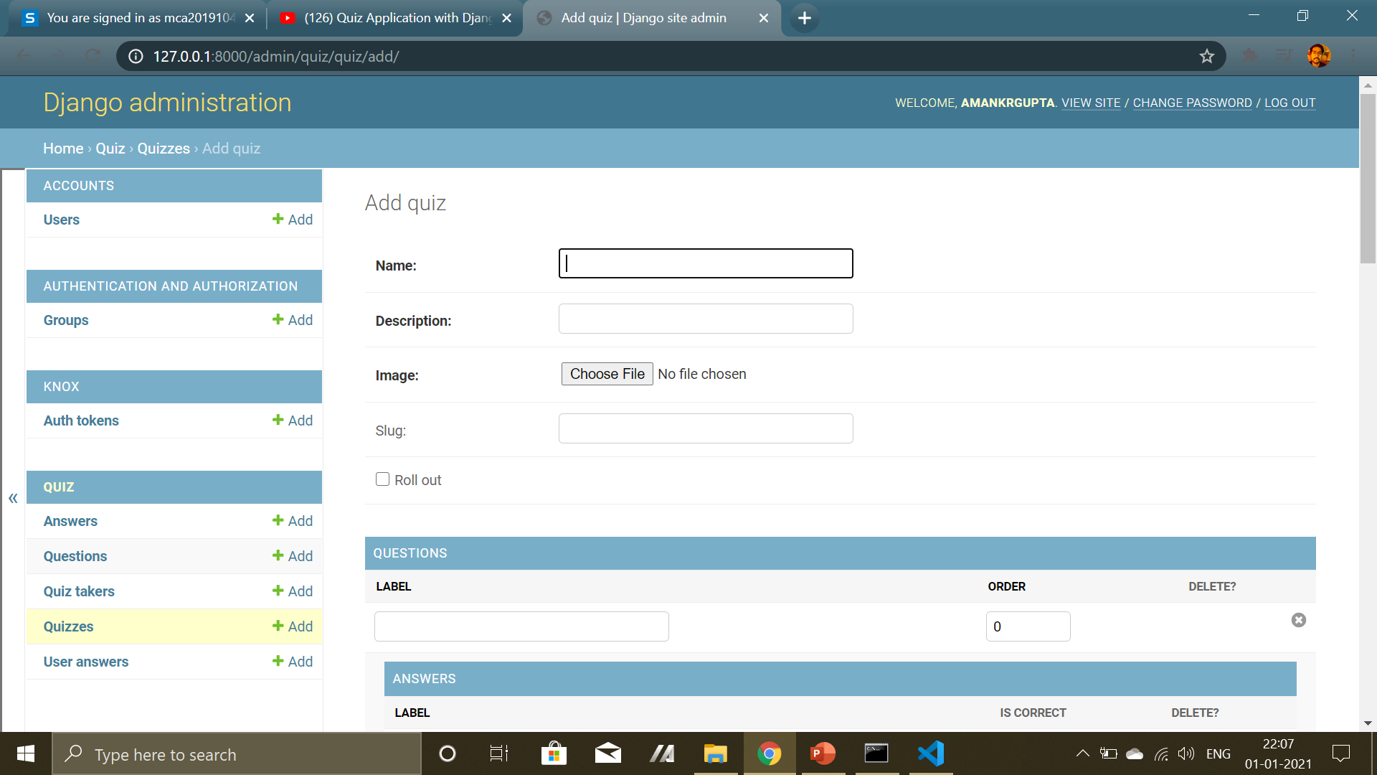
Create Quiz

Slide 11
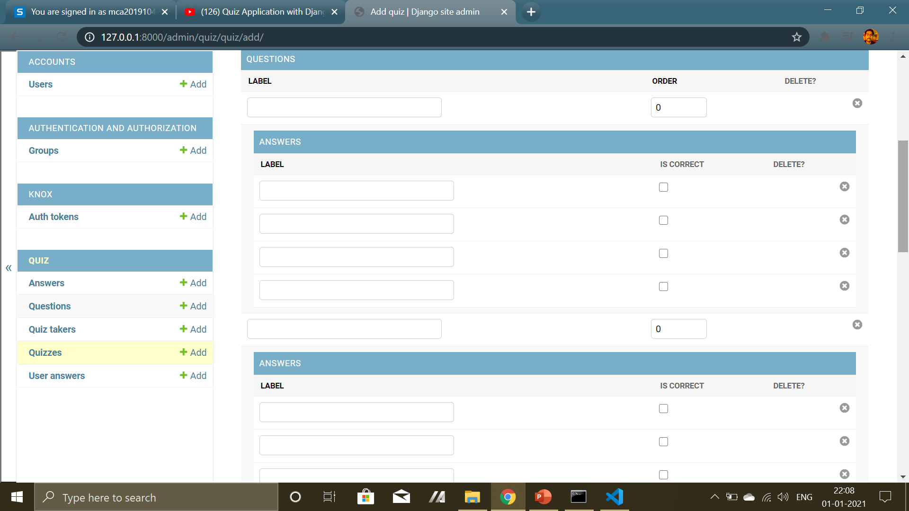
Enter order
Adding Question
Adding question
Marking correct answer

Slide 12
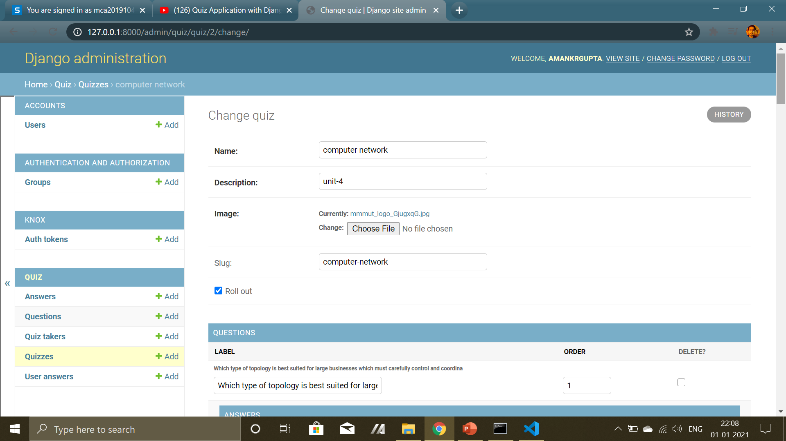
Quiz Created

Slide 13
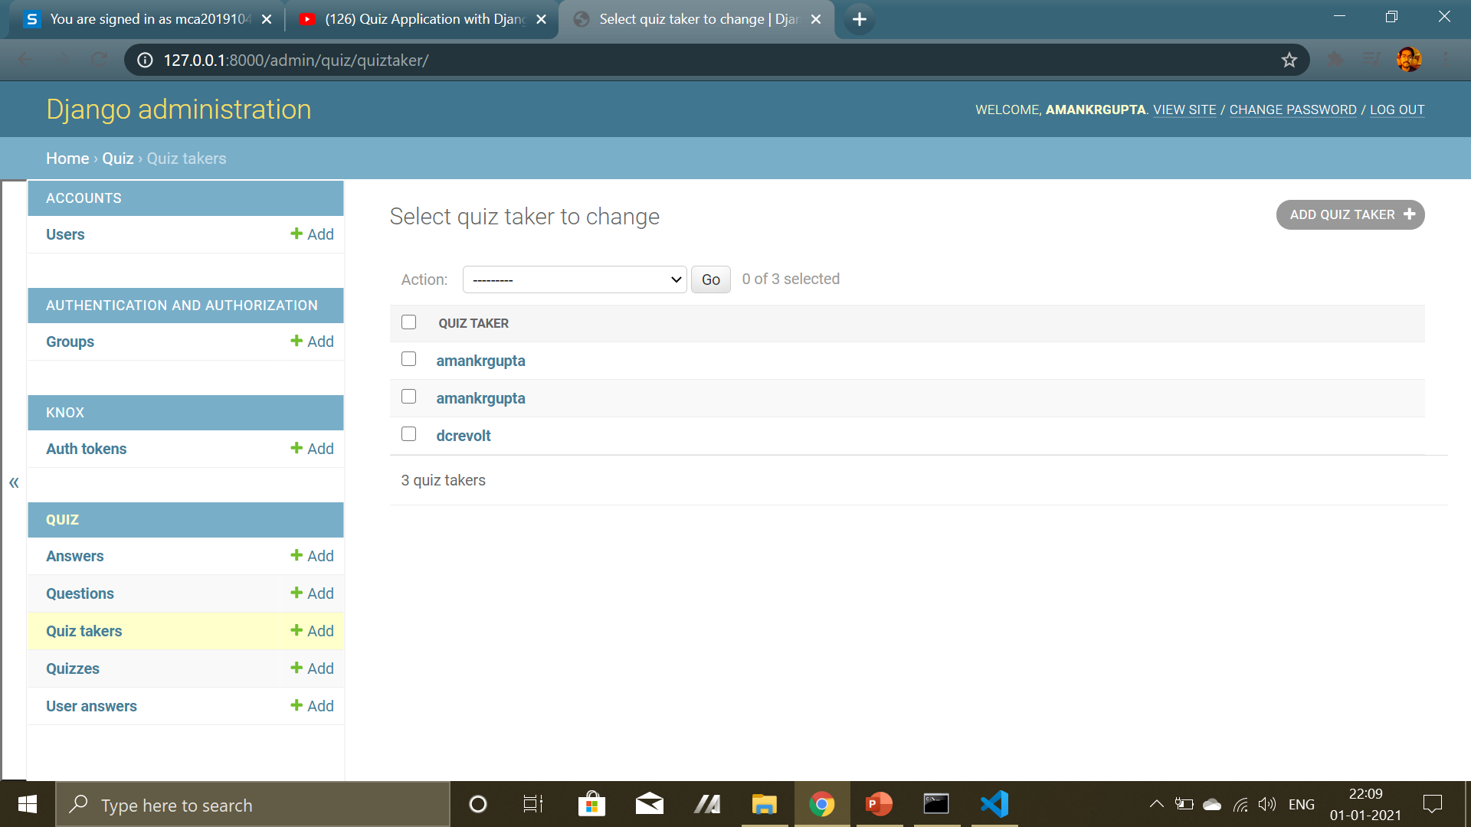
Quiz Takers

Slide 14
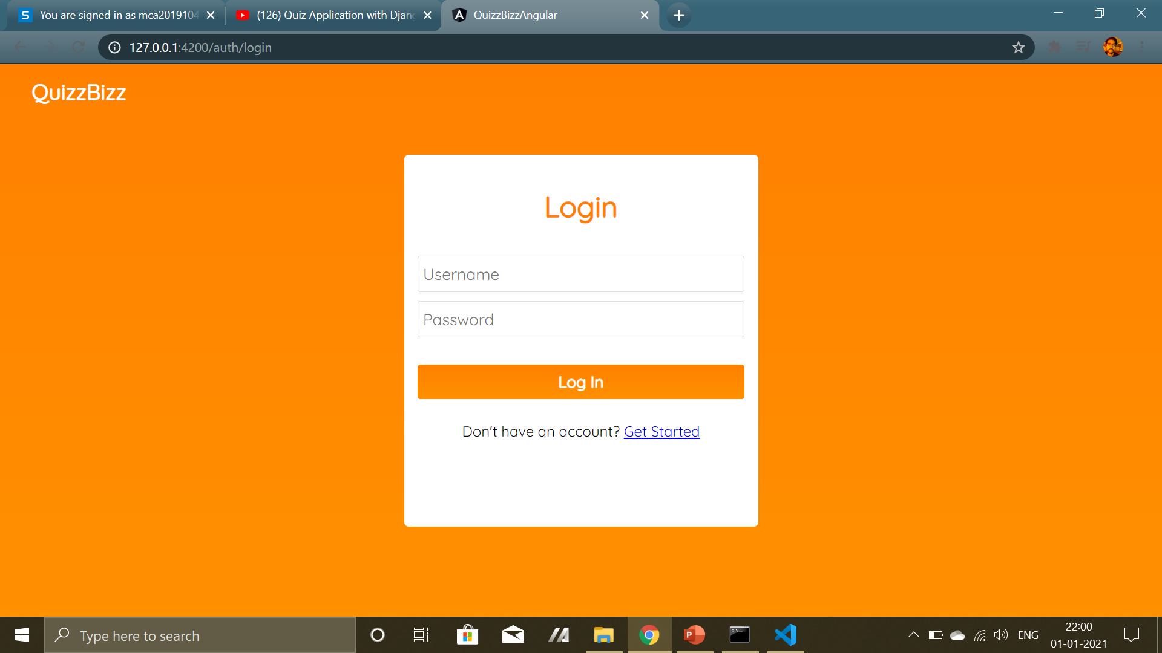
User can login by entering their credentials
Username
password
User Page

Slide 15
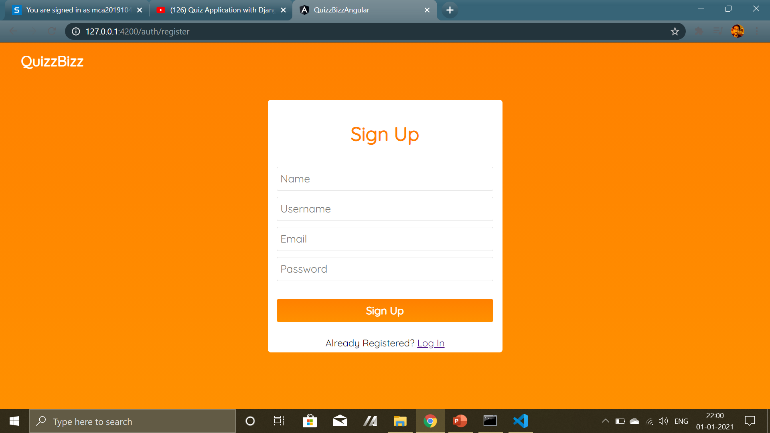
New user can register using their email and password
SignUp

Slide 16
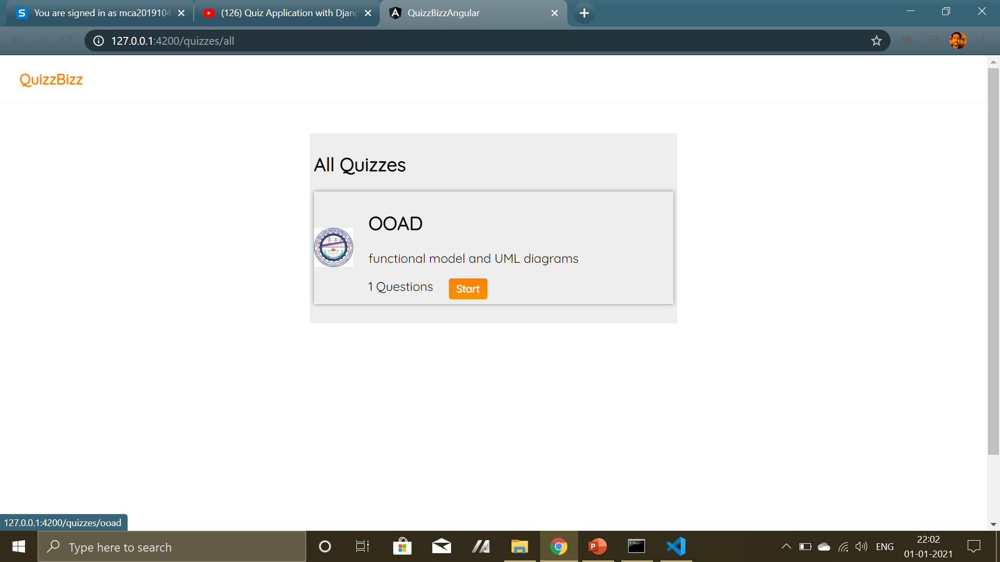
Quiz Page
User can give quiz by clicking on start button

Slide 17
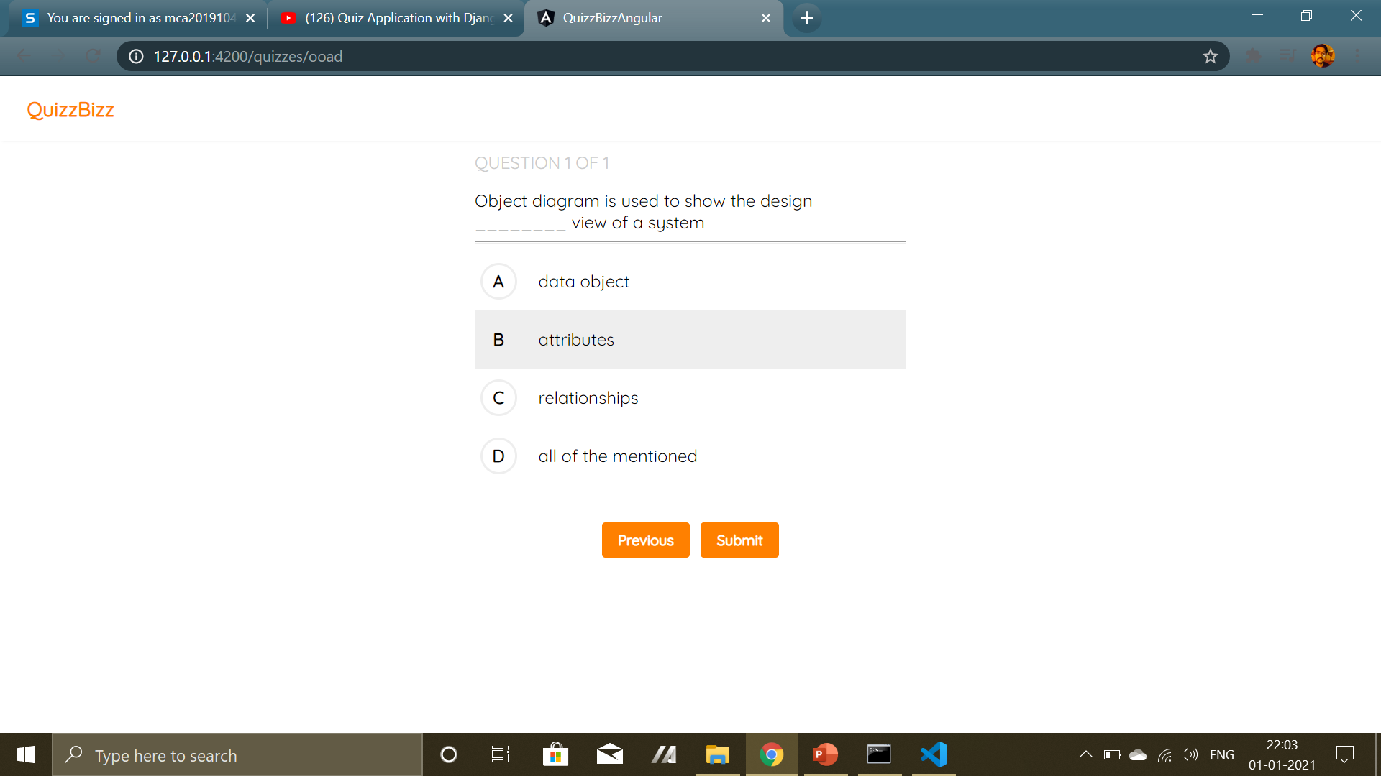
Quiz Questions

Slide 18
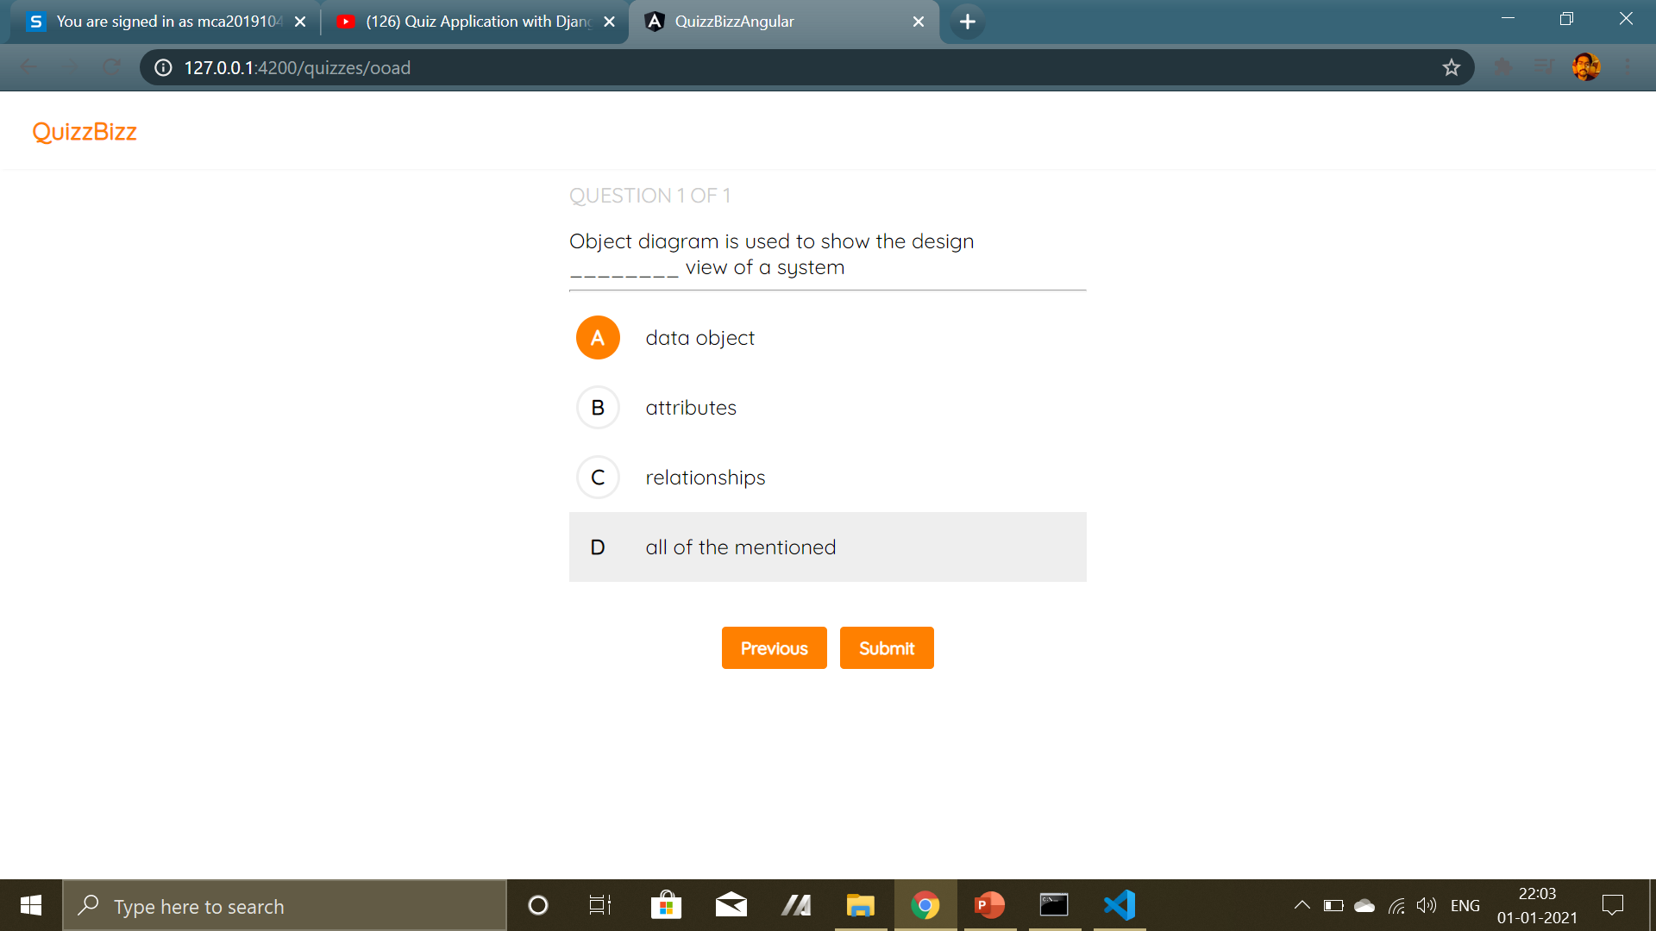
Submit Answer
Quiz taker can submit quiz by clicking on submit button

Slide 19

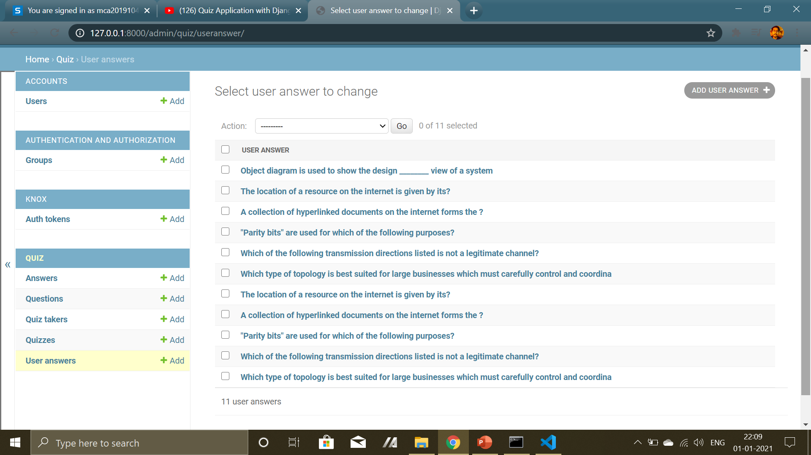
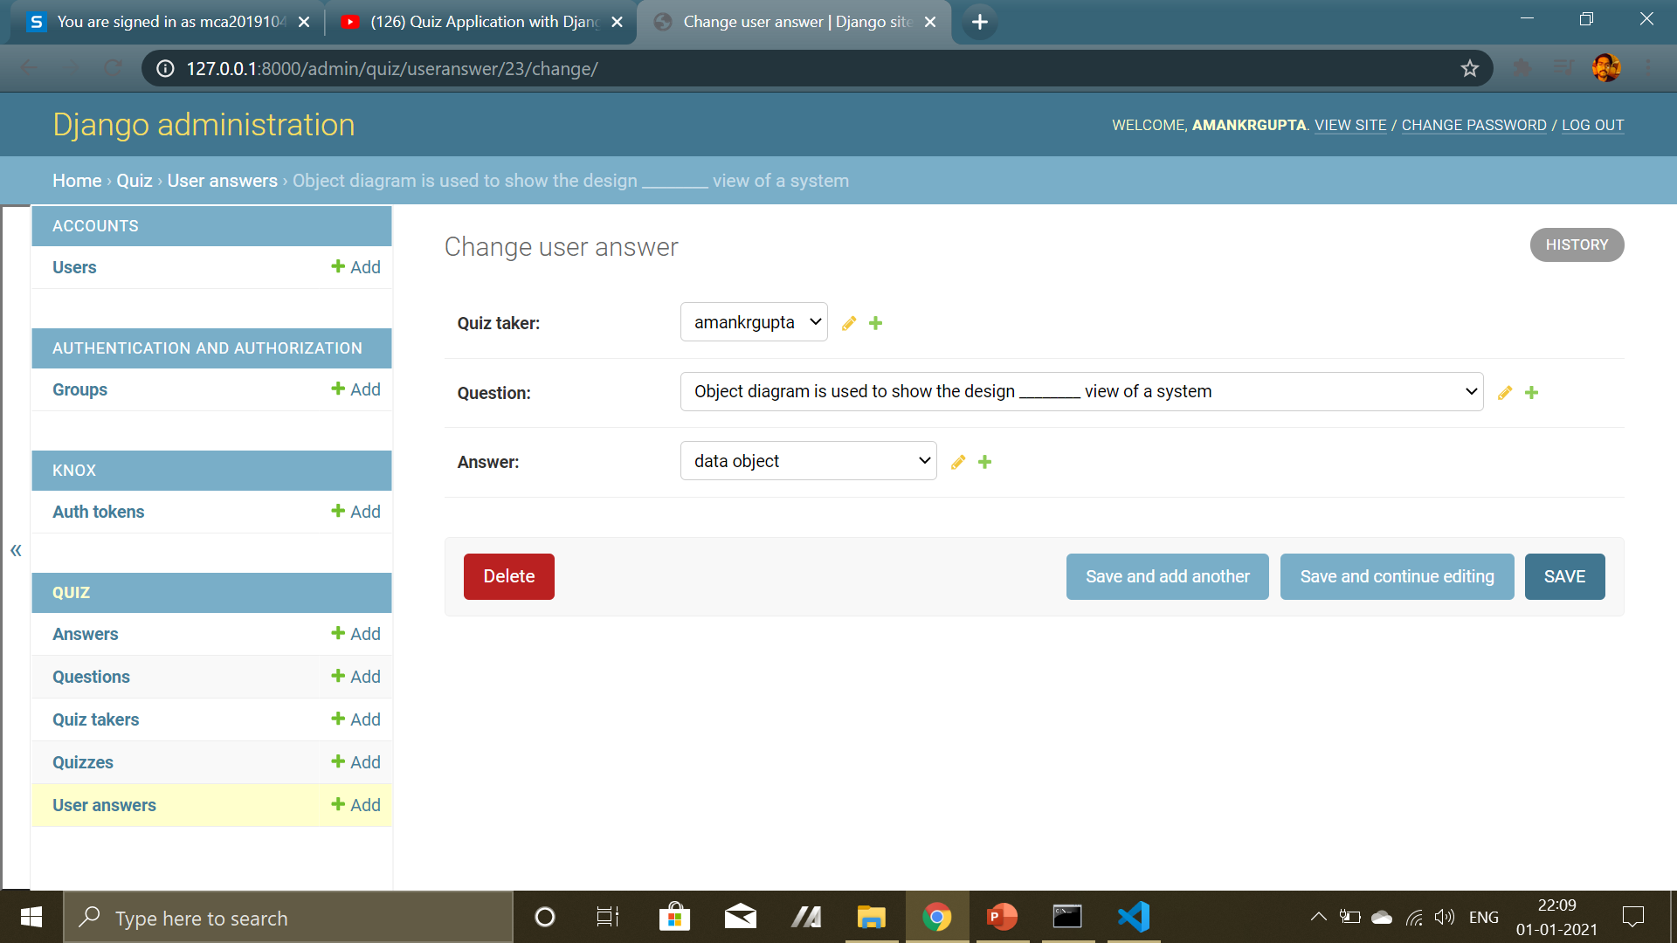
Admin can see user submitted answers of quiz
UserAnswer

