Slide 2
DOM Document Object Model
Group-12

Slide 3
Members
Archana Jha 21MCA10059
Aman Pandey 21MCA10061
Sandeep Rajput 21MCA10094
Jayesh Pawar 21MCA10100
Avinav Vyas 21MCA10101
Laveena Changhhani 21MCA10102

Slide 4
Objectives
At the End of the presentation, you will be able to:
Understand basics of DOM
Manipulation in DOM elements using JavaScript 1. Adding and Deleting DOM Elements 2. Adding and Removing attributes in DOM elements 3. Event Handling - Triggering Classes and IDs on click and hover events

Slide 5
Table of contents
01.
02.
03.
04.
Introduction
DOM Tree
What is DOM ?
DOM Structure
DOM Methods
DOM Manipulation
What are the methods we use in DOM
How you can manipulate DOM - Live Implementation

Slide 6
01.
Introduction
What is DOM?

Slide 7
Introduction
The Document Object Model (DOM) is the data representation of the objects that comprise the structure and content of a document on the web.

Slide 8
DOM and JavaScript
The DOM is not a programming language. It was designed to be independent of any programming language, making the structural representation of the document available from a single, consistent API. Even if most web developers will only use the DOM through JavaScript, implementations of the DOM can be built for any language

Slide 9
02.
DOM TREE
DOM Structure

Slide 10
DOM Tree
The DOM is often referred to as the DOM tree and consists of a tree of objects called nodes.

Slide 11
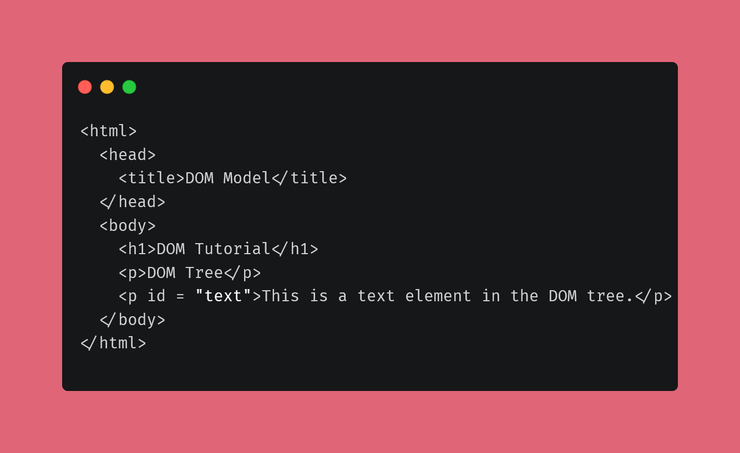

Slide 12
DOM TREE
Document
Root Element:
<html>
Element:
<head>
Element:
<body>
Element:
<h1>
Element:
<p>
Element:
<p>
Element:
<title>
Text:
DOM Tutorial
Text:
DOM Tree
Text:
This is a text element in DOM tree
Attribute
“id”
Text:
<Dom Model>

Slide 13
Every element, attribute, and text content in the HTML creates its own DOM node in the tree
Document node
Element nodes
This is added at the top of the tree and represents the entire page in the browser
All the HTML elements like heading tags and paragraph tags in the page create an element node in the tree
Attribute nodes
Text nodes
When the opening tags in the HTML document contain attributes, the tree represents them as attribute nodes
Represents a text as a node

Slide 14
Working with the DOM Tree in JavaScript DOM
Document
html
head
Element:
<body>
style
Attribute:
type
div
Attribute:
id
ul
script
ul
Element:
<h1>
Element:
<h1>
Attribute:
type
Attribute:
type
Attribute:
type
Attribute:
type
Attribute:
type
Attribute:
type
Attribute:
id
Attribute:
type
Attribute:
type
Attribute:
type
Attribute:
type

Slide 15
Accessing the Elements
DOM Queries are the methods that find elements in the DOM tree. They may return one element or a collection of elements in a NodeList. You can select any element you desire from the NodeList with the help of an index number (starting with 0)

Slide 16
03.
DOM Methods
What are the methods we use in DOM

Slide 17
The document Object
• ‘document’ is the Global reference to the DOM entry point
• Provides methods for navigating and manipulating the DOM • The document object is the important connection between the DOM and JavaScript code

Slide 18
DOM Methods
Searching the DOM
Traversing the DOM
Changing style
Used for searching
nodes
Used for traversing between nodes
Used for Changing style attributes
Changing CSS Classes
Adding Elements
Removing Elements
Used for Changing CSS Classes
Used for Adding Elements to DOM
Used for Removing
Elements to DOM

Slide 19
Searching the DOM
finds nodes with a certain CLASS attribute
searches using CSS selectors
getElementById
getElementsByTagName
finds node with a certain ID attribute
finds nodes with a certain HTML tag
getElementsByClassName
querySelector, querySelectorAll

Slide 20
Traversing the DOM
Access children Nodes
Access sibling Nodes
Access parent Node
element.children, element.lastChild, element.firstChild
element.nextElementSibling, element.previousElementSibling
element.parentElement

Slide 21
Changing style attributes
CSS
JS
background-color
backgroundColor
border-radius
borderRadius
element.style.fontWeight = “bold”;
font-weight
fontWeight
list-style-type
listStyleType
word-spacing
wordSpacing
z-index
zIndex

Slide 22
Changing CSS Classes
className
classList
This attribute is a string of all of a Node’s classes
It is HTML5 way to modify which classes are on a Node

Slide 23
Create an element
Creating Elements
document.createElement(tagName)

Slide 24
Insert newNode at end of current Node
Insert newNode at beginning of current Node
Insert newNode before a certain childNode
Adding Elements to the DOM
node.appendChild(newNode);
node.prependChild(newNode);
node.insertBefore(newNode, sibling);

Slide 25
Remove the oldNode child
Removing Elements
node.removeChild(oldNode)

Slide 26
04.
DOM Manipulation
How you can manipulate DOM

Slide 27
The technique to add/remove HTML content is DOM Manipulation.

Slide 28

JS Event Handling

Slide 29
What is an event?
• A JavaScript event is a callback that gets fired when something happens related to the DOM on your website.
• For instance, when an element is clicked, or perhaps hovered over
• An event handler can be attached to an element so that when a specific event happens, a specific “callback” function gets fired

Slide 30

Practical Let’s GO

Slide 31

QUESTIONS?

Slide 32
Thanks!
You can find our code at: https://github.com/Lazzzy-Coder/CSS-and-JS-Projects

