Slide 1


E-Mail
One of the most popular Internet services is electronic mail (e-mail).

Slide 2
01
Introduction
History of e-mail
02
03
E-Mail Format
Table of Contents
Architecture of e-mail
04
05
High level view of e-mail
Different types of e-mail
06
07
Popular e-mail services

Slide 3
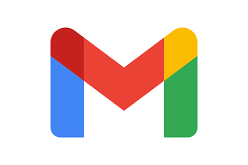
Introduction to E-mail
Email stands for Electronic Mail. It is a method to sends messages from one computer to another computer through the internet. It remains one of the Internet’s most important and utilized applications.

Slide 4
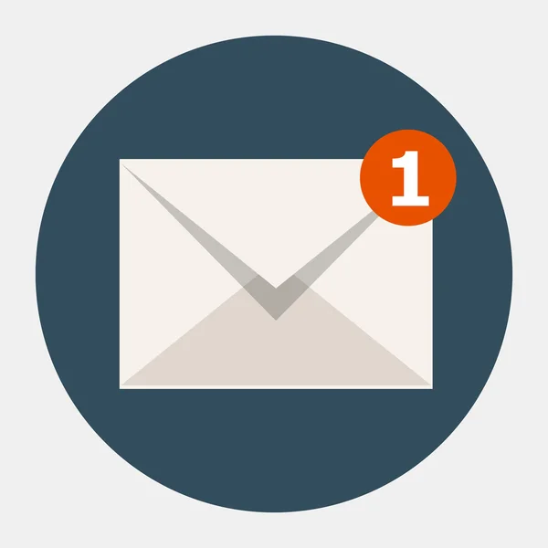
History of e-mail
The first example of email can be found on computers at MIT in a program called “MAILBOX”, all the way back in 1965. Users of MIT computers could leave messages with this program on computers at the university for other users, who would see the messages the next time they logged on to the computer. The system was quite effective, but only if the people wishing to communicate with each other were regularly using the same computer.
In 1969, the US Department of Defense implemented ARPANET (Advanced Research Projects Agency Network), a network connecting numerous computers across the department for the purpose of communication within the organization.
On October 29th 1969, the first message was sent from computer to computer on ARPANET.
It was 1971 when Ray Tomlinson invented and developed electronic mail, as we know it today, by creating ARPANET’s networked email system.
By 1976, 75% of all ARPANET traffic was electronic mail. The medium had proved so useful that ideas were beginning to spring up about how one might be able to send an electronic mail message to a user on a computer outside of an internal network.
By 1993 the word “electronic mail” had been replaced by “email” in the public lexicon and internet use had become more widespread.
In the late 1990’s internet use exploded, growing from 55 million users worldwide in 1997 to 400 million by 1999. As the market potential of the internet became widely apparent, email spam began to multiply exponentially, creating the need for email sorting software.

Slide 5
Format of E-mail :
An e-mail consists of three parts that are as follows :
1. Envelope
2. Header
3. Body
1.Envelope : The envelope part encapsulates the message. It contains all information that is required for sending any e-mail such as destination address, priority and security level. The envelope is used by MTAs for routing message.

Slide 6
2. Header :
The header consists of a series of lines. Each header field consists of a single line of ASCII text specifying field name, colon and value. The main header fields related to message transport are:
To: It specifies the DNS address of the primary recipient(s).
Cc : It refers to carbon copy. It specifies address of secondary recipient(s).
BCC: It refers to blind carbon copy. It is very similar to Cc. The only difference between Cc and Bcc is that it allow user to send copy to the third party without primary and secondary recipient knowing about this.
From : It specifies name of person who wrote message.
Sender : It specifies e-mail address of person who has sent message.
Received : It refers to identity of sender’s, data and also time message was received. It also contains the information which is used to find bugs in routing system.
Return-Path: It is added by the message transfer agent. This part is used to specify how to get back to the sender.

Slide 7
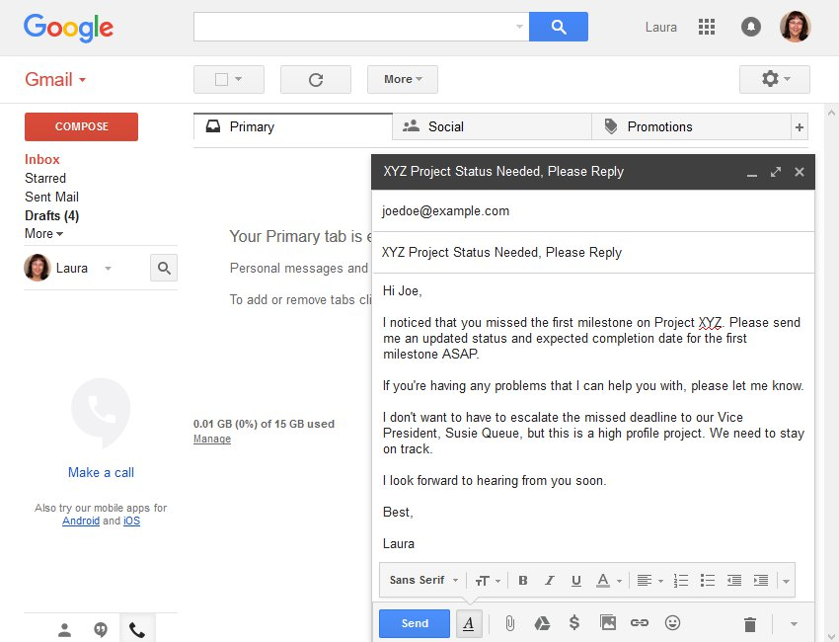
3. Body :
The body of a message contains text that is the actual content/message that needs to be sent, such as “Employees who are eligible for the new health care program should contact their supervisors by next Friday if they want to switch.” The message body also may include signatures or automatically generated text that is inserted by the sender’s email system.

Slide 8
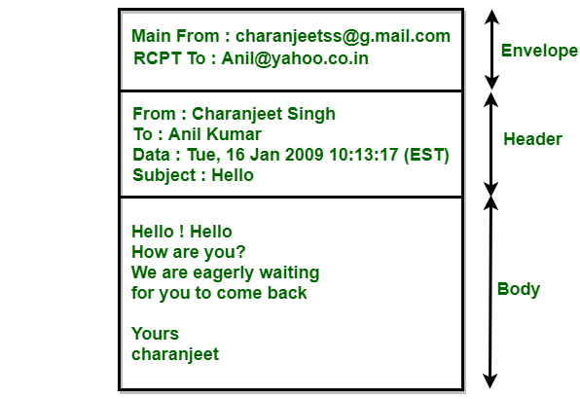
E-mail format:

Slide 9
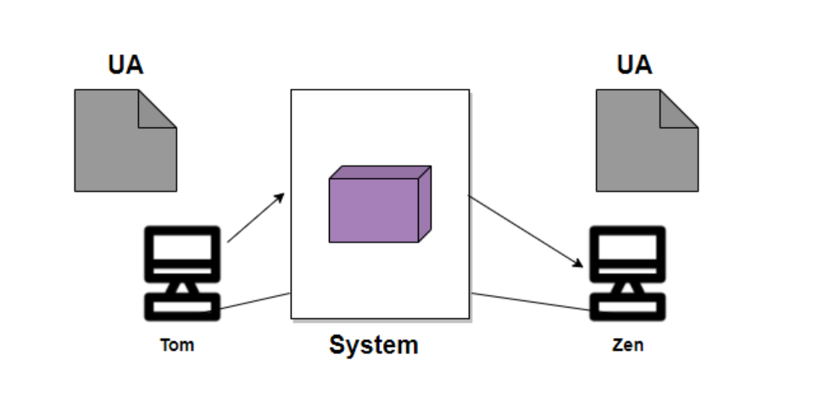
Architecture of Email
First Scenario:
When the sender and the receiver of an E-mail are on the same system, then there is the need for only two user agents.

Slide 10
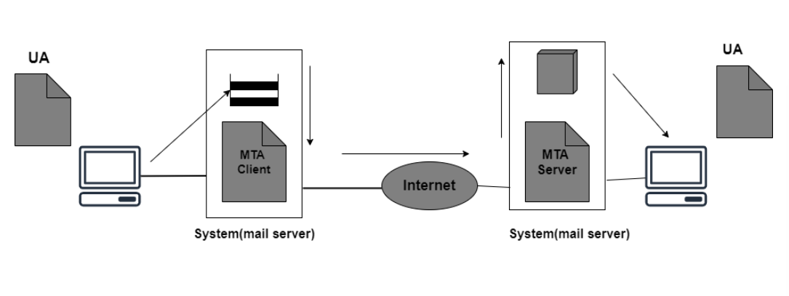
Architecture of Email contd..
Second Scenario:
In this scenario, the sender and receiver of an e-mail are basically users on the two different systems. Also, the message needs to send over the Internet. In this case, we need to make use of User Agents and Message transfer agents(MTA).

Slide 11
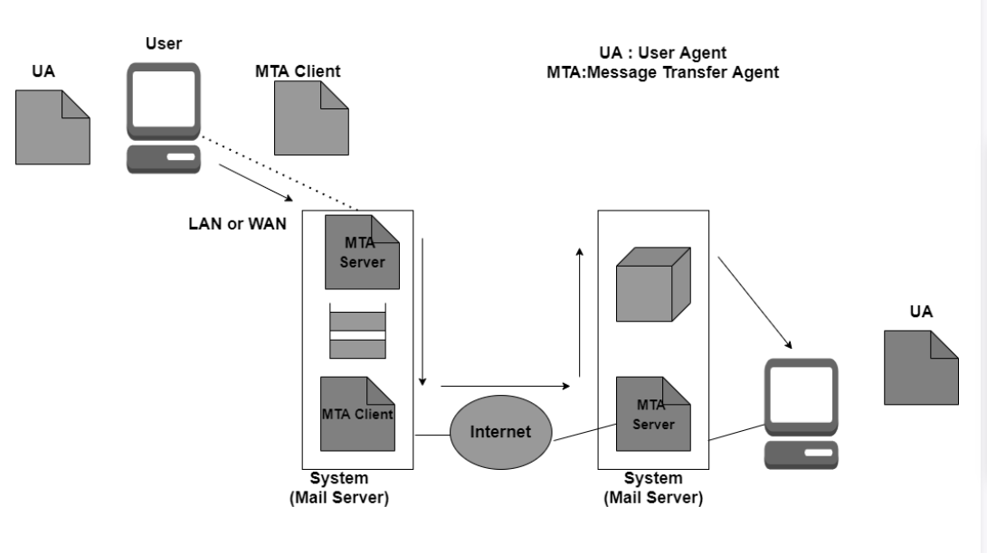
Architecture of Email contd..
Third Scenario:
In this scenario, the sender is connected to the system via a point-to-point WAN it can be either a dial-up modem or a cable modem. While the receiver is directly connected to the system like it was connected in the second scenario.

Slide 12
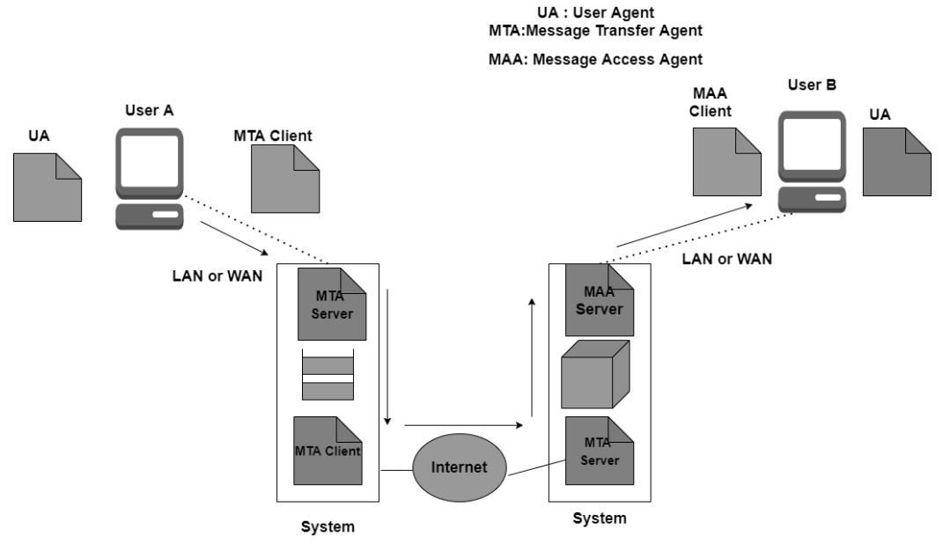
Architecture of Email contd..
Fourth Scenario:
When the message arrives the receiver needs to retrieve the message; thus there is a need for another set of client/server agents. The recipient makes use of MAA(Message access agent) client in order to retrieve the message.
In this, the client sends the request to the Mail Access agent(MAA) server and then makes a request for the transfer of messages.

Slide 13
A high-level view of the Internet e-mail system
Figure 1 presents a high-level view of the Internet mail system. We see from this diagram that it has three major components: user agents, mail servers, and the Simple Mail Transfer Protocol (SMTP).
Alice, sending an e-mail message to a recipient, Bob. User agents allow users to read, reply to, forward, save, and compose messages. Microsoft Outlook and Apple Mail are examples of user agents for e-mail.
Alice is finished composing her message, her user agent sends the message to her mail server, where the message is placed in the mail server’s outgoing message queue. When Bob wants to read a message, his user agent retrieves the message from his mailbox in his mail server.
Mail servers form the core of the e-mail infrastructure. Each recipient, such as Bob, has a mailbox located in one of the mail servers.
SMTP is the principal application-layer protocol for Internet electronic mail. It uses the reliable data transfer service of TCP to transfer mail from the sender’s mail server to the recipient’s mail server.
When a mail server sends mail to other mail servers, it acts as an SMTP client. When a mail server receives mail from other mail servers, it acts as an SMTP server.

Slide 14
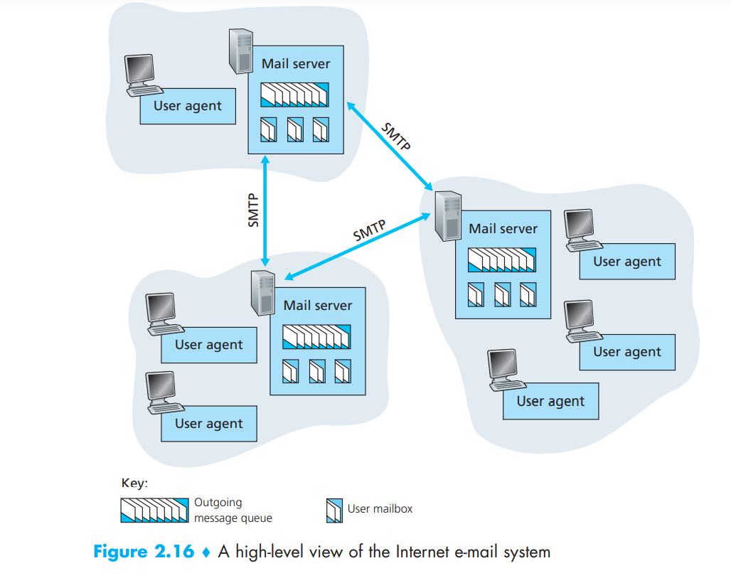
1

Slide 15
Different types of E-mail
Newsletters:
It is studying by Clutch, the newsletter is the most common type of email that are routinely sent to all mailing list subscribers. These emails often contain from the blog or website, links curated from other sources, and selected content that the company has recently published. Typically, Newsletter emails are sent on a consistent schedule, and they offer businesses the option to convey important information to their client through a single source.
Lead Nurturing:
Lead-nurturing emails are a series of related emails that marketers use to take users on a journey that may impact their buying behavior. Lead-nurturing emails are also known as trigger campaigns, which are used for solutions in an attempt to move any prospective sale into a completed purchase and educate potential buyers on the services. These emails are not only helpful for converting emails but also drive engagement.
Promotional emails:
It is the most common type of B2B (Business to Business) email, which is used to inform the email list of your new or existing products or services. These types of emails contain creating new or repeat customers, speeding up the buying process, or encouraging contacts to take some type of action. It provides some critical benefits to buyers, such as a free month of service, reduced fees for managed services, or percentage off the purchase price.

Slide 16
Different types of E-mail Contd..
Standalone Emails:
These emails are popular like newsletters emails, but they contain a limitation. If you want to send an email with multiple links or blurbs, your main call-to-action can weaken. Your subscriber may skip your email and move on, as they may click on the first link or two in your email but may not come back to the others.
Onboarding emails:
An onboarding email is a message that is used to strengthen customer loyalty, also known as post-sale emails. These emails receive users right after subscription. The onboarding emails are sent to buyers to familiarize and educate them about how to use a product effectively. Additionally, when clients faced with large-scale service deployments, these emails help them facilitate user adoption.
Transactional:
These emails are related to account activity or a commercial transaction and sent from one sender to one recipient. Some examples of transactional email are purchase confirmations, password reminder emails, and personalized product notifications. These emails are used when you have any kind of e-commerce component to your business.

Slide 17
Different types of E-mail Contd..
Plain-Text Emails:
It is a simple email that does not include images or graphics and no formatting; it only contains the text. These types of emails contain just simple text similar to other text message services. It does not include images, videos, documents, graphics, or any attachments. Plain-text emails are also used to send casual chatting like other text message services.
Welcome emails:
It is a type of B2B email and common parts of onboarding emails that help users get acquainted with the brand. These emails can improve subscriber constancy as they include additional information, which helps to the new subscriber in terms of a business objective. Generally, welcome emails are sent buyers who got a subscription to a business's opt-in activities, such as a blog, mailing list, or webinar.

Slide 18
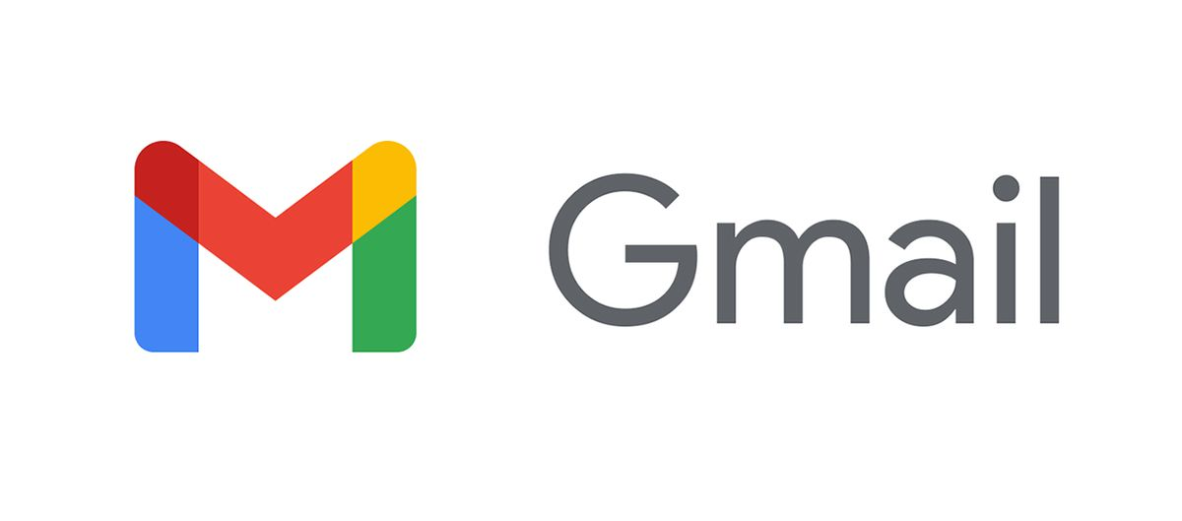
Popular Email Services
Gmail is the world’s most used email service provided by Google. Today, more than 1.5 billion active users worldwide. It is a web-based email service available on various devices. It supported email clients via the POP and IMAP protocols. Gmail is like other mail services, we can send and receive emails, block spam, create an address book, and perform other basic email tasks.
To access Gmail, we need a Google account. It is just like many services offered by Google by registered users. The creation of a new Google account is free for everyone. The domain of Gmail is xyz@gmail.com where Xyz is your unique username.

Slide 19
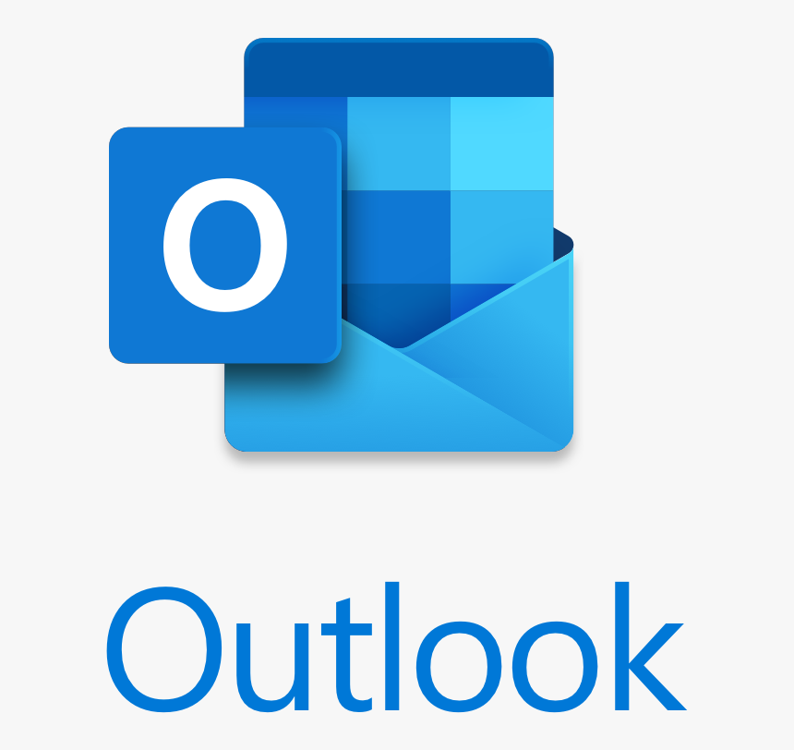
Popular Email Services contd..
Outlook is also a popular webmail service founded in 1996 by Sabeer Bhatia and Jack Smith as Hotmail later in 1997 acquired by Microsoft. It is older than Gmail. Like other webmail services, Outlook supports Chrome, Firefox, Safari, and later versions of Internet Explorer. It has more features like keyboard controls ability that provide more facility to the users.
To access Outlook, we need an Outlook account. It is free to create an account and sending mail. It also operates other Microsoft applications like Microsoft Word, Power BI, etc. The domain of Outlook is abc@outlook.com where the abc is our unique username.

Slide 20

21MCA10059
Archana Jha

