Slide 1

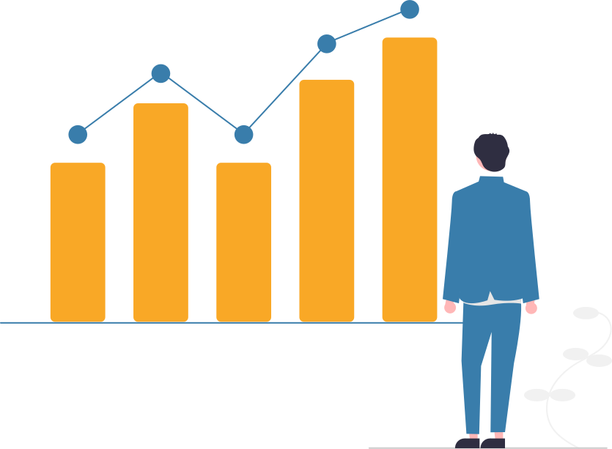
Data Mining
Support and Confidence

Slide 2
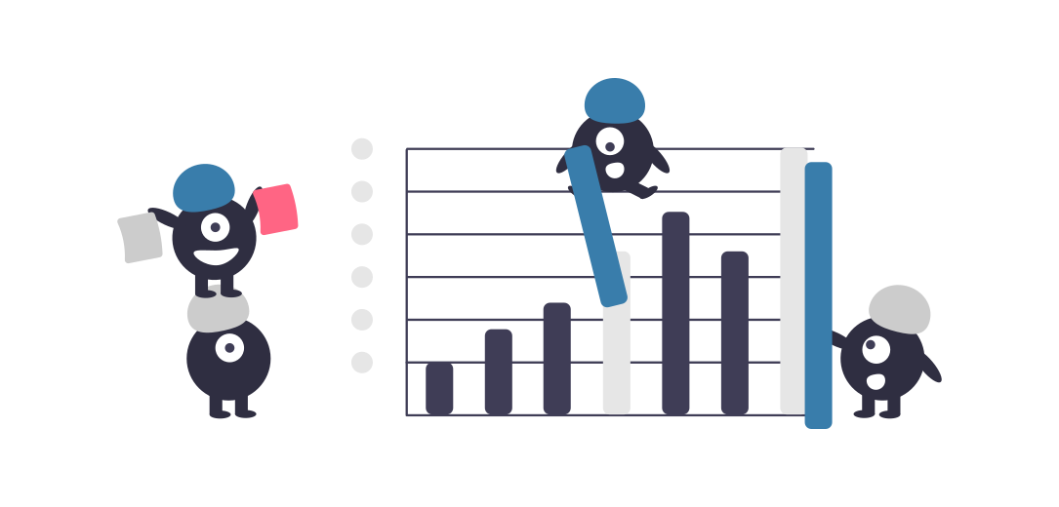
Prepared by: 1. Aman Kumar Pandey (21MCA10061) 2. Archana Jha (21MCA10059)

Slide 3
01
Background
Support
02
03
Confidence
Table of Contents
Examples
04
05
Conclusion

Slide 4

Background

Slide 5
Association is a data mining function that discovers the probability of the co-occurrence of items in a collection. The relationships between co-occurring items are expressed as Association Rules.
Association rule mining searches for relationships between items in a dataset.
Association rules have been widely used in prediction, personalized recommendation, risk analysis and other fields.
The most widely accepted evaluation indexes of association rules are Support and Confidence
Association and Association Rules

Slide 6
Association Rule Discovery − Given a set of transactions T, discover some rules having support ≥ minsup and confidence ≥ minconf , where minsup and minconf are the equivalent support and confidence thresholds.
A brute-force method for mining association rules is to calculate the support and confidence for each applicable rule. This method is intensely expensive because there are exponentially several rules that can be copied from a data set.
A a common strategy offshore by several association rule mining algorithms is to decompose the issues into two major subtasks − Frequent Itemset Generation − The objective is to discover some itemsets that need a threshold. These itemsets are known as frequent itemsets. Rule Generation − The objective is to extract some high-confidence rules from the frequent itemsets discovered in the previous step. These rules are known as strong rules. The computational requirements for frequent itemset generation are frequently more costly than those of rule generation.
Association and Association Rules contd.

Slide 7
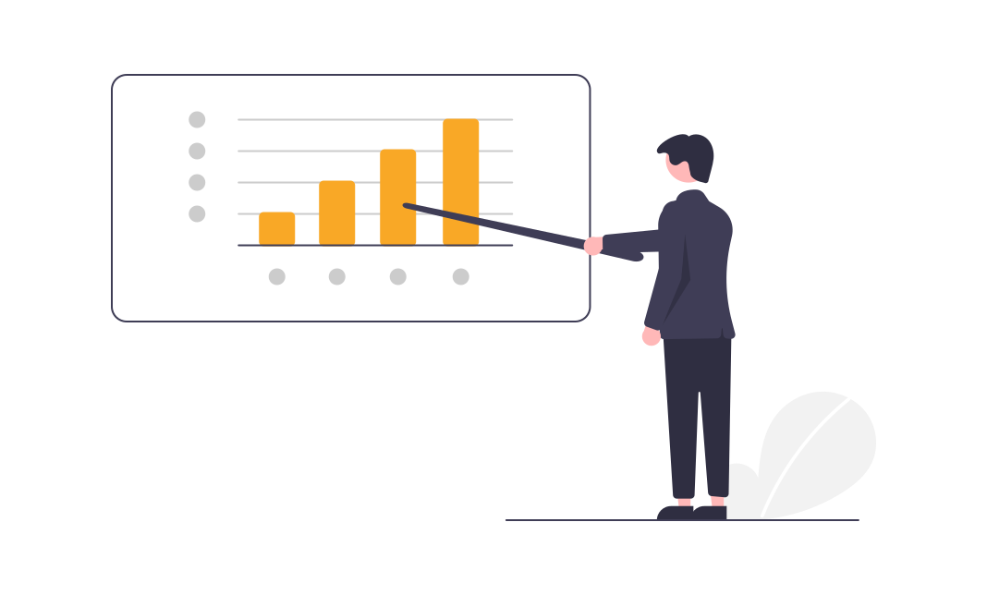
Basic Definitions

Slide 8
Basic Definitions
Transactions
A transaction is an event that has a impact on an entity’s statements, and is recorded as an entry in its records.
Item
Single object or entity in the transaction
Itemset
A collection of one or more items.
If an itemset that contains k items then it is known as K-itemset
Frequent Itemset
An itemset whose support is greater than or equal to a minsup threshold

Slide 9
Basic Definitions - Examples
Suppose there is a data of an e - commerce website where the transactions of users has been recorded
Transactions: Here all the rows are transactions where, 1,2,3,4,5 are transaction id’s.
T. ID | Items
1 | Guitar, Strings
2 | Guitar, Picks, Capo, Mouthorgan
3 | Strings, Pics, Capo, Amplifier
4 | Guitar, String, Picks, Capo
5 | Guitar, String, Picks, Amplifier
Item: Guitar, Picks, amplifier etc are Items.
Itemset: Here, in each transaction, items which are bought together are itemset.
Example: {Guitar, Picks, Capo, Mouthorgan }
Frequent Itemset: For frequent itemset we should know support. So,
What is Support ?
Association Rule: An implication expression of the form X → Y, where X and Y are itemsets. Example: {Strings, Pics} → {Capo}

Slide 10

Support

Slide 11
Support
It is the percentage of transactions where the association rule holds. Support can be used to assess the usefulness of association rules. When the frequencies of A and B occurring simultaneously are equal to or higher than the set Support threshold, itemsets(A, B) as a frequent pattern.
The formula is as follows:
|
where N(AB) is the number of records that A and B appear together, and |D| is the total record number of transactions in data sets.
N(AB) is also known an Support Count and is denoted by σ and Support is denoted by s. So, the given equation will become:
s(A → B) = σ(A,B) / |D|
Supp(A → B) = Supp(A ∪ B) = P(AB) = N(AB) / |D|

Slide 12
Support - Example
Suppose there is a data of an e - commerce website where the transactions of users has been recorded.
Solution:
{Strings, Picks} → {Capo}
Let X = {Strings, Picks} and Y = {Capo}
Here number of transactions (|D|) are 5
So,
σ(X,Y) = σ(Strings, Picks, Capo} = 2
s(X →Y) = σ(X,Y) / |D|
= 2 / 5
= 0.4
T. ID | Items
1 | Guitar, Strings
2 | Guitar, Picks, Capo, Mouthorgan
3 | Strings, Picks, Capo, Amplifier
4 | Guitar, String, Picks, Capo
5 | Guitar, String, Picks, Amplifier
Inference:
Out of 5 transactions, Strings, Picks and Capo were bought together 2 times. Which means nearly half of the time they are bought. So, we can say that it is frequent itemset if we put minimum threshold of 30% i.e. 0.3.
Q. Find Support Count and Support if
Association Rule: {Strings, Picks} → {Capo}

Slide 13

Confidence

Slide 14
Confidence
Confidence is the statistic of probability P(B|A) that subsequent events occur under the condition of occurrence of the precursor events in trading data sets. It is used to measure the reliability of the rules. The formula is as follows:
Confident is denoted by c. So, the given equation will become:
Conf(A → B) = P(B|A) = P(AB)/P(A) = Sup(A ∪ B)/Sup(A)
=> Conf(A → B) = Sup(A ∪ B)/Sup(A)
c(A → B) = σ(AB) / σ(A)

Slide 15
Confidence - Example
Suppose there is a data of an e - commerce website where the transactions of users has been recorded.
Solution:
{Strings, Picks} → {Capo}
Let X = {Strings, Picks} and Y = {Capo}
So,
σ(X) = σ({Strings, Picks} ) = 3
σ(X,Y) = σ({Strings, Picks, Capo} )= 2
c(X →Y) = σ(X,Y) / σ(X)
= 2 / 3
= 0.67
T. ID | Items
1 | Guitar, Strings
2 | Guitar, Picks, Capo, Mouthorgan
3 | Strings, Picks, Capo, Amplifier
4 | Guitar, Strings, Picks, Capo
5 | Guitar, Strings, Picks, Amplifier
Inference:
Out of all the transactions when Strings and Picks were bought together the probability of Capo getting bought with Strings and Picks was 67% i.e. 0.67.
Q. Find the confidence if
Association Rule: {Strings, Picks} → {Capo}

Slide 16
Support and Confidence – Example contd.
Q. Given the below dataset. Find support count, support and confidence, if the association rule is:
{Guitar, Strings} → {Picks}
Also find if the itemset is frequent or not if the threshold is 0.3.
Solution:
{Guitar, Strings} → {Picks}
Let X = {Guitar, Strings} and Y = {Picks}
Here number of transactions (|D|) are 5
So,
σ(X,Y) = 2
s(X →Y) = σ(X,Y) / |D|
= 2 / 5
= 0.4
T. ID | Items
1 | Guitar, Strings
2 | Guitar, Picks, Capo, Mouthorgan
3 | Strings, Picks, Capo, Amplifier
4 | Guitar, Strings, Picks, Capo
5 | Guitar, Strings, Picks, Amplifier

Slide 17
Support and Confidence – Example contd.
σ(X) = σ({Guitar, Strings}} ) = 3
σ(X,Y) = σ({Guitar, Strings, Picks} )= 2
c(X →Y) = σ(X,Y) / σ(X)
= 2 / 3
= 0.67
T. ID | Items
1 | Guitar, Strings
2 | Guitar, Picks, Capo, Mouthorgan
3 | Strings, Picks, Capo, Amplifier
4 | Guitar, Strings, Picks, Capo
5 | Guitar, Strings, Picks, Amplifier
Inference:
Out of 5 transactions, Strings, Picks and Capo were bought together 2 times i.e. 40% (0.4).
Out of all the transactions when Strings and Picks were bought together the probability of Capo getting bought with Strings and Picks was 67% i.e. 0.67.
Here threshold is 0.3 and we have support 0.4 which means itemset is frequent itemset. Also confidence is 67% which is a good value. So this association rule would become a good recommender system.

Slide 18
Conclusion
An association rule is an implication description of the form X→Y where X and Y are disjoint itemsets, i.e., X∩Y= ϕ.
The durability of an association rule can be computed in terms of its support and confidence. Support decides how to provide a rule that is accessible to a given data set, while confidence decides how frequently items in Y occurs in transactions that include X.
Confidence measures the accuracy of the inference produced by a rule.

Slide 19
Conclusion Contd.
Support is a substantial measure because a rule that has very low support can appear easily by chance. A low support rule is also feasible to be tedious from a business viewpoint because it cannot be profitable to enhance items that users seldom purchase together.
1
An association rule is an implication description of the form X→Y where X and Y are disjoint itemsets, i.e., X∩Y=ϕ. The durability of an association rule can be computed in terms of its support and confidence. Support decides how to provide a rule that is accessible to a given data set, while confidence decides how frequently items in Y occurs in transactions that include X.
2
Confidence measures the accuracy of the inference produced by a rule. For a given rule form X→Y, the larger the confidence, the more acceptable it is for Y to be present in transactions that include X. Confidence also supports an estimate of the conditional probability of Y given X.
3
Association analysis results must be executed with care. The inference produced by an association rule does not essentially signify causality. Rather than it suggests a powerful co-appearance relationship among elements in the antecedent and consequent of the rule. Causality needed knowledge about the causal and effect attributes in the information and generally contains relationships appearing over time.
4

Slide 20

Thank You for Your Precious Time!!
Questions and Feedback

Slide 21
Thank You!

