Slide 1


DNS
The Domain Name System (DNS) is the phonebook of the Internet.

Slide 2
Table of Contents
01
Introduction and Definition
02
DNS Protocol
03
Working of DNS
04
Services Provided by DNS
05
DNS Resolver
06
DNS Caching

Slide 3
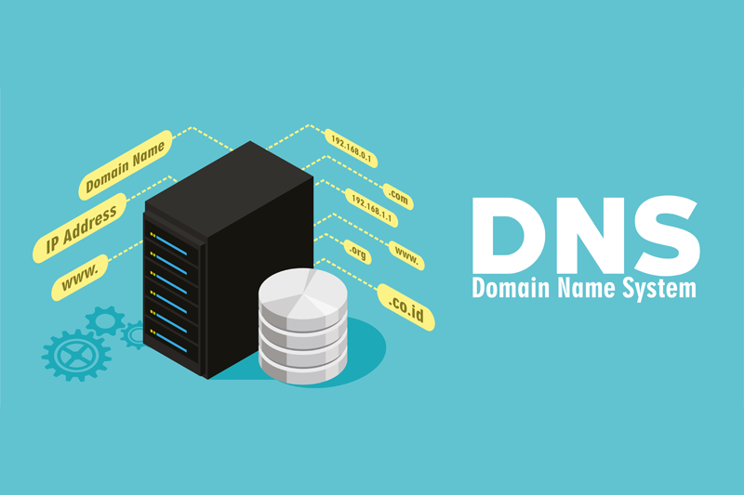
Introduction to DNS
The Domain Name System (DNS) is the phonebook of the Internet. Humans access information online through domain names, like nytimes.com or espn.com. Web browsers interact through Internet Protocol (IP) addresses. DNS translates domain names to IP addresses so browsers can load Internet resources.

Slide 4
What is DNS?
DNS stands for Domain Name System.
DNS is a directory service that provides a mapping between the name of a host on the network and its numerical address.
DNS is required for the functioning of the internet.
Each node in a tree has a domain name, and a full domain name is a sequence of symbols specified by dots.
DNS is a service that translates the domain name into IP addresses. This allows the users of networks to utilize user-friendly names when looking for other hosts instead of remembering the IP addresses.
For example, suppose the FTP site at EduSoft had an IP address of 132.147.165.50, most people would reach this site by specifying ftp.EduSoft.com. Therefore, the domain name is more reliable than IP address.

Slide 5
A brief history
The U.S. Department of Defense’s ARPANET (Advanced Research Projects Agency Network) originally developed IP. As a result, U.S. research centers shared information among themselves more quickly. To do this, it used a huge directory of websites and their corresponding IP addresses—a digital phone book of sorts.
By the 1970s, the number of computers in this network was growing rapidly. The system to track them was unwieldy and fragmented. Subsequently, numerical IP addresses became increasingly long and impossible to memorize. One united system was needed to simplify networking.
American computer scientists and internet pioneers Paul Mockapetris and Jon Postel invented the Domain Name System in 1983. In 1986, the Internet Engineering Task Force (IETF) certified it as one of the original Internet Standards. Two IETF documents describe the functionality of this protocol and data types it can carry: RFC 1034 and RFC 1035.

Slide 6
DNS Protocol :
Like HTTP, FTP, and SMTP, the DNS protocol is an application-layer protocol since it (1) runs between communicating end systems using the client-server paradigm and (2) relies on an underlying end-to-end transport protocol to transfer DNS messages between communicating end systems. In another sense, however, the role of the DNS is quite different from Web, file transfer, and e-mail applications. Unlike these applications, the DNS is not an application with which a user directly interacts. Instead, the DNS provides a core Internet function—namely, translating hostnames to their underlying IP addresses, for user applications and other software in the Internet. We noted in Section 1.2 that much of the complexity in the Internet architecture is located at the “edges” of the network. The DNS, which implements the critical name-to-address translation process using clients and servers located at the edge of the network, is yet another example of that design philosophy

Slide 7
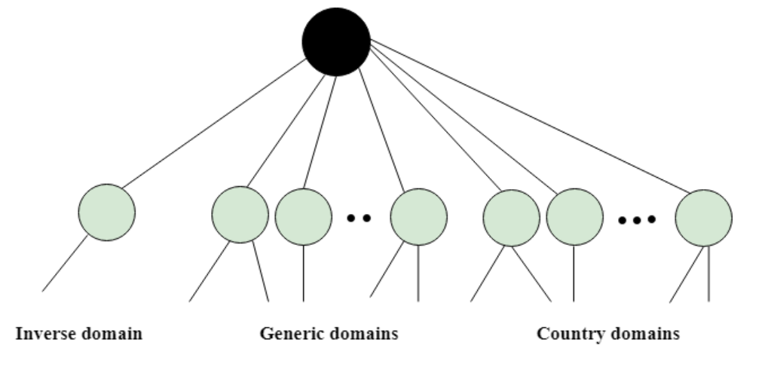
Types of Domain
The domain name space is divided into three different sections: generic domains, country domains, and inverse domain.

Slide 8
Hierarchy of Name Servers
Root name servers – It is contacted by name servers that can not resolve the name. It contacts authoritative name server if name mapping is not known. It then gets the mapping and return the IP address to the host.
Top level server – It is responsible for com, org, edu etc. and all top level country domains like uk, fr, ca, in etc. They have info about authoritative domain servers and know names and IP addresses of each authoritative name server for the second level domains.
Authoritative name servers This is organization’s DNS server, providing authoritative hostname to IP mapping for organization servers. It can be maintained by organization or service provider. In order to reach cse.dtu.in we have to ask the root DNS server, then it will point out to the top level domain server and then to authoritative domain name server which actually contains the IP address.

Slide 9
Working of DNS
DNS is a client/server network communication protocol. DNS clients send requests to the. server while DNS servers send responses to the client.
Client requests contain a name which is converted into an IP address known as a forward DNS lookups while requests containing an IP address which is converted into a name known as reverse DNS lookups.
DNS implements a distributed database to store the name of all the hosts available on the internet.
If a client like a web browser sends a request containing a hostname, then a piece of software such as DNS resolver sends a request to the DNS server to obtain the IP address of a hostname. If DNS server does not contain the IP address associated with a hostname, then it forwards the request to another DNS server. If IP address has arrived at the resolver, which in turn completes the request over the internet protocol.

Slide 10
Services provided by DNS :
Host aliasing. A host with a complicated hostname can have one or more alias names. For example, a hostname such as relay1.west-coast.enterprise.com could have, say, two aliases such as enterprise.com and www.enterprise.com. In this case, the hostname relay1.westcoast.enterprise.com is said to be a canonical hostname. Alias hostnames, when present, are typically more mnemonic than canonical hostnames.
Mail server aliasing: For obvious reasons, it is highly desirable that e-mail addresses be mnemonic. For example, if Bob has an account with Hotmail, Bob’s e-mail address might be as simple as bob@hotmail.com. However, the hostname of the Hotmail mail server is more complicated and much less mnemonic than simply hotmail.com (for example, the canonical hostname might be something like relay1.west-coast.hotmail.com). DNS can be invoked by a mail application to obtain the canonical hostname for a supplied alias hostname as well as the IP address of the host. In fact, the MX record (see below) permits a company’s mail server and Web server to have identical (aliased) hostnames; for example, a company’s Web server and mail server can both be called enterprise.com.

Slide 11
Services provided by DNS :
Load distribution: DNS is also used to perform load distribution among replicated servers, such as replicated Web servers. Busy sites, such as cnn.com, are replicated over multiple servers, with each server running on a different end system and each having a different IP address. For replicated Web servers, a set of IP addresses is thus associated with one canonical hostname. The DNS database contains this set of IP addresses. When clients make a DNS query for a name mapped to a set of addresses, the server responds with the entire set of IP addresses, but rotates the ordering of the addresses within each reply. Because a client typically sends its HTTP request message to the IP address that is listed first in the set, DNS rotation distributes the traffic among the replicated servers.

Slide 12
DNS lookup
For most situations, DNS is concerned with a domain name being translated into the appropriate IP address. To learn how this process works, it helps to follow the path of a DNS lookup as it travels from a web browser, through the DNS lookup process, and back again. Let's take a look at the steps.
Note: Often DNS lookup information will be cached either locally inside the querying computer or remotely in the DNS infrastructure. There are typically 8 steps in a DNS lookup. When DNS information is cached, steps are skipped from the DNS lookup process which makes it quicker. The example below outlines all 8 steps when nothing is cached.

Slide 13
The 8 steps in a DNS lookup:
A user types ‘example.com’ into a web browser and the query travels into the Internet and is received by a DNS recursive resolver.
The resolver then queries a DNS root name server (.).
The root server then responds to the resolver with the address of a Top Level Domain (TLD) DNS server (such as .com or .NET), which stores the information for its domains. When searching for example.com, our request is pointed toward the .com TLD.
The resolver then makes a request to the .com TLD.
The TLD server then responds with the IP address of the domain’s name server, example.com.
Lastly, the recursive resolver sends a query to the domain’s name server.
The IP address for example.com is then returned to the resolver from the name server.
The DNS resolver then responds to the web browser with the IP address of the domain requested initially.

Slide 14
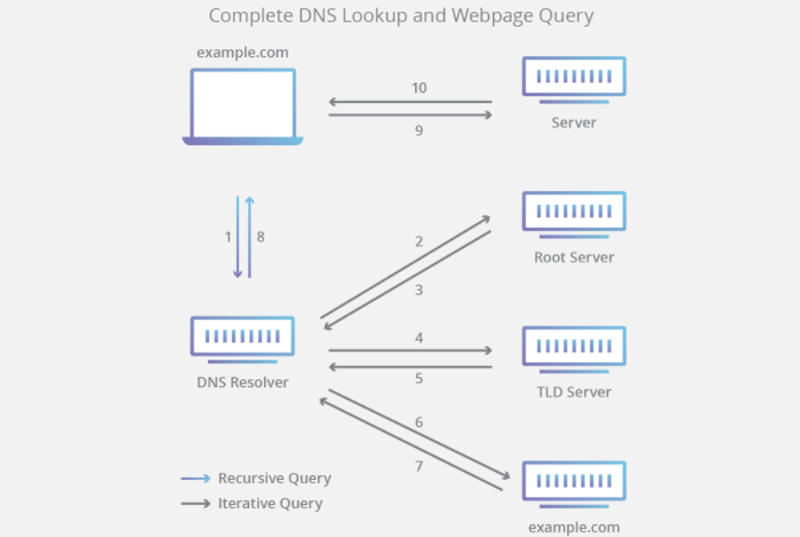

Slide 15
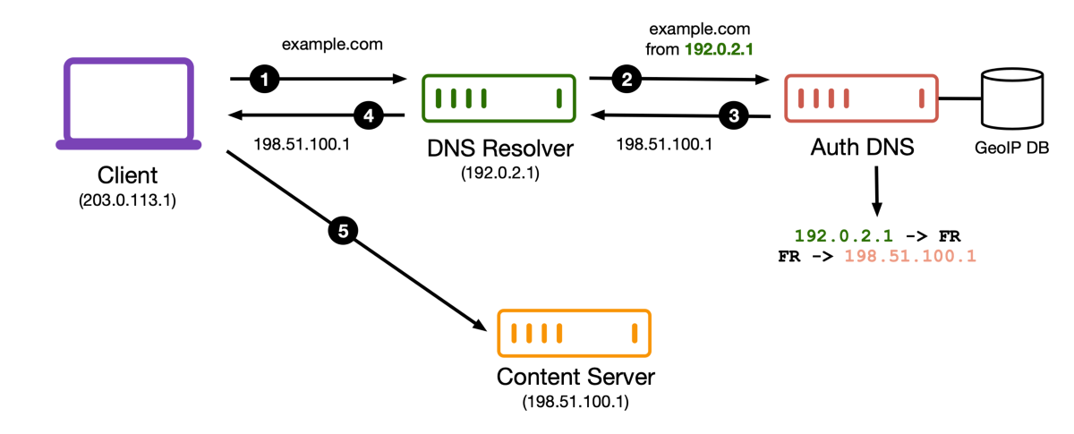
DNS Resolver
The DNS resolver is the first stop in the DNS lookup, and it is responsible for dealing with the client that made the initial request. The resolver starts the sequence of queries that ultimately leads to a URL being translated into the necessary IP address.
Note: A typical uncached DNS lookup will involve both recursive and iterative queries.
It's important to differentiate between a recursive DNS query and a recursive DNS resolver. The query refers to the request made to a DNS resolver requiring the resolution of the query. A DNS recursive resolver is the computer that accepts a recursive query and processes the response by making the necessary requests.

Slide 16
Types of DNS Queries
Recursive
Query:
In a recursive query, a DNS client requires that a DNS server (typically a DNS recursive resolver) will respond to the client with either the requested resource record or an error message if the resolver can't find the record.
Iterative Query:
In this situation the DNS client will allow a DNS server to return the best answer it can. If the queried DNS server does not have a match for the query name, it will return a referral to a DNS server authoritative for a lower level of the domain namespace. The DNS client will then make a query to the referral address. This process continues until either an error or timeout occurs.
Non-recursive Query:
Typically this will occur when a DNS resolver client queries a DNS server for a record that it has access to either because it's authoritative for the record or the record exists inside of its cache. Typically, a DNS server will cache DNS records to prevent additional bandwidth consumption and load on upstream servers.

Slide 17
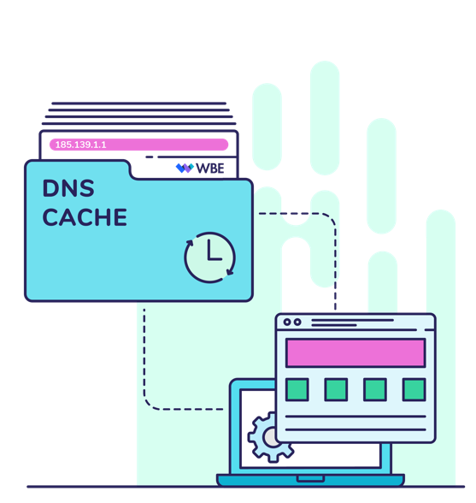
DNS Caching
A DNS cache (sometimes called a DNS resolver cache) is a temporary database, maintained by a computer's operating system, that contains records of all the recent visits and attempted visits to websites and other internet domains.
In other words, a DNS cache is just a memory of recent DNS lookups that your computer can quickly refer to when it's trying to figure out how to load a website.

Slide 18
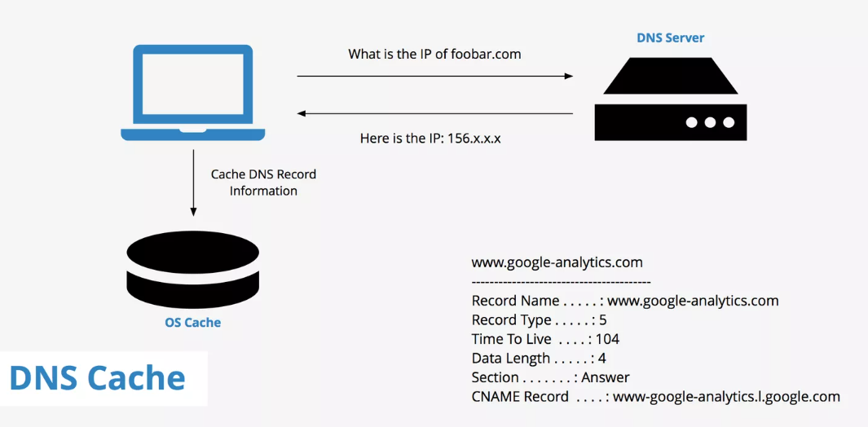

Slide 19
Free vs. Paid DNS Servers: What is the Difference?
Dynamic DNS (DDNS): A DDNS maps internet domains, matching them to IP addresses. This enables you to get into your home computer no matter where you are in the world. DDNS is different from a regular DNS because it works with changing or dynamic IP addresses, making them a good choice for home networks.
Secondary DNS: A secondary DNS name server makes sure that your domain does not go offline. It provides you with a redundancy or backup that can be accessed in the event of a complication.
Management interface: Many paid DNS servers offer users a dashboard they can use to manage their service and tweak it according to their needs.
Two-factor authentication: You can provide protection for your domain with an extra level of authentication.
More security: When you make use of a paid DNS server, you get another protective level of security. This helps shield your website from attackers.
Better, faster performance: A paid DNS server comes with a service-level agreement (SLA). Each SLA guarantees a high rate of DNS resolution, often between 99% and 100%.
Customer service: With a paid DNS server, you get the additional advantage of customer service that can answer questions and troubleshoot any issues.

Slide 20

21MCA10061
Aman Kumar Pandey

