Slide 1

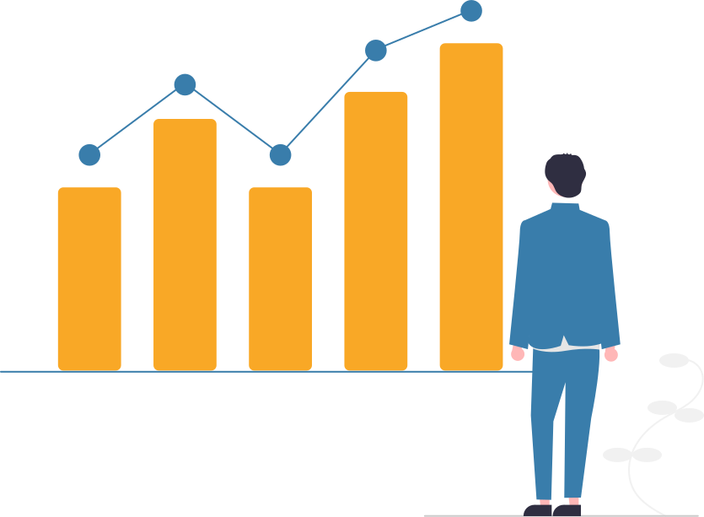
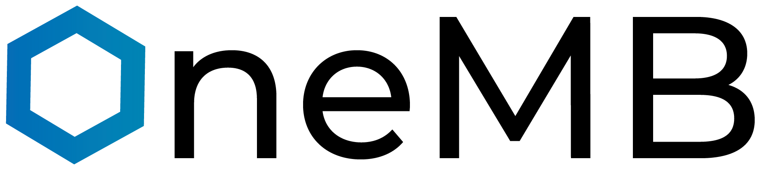
We Automate Automations..

Slide 2
TEAM MEMBERS:
O1
21MCA10059
Archana Jha
02
21MCA10061
03
Aman Kumar Pandey
Under the Guidance of :
Dr Dileep Singh Rathore
21MCA10068
Harsh Sharma
04
21MCA10072
Chirag Panchal
05
21MCA10100
Jayesh Pawar

Slide 3
01
Introduction
Proposed work and Methodology
02
03
Hardware and Software Requirements
Table of Contents
Architecture Diagram - Wireframe
04
05
Data Flow and Entity Relationship Diagrams
Modules with Explanation
06

Slide 4
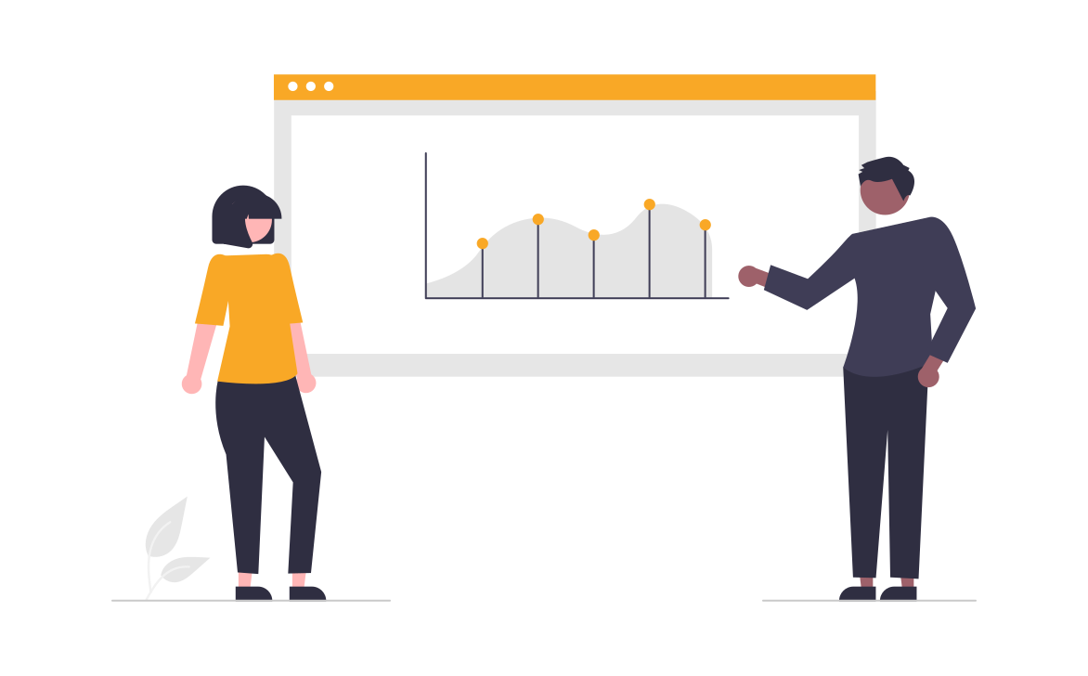
INTRODUCTION

Slide 5
1MB is a Cross platforms Data analytics tool which helps user to automate user’s ML process.
It is designed for Data Scientists and Data Scientist wannabes who can train test and deploy their ML models on the go. They can run their model at any time on any device whether it is phone tablet or desktop and in any kind of OS.
1MB uses open-source libraries like Scikit-learn, Matplotlib and seaborn to automate model building and data visualization lifecycle.
Introduction

Slide 6
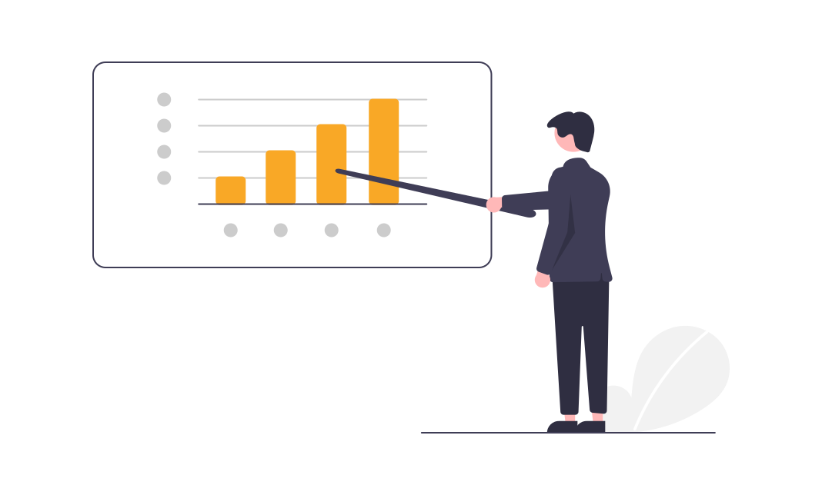
Proposed work and Methodology

Slide 7
About Project
Project Scope
Project Definition
OneMB is a Cross platforms Data Analytics Tool which helps user to automate user’s ML process.
It is designed for Data Scientists and Data Scientist wannabes who can train test and deploy their ML models on the go.
They can run their model at any time on any device whether it is phone tablet or desktop and in
any kind of OS.
Machine learning professionals, data scientists, and engineers can accelerate and manage the machine learning projects.
They can use it in their day-to-day workflows, train and build models using various Datasets, and visualize the results as per their field of expertise or area of interest.
Project Title
OneMB - We Automate Automations

Slide 8
About Data Analytics Tool
What is Data Analytics Tool?
Why Data Analytics Tool?
Data analyst tools is a term used to describe software and applications that data analysts use in order to develop and perform analytical processes that help companies to make better, informed business decisions while decreasing costs and increasing profits, help data scientists and researchers performing predictions of diseases, forecasting weather, making association relation in Web search or Internet web results and much more.
Data Analytics tool helps in improved decision making and giving more efficient operations. It analyse all the data (real-time, historical, unstructured, structured, qualitative) to identify patterns and generate insights and patterns to inform and, in some cases, automate decisions, connecting intelligence and action.

Slide 9
Working and Methodologies
Working of Present System:
Present data analytics tools are websites which enable Data scientists and ML engineers to find tools which can accelerate and automate their day-to-day workflows. Application developers use tools for building and training models, visualizing plots, comparing different models based on their accuracy.
Drawbacks of present system:
Currently, data analytics operations are supported by websites which provides data analytics tools, they requires user involvement though workstations which mandates the user to analyze in sophisticated environment to perform data pre-processing, model building, data visualization and other data analytics related activities.
Proposed System:
Developing OneMB which is a cross platform app is focusing on user's busy lifestyle, despite of that busy lifestyle user can perform data analytics on his fingertips irrespective of the geo-location, mobile devices, OS, hardware he can perform data analytics activities.
Methodology:
We have used the incremental software development life cycle model for the development of modules, as we are performing planning, designing, development and testing in the increments.

Slide 10

Architecture Diagram / Wireframe

Slide 11
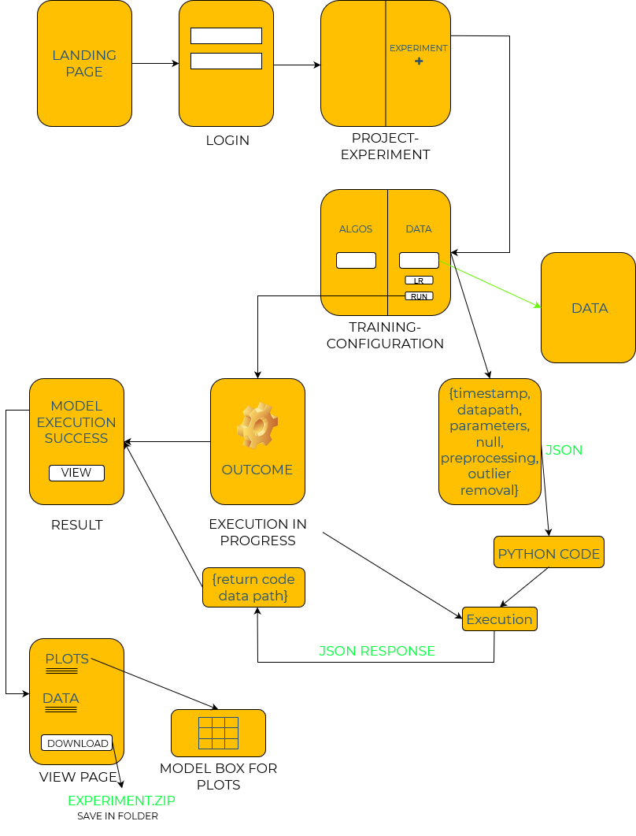
WORKFLOW
DIAGRAM

Slide 12

Data Flow and Entity Relationship Diagrams

Slide 13
Data Flow Diagrams
Entity
Connector
DFD SYMBOLS
Data Store
Process

Slide 14
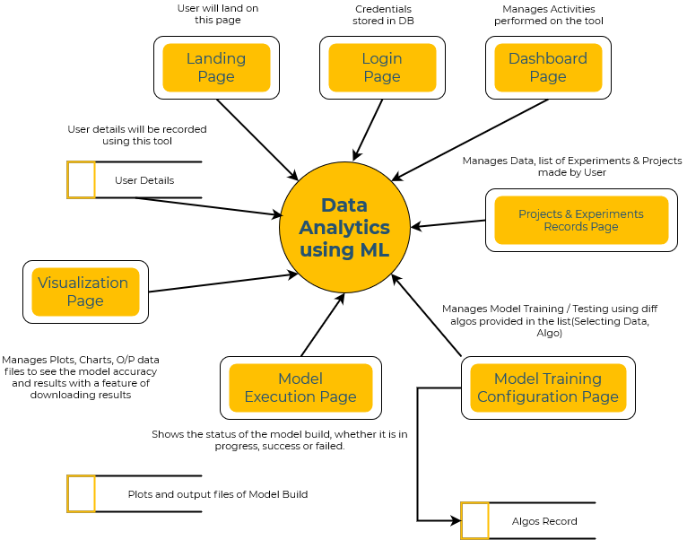
LEVEL-0
DFD

Slide 15
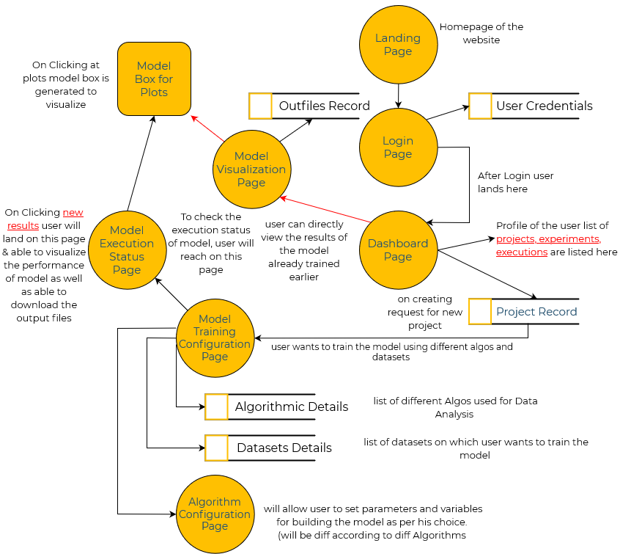
LEVEL-1
DFD

Slide 16
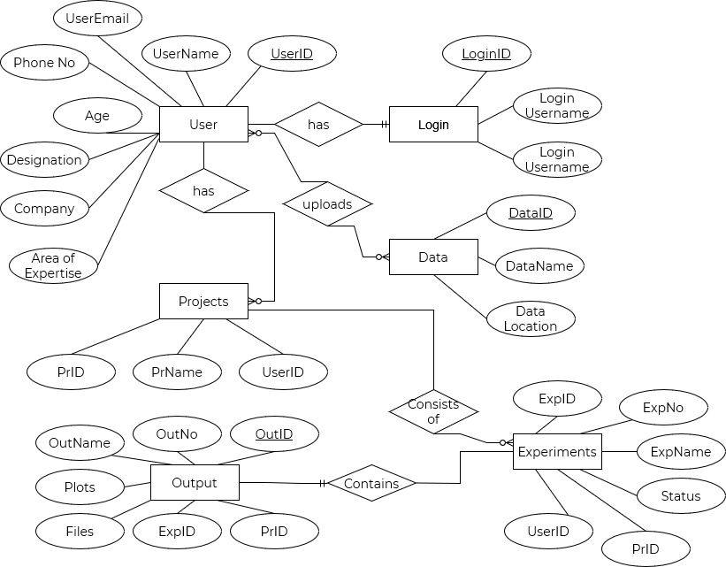
Entity Relationship
Model

Slide 17
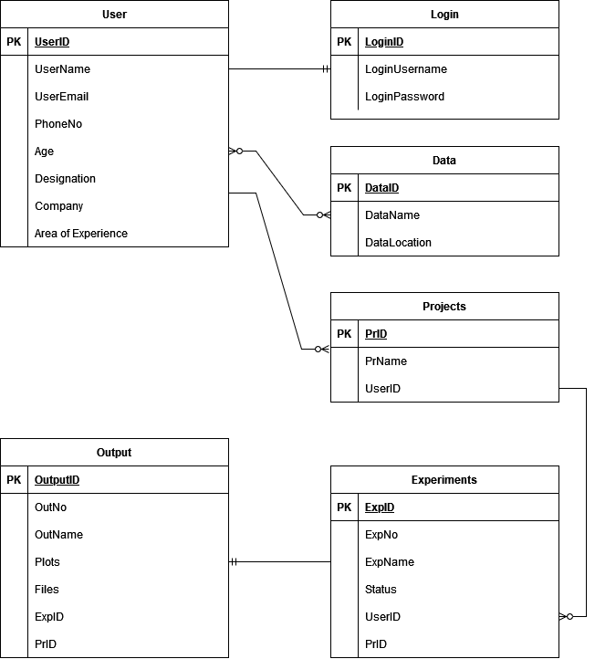
Class Diagram Model

Slide 18
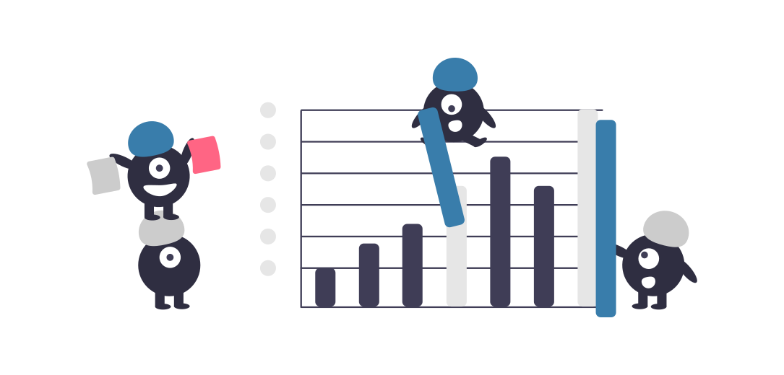
Hardware and Software Requirements

Slide 19
Hardware & Software Requirements
02
1. Technologies used
Flutter,Dart,Node.js, Express.js, mongodb, Python
software development tools.
2. Testing tools :-
Chrome, Edge, Android phones and iPhones.
Software Requirements
01
03
4. For Presentation :- Ms PowerPoint, Ms Word, and Canva.
3. Editors :- Vs Code, Spyder , Android studio.
04

Slide 20




Hardware & Software Requirements contd.
Min Req :- IOS 9 and later versions.
Min Req :- 8 Gb RAM , 100 Mb Space, Android Version 6.
Hardware Requirements
Min Req :- 8 Gb RAM , I3 10th Gen Processor, 1 Gb hard disk Space.

Slide 21
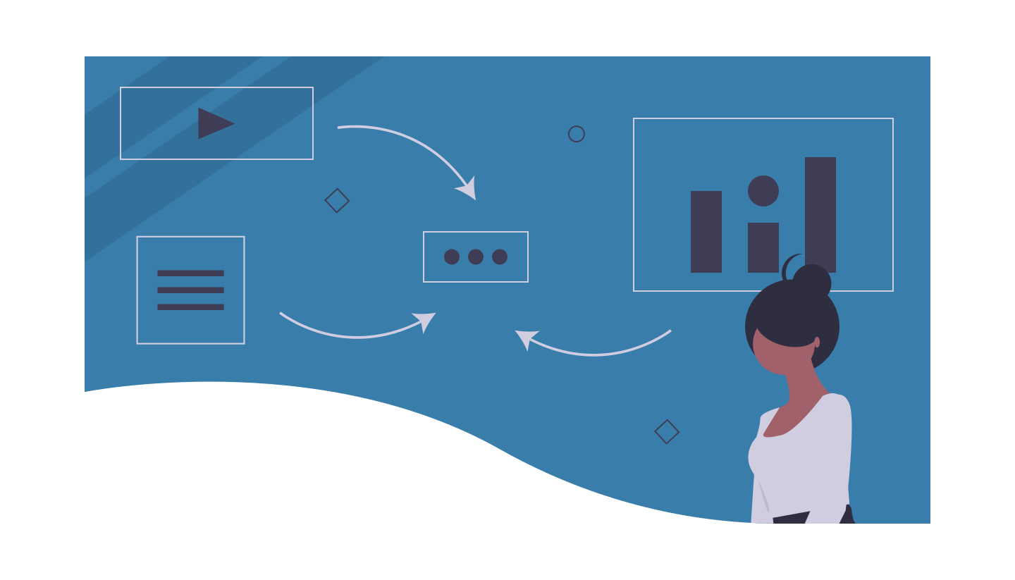
Modules Description

Slide 22
Modules
Landing Page
1
5
Model Training Configuration
User Registration and Login
2
6
Model Execution Process
3
7
User Dashboard
Status Generation
Project’s Experiment record
4
8
View and Download Results

Slide 23

1. Landing Page
This module refers to the development of static pages of the website like, Documentation of the Website, How to Use it, About the Developers etc.

Slide 24

2. User Registration and Login
User would be Able to login and New User would be able to Register on the System

Slide 25

3. User Dashboard
After Login user will be redirected to the Dashboard where all the projects that he made would be available

Slide 26

4. Project’s Experiment record
After Selecting the Particular Project User would be Able to create an Experiment

Slide 27
5. Model Training Configuration
Pre-processing
01
Classification Models
04
Visualizations
02
When the user will be able to create the experiment, he will be redirected to configuration Page where he will be able to visualize datasets, train the ML models, compare results and test the models.
Clustering
05
Regression Models
03

Slide 28
5. Model Training Configuration contd.
Preprocessing
Visualizations
Regression
Classification
Clustering
Outlier Removal
Imputation
Normalization
- Standard-Scaler
- Min-Max
- Linear Reg.
- Adaboost Reg.
-Gradient Boosting
- Support Vector
Regression
SVM Regression
Random Forest
Logistic Regression
KNN
- Histograms
- Bar plot
- Pi-chart
- Parity Plot
- Trend Plot
- Residual Plot
- Confusion Matrix
.
Model Testing Module of All Trained
All models

Slide 29
6. Model Execution Process:
After Selecting the Processes We will send the data to our Python Blackbox which will produce the results.

Slide 30

7 and 8. Status Generation and View Results
When the training done. This module will help the user to view the results after training the data.

Slide 31
Future Scopes
Developing more modules like Model Management, Optimizing Models
Adding more Modules
Improving productivity by supporting all tasks using robust cloud based services
Moving process on the Cloud
Facilitating users by supporting various model formats for Model Training.
Cross Platform Model support
Providing various visualization APIs to perform real time Data Visualization and reporting.
Adding real time data visualization

Slide 32

Thank You for Your Precious Time!!
Questions and Feedback..

