Slide 1
Online Complaint System
Parul Institute of Computer Applications
Semester 4 Project
2021-22
Team members
Aman Kumar Singh, 200510101159
Mitanshi Solanki, 200510101169
Roshani Singh, 200510101164

Slide 2
INDEX
Abstract
Tools and Technology Used
Features of Proposed System
Limitation of Proposed System
Users and their role description
System Flow Diagram
Data Dictionary
Screenshots of Development Phase 1 ( Designing of your Project)
Screenshots of Development Phase 2 ( Features Implementation)
Screenshots of Development Phase 3 ( Features Implementation)
Conclusion
Future Enhancement
References

Slide 3
Abstract
This Online Complaint System is created for our betterment of Surroundings.
By this System User’s can upload the Incident media files like Video’s, Photo’s and Audio’s of any bad incedient’s of robbery, murder, rape, Consumer Cheating’s etc.
In this System user are always unknown from everyone, which helps user by maintaining it’s privacy.
This System will help Indian Goverment and Indian Citizen by giving Punishment to those People’s who are acused but without proof, and it’ll also help in reducing crime’s.
This System forward the user’s uploaded media to the Central Governent, Central Media and State Goverment, State Media on the Mail ID of the corrosponding Sector.

Slide 4
Comparison of new system with existing system
In the previous System, there is no any features like sending mail to the Required Government Sector and Media Sector.
This System provide many option’s to the user’s for upload incident media.

Slide 5
Technology and HW, SW Requirement Specification
Programming language is used to proposed this System is Django (framework of Python) and MySql server.
Code is implemented in Microsoft Visual Studio Code.
Hardware Requirements:
Processor – i3 or more
Storage – 50 GB or more
Ram – 2 GB or more
Software Requirements:
Windows 8 or any Linux Distro or MACOS
PHP, Apache Server and MySQL Server
Any IDE (Code Editor like VS Code) and updated Browser

Slide 6
Modules and its short description
Admin Module: Admin can manage user, and he can also block user if user will upload some unwanted things in the System. Admin having the only access to verify all media which is upload by the User’s in the System, and when Admin will approve that media then it’ll forwarded.
User’s Media: User have to first register himself in the System by simply his Name, Email ID or Mobile Number, after that System will automatically generate a USERID for the User and then user have to set password. Now user can easily use all the features of the System.

Slide 7
Features of Proposed System
Secure Login
Dashboard
Submit Complaints/Queries
View Complaints History
Update Account Details
Manage Complaints
View Complaint Details
Update Complaint Status
View List of Users
Manage Category
Manage Sub-Category
Manage State
View Users Login Logs
Update Account Password

Slide 8
Limitations of proposed system
In this System there is no any automation's for checking the media.
There is not a good UI in this System, that loose interest of user’s to use this System.
System is very slow due to use of low quality server.
Thus this system is online so user have to a good internet connection to use this System.

Slide 9
Users and their role description
Once User register himself/herself in the System, he having a Option to upload media and after that User have to specify incident place by which local police can easily verify the incident and arrest the accused.
If user’s will take this serious then it’ll really brings a lot of change in the Society.
If user’s upload unnecessary media in the System then that ID will be Blocked forever.
User’s may be gifted by the Government or the Police for his work in a Private manner.

Slide 10
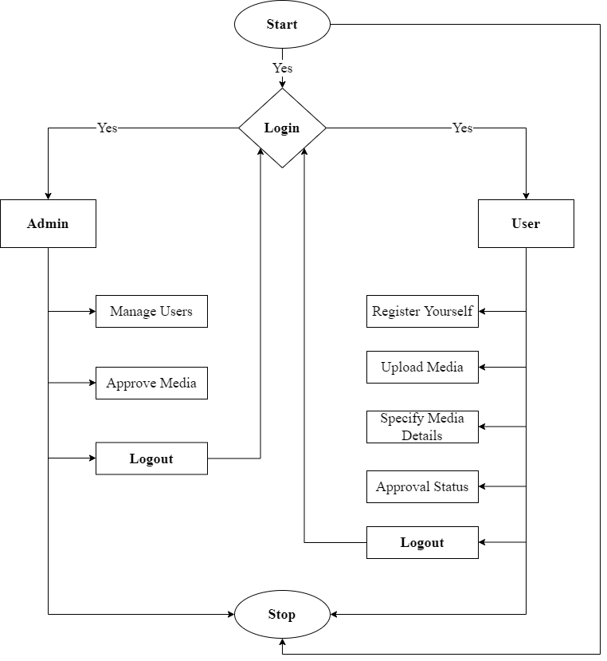
System Flow Diagram

Slide 11
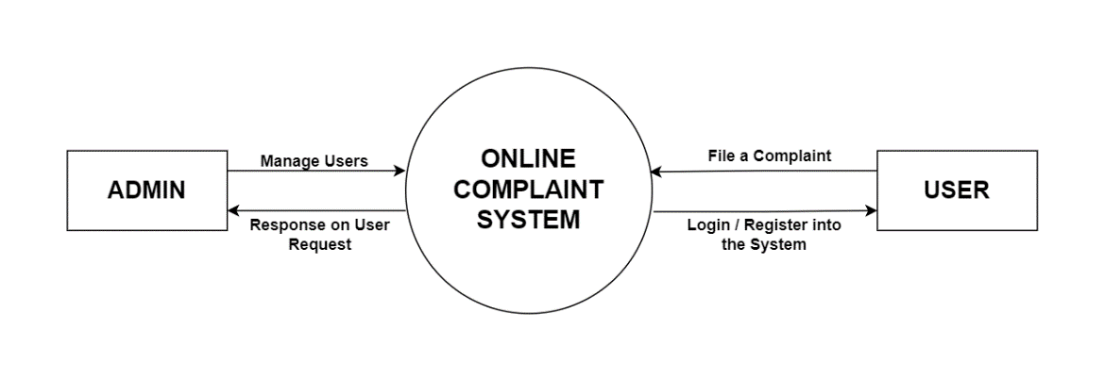
Data flow diagram (level - 0)

Slide 12
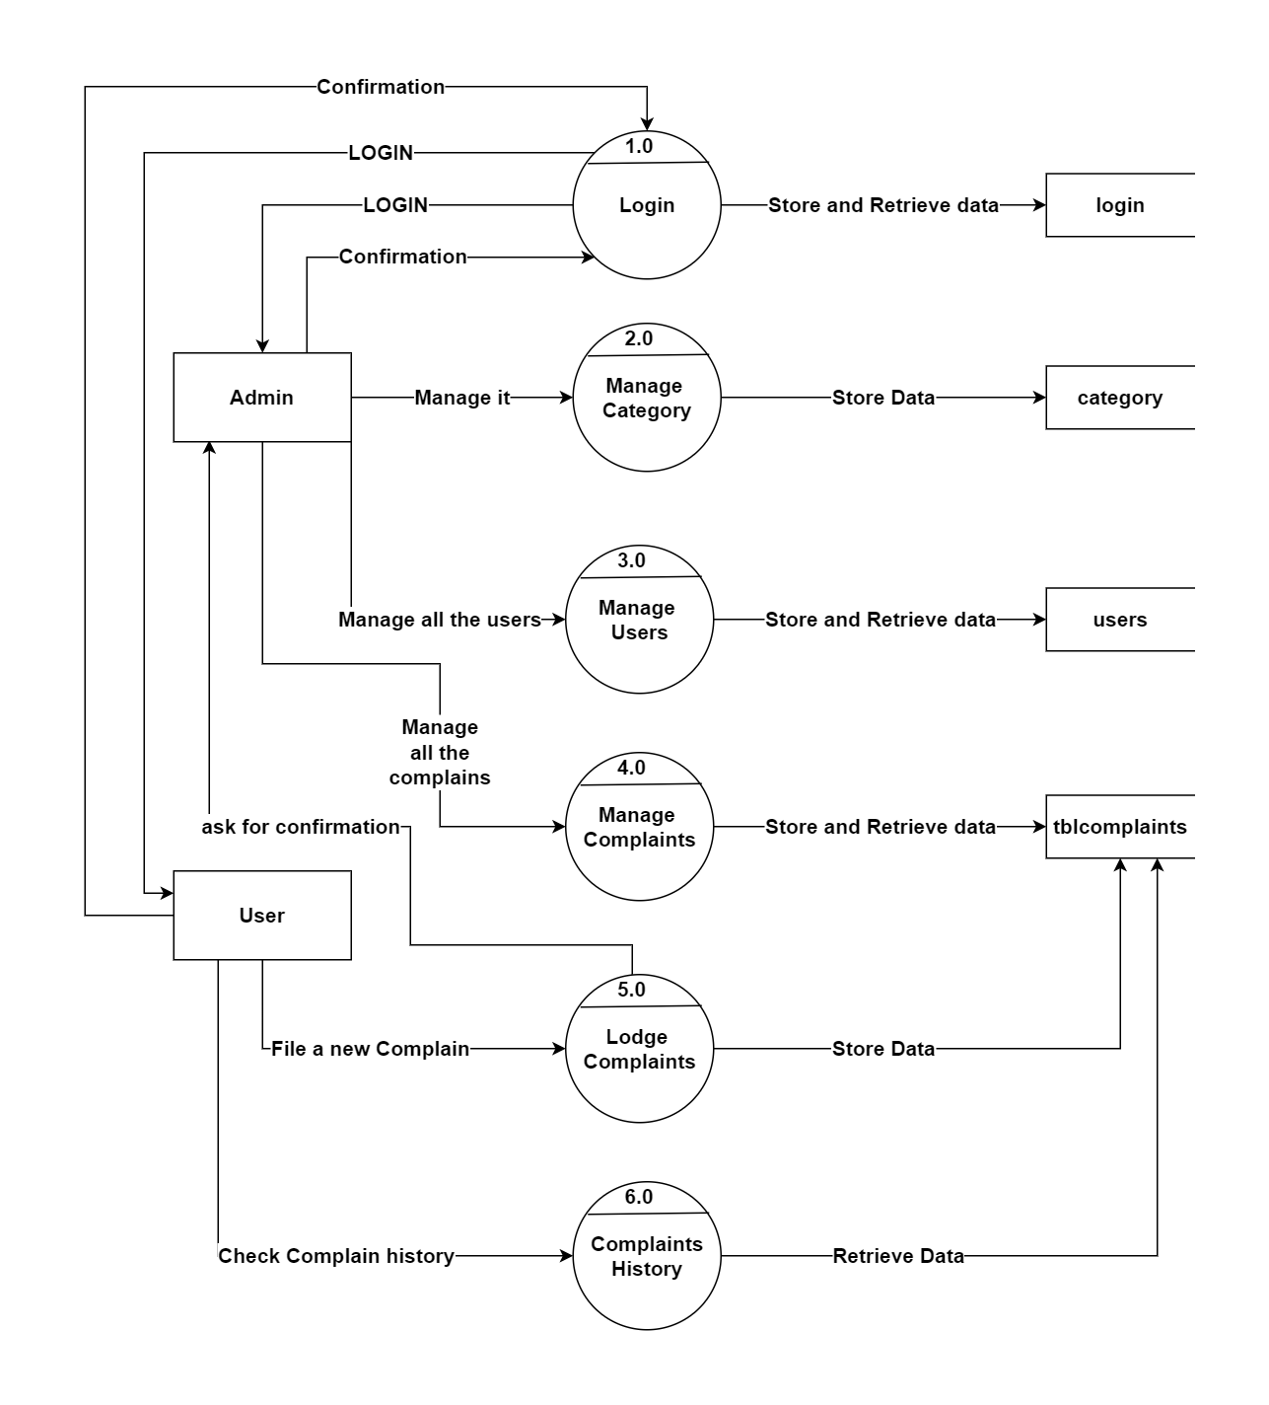
Data flow diagram (level - 1)

Slide 13
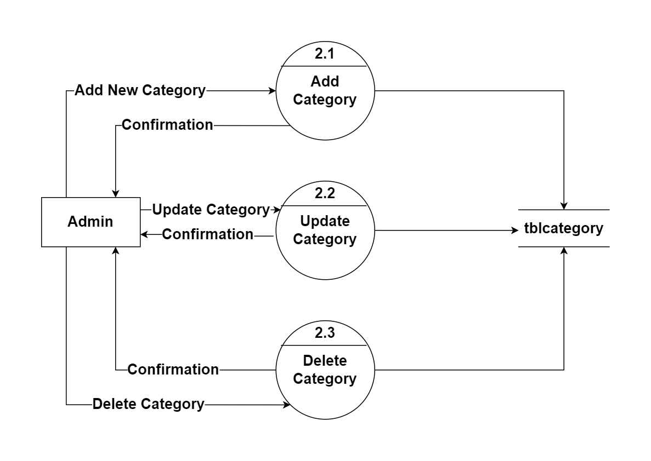
Data flow diagram (level - 2)

Slide 14
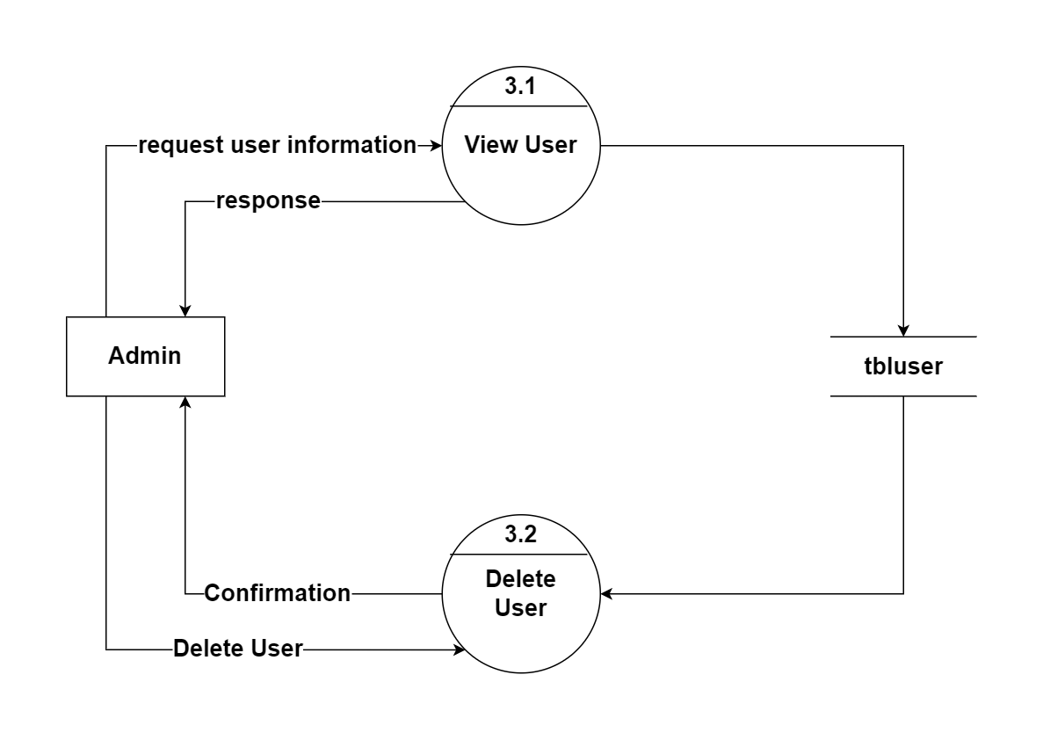
Data flow diagram (level - 2)

Slide 15
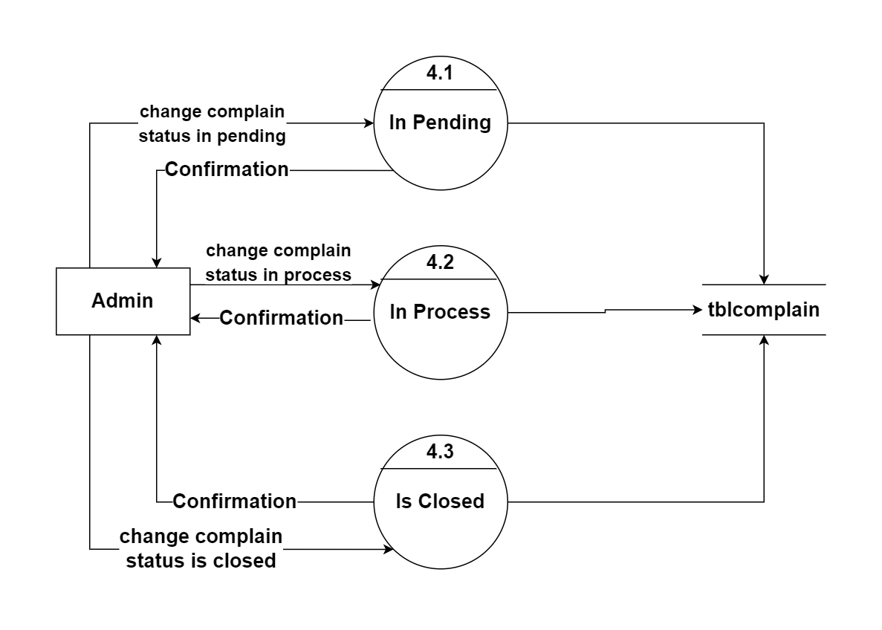
Data flow diagram (level - 2)

Slide 16
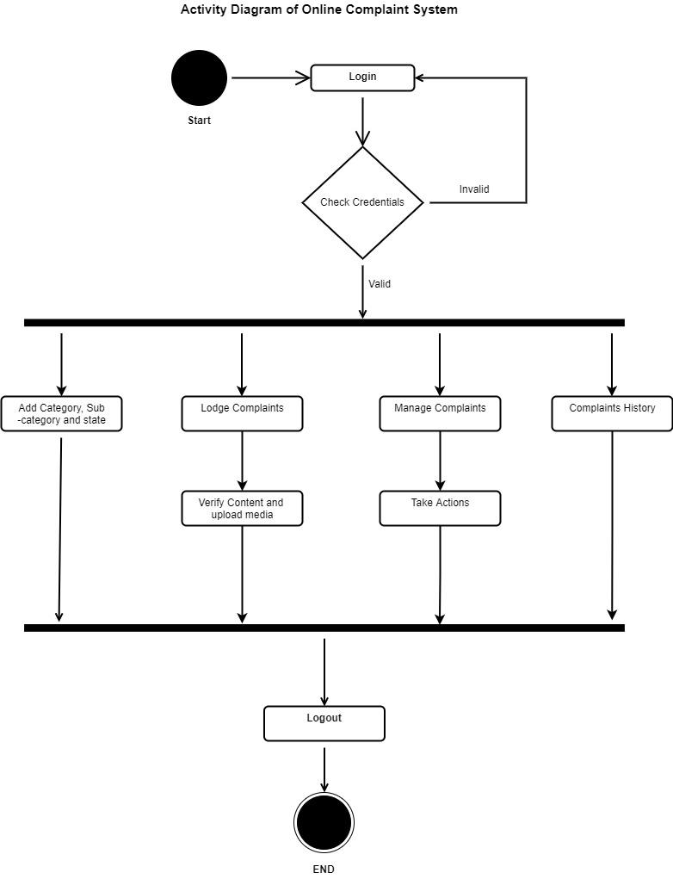
Activity diagram

Slide 17
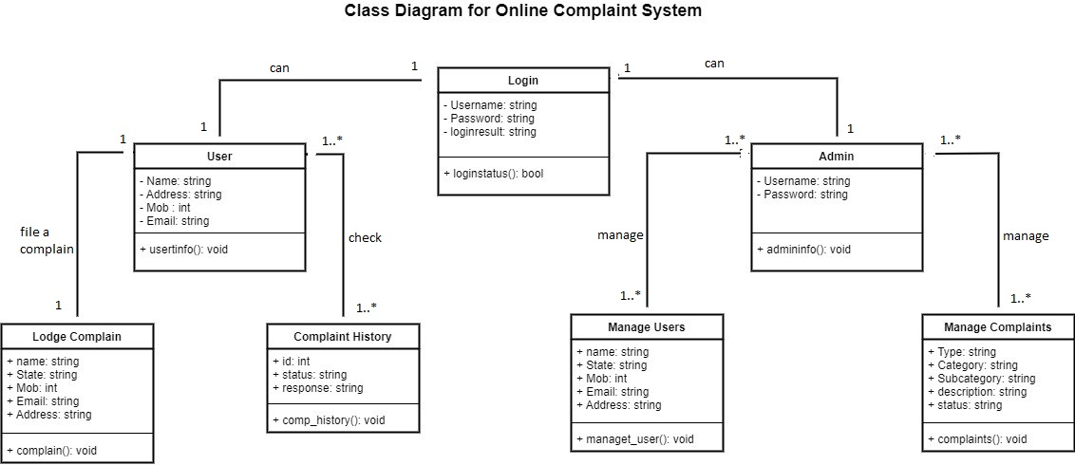
Class diagram

Slide 18
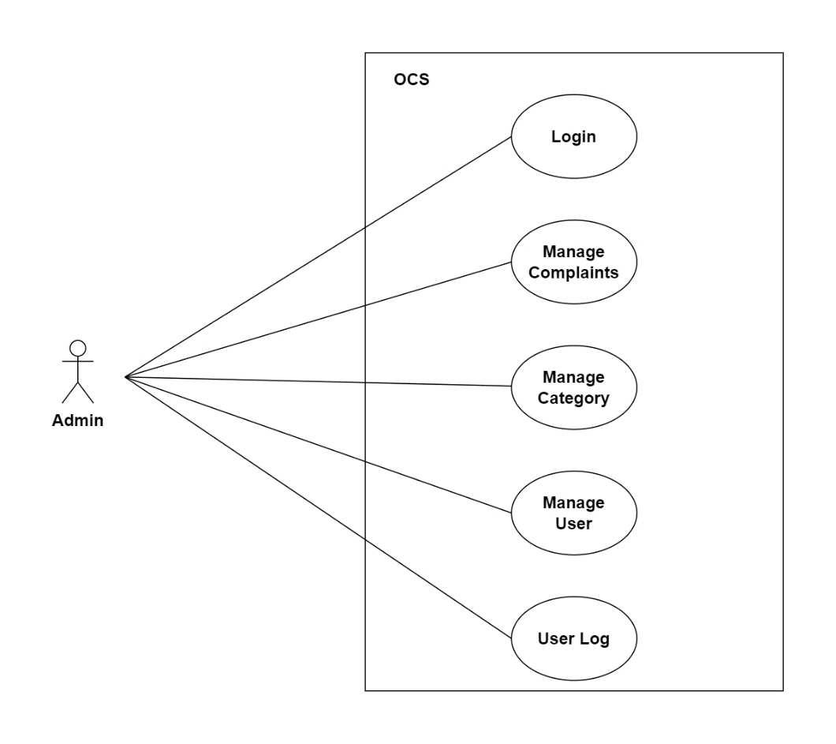
Use case diagram

Slide 19
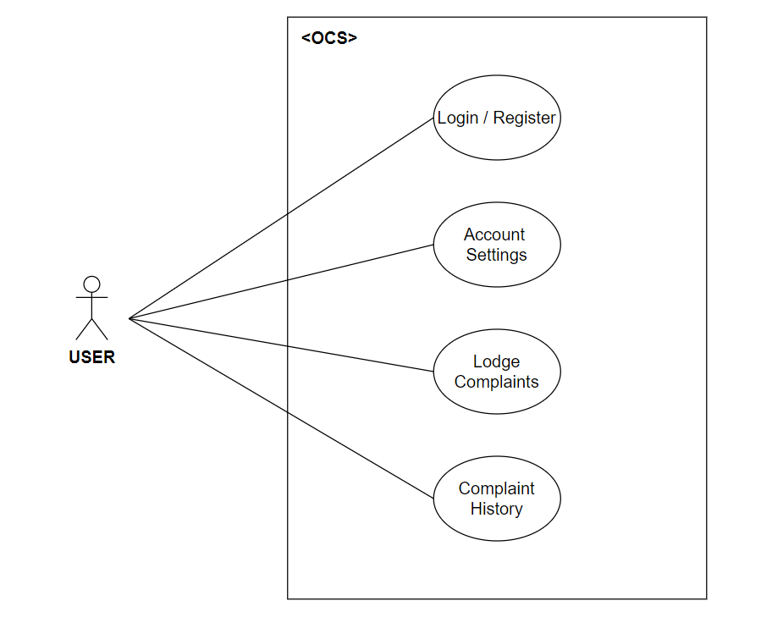
Use case diagram

Slide 20
Data Dictionary
Login Table
Sr. No. | Field Name | Data Type | Size | Constraint | Description | Example
1. | Username | varchar | 20 | Primary Key | Unique id of Username | admin
2. | Password | varchar | 20 |  | Unique id of Password | *****

Slide 21
Data Dictionary
Registration Table
Sr. No. | Field Name | Data Type | Size | Constraint | Description | Example
01 | Name | Varchar | 30 |  | Name of the User | Aman Singh
02 | Username | Varchar | 20 | Primary Key | Unique Username | Amakrs21
03 | Password | Varchar | 20 |  | Valid password | ********
04 | Conf_passw | Varchar | 20 |  | Valid confirm password | Aman1234$@
05 | Mob_no | Integer | 12 |  | User Mobile Number | 9876543210
06 | Email_ID | Varchar | 25 |  | User Email ID | abc@mail.com

Slide 22
Data Dictionary
Complaint Table
Sr. No. | Field Name | Data Type | Size | Constraint | Description | Example
1. | Complain ID | int | 10 | Primary Key | Unique id of every complain | 0001
2. | Category | varchar | 20 | Foreign Key | Category of the Complain | Cybercrime
3. | Sub-Category | varchar | 20 |  | Sub-category of the Complain | Online Scams
4. | Complaint Type | varchar | 100 |  | Type of Complain | Money Fraud
5. | Description | varchar | 500 |  | Description of the Complaint in Details. | I have been cheated in Online Scam.

Slide 23
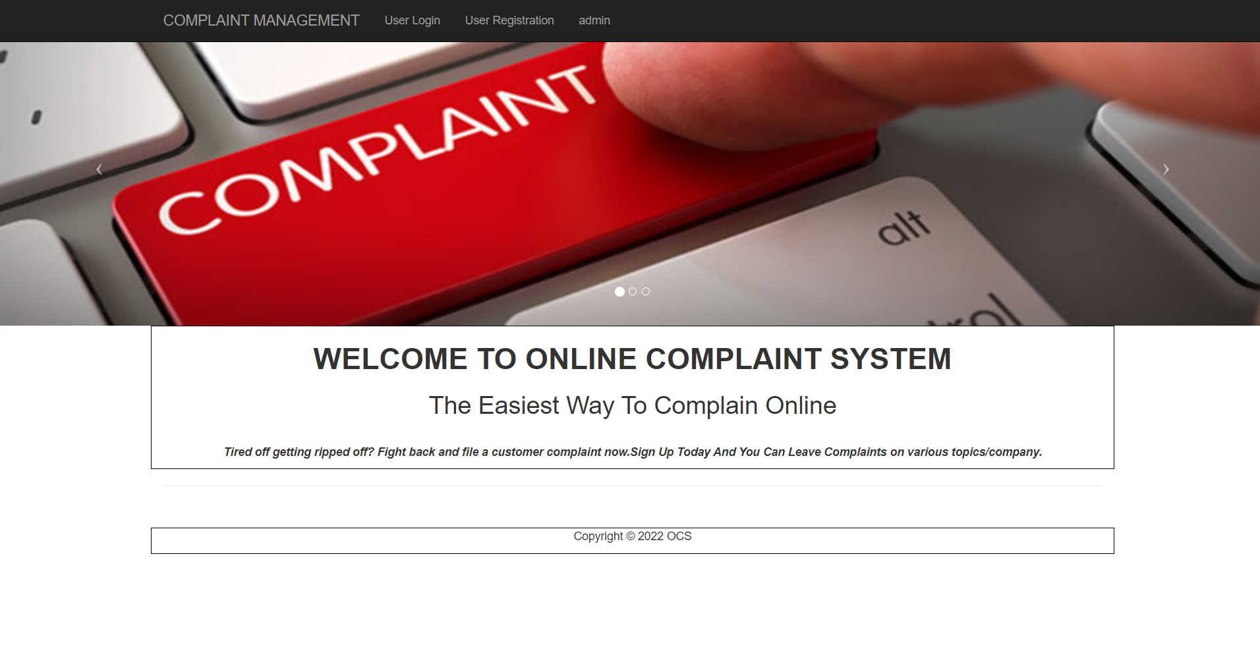
Screenshots of Development Phase 1 ( Designing of your Project)
Main Homepage Design

Slide 24
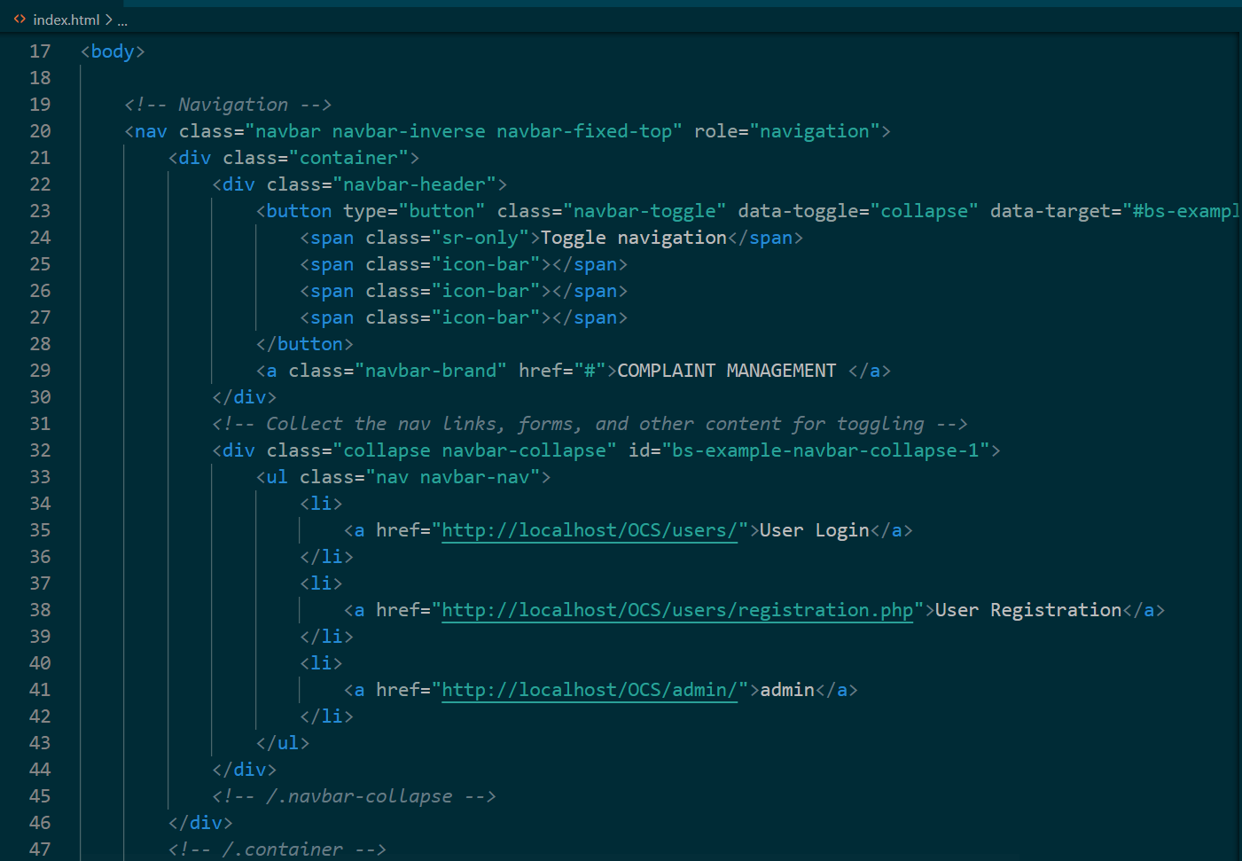
Screenshots of Development Phase 1 ( Designing of your Project)
Code for Main Homepage Design

Slide 25
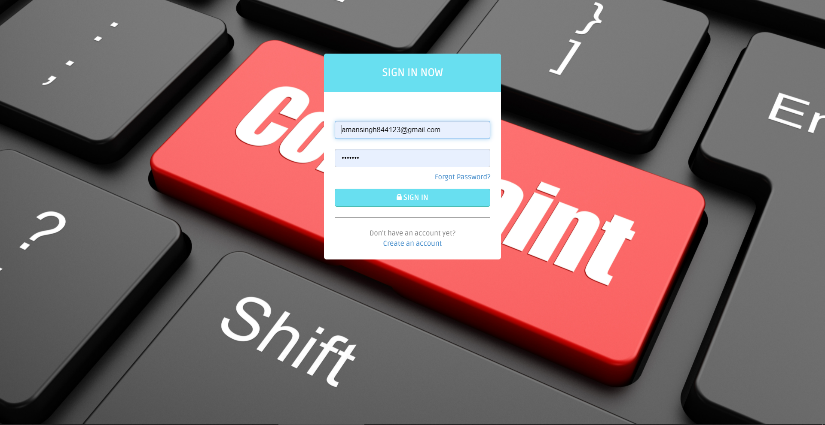
Screenshots of Development Phase 1 ( Designing of your Project)
Login Design

Slide 26
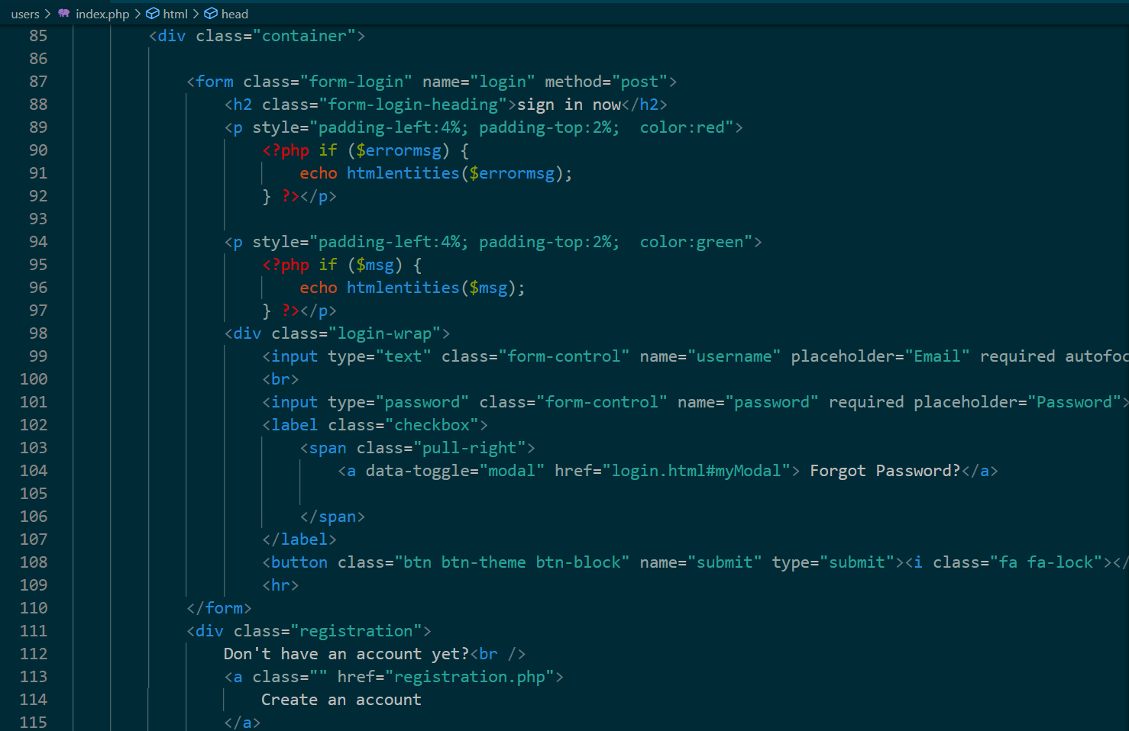
Screenshots of Development Phase 1 ( Designing of your Project)
Code for Login Design

Slide 27
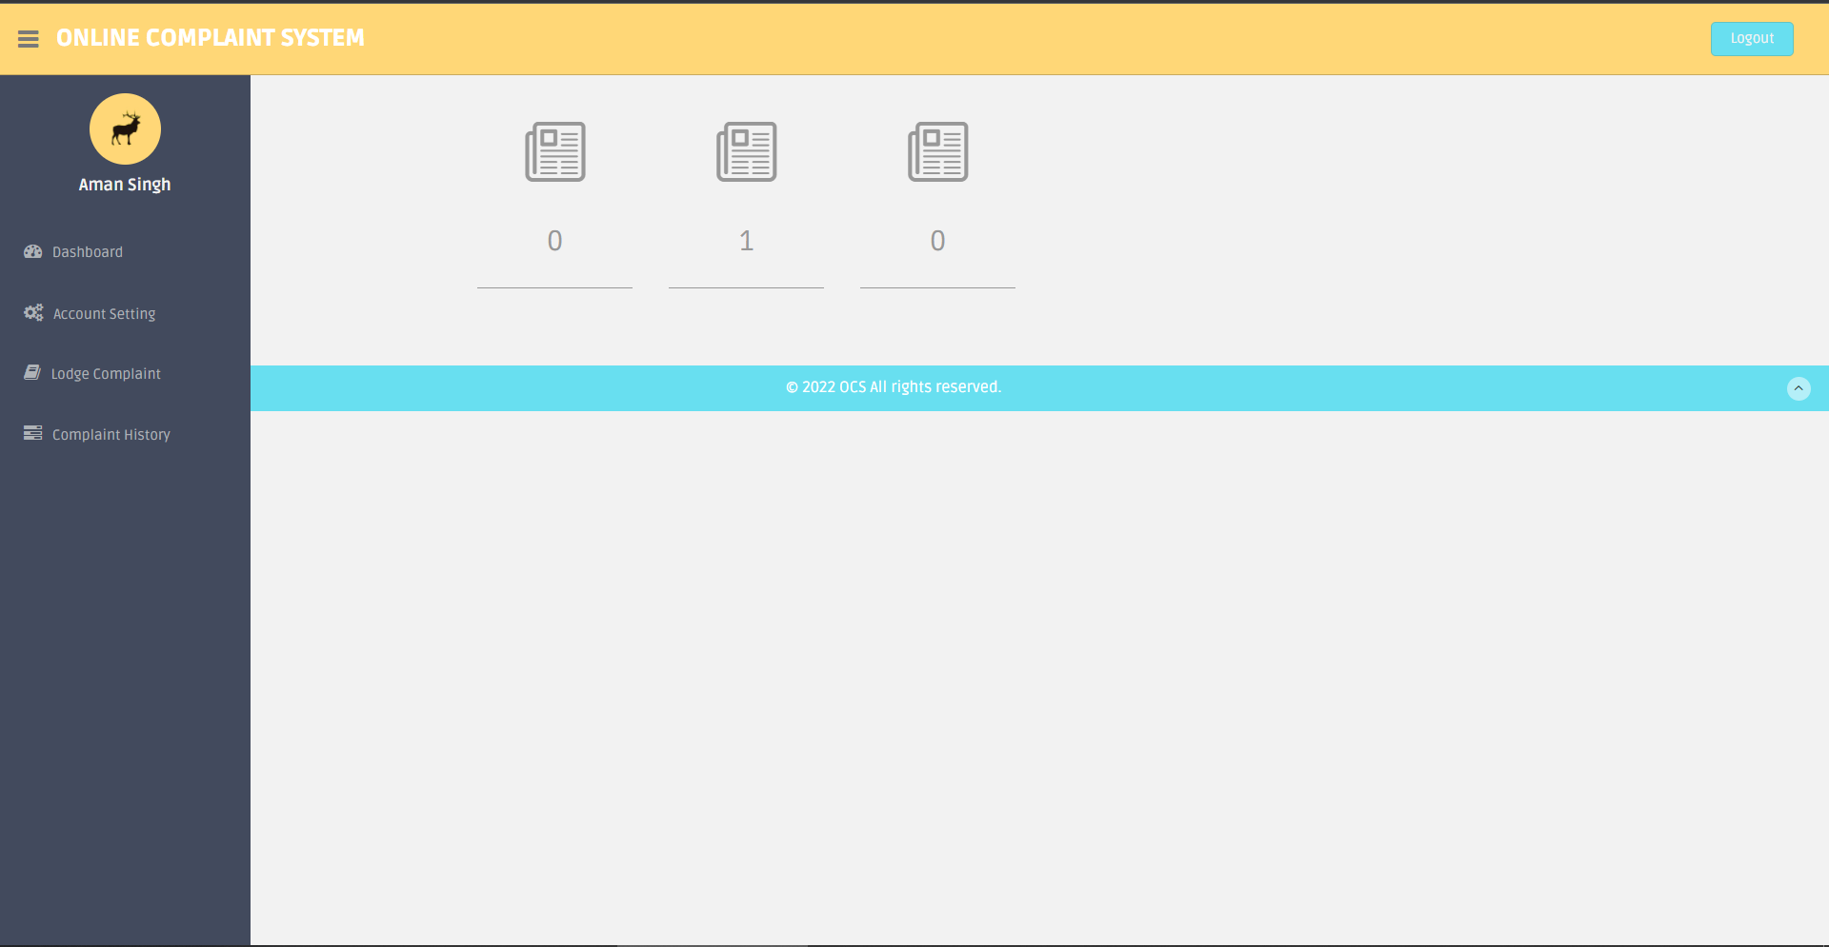
Screenshots of Development Phase 2 ( Features Implementation)
User Dashboard

Slide 28
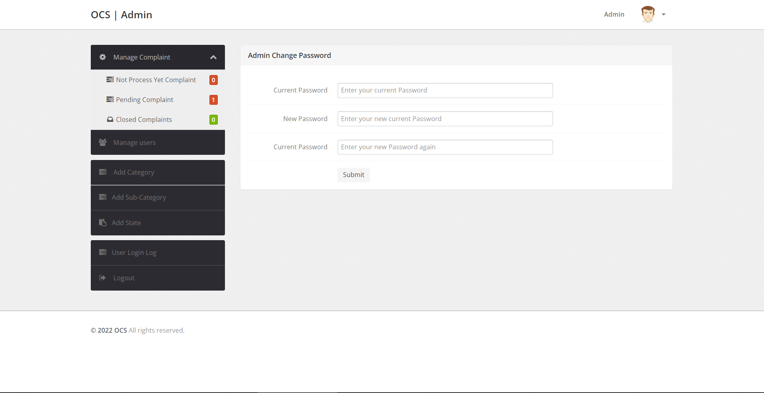
Screenshots of Development Phase 2 ( Features Implementation)
Admin Dashboard

Slide 29
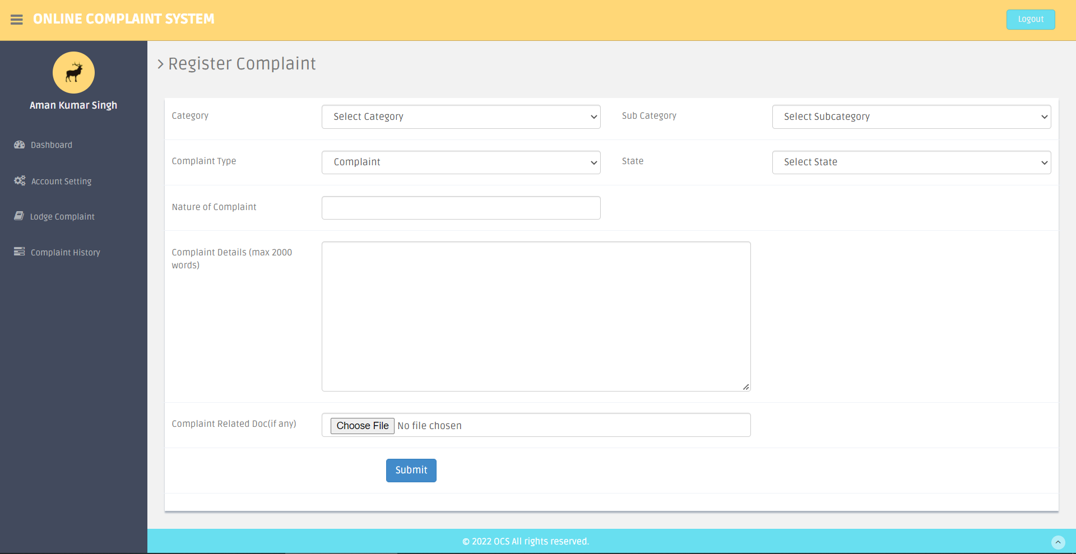
Screenshots of Development Phase 3 ( Features Implementation)
Lodge Complaint

Slide 30
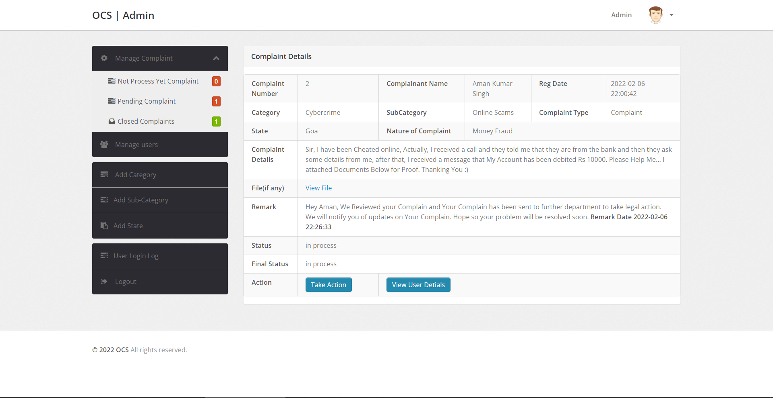
Screenshots of Development Phase 3 ( Features Implementation)
Manage Complaints

Slide 31
Conclusion
So, finally we built a working website in which user can easily register in it, and they can easily use all the features which is provided by the system.
This System is fully secured, because on each login user required password and their login activity is saved along with their IP address.
This system currently works manually using admin, for verify the Complaints of the User and send response on their complain.

Slide 32
Future Enhancement
Firstly, we will add email ids of Government and Media (Local and National Media), so Complain will also being public and user get a better and fast solution.
We will add automation using Machine Learning techniques that reduce the burden of admin to always verify each complain of the user.
After we will improve the UI of this System that will give a better experience to the User’s.

Slide 33
References
Book:
PHP in Advanced
SQL Beginners Guide
Other Resources:
Some Journals
YouTube
Website:
https://www.php.net/docs.php
https://dev.mysql.com/doc/
https://github.com/
https://stackoverflow.com/
https://www.quora.com/
https://docs.microsoft.com/en-us
https://www.geeksforgeeks.org/
https://www.khanacademy.org/

Slide 34
Thank you !!!

