Slide 1
flight booking system
Parul Institute of Computer Applications
Semester 2 Project -1
2020-21
Team members
1. 200510101159 Aman Kumar Singh, C
2. 200510101164 Roshani Singh, C
3. 200510101169 Mitanshi Solanki, C

Slide 2
INDEX
Abstract
Tools and Technology Used
Features of Proposed System
Limitation of Proposed System
Users and their role description
System Flow Diagram
Data Dictionary
Screenshots of Development Phase 1 ( Designing of your Project)
Screenshots of Development Phase 2 ( Features Implementation)
Screenshots of Development Phase 3 ( Features Implementation)

Slide 3
Abstract
In order to book a flight, the user has to enter his/her destination, boarding, last 4 digits of citizenship number, class, day of travel and flight time.
The user can search for flights by providing boarding, destination and day of travel.
Likewise, to cancel the flight, the user has to enter his/her last 4 digits of citizenship number, class and boarding.
This simple GUI application, airline booking system that uses external file (SQLite) as a database to store the user’s data permanently.

Slide 4
Tools and Technology Used
Programming language used in making this system is Python and MSSQL.
Code is implemented in Visual Studio Code.
Hardware Requirement:
Processor – Dual Core
Hard Disk – 50 GB
Memory – 1GB RAM or more
Software Requirement:
Windows 7 or more
Python Interpreter
Any IDE (Code Editor)
MSSQL

Slide 5
Features of Proposed System
System having some Guidelines that will help user to use this system.
System helps the user in searching of flights, cancelation and booking of flights of his/her choices.
A passenger can choose their class(Economy, Premium economy , Business, and first class).
He/she can choose the day of travel according to their convenience.
This system is efficient and a big time saver for the users.

Slide 6
Limitation of Proposed System
Inability of passengers to select their preferred seat(s) from the reservation system.
No option of passengers printing their boarding pass from the existing system.
Non-notification of passengers of flight cancellation or delay.
Passengers don‘t have access to aircraft maintenance report to ease the fears associated with air travel and its disasters

Slide 7
Users and their role description
Admin:
Admin can add/delete/modify Flight Info, Customer Info, Scheduled Info, View Cancelled and Reserved tickets
Client:
Client can view flight details and they can also book ticket.
User:
User can view Homepage, Scheduled Info, Journey Details.

Slide 8
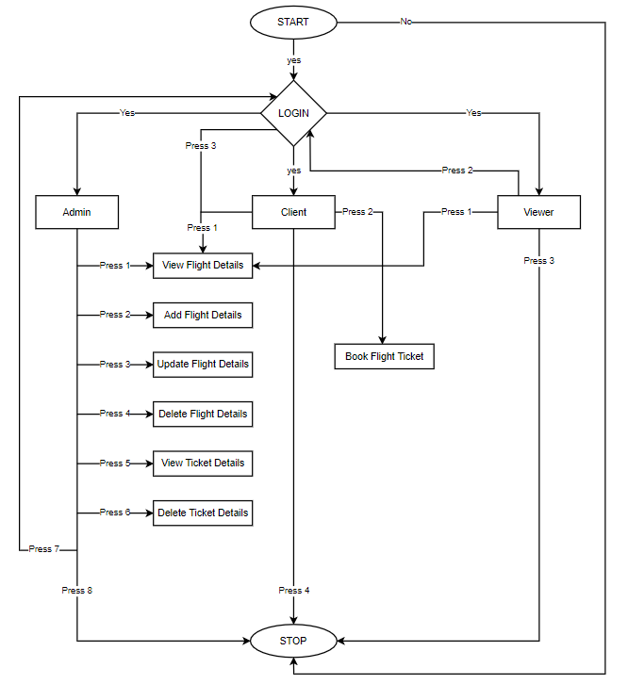
System Flow Diagram

Slide 9
Data Dictionary
Login Table
In this Table Program will ask the User to input correct Username and Password for Login into the System.
Sr. No. | Field Name | Data Type | Size | Constraint | Description | Example
1. | Username | varchar | 10 | Primary Key | Unique id of Username | admin
2. | Password | varchar | 10 |  | Unique id of Password | admin

Slide 10
Data Dictionary
2. Add Flight Details
In this Table Program will ask for Flight ID, Destination Point and Departure Point for Add Flight Details in the System.
Sr. No. | Field Name | Data Type | Size | Constraint | Description | Example
1. | Flight ID | Varchar | 10 | Primary Key | Unique flight ID | AIRINDIA101
2. | Departure Point | Varchar | 10 |  | It will ask for Departure Point | Pune
3. | Destination Point | Varchar | 10 |  | It will ask for Destination Point | Vadodara

Slide 11
Data Dictionary
3. Update Flight Details
In this Table Program will ask for Flight ID, New Destination Point and New Departure Point for Updating Existing Flight Details.
Sr. No. | Field Name | Data Type | Size | Constraint | Description | Example
1. | Flight_ID | Varchar | 10 | Primary Key | Unique existing flight ID | AIRINDIA101
2. | New Departure Point | Varchar | 10 |  | It will replace old Departure Point | DUBAI
3. | New Destination Point | Varchar | 10 |  | It replace old Destination Point | MUMBAI

Slide 12
Data Dictionary
4. Delete Flight Details
In this Table Program will ask for Flight ID which should be already exist in the system for Delete that Flight Details from the System.
Sr. No. | Field Name | Data Type | Size | Constraint | Description | Example
1. | Flight ID | Varchar | 10 | Primary Key | Unique flight ID that exists in System | AIRINDIA101

Slide 13
Data Dictionary
5. Book Flight Ticket
In this Table Program will ask for some details to Book your Ticket then give user a Confirmation message that your Ticket is Booked Successfully.
Sr. No. | Field Name | Data Type | Size | Constraint | Description | Example
1. | Choose Class | Integer | 1 |  | Some options are given and User have to choose one | Press 4 4
2. | Phone Number | Integer | 10 |  | It will ask for 10 digit Mobile Number | 1234567890
3. | Name | Varchar | 30 |  | It will ask for Person Name | The Rock
4. | Departure Point | Varchar | 10 |  | It will ask for point where Person will take his/her Flight. | New York

Slide 14
Data Dictionary
5. | Destination Point | Varchar | 10 |  | It will ask for point where Person will have to GO. | Dubai
6. | Age | Integer | 3 |  | It will ask for Person Age. | 18
7. | Last 4-digit of Aadhar Number | Integer | 4 |  | It will ask for Person Aadhar Number (Last 4-digit) | 5489

Slide 15
Data Dictionary
6. Delete Flight Ticket
In this Table Program will ask Registered Phone Number and Name on Ticket should be already exist in the system for Delete that Flight Details from the System.
Sr. No. | Field Name | Data Type | Size | Constraint | Description | Example
1. | Mobile Number | Integer | 10 |  | Existing Phone Number that is already Booked. | 1234567890
2. | Name | Varchar | 30 |  | Name which is registered with Phone Number mentioned above. | The Rock

Slide 16
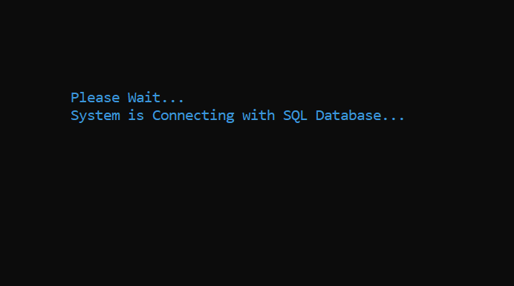
Screenshots of Development Phase 1 ( Designing of your Project)

Slide 17
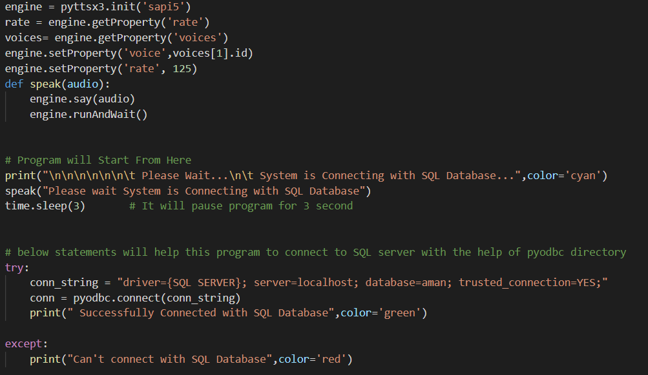
Screenshots of Development Phase 1 ( Designing of your Project)

Slide 18
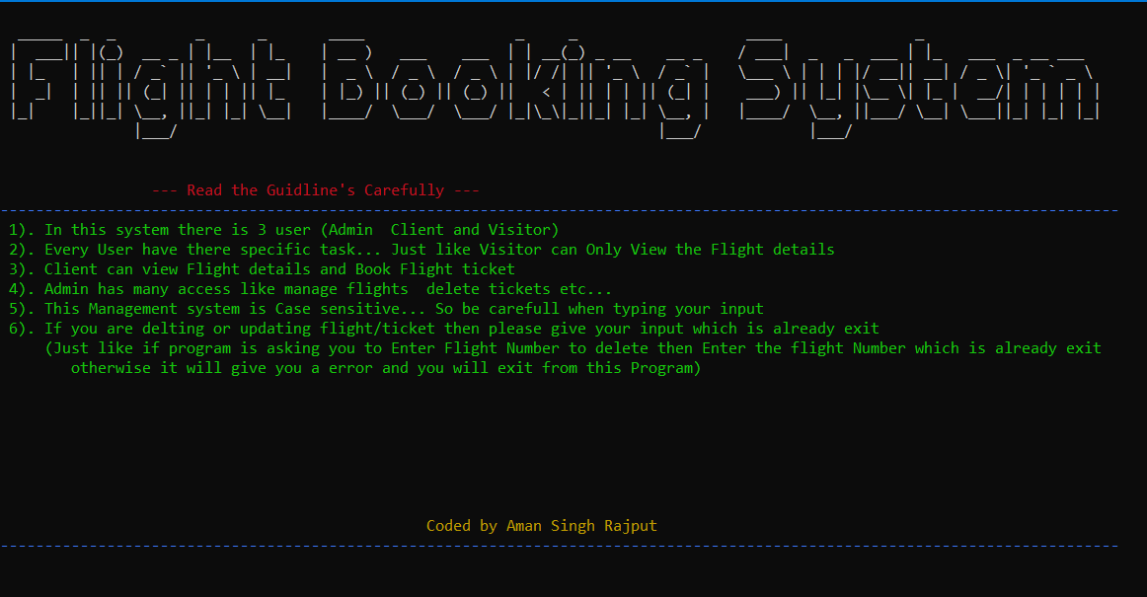
Screenshots of Development Phase 1 ( Designing of your Project)

Slide 19
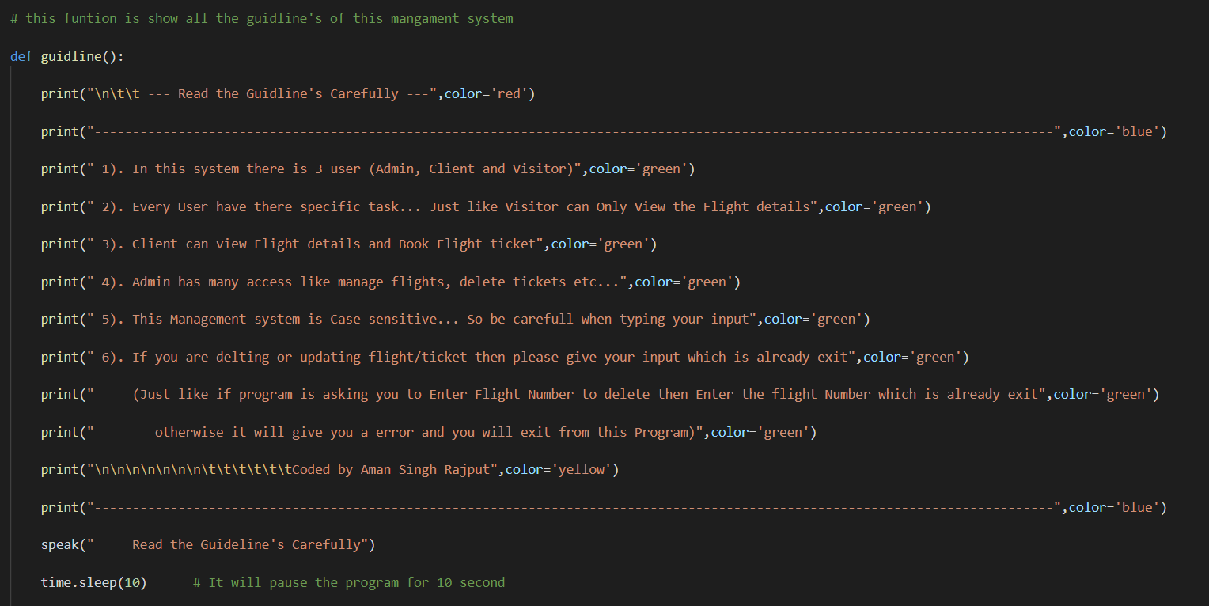
Screenshots of Development Phase 1 ( Designing of your Project)

Slide 20
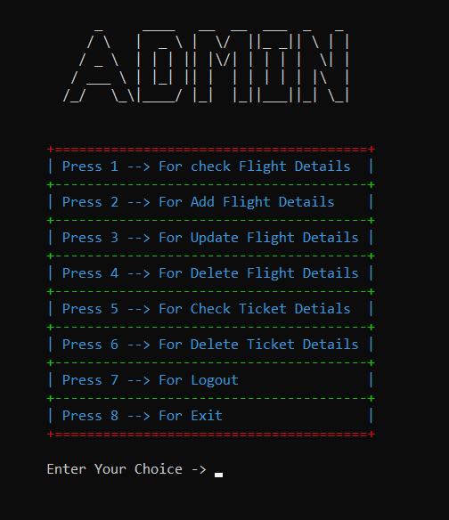
Screenshots of Development Phase 2 ( Features Implementation)

Slide 21
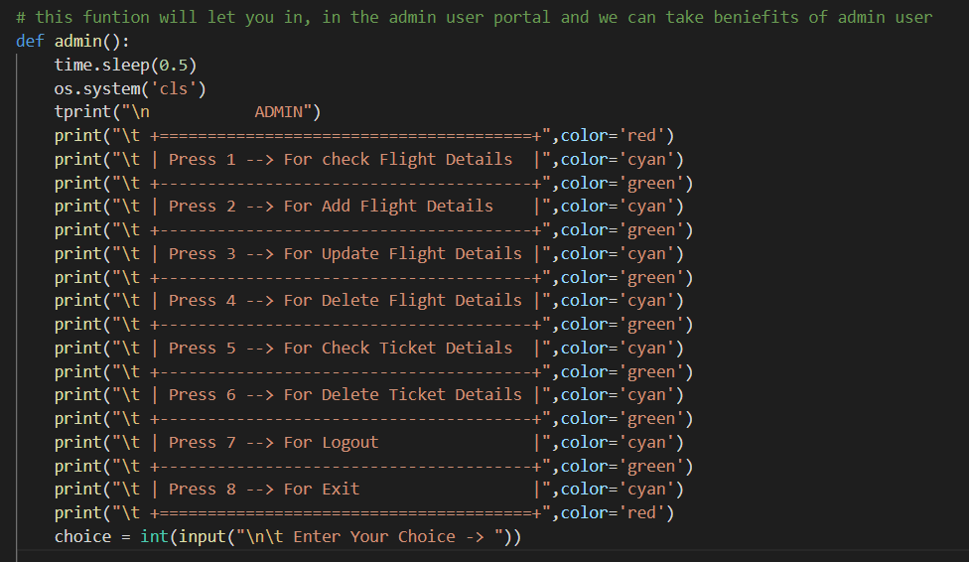
Screenshots of Development Phase 3 ( Designing of your Project)

Slide 22
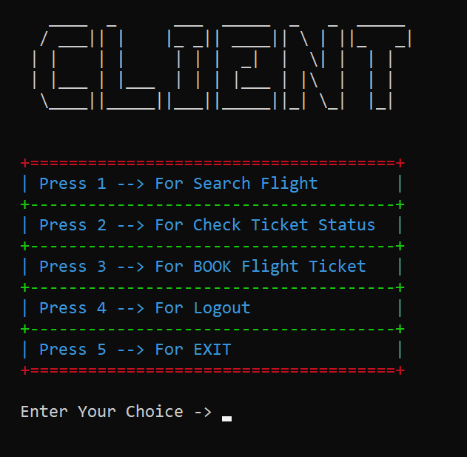
Screenshots of Development Phase 2 ( Features Implementation)

Slide 23
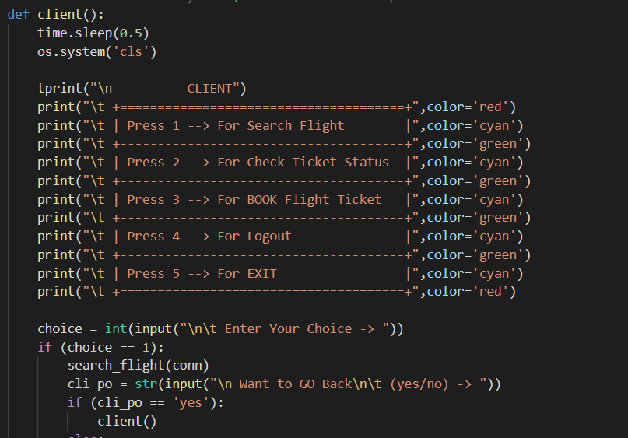
Screenshots of Development Phase 2 ( Features Implementation)

Slide 24
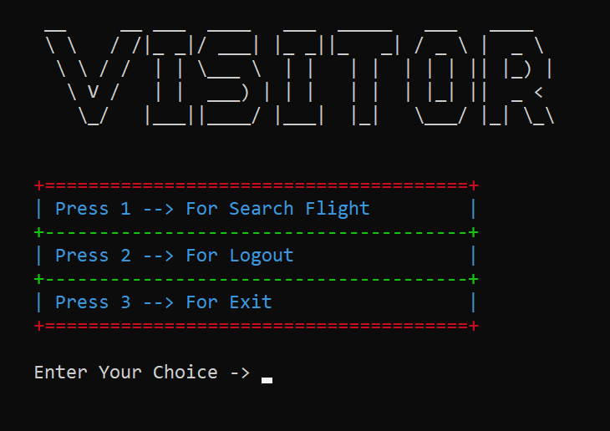
Screenshots of Development Phase 2 ( Features Implementation)

Slide 25
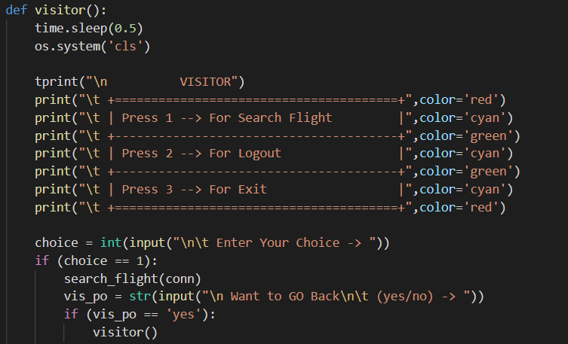
Screenshots of Development Phase 2 ( Features Implementation)

Slide 26
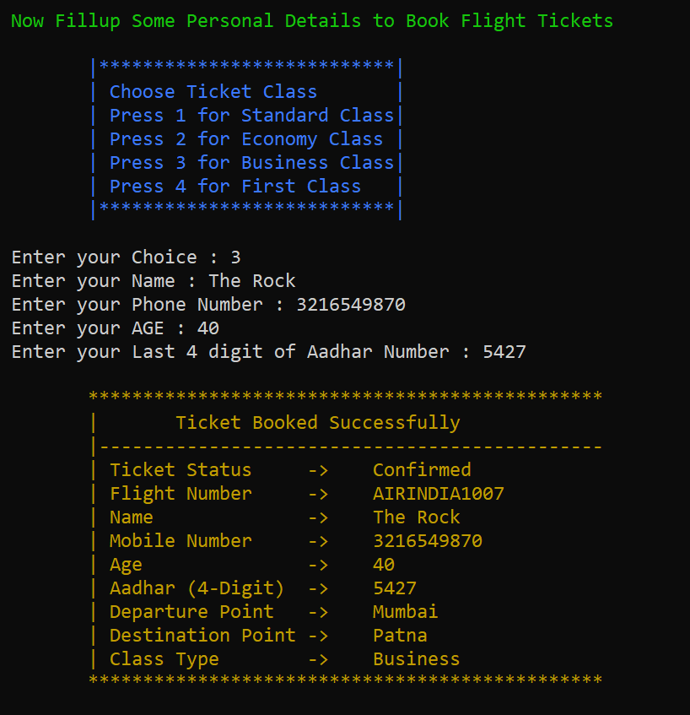
Screenshots of Development Phase 3 ( Features Implementation)

Slide 27
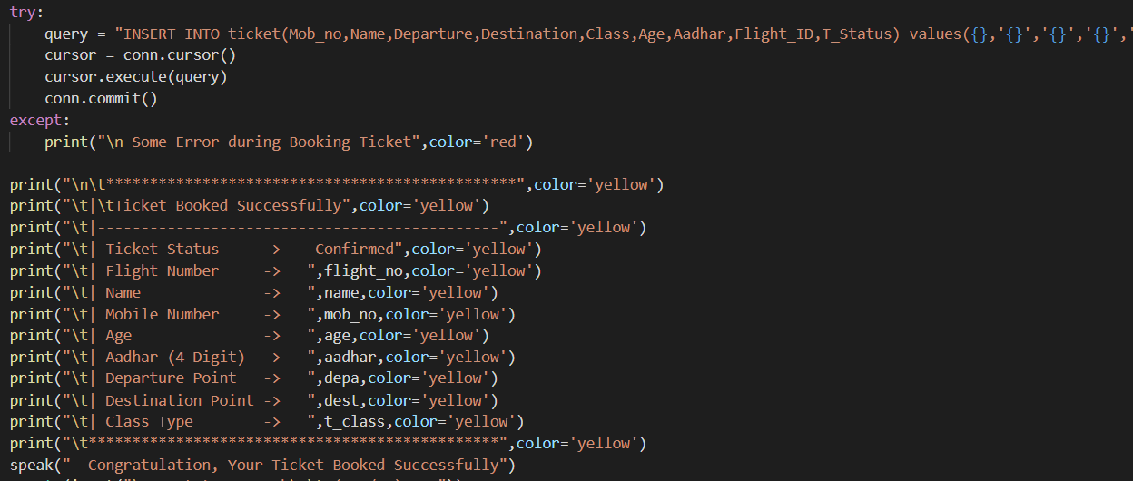
Screenshots of Development Phase 3 ( Features Implementation)

Slide 28
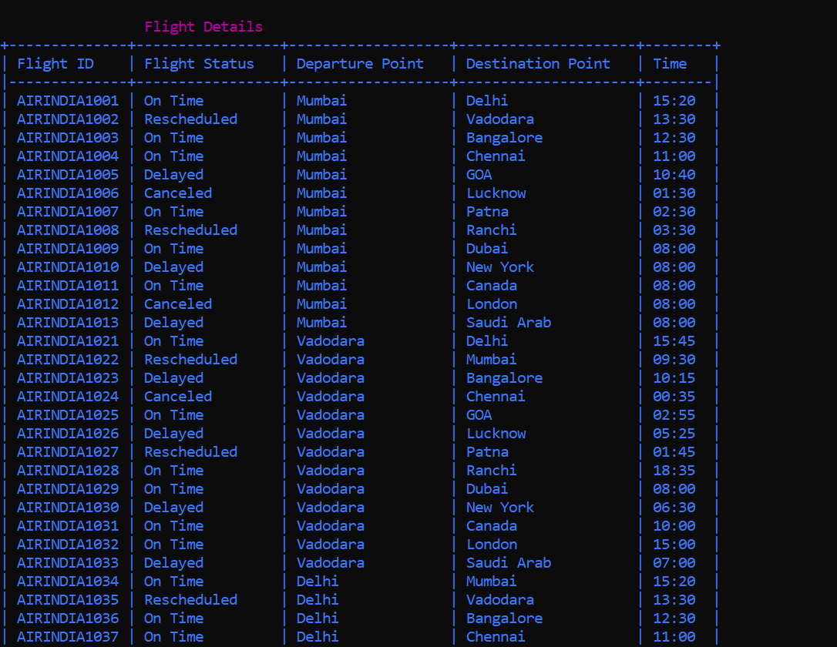
Screenshots of Development Phase 3 ( Features Implementation)

Slide 29
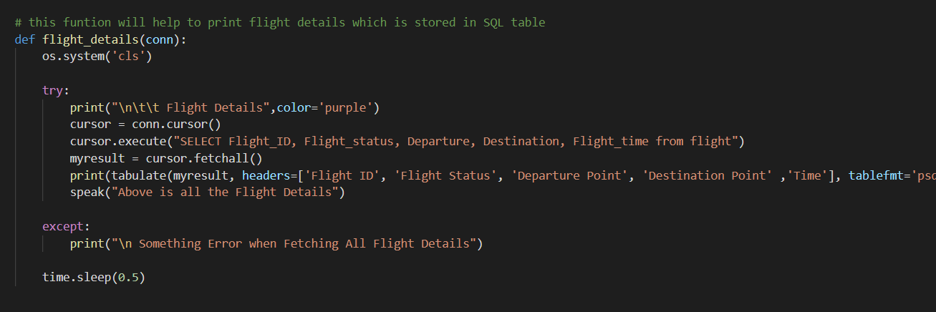
Screenshots of Development Phase 3 ( Features Implementation)

Slide 30
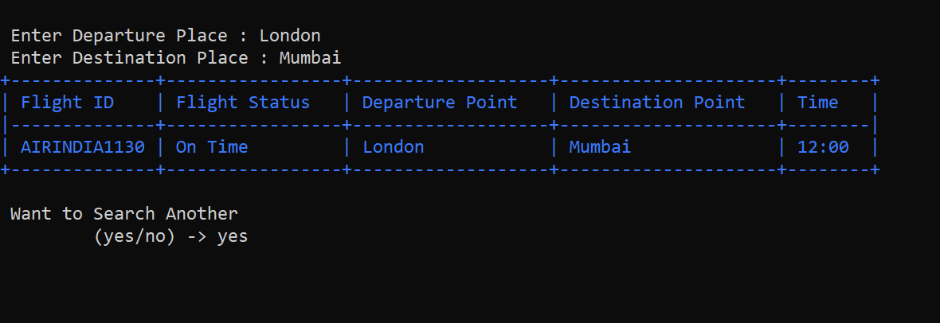
Screenshots of Development Phase 3 ( Features Implementation)

Slide 31
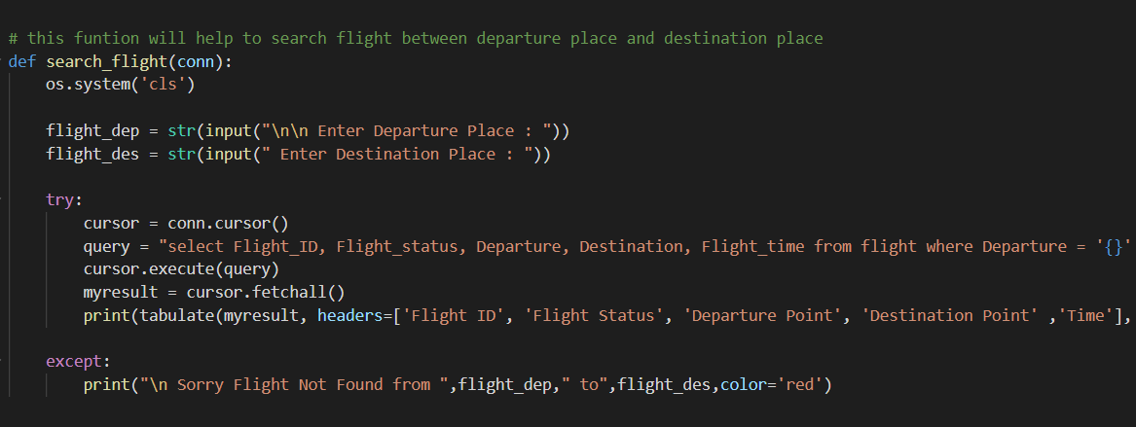
Screenshots of Development Phase 3 ( Features Implementation)

Slide 32
Conclusion
Our System Flight Booking System finally completed and runs with error free. At the time of developing this system we face a lot issue but we founded solution of every problem.
Our First problem was to connect our system with SQL Server, and it takes a lot of time to solve. We also add some features that we don’t decided previously like Voice Command and Searching Ticket Status.
We try our best to make this system error free and we also tested our system more than 100 times and tried to solve every small issues. And now we can proudly say that there is no any error in Our System, there are only lack of some features that we will add in Future.

Slide 33
Future Enhancement
In future we will give a better Graphics to this System that will help more easier use it.
We will also add voice recognizable feature that can help user in any task without typing.
There is disadvantage in Our System that is there is no limit of Booking Ticket, so in Future we will Limit the Booking of Ticket.
In Our system no other user can Register themselves, so we will also add this feature in Future.
The main Problem of our system is that SQL Server can’t connect in another device, for this we have to connect SQL Server with IP Address and we will implement this in Future.
Also this system is only made for Windows, Linux and MAC, so we can’t access it from our Smartphone and for that we will also do something that user can also use this system on the smartphone.

Slide 34
Reference
Website
https://github.com/
https://stackoverflow.com/
https://docs.microsoft.com/en-us
https://www.quora.com/
Book
Python For Everyone
SQL Beginners Guide
Other Resources
Some Journals

Slide 35
Thank you !!!

