Slide 1


SURGE-2022 Project Report Adding Color Information to LiDAR using Camera Calibration
Submitted by Aman Kumar Singh SURGE No.: 2230061 Department of Civil Engineering IIT Kanpur
Under the guidance of Prof. SALIL GOEL Department of Civil Engineering IIT Kanpur
INDIAN INSTITUTE OF TECHNOLOGY, KANPUR

Slide 2
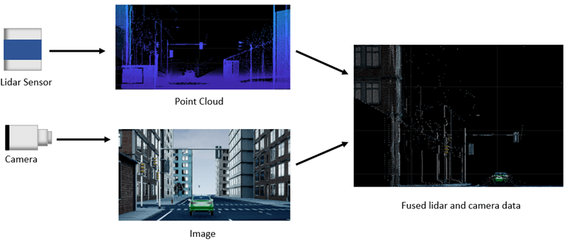
OBJECTIVE OF THE PROJECT
LiDAR technology can collect 3D points with a range of up to 200 metres. Furthermore, LiDAR may be used in low-textured environments as well as scenes with changing lighting conditions. However, the LiDAR-generated 3D model data is limited and lacks colour information.
A camera is a small and inexpensive device that can capture colour information. It must match to feature points during calculation, which will take time and be light sensitive.
The project's goal is to merge the LiDAR's 3D point cloud with the camera's 2D image to build a 3D LiDAR model with colour information.
Source: https://in.mathworks.com/help/lidar/ug/calibration_fuselidarcamera.png

Slide 3
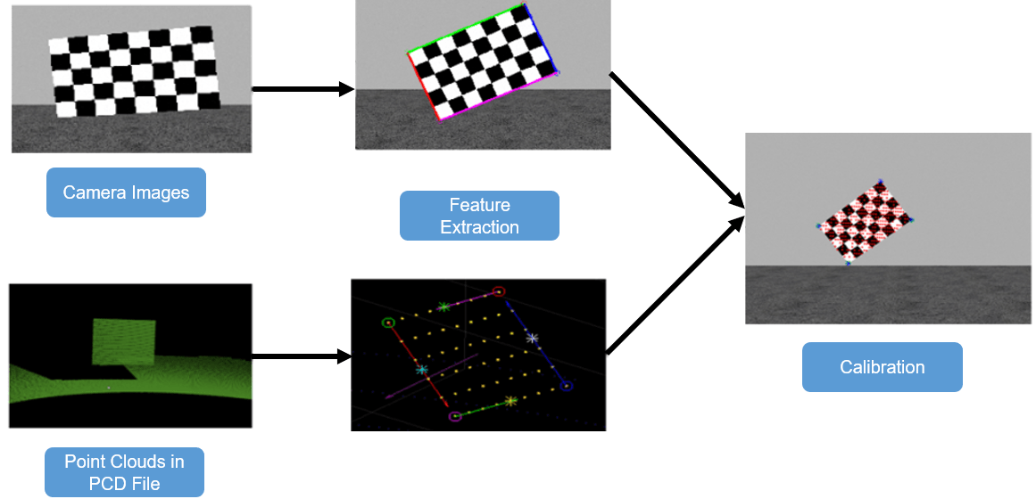
KEY POINTS
The 3D LIDAR sensor can provide a 3D location and depth data about objects, while the color camera collects their 2D color characteristics. By combining 2D picture data with 3D positional information, it is possible to display the objects with a more realistic perspective and enhance our object detection and classification.
The strategy for calibration is to find point-to-point correspondences between the 2D picture and the 3D point clouds by estimating the 3D locations of vertices from the scanned laser data and their corresponding corners in the 2D image.
This diagram depicts the workflow for the lidar and camera calibration (LCC) procedure, with checkerboard serving as the calibration object. The checkerboard corners and planes are extracted from lidar and camera data, and a geometrical relationship between their coordinate systems is established to perform calibration
Image source: https://in.mathworks.com/help/examples/lidar/win64/LidarCameraCalibrationExample_01.png

Slide 4
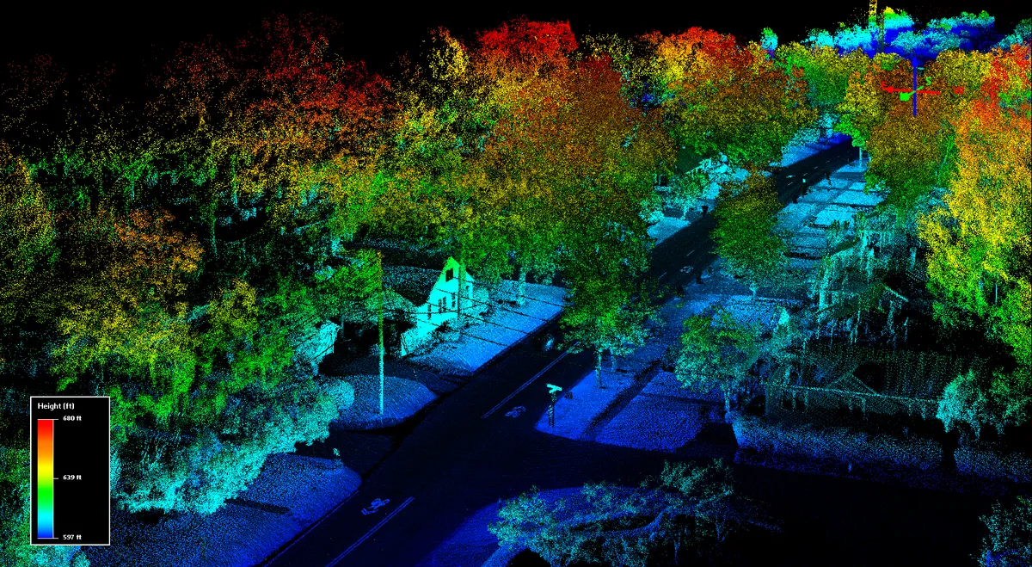
RESULTS
The transformation matrix obtained can be used to
Evaluate the accuracy of your calibration by calculating the error.
Project lidar points onto an image.
Fuse the lidar and camera outputs.
Estimate the 3-D bounding boxes in a point cloud based on the 2-D bounding boxes in the corresponding image.
This project is my starting point to get hands on experience of what research is and explore my research topic. This project made me familiar with the basics of camera calibration and introduced me to research going in the field of Geoinformatics particularly about LiDAR.
The main result of the project is to add color information to LiDAR. This is implemented using the concept of draping. We take depth information from LiDAR and take image from a camera and then we fuse the images after completing LiDAR Camera Calibration.
Image source: https://www.zdnet.com/a/img/resize/ea472a74b5d2cc1768704b5b2f1038aa478fa037/2019/04/21/3bc68be4-6828-4e0a-9c25-aaabf583f58a/blackmore-lidar.png?auto=webp&width=1200

Slide 5
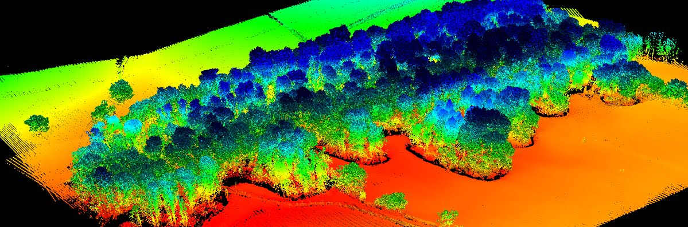
SUMMARY
LiDAR technology can gather 3D points with an effective range of up to 200 meters. In addition, LiDAR can be used in low-textured scenes and scenes with varying lighting conditions. However, the 3D model data generated by LiDAR is sparse and lacks colour information. A camera is a portable and cheap device that can obtain colour information. However, it needs to correspond to feature points during calculation, which will be time- consuming and sensitive to light.
A combination of cameras and LiDAR requires obtaining transformation parameters between the coordinate systems of the two kinds of sensors.
The 3D point cloud of the LiDAR is combined with the 2D image of the camera to create a 3D LiDAR model with colour information.
Image source: https://www.routescene.com/wp-content/uploads/2021/05/Routescene-software.jpg

