Slide 1
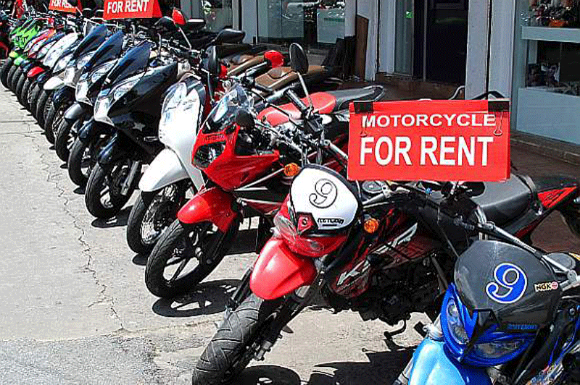

Exploring Urban Mobility Patterns: A Data-Driven Analysis of Bike Rental Services
By: Aman Kumar
Instructor: Assistant Prof. Neeraj Kumar Sharma

Slide 2
Motivation
Emerging Industry:
Motorbike rental services have become increasingly popular, especially in urban areas and tourist destinations.
Analyzing this industry can provide insights into the trends, challenges, and opportunities within the market.
Societal Impact:
Understanding motorbike rental patterns can have broader societal implications, such as promoting sustainable transportation and reducing traffic congestion.
Business Optimization:
Businesses offering motorbike rental services can benefit from data-driven insights to optimize operations, pricing, and customer experiences.
Tourism and Travel:
In tourist-heavy areas, motorbike rentals are a popular mode of transportation for visitors.
Analysis can shed light on seasonal trends, preferences, and the impact of tourism on motorbike rental demand.
Personal Connection!!
Growing up with a love for motorbikes, I have always been intrigued by the freedom and flexibility they offer.

Slide 3
Block Diagram
Problem statement: To find number of Bikes rent by Registered/Un-Registered users based on attributes like Seasons, Weekends, Weekday, Weather, Months, Different days of the week ,Temperature, Humidity, Wind Speed etc .
Distribution of Bike Users on
1. Hourly basis
2. Monthly basis
3. Seasonal basis
4. Working and Non-working basis
5. Temperature basis
6. Humidity basis
7. Wind basis
8. Hoildays and Non-holiday basis
9. Daily trend of bike
10. Weekdays and Weekend
Registered Users
Data Collection
2​
Un-Registered Users

Slide 4
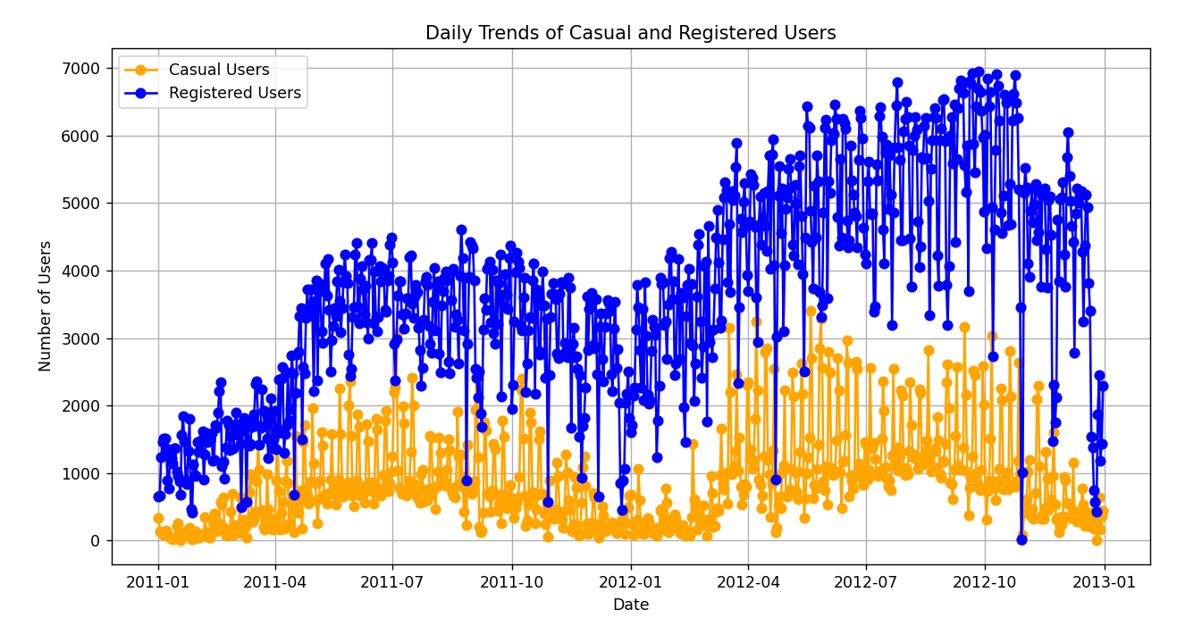
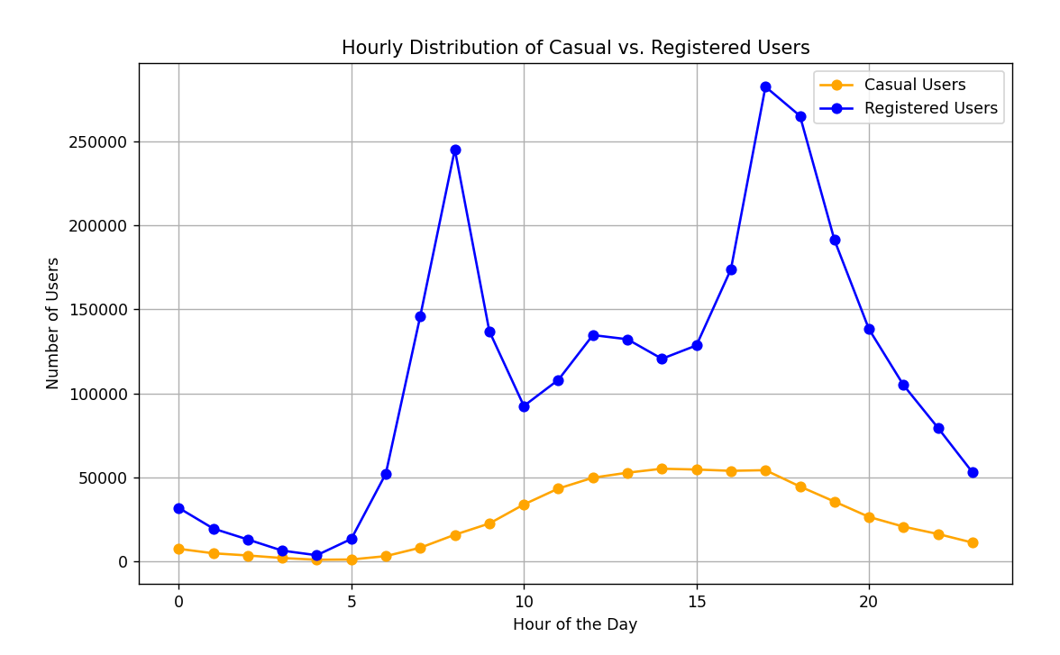
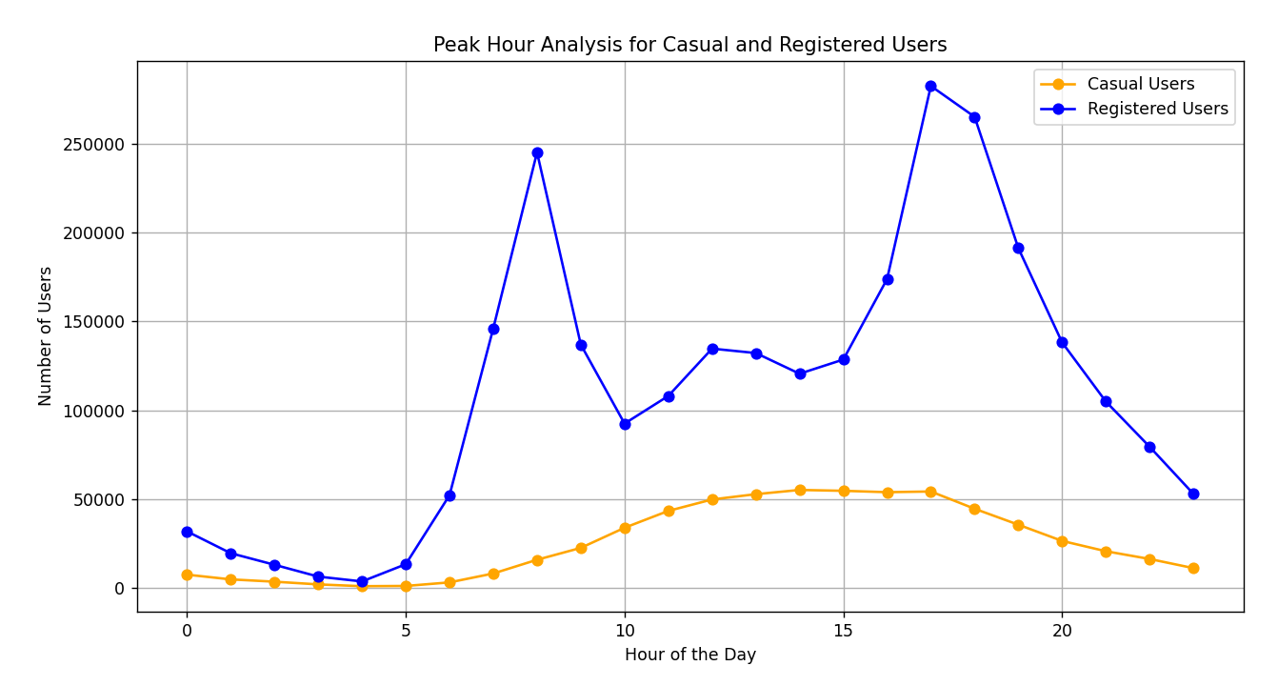
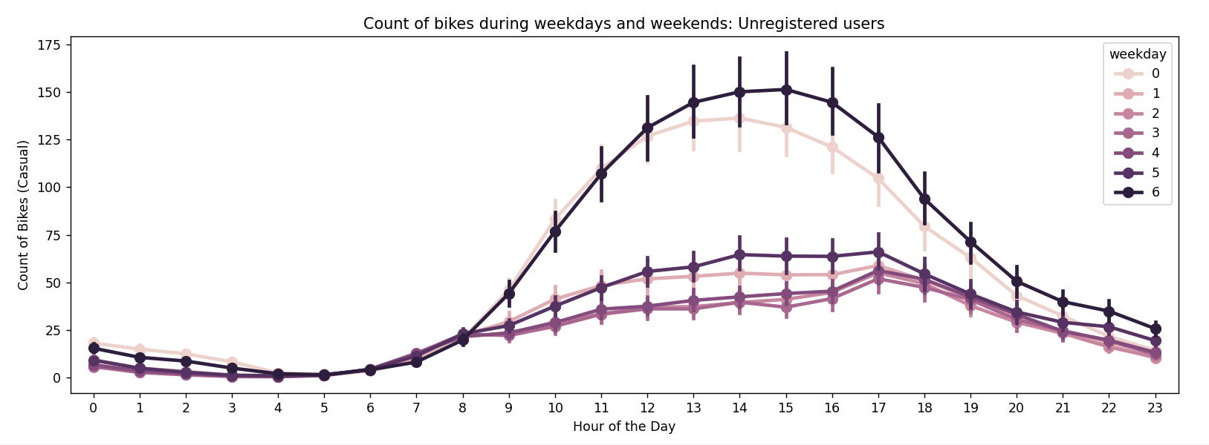
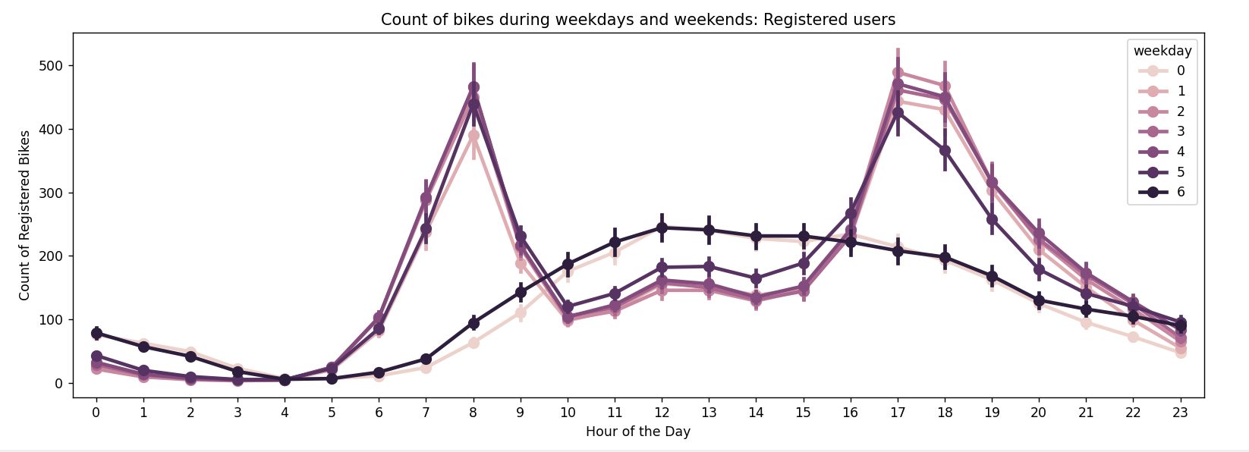
Registered Users And Un-Registered Users

Slide 5
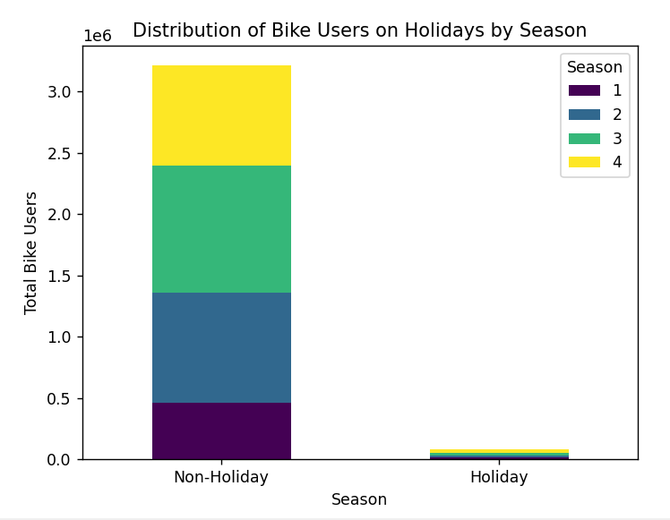
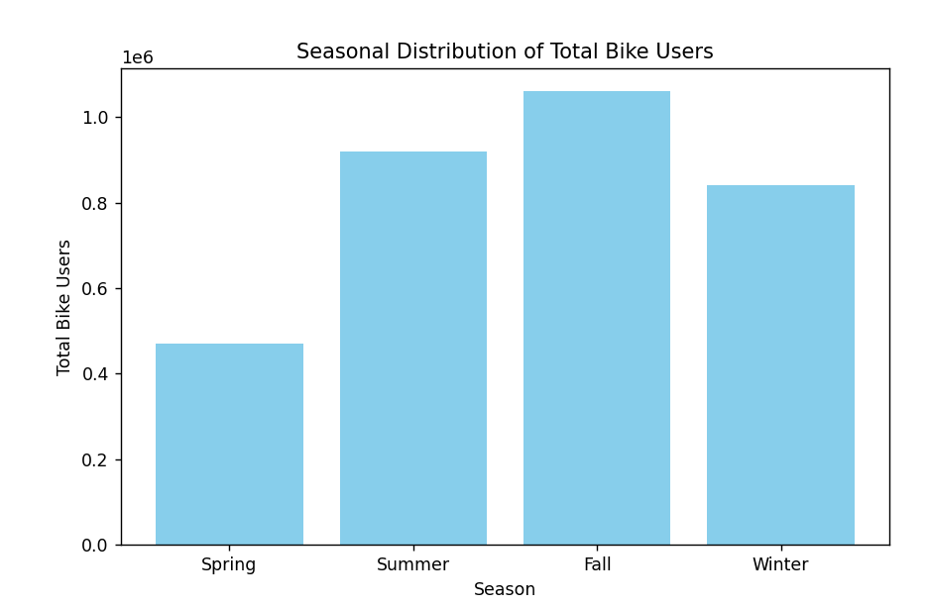
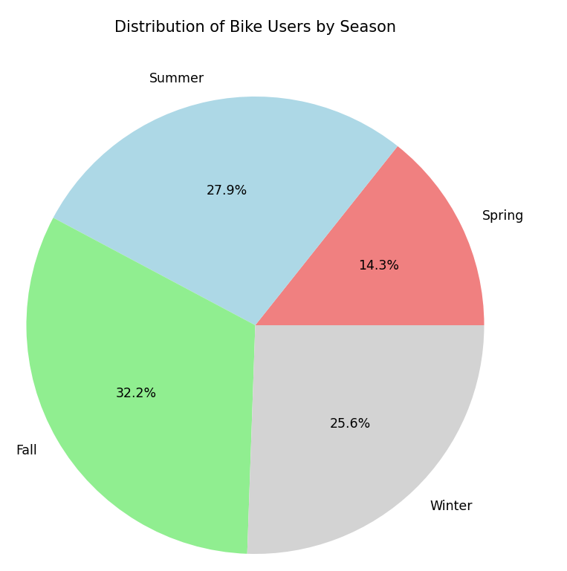
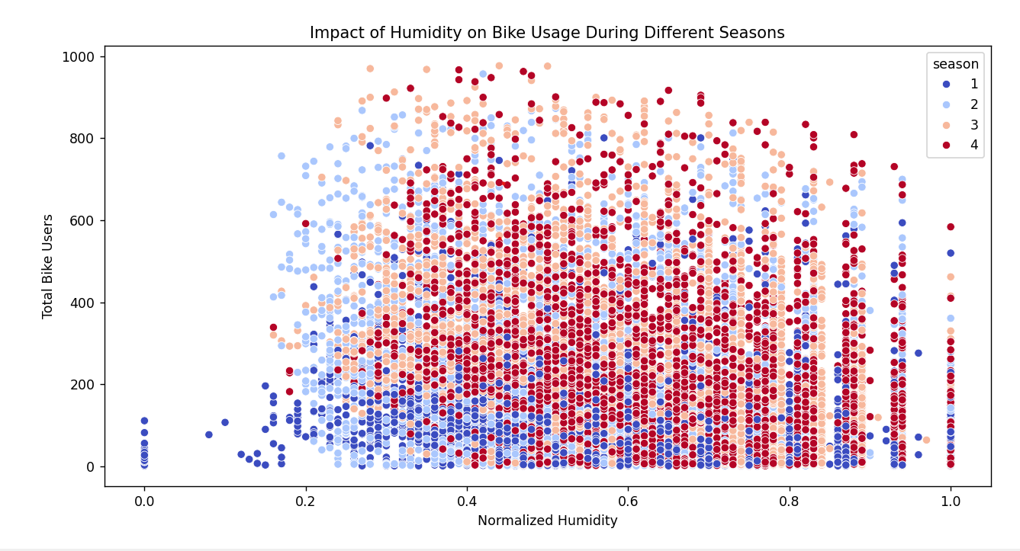
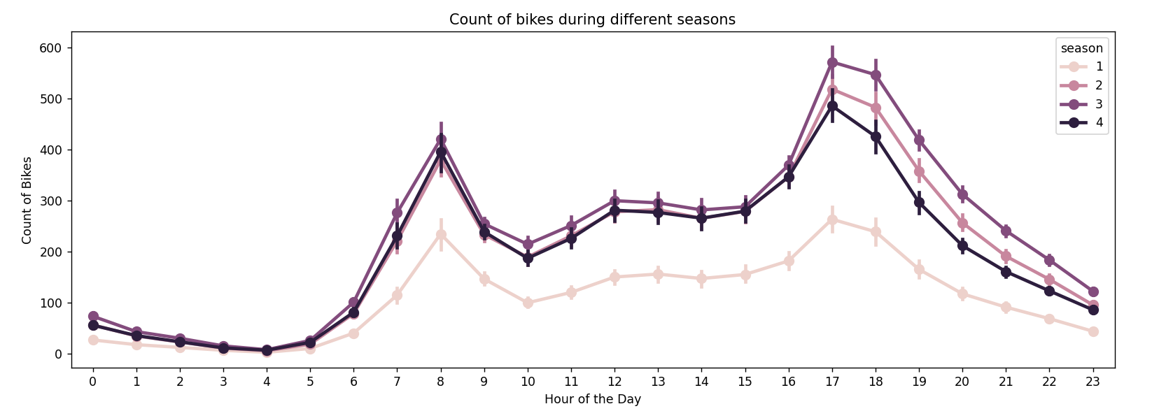
Season

Slide 6
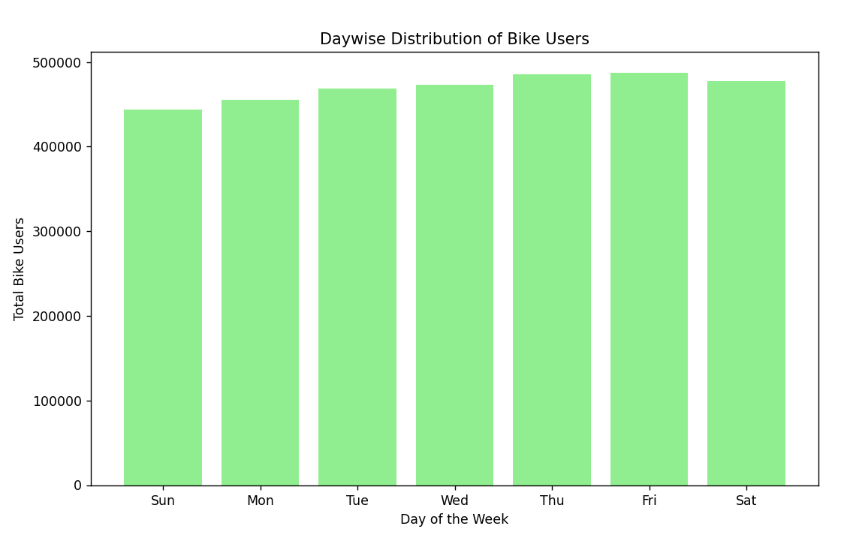
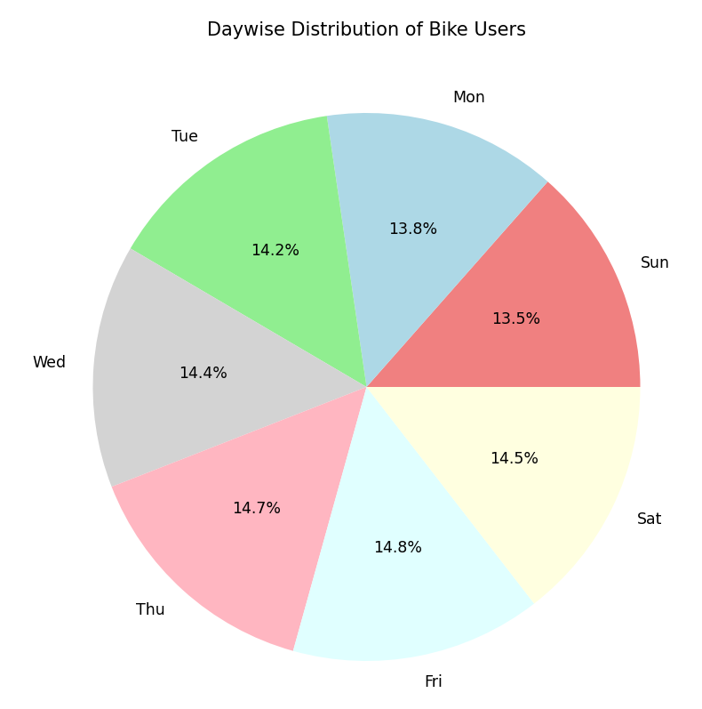
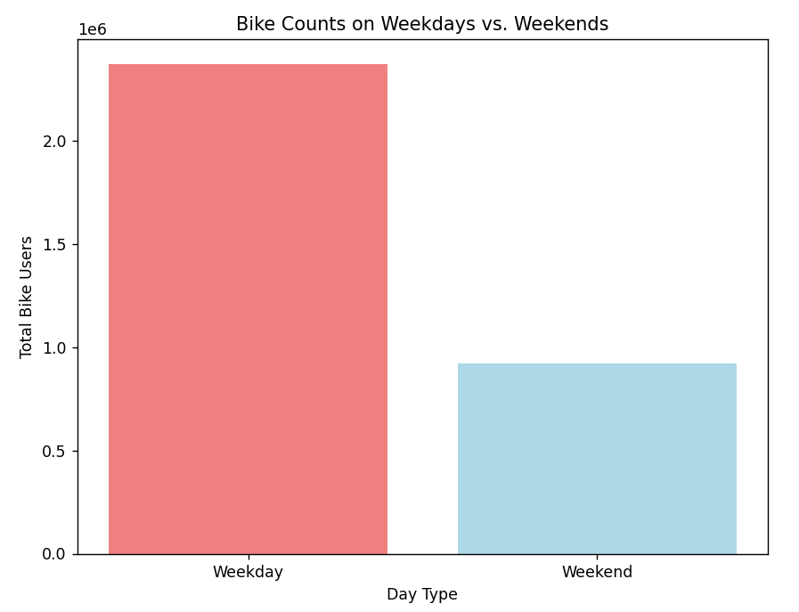
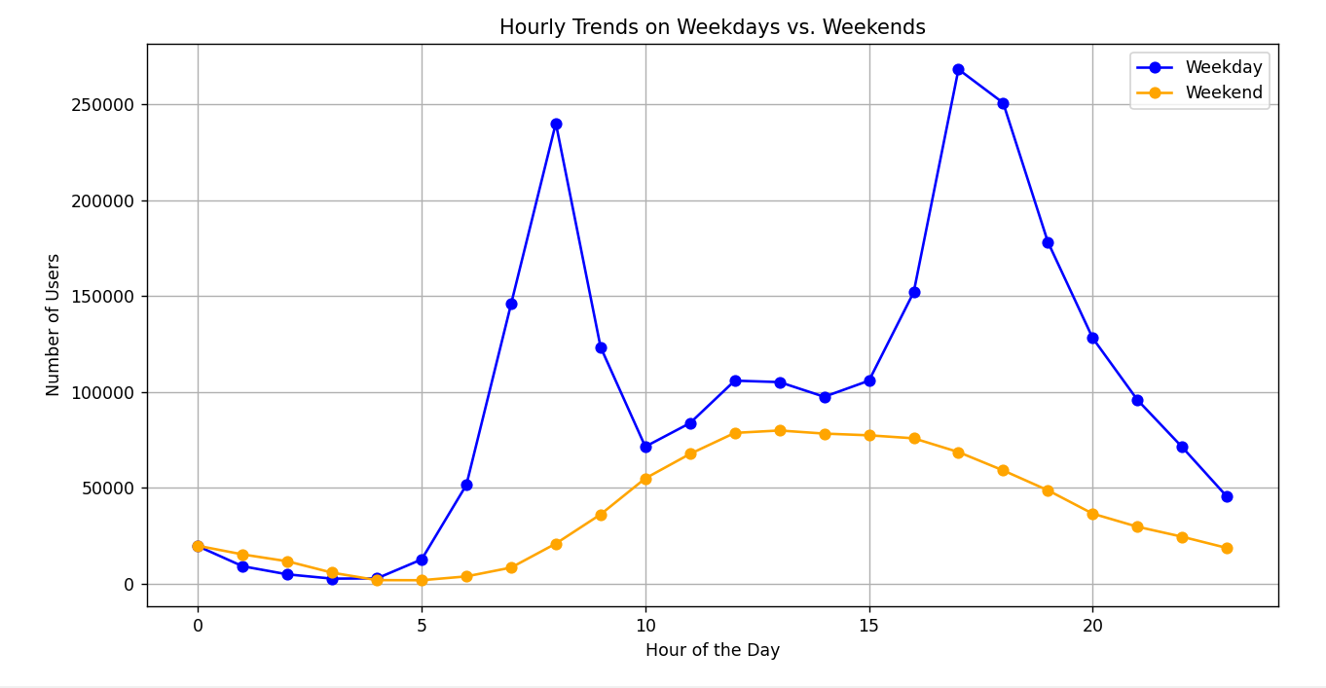
Days Of Week + Weekdays And Weekend

Slide 7
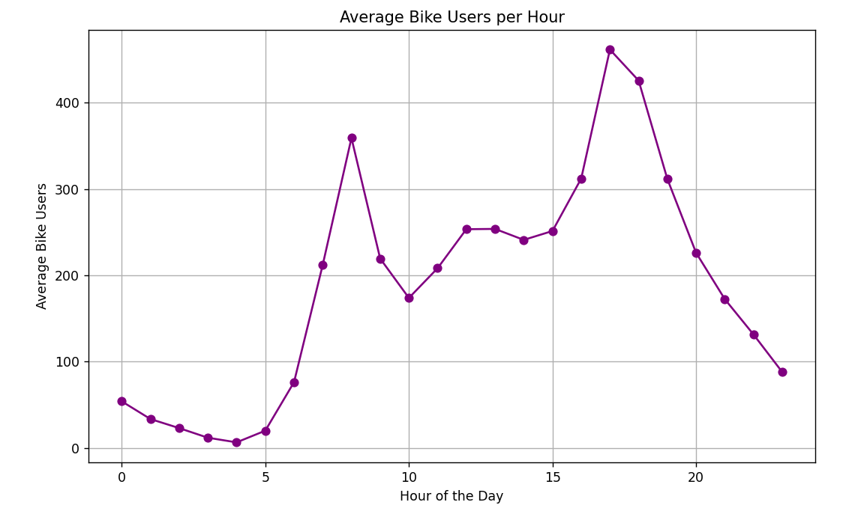
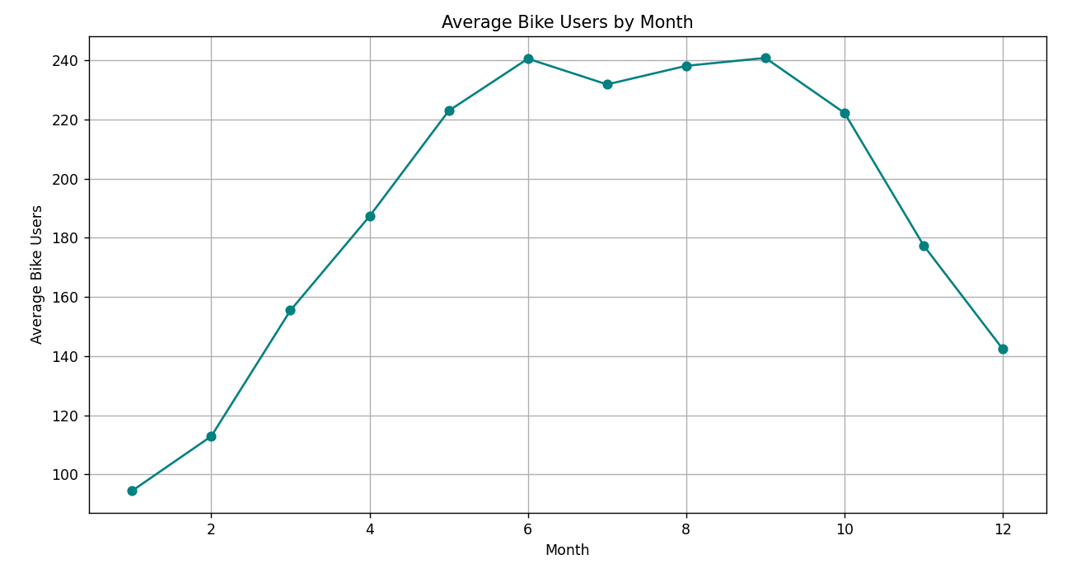
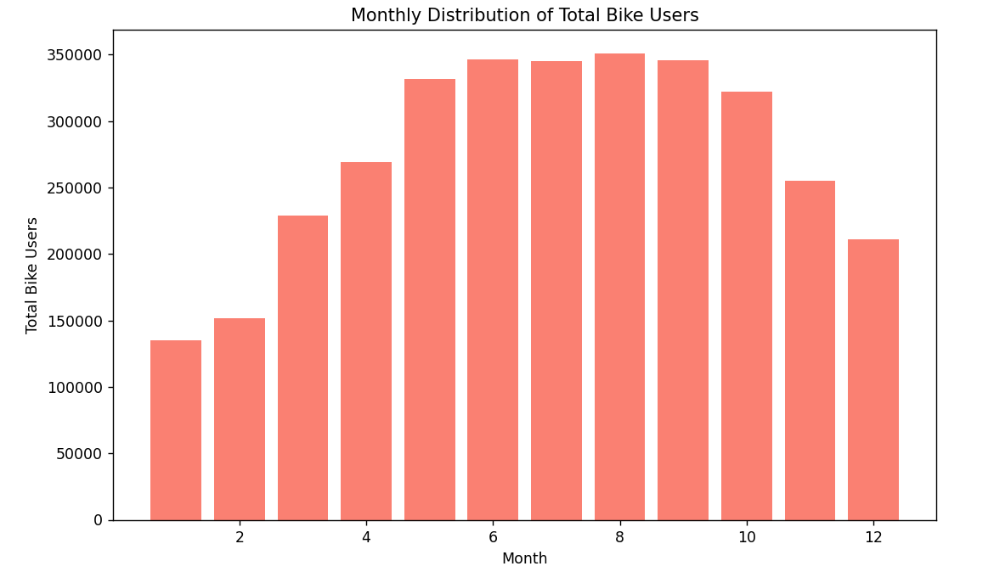
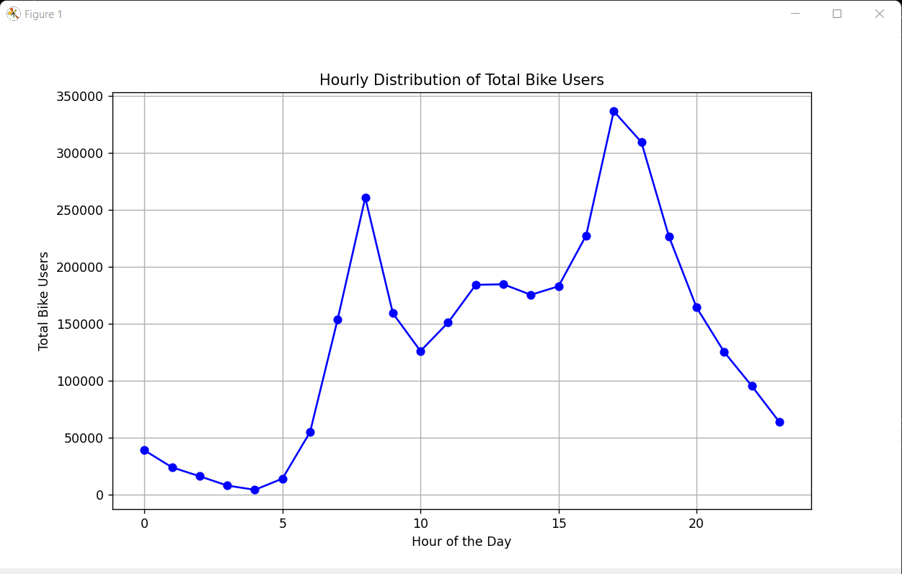
Hourly And Monthly

Slide 8
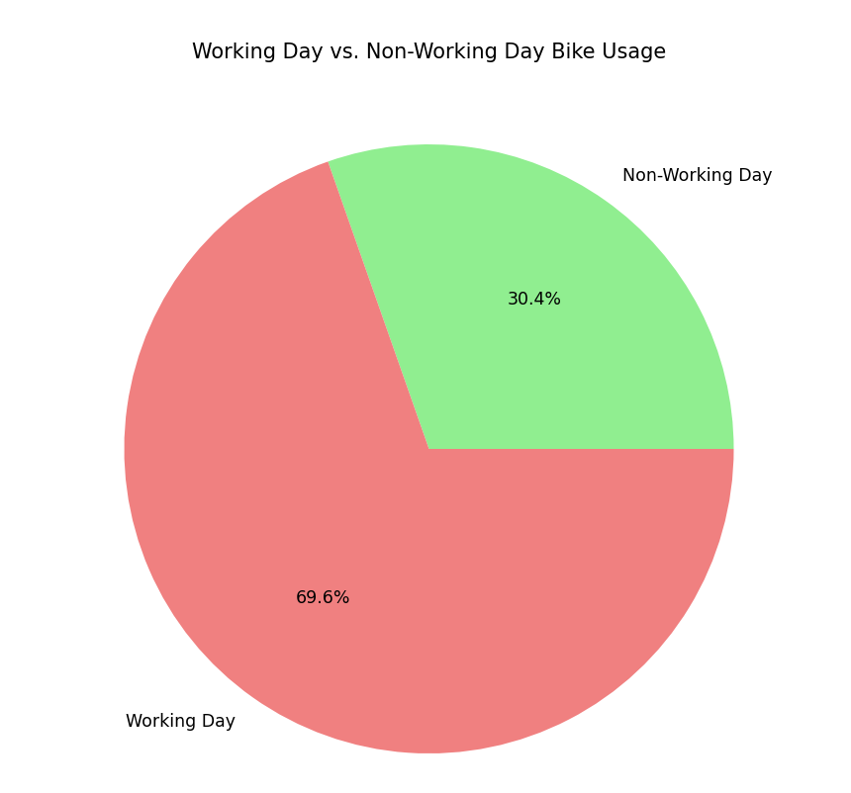
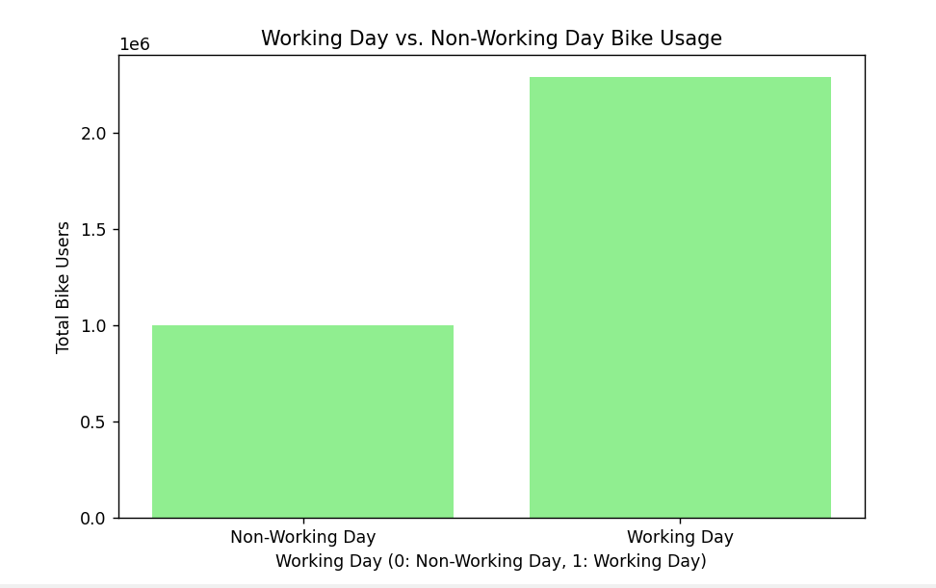
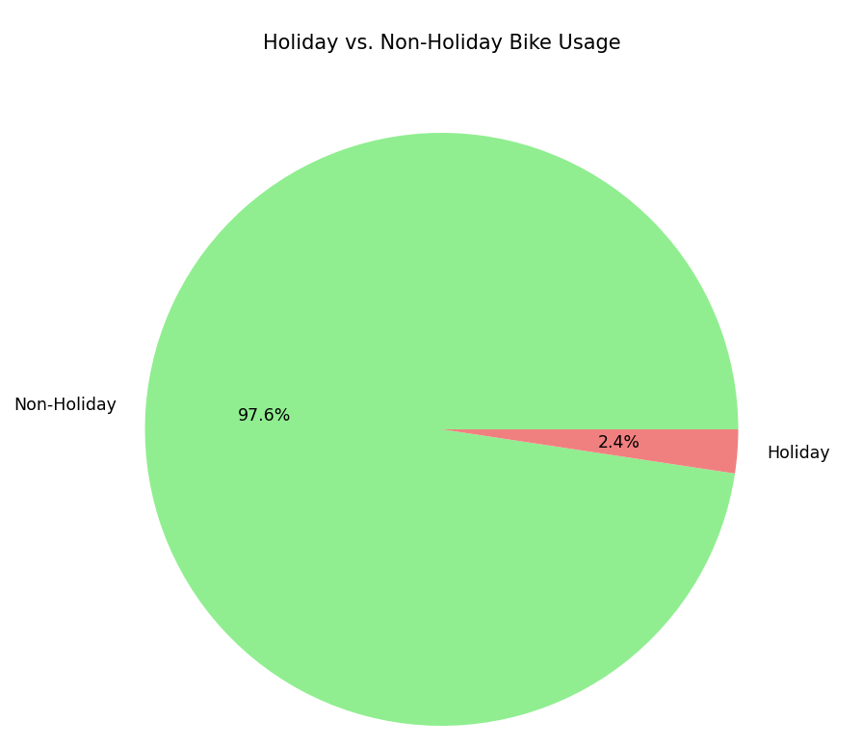
Working And Non-Working Days

Slide 9
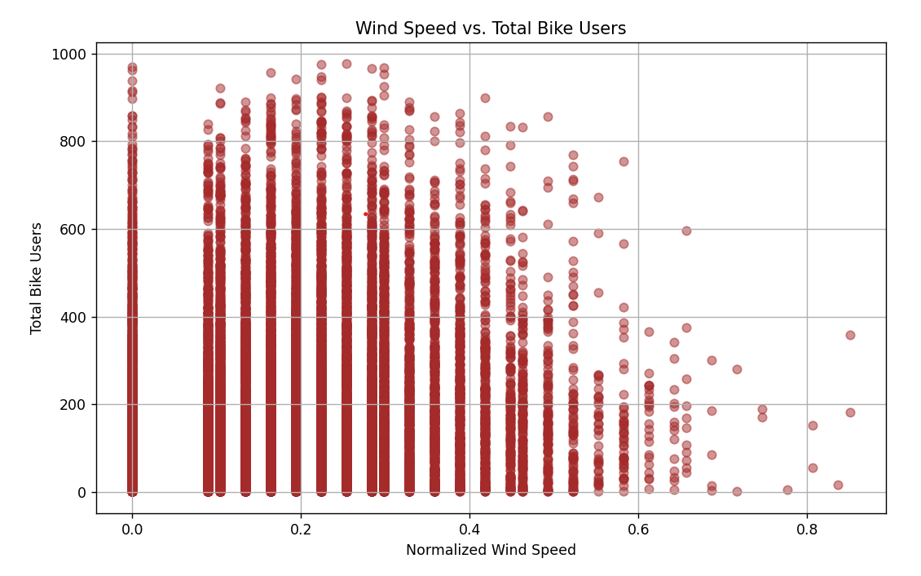
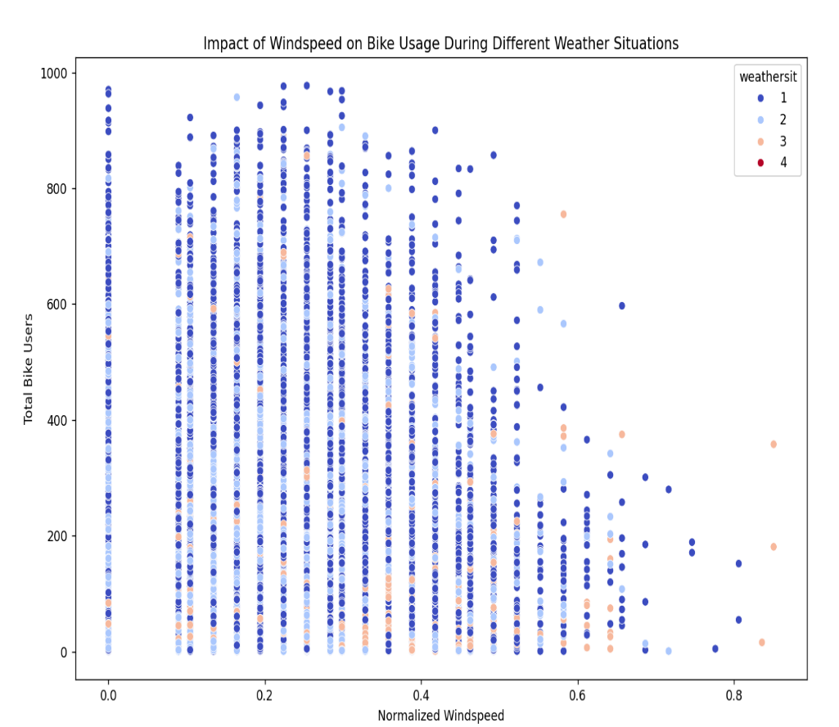
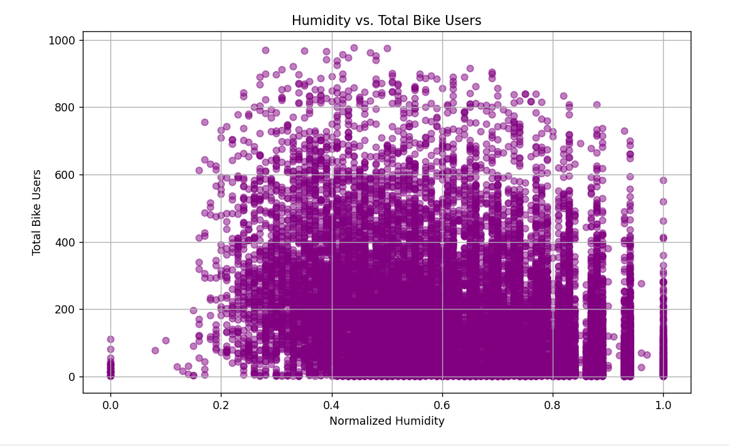
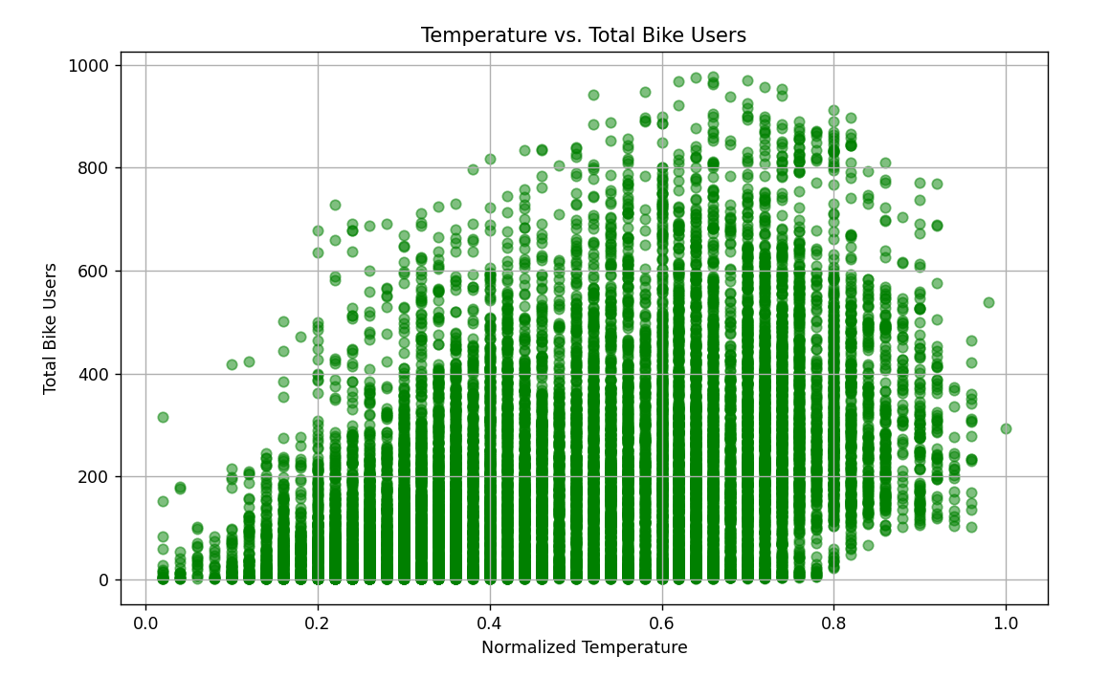
Temperature, Humidity, Wind Speed

Slide 10
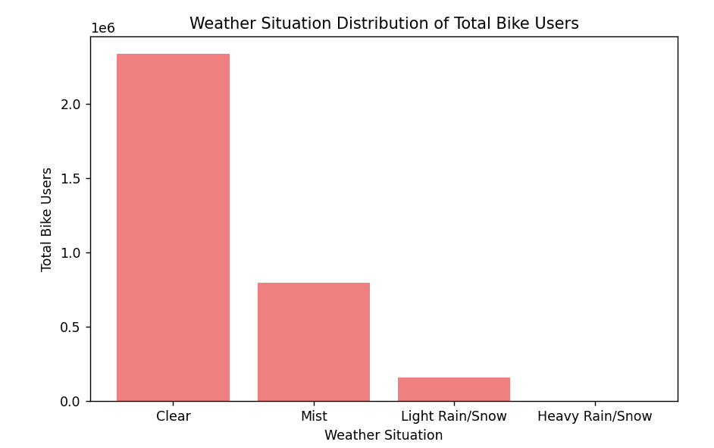
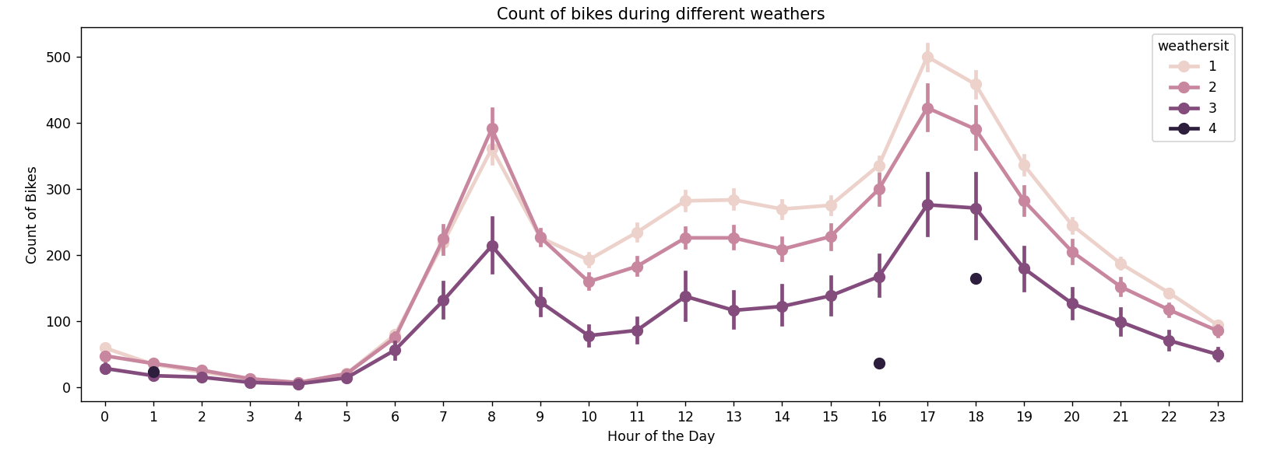
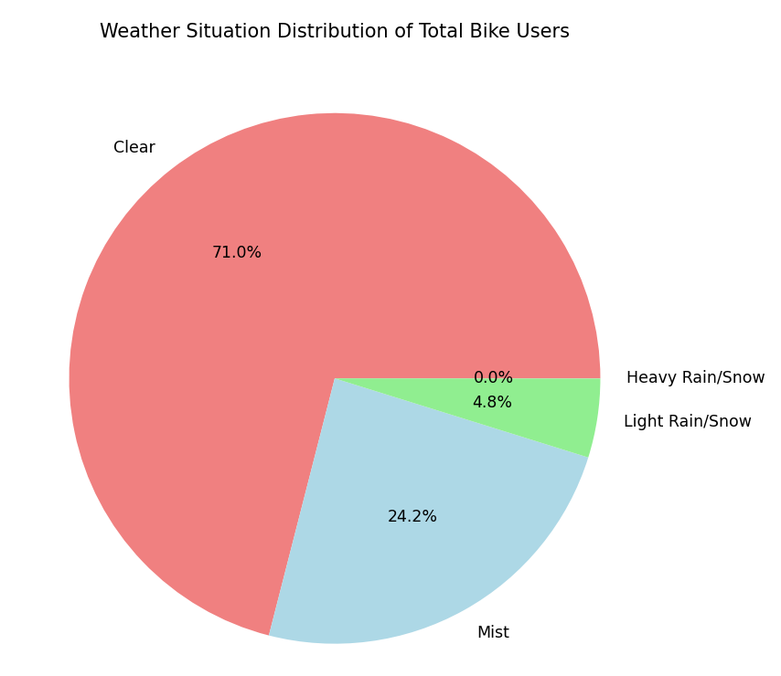
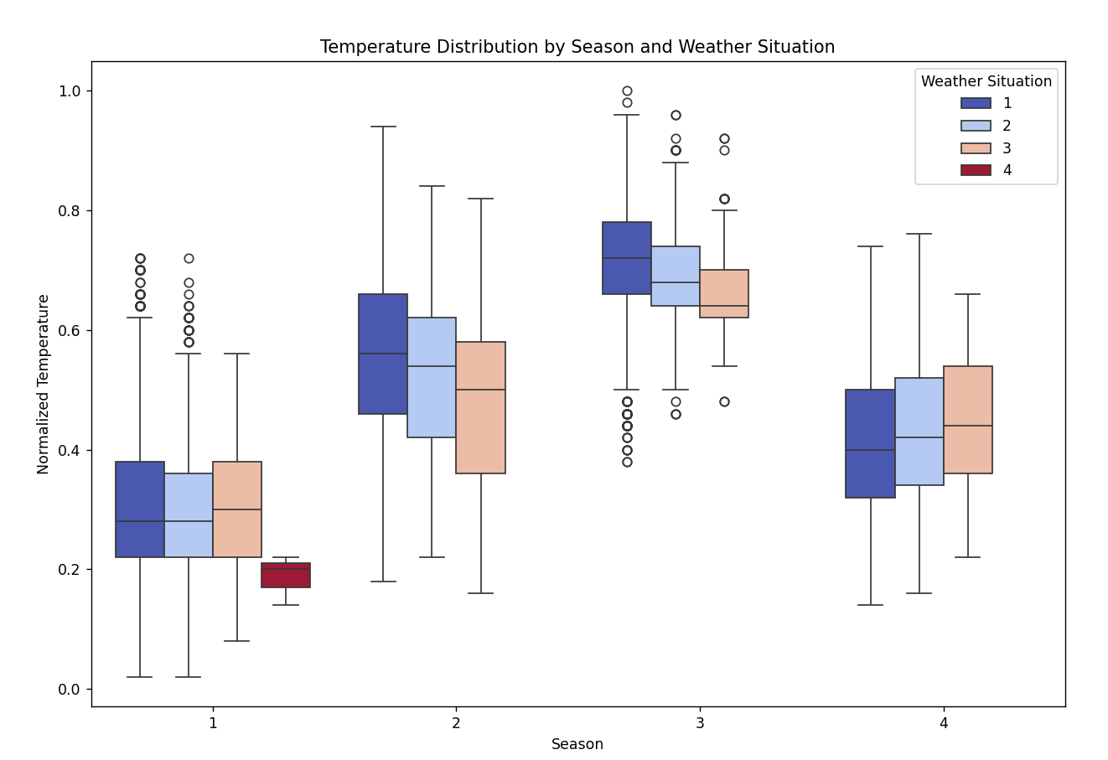
Weather

Slide 11
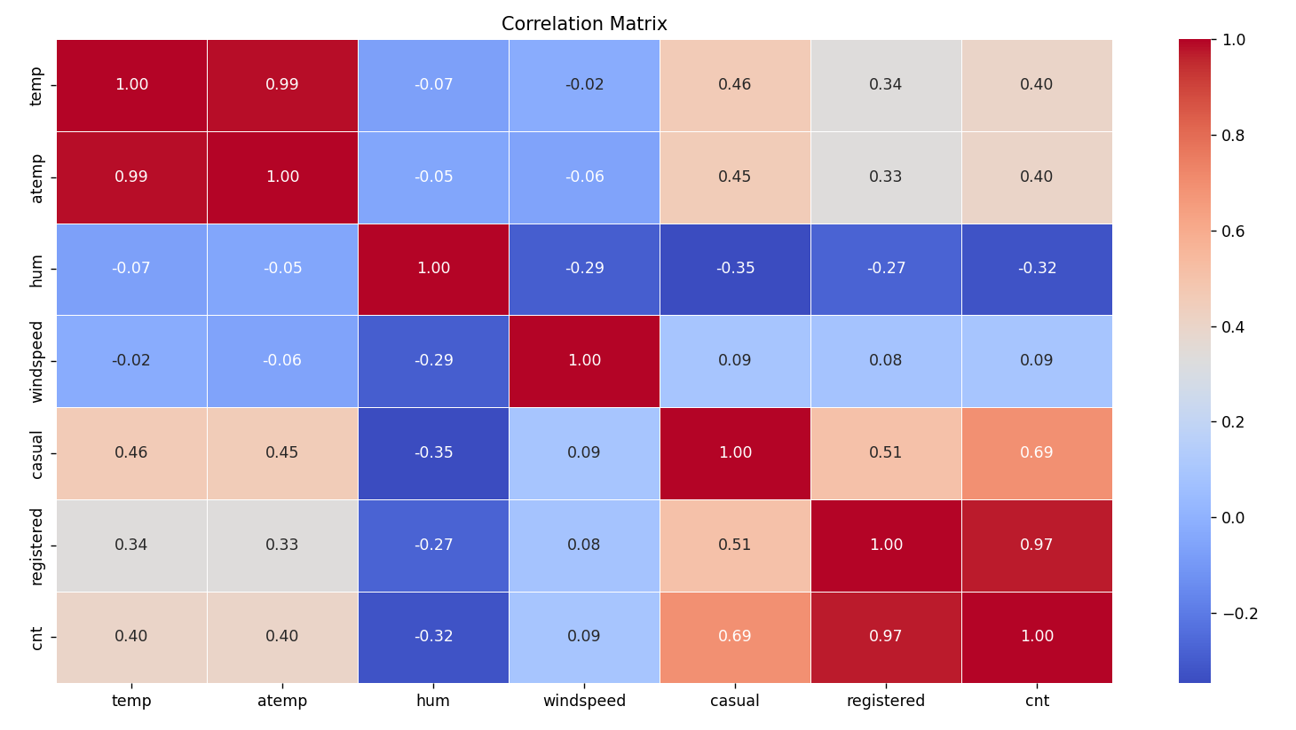
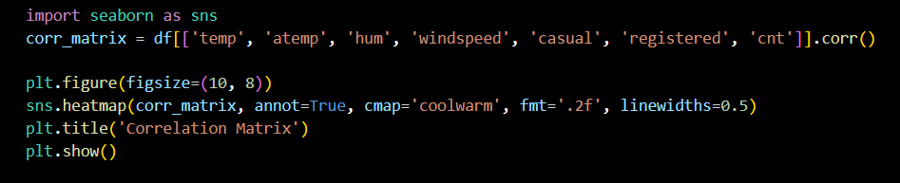
Correlation Matrix

Slide 12
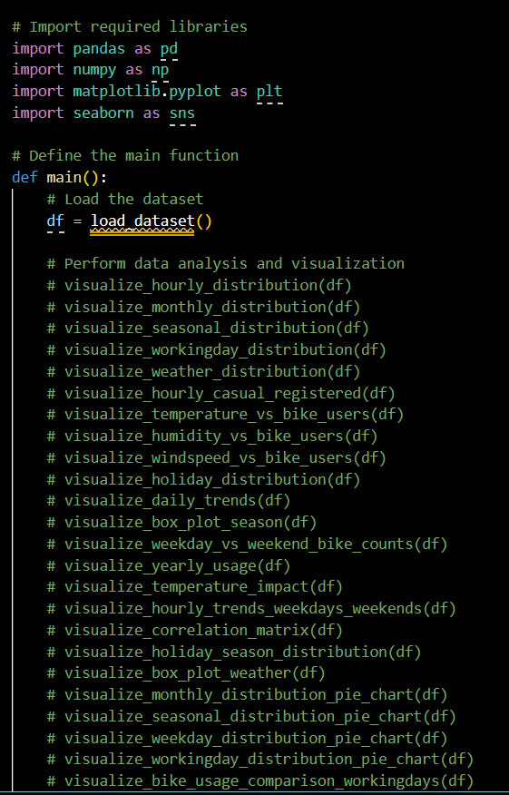
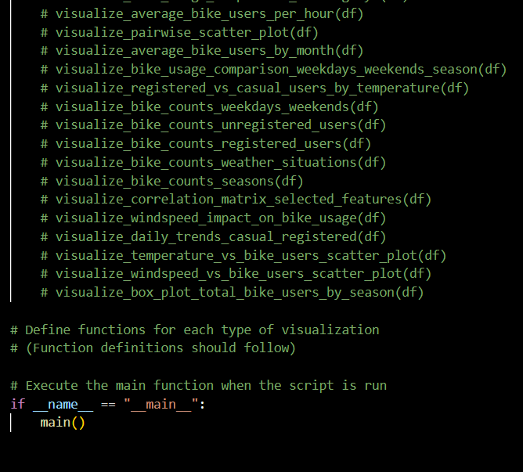
Pseudo Code

Slide 13
Observation
Hourly Distribution: There is a clear hourly trend, with peak bike usage during certain hours of the day, indicating potential commuting patterns.
Monthly Distribution: The bike usage shows variations over the months, with potential seasonality trends. More people may rent bikes during specific months, likely influenced by weather conditions.
Seasonal Distribution: Different seasons impact bike rental patterns. For example, usage might increase during warmer seasons and decrease during colder ones.
Working Day vs. Non-Working Day: Bike usage patterns differ between working days and non-working days. It's common to see increased usage on working days, possibly due to commuting purposes.
Weather Situation Distribution: Weather conditions affect bike rental demand. Clear weather might attract more riders, while adverse conditions like rain or snow may reduce usage.
Casual vs. Registered Users: Distinguishing between casual and registered users helps understand user behavior. Casual users might contribute more to peak usage, while registered users show consistent patterns.
Temperature, Humidity, and Windspeed Impact: Temperature and weather-related features have a significant impact on bike usage. There might be an optimal temperature range for bike rentals.
Holiday vs. Non-Holiday Usage: Holidays may influence bike rental patterns, with potential increased usage for recreational purposes or decreased usage due to travel.
Daily Trends: Analyzing daily trends provides insights into user preferences and habits. Weekdays may show more commuting-related usage, while weekends may exhibit more leisure-oriented patterns.
Correlation Matrix: Examining correlations between various features, such as temperature, humidity, and windspeed, helps identify relationships and potential predictors of bike usage.
Bike Usage Over Years: Understanding how bike usage evolves over the years helps identify overall growth or decline in popularity.

