Slide 1

Presentation on
Hindi Ambiguity Resolution using Large Language Models
By :-
Name : AYUSH ANAND
Reg no: 202300188
Course Name: (CD306A1) Text Analytics & Natutral Language Processing
Department: AI&DS
SMIT, SMU

Slide 2

Hindi Ambiguity Resolution using Large Language Models
TABLE OF CONTENTS
SL. NO. | TOPICS | PAGES
1. | Introduction | 3
2. | Types of Ambiguity in Hindi | 4
3. | Dataset Overview | 5
4. | Proposed Approach & Pipeline | 6
5. | Proposed Approach & Pipeline | 7
6. | Data Formatting | 8
7. | Model: Qwen2.5-0.5B | 9
8. | LoRA: Parameter Efficient Fine-Tuning | 10
9. | Training Configuration | 11
10. | Training Results & Evaluation | 12
2
Department of AI&DS
Sikkim Manipal Institute of Technology, SMU
1
Notes:
QoS aware Named Data Wireless Sensor Network
Department of Computer Science and Engineering
Improving Security in Internet of Things

Slide 3
Hindi Ambiguity Resolution using Large Language Models
TABLE OF CONTENTS
SL. NO. | TOPICS | PAGES
11. | Results & Model Output | 13
12. | Key Observations & Challenges | 14
13. | Applications & Future Scope | 15
14. | References | 16
2
Department of AI&DS
Sikkim Manipal Institute of Technology, SMU
2
Notes:
QoS aware Named Data Wireless Sensor Network
Department of Computer Science and Engineering
Improving Security in Internet of Things

Slide 4
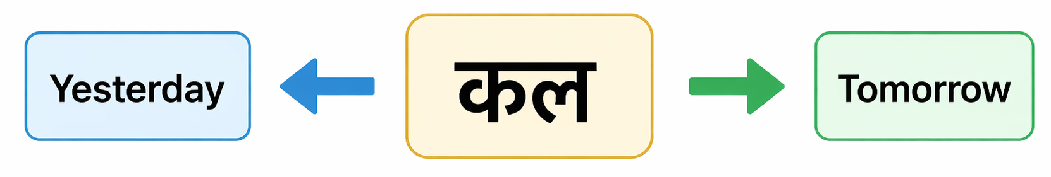
Hindi Ambiguity Resolution using Large Language Models
Introduction
In Natural Language Processing, ambiguity occurs when a word or sentence has multiple possible meanings.
Humans resolve this through context, but machines struggle to identify the correct interpretation.
Hindi is especially challenging due to its morphologically rich structure — the same word can mean different things in different contexts.
Goal: Fine-tune a small transformer model that can identify the correct meaning of ambiguous Hindi words based on context.
Input → Hindi sentence + ambiguous word + ambiguity type.
Output → Correct meaning of that word in the given context.
Fig 1: Time Ambiguity
4
Department of AI&DS
Sikkim Manipal Institute of Technology, SMU
3
Notes:
QoS aware Named Data Wireless Sensor Network

Slide 5
Hindi Ambiguity Resolution using Large Language Models
Types of Ambiguity in Hindi
Hindi ambiguity falls into 10 distinct categories based on the nature of the confusion.
Time Ambiguity — कल means yesterday OR tomorrow depending on context.
Morphological — सोना means sleep OR gold (same spelling, different meaning).
Pronoun — वह गया — reference of subject is unclear without context.
Sarcasm — बहुत होशियार हो — can be genuine praise OR sarcastic remark.
Idiom — पानी में मछली — literal OR idiomatic meaning.
Hinglish — mood off है — code-switched Hindi-English with domain-specific meaning.
Also covered: Syntactic, Pragmatic, Place, and Object-Action ambiguity.
Department of AI&DS
Sikkim Manipal Institute of Technology, SMU
4

Slide 6
Hindi Ambiguity Resolution using Large Language Models
Dataset Overview
A custom annotated dataset of 1000 Hindi sentences was created for this project.
391 unique ambiguous words are covered across 10 ambiguity categories.
Each entry contains: sentence, ambiguous word, correct meaning, and category.
Category distribution: Time (133), Object-Action (112), Hinglish (110), Idiom (108), Morphological (101).
Remaining: Syntactic (96), Pragmatic (90), Pronoun (85), Sarcasm (85), Place (80).
Language: Hindi | Source: custom_annotated | Total columns: 7.
Train-Test split: 900 training samples and 100 test samples (90-10 ratio).
Department of AI&DS
Sikkim Manipal Institute of Technology, SMU
5

Slide 7
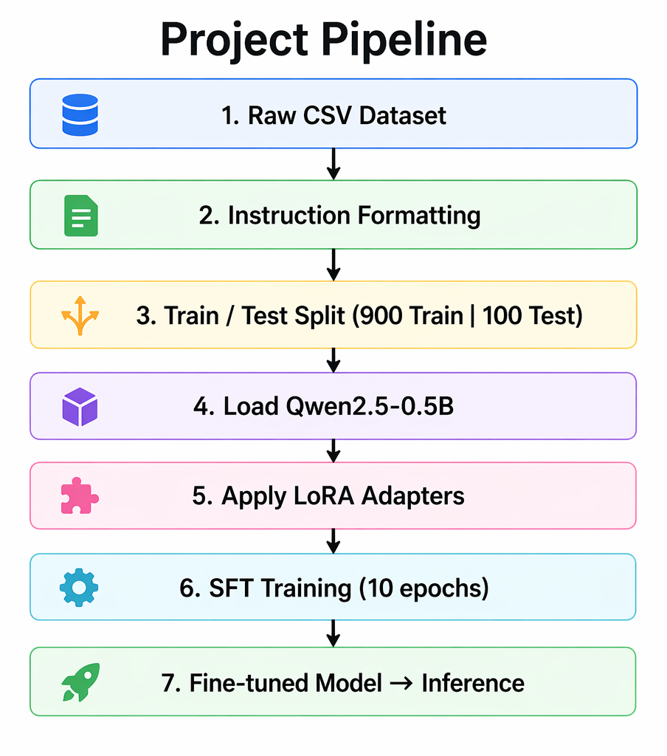
Hindi Ambiguity Resolution using Large Language Models
Proposed Approach & Pipeline
Approach: Supervised Fine-Tuning (SFT) on a pre-trained Large Language Model.
Raw CSV dataset is converted into Instruction-Input-Response format (Alpaca format).
LoRA adapters are applied — only a small fraction of model parameters are trained.
Pipeline: Raw CSV Dataset → Instruction Formatting → Train/Test Split (900/100).
→ Load Qwen2.5-0.5B Base Model → Apply LoRA Adapters → SFT Training (10 Epochs).
→ Fine-tuned Model saved → Inference on test sentences.
Fig 2 : Pipeline of Hindi Ambiguity Resolution using Large Language Models
Department of AI&DS
Sikkim Manipal Institute of Technology, SMU
6

Slide 8
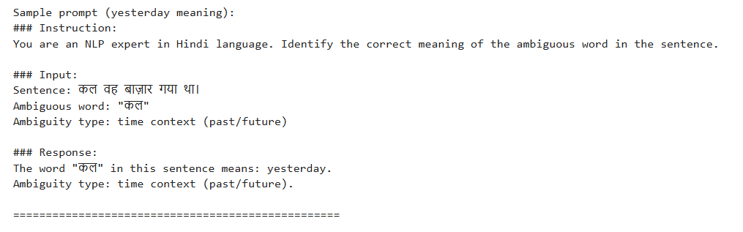
Hindi Ambiguity Resolution using Large Language Models
Data Formatting
Each row of the CSV was converted into a structured prompt using the Alpaca instruction format.
This format teaches the model: given a sentence and ambiguous word → predict the correct meaning.
A total of 1000 such prompts were automatically generated from the dataset.
Format: Instruction: (task description) | Input: (sentence + word + type) | Response: (meaning).
Example — Sentence: कल वह बाज़ार गया था। | Word: "कल" | Type: time context → Response: means yesterday.
The category description was mapped to a human-readable string for each of the 10 types.
Fig 3: Sample prompt(yesterday meaning)
Department of AI&DS
Sikkim Manipal Institute of Technology, SMU
7

Slide 9
Hindi Ambiguity Resolution using Large Language Models
Model: Qwen2.5-0.5B
Model: Qwen/Qwen2.5-0.5B developed by Alibaba Cloud — available on HuggingFace.
Parameters: ~494 Million.
Architecture: Decoder-only Transformer (similar to GPT) — suitable for text generation tasks.
Loaded in float16 precision on a single GPU (cuda:0) for stable training.
Why Qwen2.5? — Strong multilingual support for Hindi and Hinglish text.
Open source and freely available — fits within Kaggle T4 GPU memory constraints.
Pre-trained on diverse multilingual data — strong base for Hindi fine-tuning.
Department of AI&DS
Sikkim Manipal Institute of Technology, SMU
8

Slide 10
Hindi Ambiguity Resolution using Large Language Models
LoRA: Parameter Efficient Fine-Tuning
LoRA (Low-Rank Adaptation) enables fine-tuning without updating all model weights.
Original model weights remain frozen — only small low-rank adapter matrices are trained.
Result: Only ~1-2% of total parameters were trained, keeping memory usage low.
Config used — Rank (r): 16 | Alpha: 32 | Dropout: 0.05 | Bias: none.
Target modules: q_proj, v_proj, k_proj, o_proj — all attention projection layers.
Comparison: Full Fine-Tuning trains 100% params (very high memory) vs LoRA trains ~1-2% (low memory).
LoRA achieves comparable performance to full fine-tuning in a fraction of the time.
Department of AI&DS
Sikkim Manipal Institute of Technology, SMU
9

Slide 11
Hindi Ambiguity Resolution using Large Language Models
Training Configuration
Base Model: Qwen/Qwen2.5-0.5B | Training Platform: Kaggle GPU T4 (single GPU).
Training Epochs: 10 | Batch Size per device: 2 | Gradient Accumulation Steps: 8.
Effective Batch Size: 16 (2 x 8) — simulates larger batch without extra memory.
Learning Rate: 2e-4 | LR Scheduler: Cosine | Warmup Ratio: 5%.
Precision: FP16 (float16) — reduces memory usage and speeds up training on T4.
Max Sequence Length: 256 tokens | Evaluation Strategy: every epoch.
Best model checkpoint saved automatically based on evaluation loss.
Department of AI&DS
Sikkim Manipal Institute of Technology, SMU
10

Slide 12
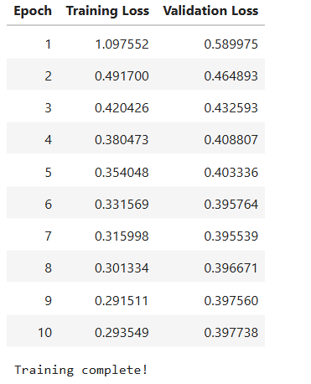

Hindi Ambiguity Resolution using Large Language Models
Training Results & Evaluation
The training loss decreased significantly from 1.097 in Epoch 1 to 0.293 by Epoch 10, representing a 73% reduction, which indicates strong learning progress during training.
The validation loss also consistently decreased, from 0.589 to 0.395, showing stable performance improvement on unseen data.
There were no signs of overfitting, as both training and validation losses decreased together throughout the training process.
The model achieved a final accuracy of 56% on 50 test samples, which is a strong result for a 500M-parameter model applied to Hindi Word Sense Disambiguation (WSD).
Overall, the results demonstrate that the model successfully learned context-based word sense disambiguation.
Fig 5: Result
Fig 4: epoch vs loss
Department of AI&DS
Sikkim Manipal Institute of Technology, SMU
11

Slide 13
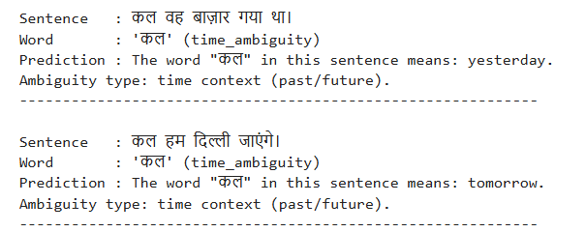
Hindi Ambiguity Resolution using Large Language Models
Results & Model Output
The fine-tuned model was tested on 7 Hindi sentences covering multiple ambiguity types.
Result 1 — Sentence: कल वह बाज़ार गया था | Word: कल | Prediction: yesterday
Result 2 — Sentence: कल हम दिल्ली जाएंगे | Word: कल | Prediction: tomorrow
Result 3 — Sentence: उसके गले में सोने का हार था | Word: सोने | Prediction: gold
Result 4 — Sentence: हाँ, बहुत होशियार हो तुम | Word: होशियार | Prediction: sarcastic
Result 5 — Sentence: वह पानी में मछली की तरह है | Word: मछली | Prediction: idiomatic
Result 6 — Sentence: उसका mood बहुत off है आज | Word: mood | Prediction: code-switched
Fig 6: Prediction
Department of AI&DS
Sikkim Manipal Institute of Technology, SMU
12

Slide 14
Hindi Ambiguity Resolution using Large Language Models
Key Observations & Challenges
The model correctly distinguished कल as yesterday vs tomorrow based purely on sentence tense.
Hinglish sentences with mixed Hindi-English words were handled effectively by the model.
Training only ~1-2% of parameters via LoRA still produced meaningful disambiguation results.
A 500M parameter model is capable of context-aware word sense disambiguation in Hindi.
CHALLENGE 1 — Multi-GPU conflict: 4-bit quantization was incompatible with DataParallel; resolved by switching to single GPU (cuda:0) with float16.
CHALLENGE 2 — Dataset size: 1000 samples are limited for complex ambiguity types like sarcasm and pragmatics.
CHALLENGE 3 — Sarcasm and pragmatic ambiguity are the hardest; context is highly subtle and implicit.
Department of AI&DS
Sikkim Manipal Institute of Technology, SMU
13

Slide 15
Hindi Ambiguity Resolution using Large Language Models
Applications & Future Scope
APPLICATIONS — Improving Hindi query understanding in search engines (Google, Bing).
Enhancing Hindi language support in virtual assistants like Alexa and Google Assistant.
Increasing accuracy in Hindi-to-English machine translation systems.
Sarcasm and sentiment detection in Hindi social media content and news platforms.
Interpreting patient queries accurately in Hindi-language healthcare chatbots.
FUTURE SCOPE — Expand dataset to 10,000+ annotated samples for better generalization.
Experiment with larger models (Qwen2.5-1.5B), extend to Bengali, Tamil, Marathi, and deploy a real-time FastAPI inference service.
Department of AI&DS
Sikkim Manipal Institute of Technology, SMU
14

Slide 16
Hindi Ambiguity Resolution using Large Language Models
References
Qwen Team (2024) — Qwen2.5 Technical Report — https://huggingface.co/Qwen/Qwen2.5-0.5B
HuggingFace PEFT Library — Parameter-Efficient Fine-Tuning — https://github.com/huggingface/peft
TRL SFTTrainer Documentation — Supervised Fine-Tuning — https://github.com/huggingface/trl
Project GitHub Repository — https://github.com/ayushanand1009/hindi-ambiguity-resolution
Dataset — Custom Annotated, 1000 Hindi Sentences, 10 Ambiguity Categories, 391 Unique Words.
Department of AI&DS
Sikkim Manipal Institute of Technology, SMU
15

