Slide 1
MET CS 665 SOFTWARE DESIGN PATTERNS Final Project Presentation Restaurant Manager
Name : Aman Kumar
BU ID: U93309600

Slide 2
DESIGN PATTERNS IMPLEMENTED
State Pattern: Manages transitions and behaviors of restaurant tables based on their state, such as free, occupied, or reserved, encapsulating state-specific actions.
Builder Pattern: Simplifies the creation of complex food items, allowing for customizable and variable constructions without cluttering the code with constructors.
Decorator Pattern: Enables dynamic addition of new functionalities like extra sauces or cheese to food items, enhancing flexibility without altering the base object.
Strategy Pattern: Allows the dynamic selection of algorithms for pricing strategies based on varying conditions such as time of day or promotional events.
Chain of Responsibility Pattern: Decouples request handling by passing them along a chain of potential handlers until one can process the request, enhancing modularity and flexibility.

Slide 3
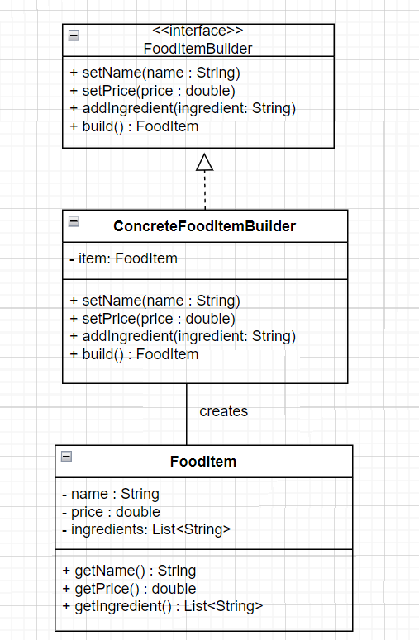
UML BUILDER PATTERN

Slide 4
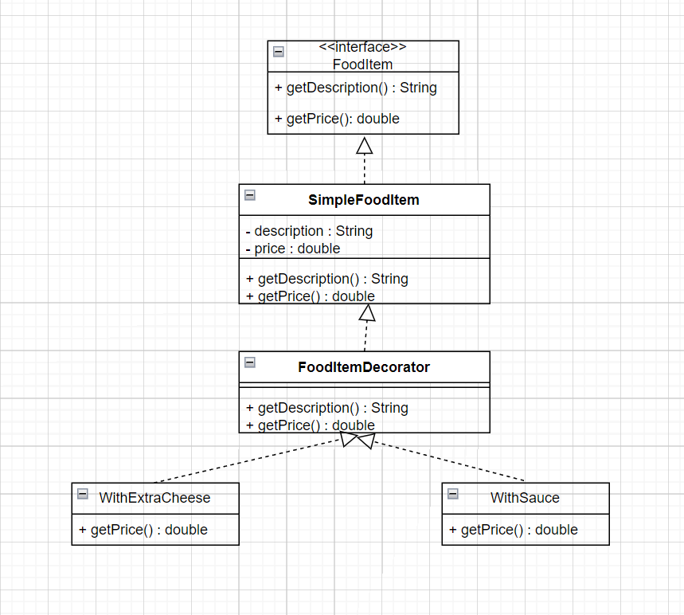
UML DECORATOR PATTERN

Slide 5
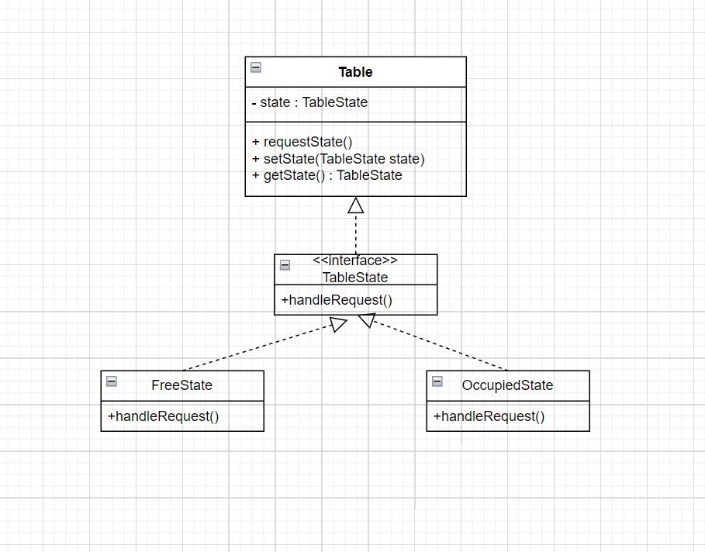
UML STATE PATTERN

Slide 6
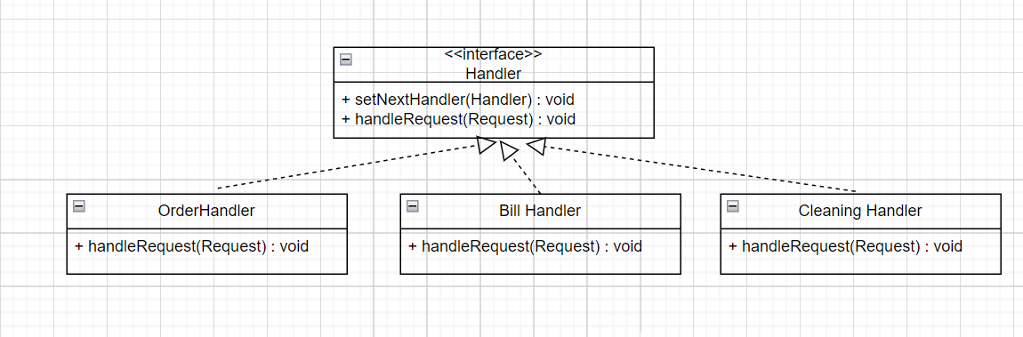
UML CHAIN OF RESPONSIBILITY PATTERN

Slide 7
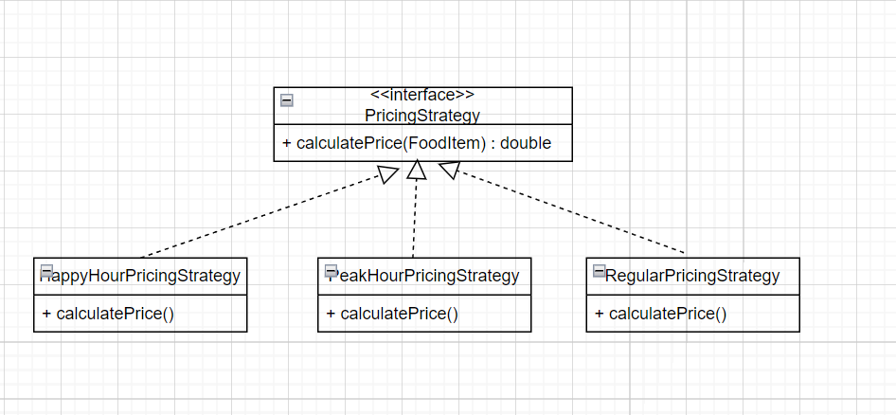
UML Strategy Pattern

Slide 8
DEMO

Slide 9

Thank You!

