Slide 1
Deep learning project Image classification
Submitted to: Submitted by:
Dr. R.K. Sharma Aman Kumar
401503006
COE-12

Slide 2
Introduction
Image classification is one of the many applications of deep learning
Concept of CNN has revolutionized the field of computer vision
This technology is used in text extraction from real world images
Application – Google lens, self-driving cars

Slide 3
Dataset
MNIST database of handwritten digits
10 classes – from digit 0 to 9
Training set contains 60,000 images
Test set contains 10,000 images

Slide 4
Concept
The task of image classification suffers from the curse of dimensionality
Convolutional neural networks(CNNs) layers reduce the features by selecting the most significant features
Therefore, before inputting the features of the images directly to the ANN, images are pre-processed and features are selected
This has been achieved by adding several layers of convolution and pooling
And finally to the ANN for classification

Slide 5
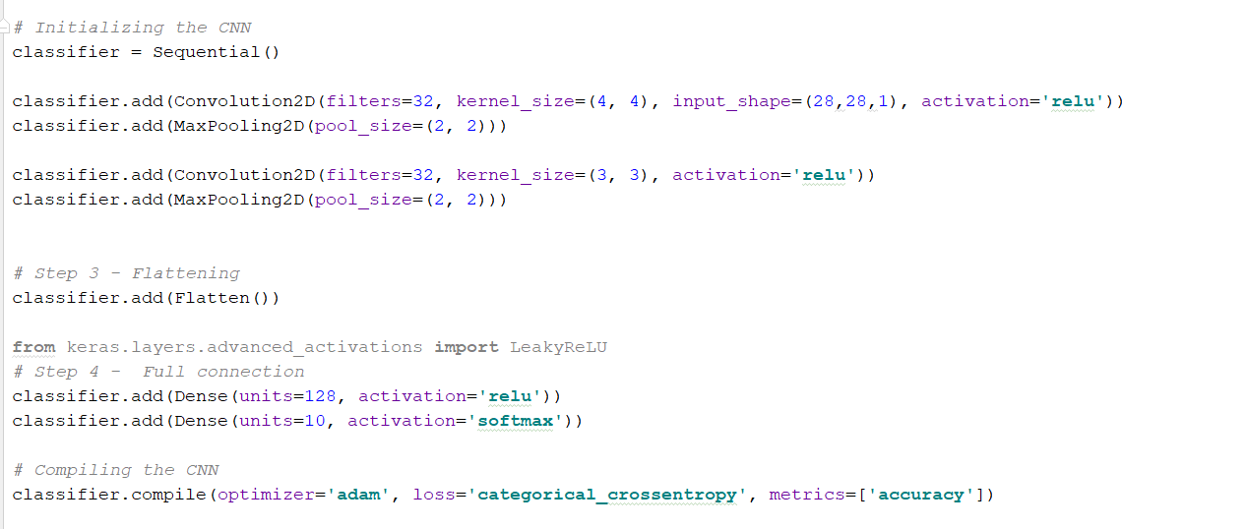
Network architecture

Slide 6
Two Approaches
Without image augmentation
With image augmentation
Shear
zoom

Slide 7
Results
Without image augmentation
Training accuracy – 99.6%
Testing accuracy – 99.04%
With image augmentation
Training accuracy – 99.6 %
Testing accuracy – 99.3 %

Slide 8
Thank You

