Slide 1


A
Project Report On
Armanee Tea Leave
As a Partial fulfillment of B.C.A. Final Year Batch Year (2024-25)
Under taken at
Narsinhbhai Patel College of Computer Studies & Management, Kadi - 382715
SUBMITTED BY
LUHAR ARSHIN FARUKBHAI
KURESHI AMANBHAI MAHEBOOBBHAI
SUBMITTED TO
Narsinhbhai Patel College of Computer Studies & Management, Kadi –
382715

Slide 2


Certificate
This to certify that
Luhar Arshin Farukbhai
Is a student of semester – V Bachelor of Computer Application (B.C.A SEM-V) during academic year 2024-25 in N.P College of Computer Studies And Management, Kadi
He developed project on
Tea Leave
Using Python as Front End and NoSql as Back End at NPCCSM Kadi.
The duration of the project is 120 days.
The system is verified by us and found suitable for implementation at the Firm/Institute.
During project work, He was sincere and regular.
Dr. Nirmesh B. Patel
Project Coordinator
Head of Department
2

Slide 3
Certificate
This to certify that
Kureshi Amanbhai Maheboobbhai
Is a student of semester – V Bachelor of Computer Application (B.C.A SEM-V) during academic year 2024-25 in N.P College of Computer Studies And Management, Kadi
He developed project on
Tea Leave
Using Python as Front End and NoSql as Back End at NPCCSM Kadi.
The duration of the project is 120 days.
The system is verified by us and found suitable for implementation at the Firm/Institute.
During project work, He was sincere and regular.
Dr. Nirmesh B. Patel
Project Coordinator
Head of Department
3

Slide 4
ACKNOWLEDGEMENT
It is always a pleasure to remain the fine people in KSV University for their sincere guidance I received so much help from so many people. In the present world of succeed. Project is like a bridge between theoretical and practical working. With this willing I joined this project.
First of all, I thanks to my parent for giving encouragement, enthusiasm and invaluable assistance to me. Without all this, I might not be able to complete this project. I am feeling oblige in talking the opportunity to sincerely thanks to my worthy teacher Mr. Rajendra Patel sir moreover. I am highly obliged in talking the opportunity to sincerely thank to all the staff members of BCA department for their generous attitude and friendly behavior. At last, but not the least I am thankful to all my teachers and friends who have been always helping and encouraging me though out the year. I have no valuable words to express my heart is still full of the favor received from every person.

Slide 5
PREFACE
Bachelor of computer application & information technology Integrated course offering unique chance to able to find way thought the intricacies and complexities of today information technology word. It covers a very wide spectrum of activities and throughout the course practical knowledge one cannot actually survive in today era of information technology.
I made a Project on Armanee Tea Leave. The project training in 5th semester of the course aims at giving an exposure of real word to all student the course. The objective of project training at this level is to have a practical experience of the word by undertaking a live project. The project consists of develop projects for other institutes of organization.

Slide 6
I | ACKNOWLEDGEMENT
II | PREFACE
INDEX
NO. | CONTENT |  | PAGE NO.
1 | PROJECT PROFILE |  | 7
2 | PRELIMINARY INVESTIGATION
 | 2.1 | NEED OF PROJECT & PROJECT SCOPE | 8
 | 2.2 | Existing system & LIMITATION | 8
 | 2.3 2.4 | ADVANTAGES & DISADVANTAGES OF EXISTING SYSTEM | 9
 | 2.5 | PROPOSED SYSTEM | 9
3 | SYSTEM REQUIREMENT SPECIFICATION
 | 3.1 | HARDWARE & SOFTWARE at Server side | 10
 | 3.2 | HARDWARE & SOFTWARE at Client side | 10
 | 3.3 | NON-FUNCTIONAL REQUIREMENTS | 11
 | 3.4 | FRONTEND AND ITS NEED | 12
 | 3.5 | BACKEND AND ITS NEED | 13
4 | SYSTEM ANALYSIS & DESIGN |  | 14
 | 4.1 | HERACHICAL CHART | 15
 | 4.2 | DATA FLOW DIAGRAM | 16
 | 4.3 | DFD-1 DIAGRAM | 17
 | 4.4 | DATA DICTIONARY | 21

Slide 7
1.) PROJECT PROFILE
PROJECT TITLE: - Armanee Tea Leave
PROJECT DEFINITION: The "Armanee Tea Leaves" project is an e-commerce platform designed to sell a variety of tea leaves packets online.
INTERNAL GUIDE: -Aman Kureshi
FRONTEND: -HTML,CSS,BOOSTRAP-5
BACKEND: - Python,Django
TEAM NUMBER: -
GROUP DETAIL: -
N0 | NAME | ROLL.NO. | ENROLLMENT NO | EXEAM NO
1 | LUHAR ARSHIN FARUKBHAI | 210 | 22BCA24055 | 165060
2 | KURESHI AMANBHAI MAHEBOOBBHAI | 90 | 22BCA240151 | 165056
7

Slide 8
2) . PRELIMINARY INVESTIGATION
  NEED OF PROJECT
    Armanee Tea Leave Provide power full database security to user.
    Authorized person can access functionality of this system.
  PROJECT SCOPE & LIMITATION PROJECT SCOPE:
    The project focuses on building an e-commerce platform for selling tea leaves under the brand "Armanee Tea Leaves." Users can browse tea products, add them to the cart, and place orders online.
LIMITATION:
It may also face challenges in handling high traffic without advanced server optimization.
  Existing system
    In the current market, tea leaves are usually sold through physical stores or basic websites without advanced e-commerce functionalities.In existing system more paper work compared to new system.
    Many tea sellers rely on third-party platforms for online sales, limiting brand control.
2.4) ADVANTAGES & DISADVANTAGES OF EXISTING SYSTEM
Advantages: -
8

Slide 9
Delivery delays could impact customer satisfaction.
Disadvantages: -
Requires internet access, which may exclude some users.
  Proposed System
    The proposed system is a dedicated e-commerce platform for Armanee Tea Leaves that allows customers to easily buy tea leaves online.
  FEASIBILITY STUDY
    Economic Feasibility: -
      The project is technically feasible as the necessary technologies like e-commerce platforms, payment gateways, and delivery systems are available
9

Slide 10
3) SYSTEM REQUIREMENT SPECIFICATION
3.1) HARDWARE & SOFTWARE at server side:
Hardware specification: -
RAM – 4GB (Minimum)
Hard-disk – 40GB (Minimum)
Intel Core i3 Or AMD A8 (Better Performance)
Software Specification: -
Python Django
Visual Studio Code
3.2) HARDWARE & SOFTWARE at client side:
Hardware specification: -
RAM – 2 GB (Minimum) Hard-disk 10 GB
(Minimum) Any Processor.

Slide 11
Software Specification: -
Window, Linux, Parrot OS (user can use any operation system except dos.)
Web Browser JavaScript enabled
3.3) Non-Functional Requirements: -
Security:
Only Authorized users can access the system with username and password.
The details of user must be safe and secure.
Performance:
Web pages are loaded in few seconds.
Easy tracking of records and updating can be done.
User Friendly:
The System is very interactive and menu-based interface.
Maintainability:
The Database must be keep backed up
Availability:
The system is available 100% for the user and is used 24 hrs.
A day and 365 days a year.

Slide 12
3.4) FRONTEND AND ITS NEED
HTML: -
The Hypertext Markup Language, or HTML is the standard markup language for documents designed to be displayed in a web browser.
It is used to generate web page.
It provides a means to describe the structure of text- based information in a document.
CSS: -
Cascading Style Sheets is a style sheet language used for describing the presentation of a document written in a markup language such as HTML.
Target various screen sizes to make web page responsive
Primarily handles the “Look and Feel” of a web page
JavaScript: -
Interactivity to a web page.
Handles complex function and Features Frontend validation
Bootstrap: -
Speed development Customizable Contains grid system
It is well documented and supported Make responsive website
12

Slide 13
Python: -
Python is a general-purpose, high-level, interpreted programming language that's used to build software, websites, and conduct data analysis.
Python is easy to learn, efficient, and can run on many platforms.
Python runs on various platforms (Windows, Linux, UNIX, Mac OS X, etc.)
Python supports a wide range of databases(NoSql).
NoSQL: -
A NoSQL database is a non-relational database that stores data in a flexible schema, rather than in tables. NoSQL stands for "not only SQL".
Data model: NoSQL databases can store a variety of data models, including documents, key-value, wide columns, and graphs.
Django : -
Django is a popular Python web framework that is primarily used for backend development. It can be used to build complex and web applications.
Django does not officially support NoSQL databases, but there are side projects and forks that can enable NoSQL functionality in Django
NoSQL stands for non-relational, distributed, flexible, and scalable database.

Slide 14
4) SYSTEM ANALYSIS & DESIGN

Slide 15
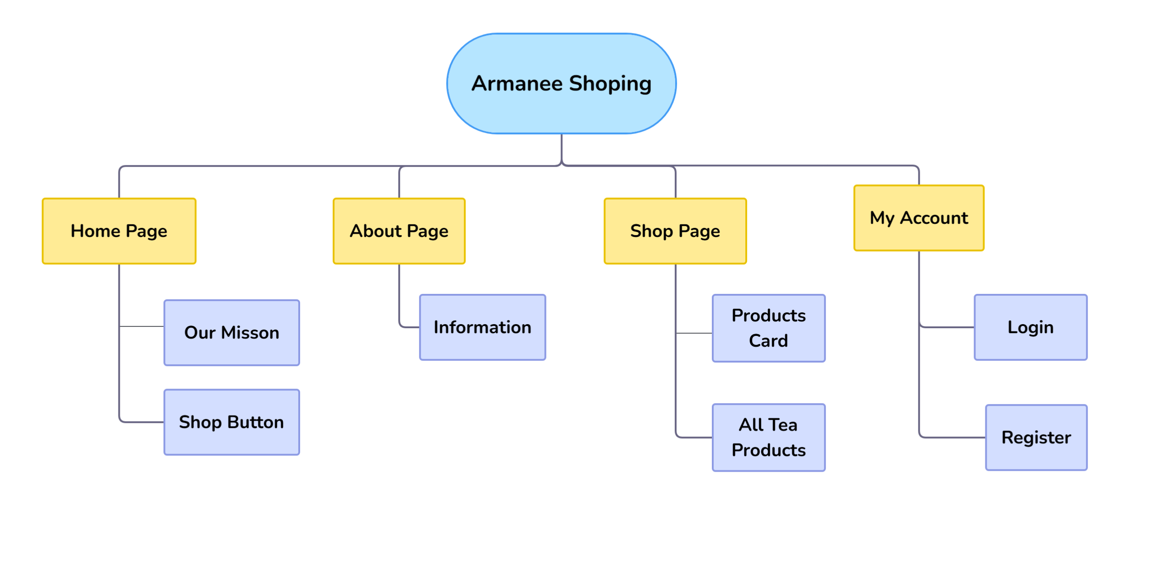
1.1 HIERARCHICAL CHART

Slide 16
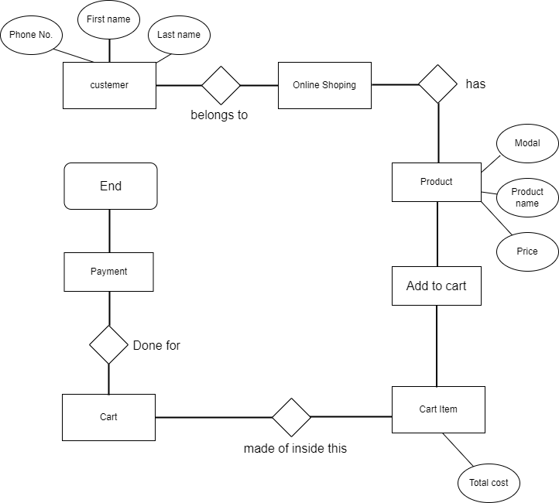
1.2) ER DIAGRAM:
Fig 1

Slide 17
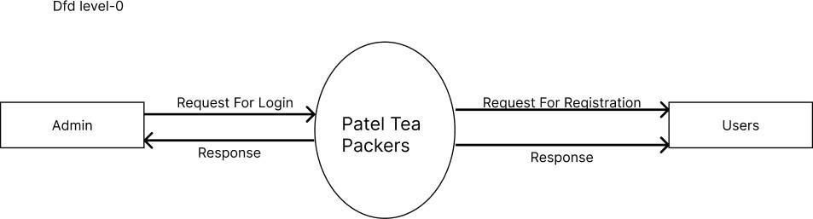
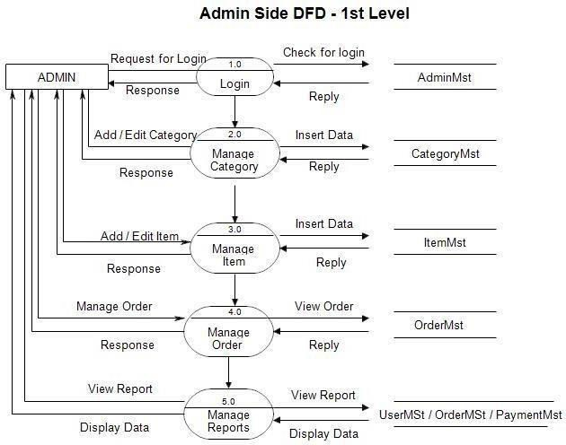
1.
Level 0
Armanee
Tea
Leave
Fig 1: DFD Level 0
2 Level 1 Admin Side DFD
Fig 2: Level 1 Admin Side DFD

Slide 18
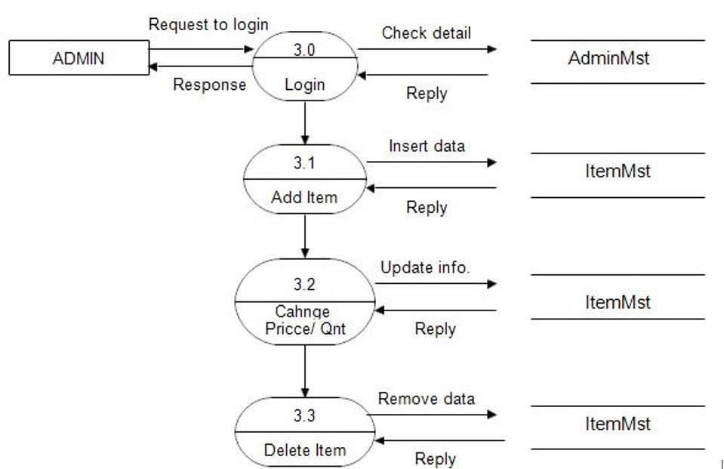
Level 2 Admin Side DFD
Fig 3: Level 2 Admin Side DFD

Slide 19
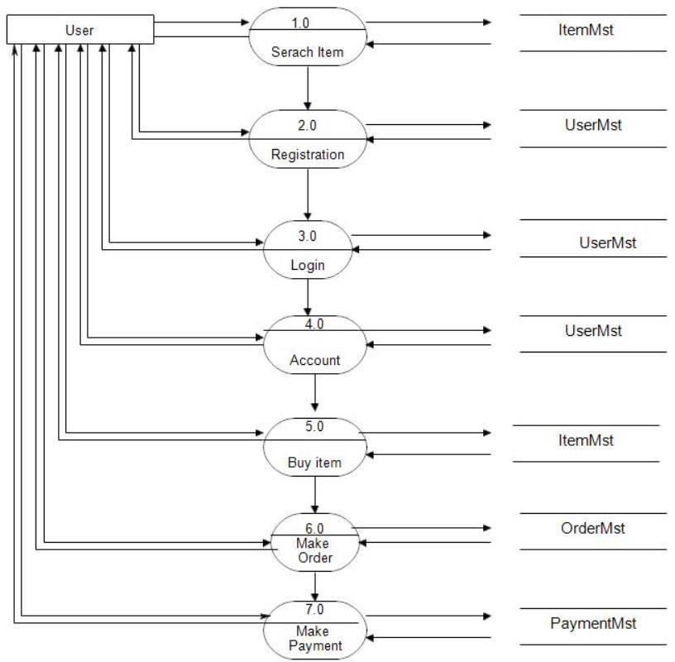
Level 2.1 User
Fig 4: Level 1 User Side DFD

Slide 20
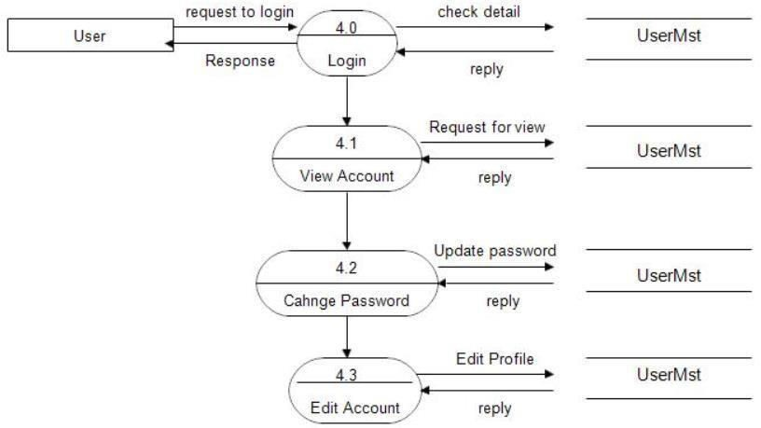
Level 2.2 User
Fig 5: Level 2 User Side DFD

Slide 21
2. DD (List Of Tables)
1. User Table
Field | Datatype
UserID | INT
FirstName | VARCHAR
LastName | VARCHAR
Email | VARCHAR
Password | VARCHAR
PhoneNumber | VARCHAR
Address | VARCHAR
Registration Date | DATE
UserType | VARCHAR
Table 1: User Table
2 .Admin Table
Field | Datatype
AdminID | INT
FirstName | VARCHAR
LastName | VARCHAR
Email | VARCHAR
Password | VARCHAR
AdminType | VARCHAR
Table 2: Admin Table
3 Item Table
Field | Datatype
TransactionID | INT
BuyerID | INT
SellerID | INT
ItemID | INT
TransactionDate | DATETIME
Amount | DECIMAL(10,2)
PaymentStatus | ENUM
Table 3: Item Table

