Slide 1

INTRODUCTION TO MICROPROCESSORS

Slide 2

Explanation of Terms
Evolution of theMicroprocessor

Slide 3

The basic blocks of a computer are the central processing unit (CPU), the memory, and the input/output (I/O).
Computer hardware includes such components as memory, CPU, transistors
Computer software consists of a collection of programs that contain instructions and data for performing a specific task.
a translator is necessary to convert such a program into binary and this is achieved using a translator program called a compiler.

Slide 4
Microprocessor is fabricate a CPU on a single chip
Both metal-oxide semiconductor (MOS)
and bipolar technologies are used in the fabrication process.
Along with the microprocessor chip, appropriate memory
and I/O chips can be used to design a microcomputer.
Microcontrollers include a microcomputer, timers, and A/D (analog-to- digital) and D/A (digital to analog) converters, all on a single chip.

Slide 5

An Address is a pattern of 0’s and 1 ’s that represents a specific location in memory or a particular I/O device. Typical 8-bit microprocessors have 16 address lines, and,
these 16 lines can produce unique 16-bit patterns from 0000000000000000 to
11 11 1 1 11 1 11 11 11 1, representing 65,536 different address combinations.

Slide 6
Addressing mode is the manner in which the microprocessor determines the operand
(data) and destination addresses during execution of an instruction.
An Arithmetic-logic unit (ALU) is a digital circuit that performs arithmetic and logic
operations on two n-bit digital words.
Bit is an abbreviation for the term binary digit. A binary digit can have only two values,
which are represented by the symbols 0 and 1,

Slide 7
Bit size refers to the number of bits that can be processed simultaneously by the basic
arithmetic circuits of a microprocessor. A number of bits taken as a group in this
manner is called a word. For example, a 32-bit microprocessor can process a 32-bit
word. An 8-bit word is referred to as a byte , and a 4-bit word is known as a nibble.

Slide 8
A bus consists of a number of conductors (wires) organized to provide a means of
communication among different elements in a microprocessor system.
Cache Memory is a high-speed, directly accessible, relatively small, semiconductor
read/write memory block used to store data/instructions that the microprocessor may need in the immediate future.

Slide 9
The instruction set of a microprocessor is a list of commands that the microprocessor is designed to execute.
Pipelining is a technique that overlaps instruction fetch (instruction read) with execution.

Slide 10
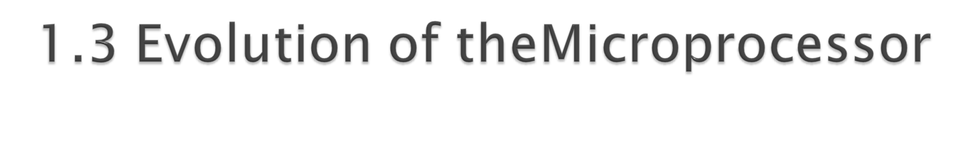
The Intel Corporation is generally acknowledged as the company that introduced the first microprocessor successfully into the marketplace.
The 4004 is the first processor, was introduced in 197 1 and evolved from a development effort while making a calculator chip set
In 1973, second-generation microprocessors (8-bit microprocessors)
such as the Motorola 6800 and the Intel 8080

Slide 11

A third generation microprocessor (16-bit microprocessors)introduced in 1978 is typically represented by the Intel 8086 and the Motorola 68000, which are 16-bit microprocessors.
During the 1980’s, fourth-generation(32-bit microprocessor,
Since 1985, more 32-bit microprocessors have been introduced. These include Motorola’s
68020, 68030, 68040, 68060, PowerPC, Intel’s 80386, 80486, the Intel Pentium family, Core Duo, and Core2 Duo microprocessors..

Slide 12
The original Pentium processor was introduced by Intel in 1993, and the name was changed from 80586 to Pentium because of copyright laws.
latest speed of 233 MHz.

Slide 13
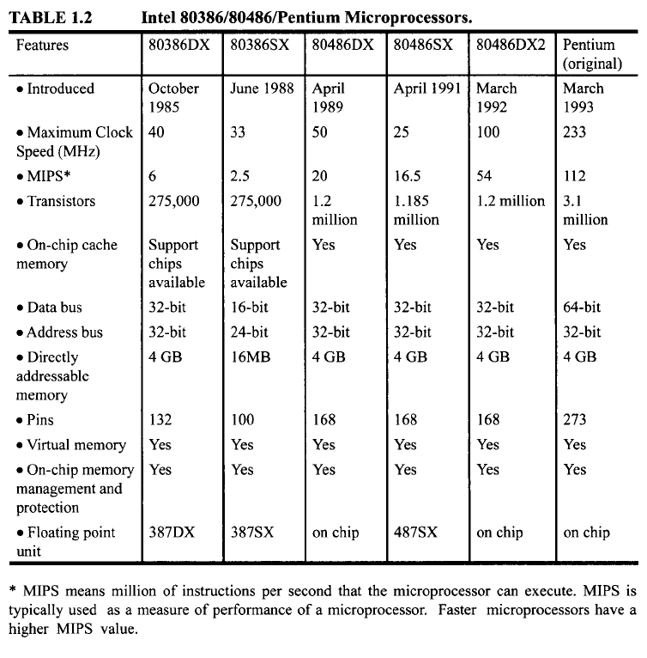

Slide 14
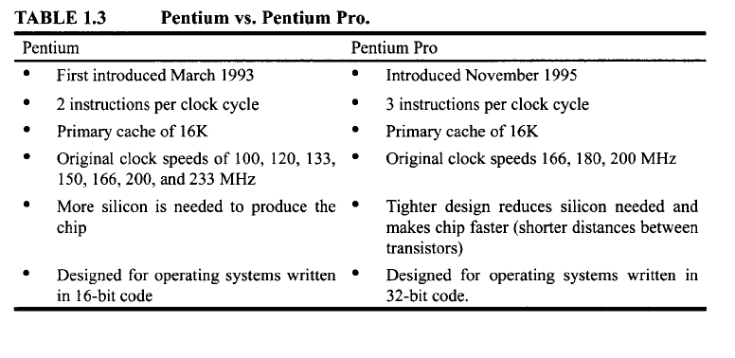

Slide 15
Pentium II It basically takes attributes of the Pentium Pro processor plus the capabilities of MMX technology to yield processor speeds of 333, 300, 266, and 233 MHz.
MMX (matrix math extensions)is intended for efficient multimedia and communications operations.
The Intel Celeron processor speed up to333 MHz

Slide 16
The Pentium III operates at 450 MHz and 500 MHz.
The Pentium IIII currently available at 1.30, 1.40, 1.50, and 1.70 GHz.
Intel introduced the 32-bit Pentium M microprocessor in 2003. It was designed
specifically for the mobile computing market.
In 2006, Intel introduced the 64-bit Core Duo microprocessor that ran at a speed of 1.66 to 2.33 GHz.

Slide 17
The original Core 2 Duo ran at a speed of 1.86 to 2.93 GHz.

