Slide 1
Fashion Classifier
Group 2

Slide 2
Data Science Problem
Create a neural network to classify types of clothing.
Workflow:
First Model
Overfitting
Regularization
Feature Engineering
Performance

Slide 3
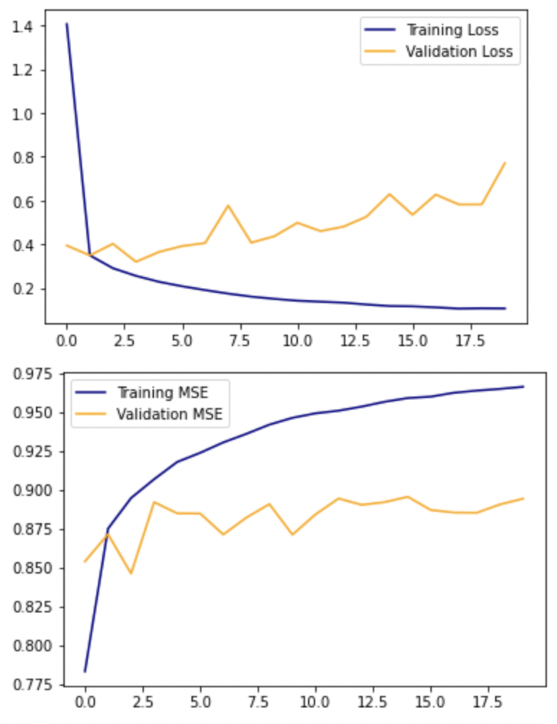
First Model
model.add(Conv2D(32, 3, activation='relu',
input_shape=(28, 28, 1)))
model.add(MaxPooling2D(2))
model.add(Conv2D(128, 3, activation='relu'))
model.add(MaxPooling2D(2))
model.add(Conv2D(128, 3, activation='relu'))
model.add(Flatten())
model.add(Dense(10, activation='softmax'))
Convolution,
MaxPooling
ACC
ACC
Dense

Slide 4
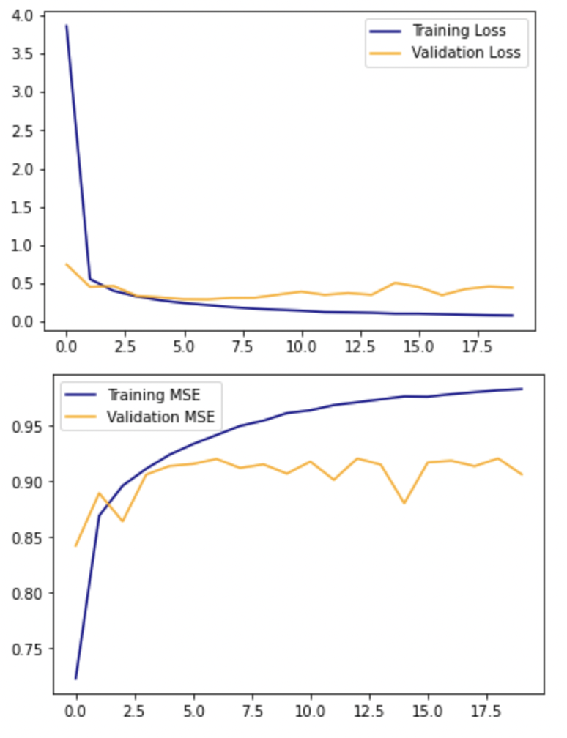
Overfitting
model.add(Conv2D(64, 3, activation='relu',
input_shape=(28, 28, 1)))
model.add(Conv2D(128, 3, activation='relu'))
model.add(MaxPooling2D(2))
model.add(Conv2D(256, 3, activation='relu'))
model.add(Conv2D(512, 3, activation='relu'))
model.add(MaxPooling2D(2))
model.add(Conv2D(512, 3, activation='relu'))
model.add(Flatten())
model.add(Dense(128, activation='relu', kernel_regularizer=l2(0.01)))
model.add(Dense(64, activation='relu', kernel_regularizer=l2(0.01)))
model.add(Dense(32, activation='relu', kernel_regularizer=l2(0.01)))
model.add(Dense(10, activation='softmax'))
Convolution,
MaxPooling
ACC
ACC
Dense:
Weight Decay

Slide 5
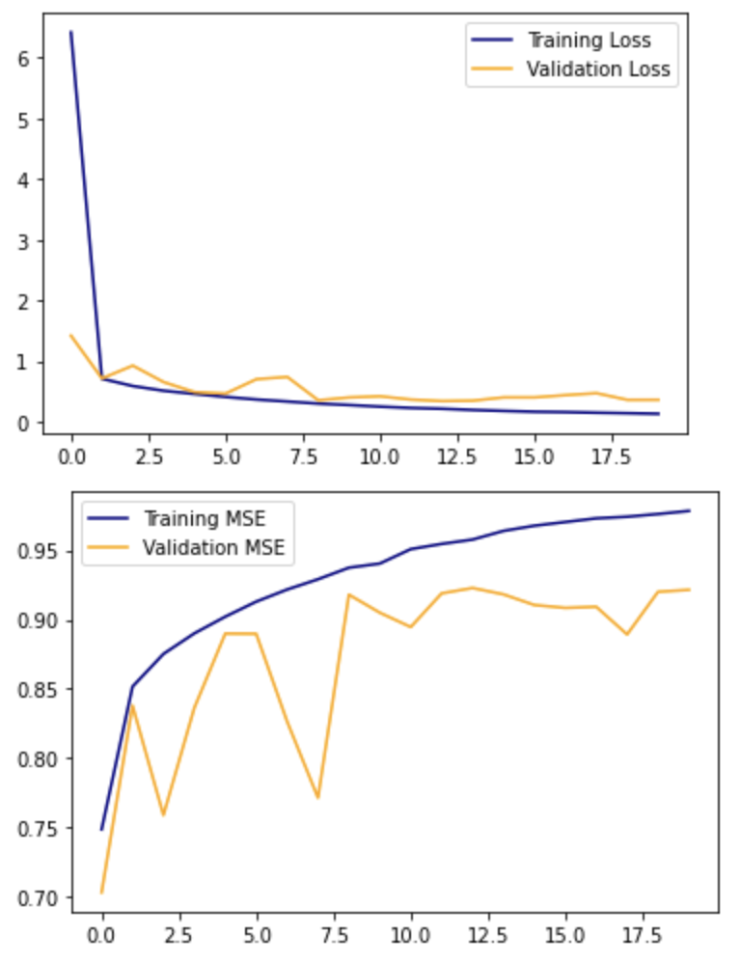
Regularization
model.add(Conv2D(64, 3, activation='relu',
input_shape=(28, 28, 1)))
model.add(Conv2D(128, 3, activation='relu'))
model.add(MaxPooling2D(2))
model.add(Conv2D(256, 3, activation='relu'))
model.add(Conv2D(256, 3, activation='relu'))
model.add(MaxPooling2D(2))
model.add(Conv2D(512, 3, activation='relu'))
model.add(Flatten())
model.add(Dense(256, kernel_regularizer=l2(0.1)))
model.add(BatchNormalization())
model.add(Activation('relu'))
model.add(Dense(128, kernel_regularizer=l2(0.1)))
model.add(BatchNormalization())
model.add(Activation('relu'))
model.add(Dense(64, kernel_regularizer=l2(0.1)))
model.add(BatchNormalization())
model.add(Activation('relu'))
model.add(Dense(32, kernel_regularizer=l2(0.1)))
model.add(Activation('relu'))
model.add(Dense(10, activation='softmax'))
Convolution,
MaxPooling
ACC
ACC
Dense:
Weight Decay,
Batch Norm

Slide 6
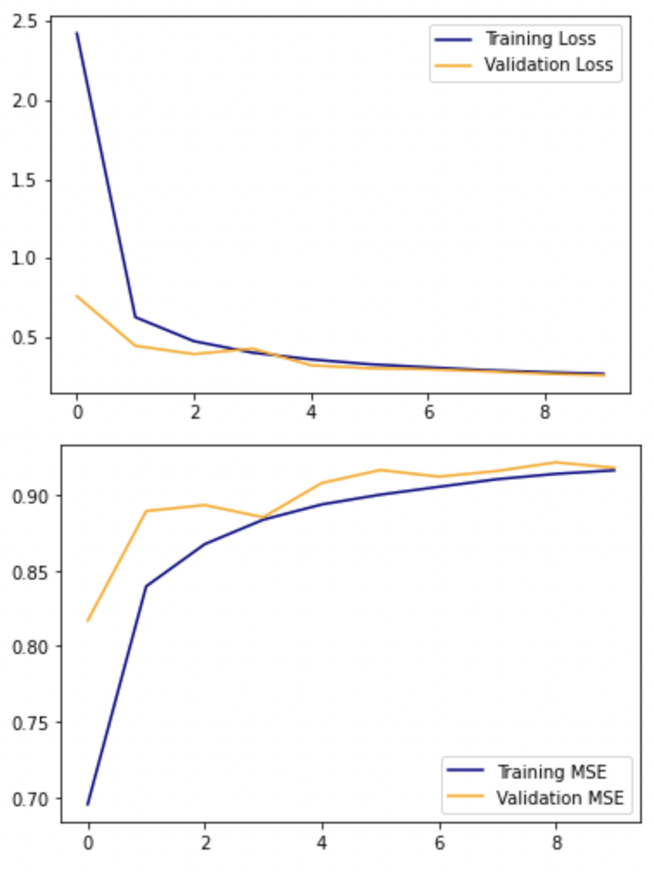
Feature Engineering
#data augmentation
datagen = ImageDataGenerator(
rotation_range=10, zoom_range=0.1
)
image_generator = datagen.flow(
X_train, y_train, batch_size=128
)
ACC
ACC

Slide 7
Final Model
~99% Train Accuracy
~92% Validation Accuracy

Slide 8
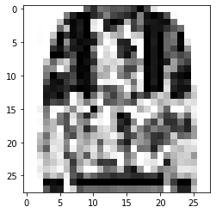
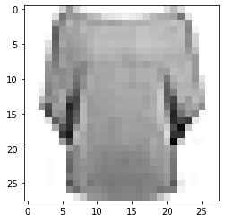
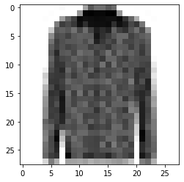
Shirts and pullovers are hard

Slide 9
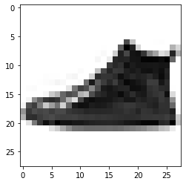
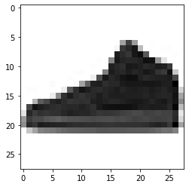
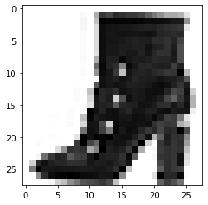
Shoes vs Ankle Boot vs Sandal are also hard

