Slide 1
What can we learn from Ames housing data?
Manlai Amarsaikhan

Slide 2
Project statement
What can we learn from house sales in Ames, IA between 2005-2010?
What affects housing price?
How much does each feature affect the price?
As a seller, what can you do to maximize profit?

Slide 3
General insights from modeling
Most of the categorical features could be converted into binary features. Some examples include,
The interior finish of the garage
The height range of the basement
The condition of the basement
The general zoning classification

Slide 4
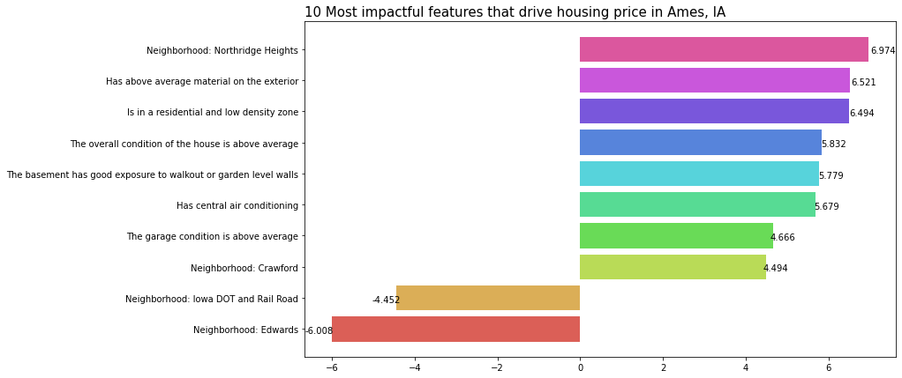
What are the most important features?

Slide 5
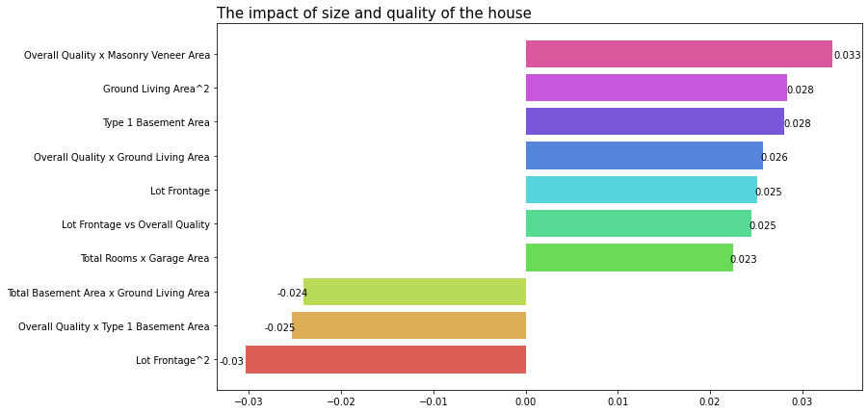
Where does size come into it?

Slide 6
Conclusion
Categorical -> binary
Neighborhood. Neighborhood. Neighborhood.
Large house good. Good quality large house good.
Large lot frontage good. Too large lot frontage bad.
Good quality masonry veneer good
Good quality large basement bad

