Slide 1


Classifying Reddit Post Titles /r/WorldNews vs /r/NotTheOnion
Manlai Amarsaikhan
DSI-919

Slide 2


/r/worldnews
/r/nottheonion

Slide 3
Background and Problem Statement
/r/WorldNews (30.1 million subscribers):
A place for major news from around the world, excluding US-internal news.
/r/NotTheOnion (21.9 million subscribers):
For true stories that are so mind-blowingly ridiculous that you could have sworn they were from The Onion.
Reddit moderators routinely remove inappropriate posts
Can they use machine learning to more efficient (and perhaps more accurate) filtering?

Slide 4
Data
Pushshift API
time, title and subreddit of each post were downloaded.
24,956 /r/WorldNews posts
24,978 /r/NotTheOnion posts
The fate of a post is never tracked

Slide 5
Data Cleaning
English stop words were removed.
NLTK.tokenize.RegexpTokenizer that matches
alphanumeric characters,
dollar amounts
non-white space characters
NLTK.pos_tag to identify parts of speech of each word
NLTK.stem.WordLemmatizer was used to group word inflections as a single word
sklearn.feature_extraction.text.CountVectorizer to convert strings to numeric features
Training data: 37444 x 25075
Testing data: 12482 x 25075
The subreddits share about half of their unique tokens

Slide 6
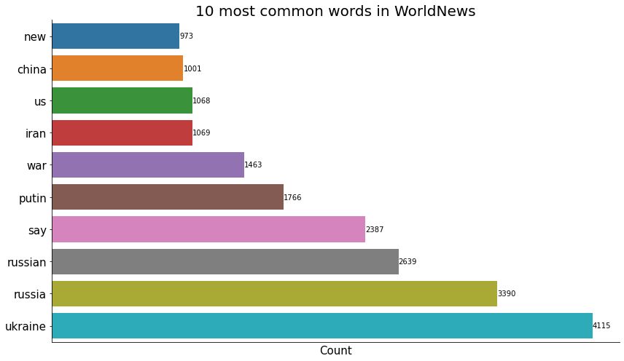

Slide 7
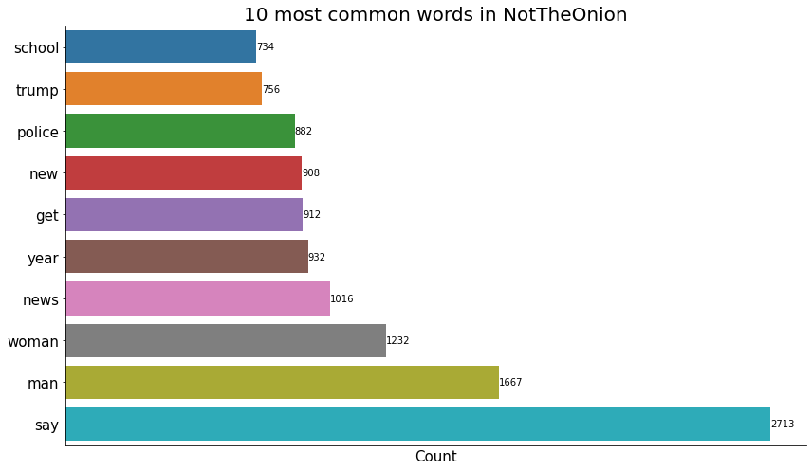

Slide 8
Models
Logistic Regression
Multinomial Naive Bayes
Random Forest
Support Vector Machine
Gradient Boosting
Ensemble of
Logistic Regression,
Multinomial Naive Bayes,
Random Forest,
Decision Tree,
Support Vector Machine

Slide 9
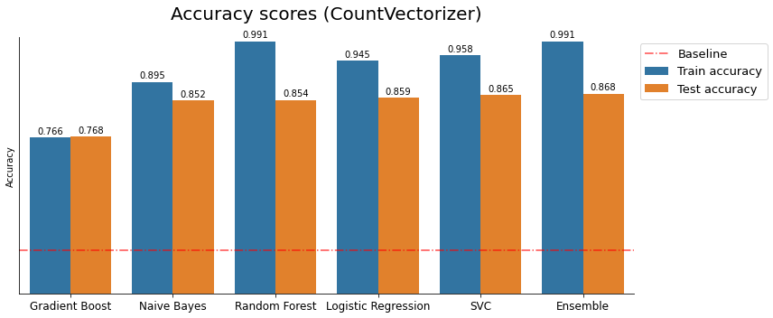
Model evaluation

Slide 10
Hyper Parameter Tuning: Logistic Regression
High-ish accuracy
Overfit
Fast

Slide 11
Hyper Parameter Tuning: Logistic Regression
ngram range
Lower cutoff point for document frequency
Upper cutoff point for document frequency
The norm of the penalty term of the Logistic Regression
Optimization algorithm
Regularization strength

Slide 12
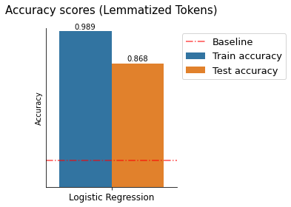
Hyper Parameter Tuning: Logistic Regression
ngram range
Lower cutoff point for document frequency
Upper cutoff point for document frequency
The norm of the penalty term of the Logistic Regression
Optimization algorithm
Regularization strength

Slide 13
Conclusion
Performs much better than baseline
Still overfit
Accurately predicts 87%.
Use lower cutoff for document frequency
Modify the tokenizer method to filter out more words
Feature engineering

