Slide 1
Achieving sustainable energy goals through cross-border cooperation
A case-study of Israel, Palestine and Jordan
Aman Majid and Suleiman Halasah
Oxford Martin School, University of Oxford

Slide 2
Project
Research Question
“Could cross-border cooperation facilitate the delivery of common energy goals to 2030?”

Slide 3
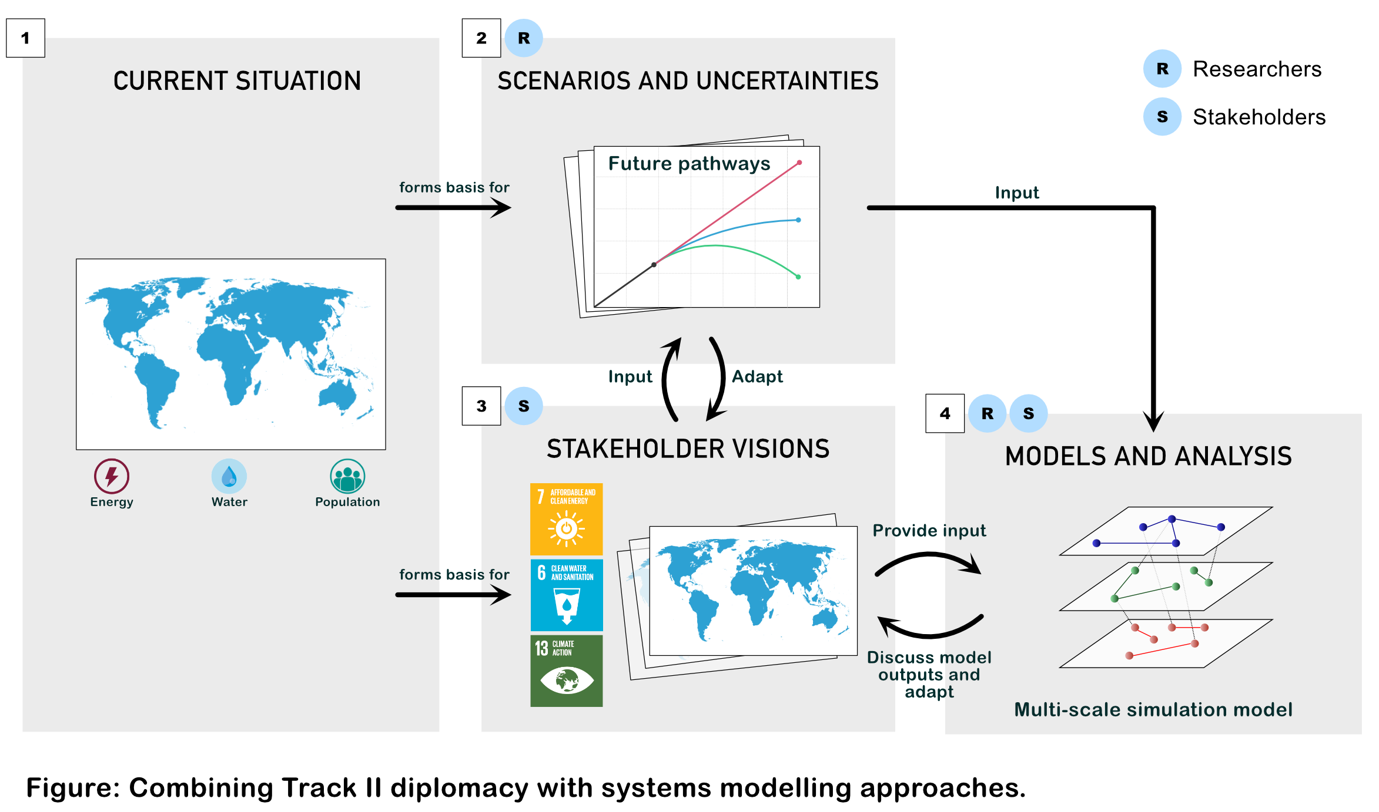
Framework

Slide 4
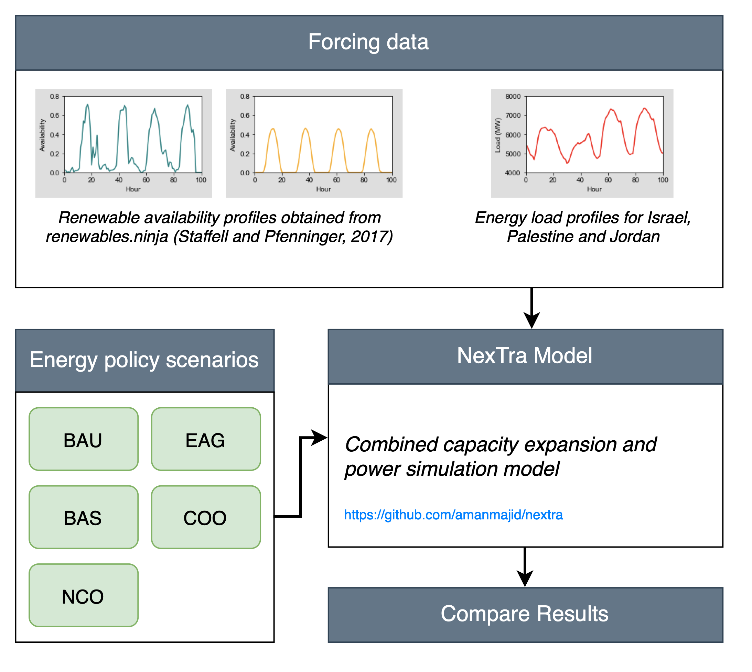
Model
Setup
Forcing data: use modelled renewable capacity factors and forecasted energy demands (2030)
Energy demands forecasts are based on historical data
Five scenarios of energy cooperation are considered
Energy capacity planning model optimises the energy mix in 2030 and simulates system performance
Model is available for free online

Slide 5
Data gaps
Energy load in Jordan: ideally we would like load profiles in northern, southern, and central Jordan
Jordan electricity exports: For example, how much electricity is exported to the West Bank?
Jordan electricity imports: For example, how much electricity does Jordan import from Egypt?
For all above, we would ideally need hourly resolution time series:
x-axis: hour
y-axis: MW or MWh

Slide 6
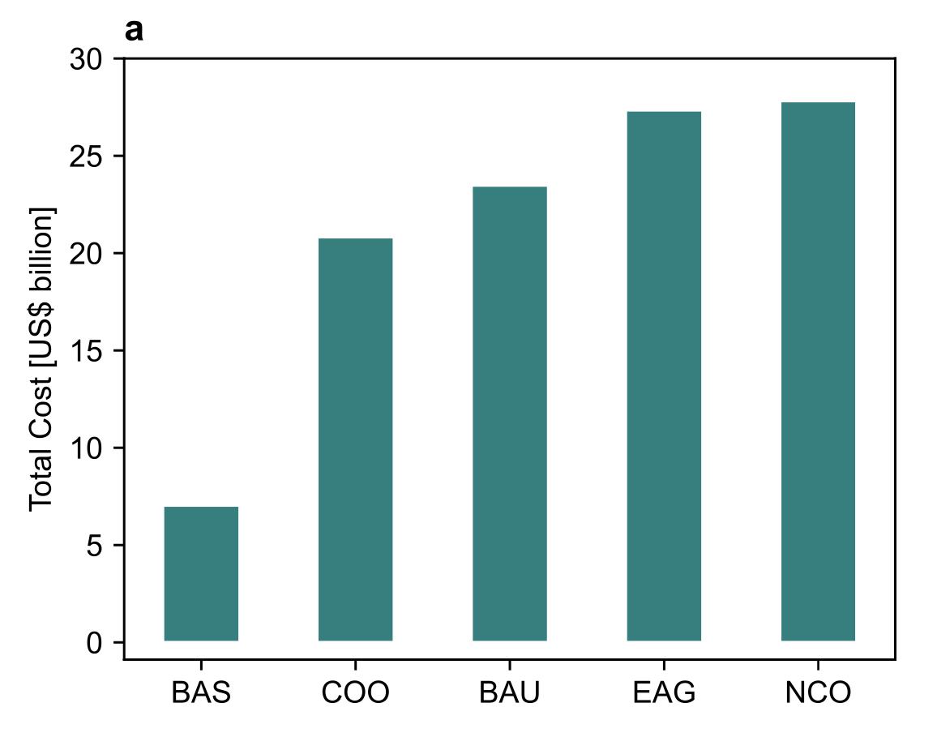
Results
Expected model outputs
We will quantify the electricity system costs in 2030 under varying levels of cooperation between IPJ
For example:
“Meeting sustainable development goals under cooperative energy policies could save 4 billion USD compared to Business-as-Usual. Jordan could export X MW of electricity to Israel and West Bank to help them meet SDG targets.”

