Slide 1
Association Rule Mining (Frequent Itemset Generation using Apriori Algorithm)
MALDAR AMAN
Notes:
You don’t need to know anything about GPUs for the first 6 out of 8 slides!

Slide 2
Agenda
Introduction to Association Rules
Analyzing Frequent Itemset Generation
Apriori Algorithm Pseudocode
GPU Kernel Implementation
Observations and Results

Slide 3
Related Work and Motivation
Background
Efficient but computation intensive algorithm
Works well with small databases
Ongoing Research work –
Distributed computing using Hadoop and MapReduce
Different optimization techniques on the dataset
Utilizing multiple GPU
Dataset transformation to bitmap to reduce memory
Memory coalescing techniques for better speedup
Notes:
Existing approach –
Hadoop distribution – distributed computing on multiple nodes using map reduce.
Apriori Algorithm is one of the techniques of Data Mining for finding Frequent Itemsets useful in Business Analysis. This is an efficient algorithm for mining Itemsets. But in reality, this algorithm is computationally intensive due to multiple scans of the database in order to find the frequent itemsets. It works efficiently for small databases whereas for large databases, due to its large size, its performance decreases. So to increase its performance and to make it efficient even for the large databases, the algorithm is parallelized on GPU using CUDA. Comparison of the execution time of Parallel-Apriori with an efficient serial Apriori program is used to show the speedup on a real-world data set and even on synthetic data set.

Slide 4
Contribution
Design and Implementation of Algorithm using transactional dataset
Perform time analysis of implementation for different datasets
Notes:
and support
Calculate the memory utilization

Slide 5
Association Rules
Introduction
Items that occur often together are associated with each other.
These together occuring items are called frequent itemset.
Trans# | Items
1 | Bread, Milk
2 | Bread, Milk, Beer, Eggs
3 | Milk, Banana, Beer, Soda
4 | Bread, Milk, Eggs, Beer
5 | Bread, Beer, Banana, Soda
Examples of association rules
{Bread} → {Milk}, {Bread, Milk} → {Eggs}, {Beer} → {Soda},
Notes:
Quick Introduction - Market Basket example . Milk and breads -> eggs
Other example – YouTube recommendation, website browsing
Advantage of this analysis is to make the products more accessible to user and generate more profit.
Dataset – fimi website – actual transcations from Belgian stores.

Slide 6




Introduction (cont.)
Rule Evaluation Metrics
Support (s)‏
Fraction of transactions that contain both X and Y
Association Rule
An implication expression of the form X → Y, where X and Y are non-overlapping itemsets
$$\text{\{}\text{Bread}\text{, }\text{Milk}\text{\}} \text{→}\text{ \{}\text{Eggs}\text{\}}$$
$$\text{\{}\text{Bread}\text{\}} \text{→}\text{ \{}\text{Eggs}\text{\}}$$
$$s= \frac{σ(Bread, Milk, Eggs)}{|T|}= \frac{2}{5}=0.4$$
$$s= \frac{σ(Bread, Milk)}{|T|}= \frac{3}{5}=0.6$$
Trans# | Items
1 | Bread, Milk
2 | Bread, Milk, Beer, Eggs
3 | Milk, Banana, Beer, Soda
4 | Bread, Milk, Eggs, Beer
5 | Bread, Beer, Banana, Soda
Trans# | Items
1 | Bread, Milk
2 | Bread, Milk, Beer, Eggs
3 | Milk, Banana, Beer, Soda
4 | Bread, Milk, Eggs, Beer
5 | Bread, Beer, Banana, Soda
Notes:
6
Goal is to find all association rules that satisfy user-specified called as minimum support and minimum confidence threshold.
Support – How often a both the items occurs in the database. If you count .. Milk and diaper appears thrice. [milk, diaper, beer appears twice]
Programmers point of view , I need to find out the frequency of occurences of pair.
It is -> an expression for association rules. Association Rules are interesting association relationship among huge amounts of transactions. An association rule is an expression of the form X => Y, where X and Y are sets of items.

Slide 7
Analysis
Name | Item #
Banana | 1
Beer | 2
Bread | 3
Eggs | 4
Soda | 5
Milk | 6
Each item has an Item #
Each transaction contains items # in ascending order
Trans.# | Items
1 | Bread, Milk
2 | Bread, Milk, Beer, Eggs
3 | Milk, Banana, Beer, Soda
4 | Bread, Milk, Eggs, Beer
5 | Bread, Beer, Banana, Soda
Trans.# | Items
1 | 3,6
2 | 2,3,4,6
3 | 1,2,5,6
4 | 2,3,4,6
5 | 1,2,3,5
Notes:
Ascending order –Apriori property
Black table is transactional data format.
Vertical Representation = This approach is referred to as a “Tidset”.

Slide 8
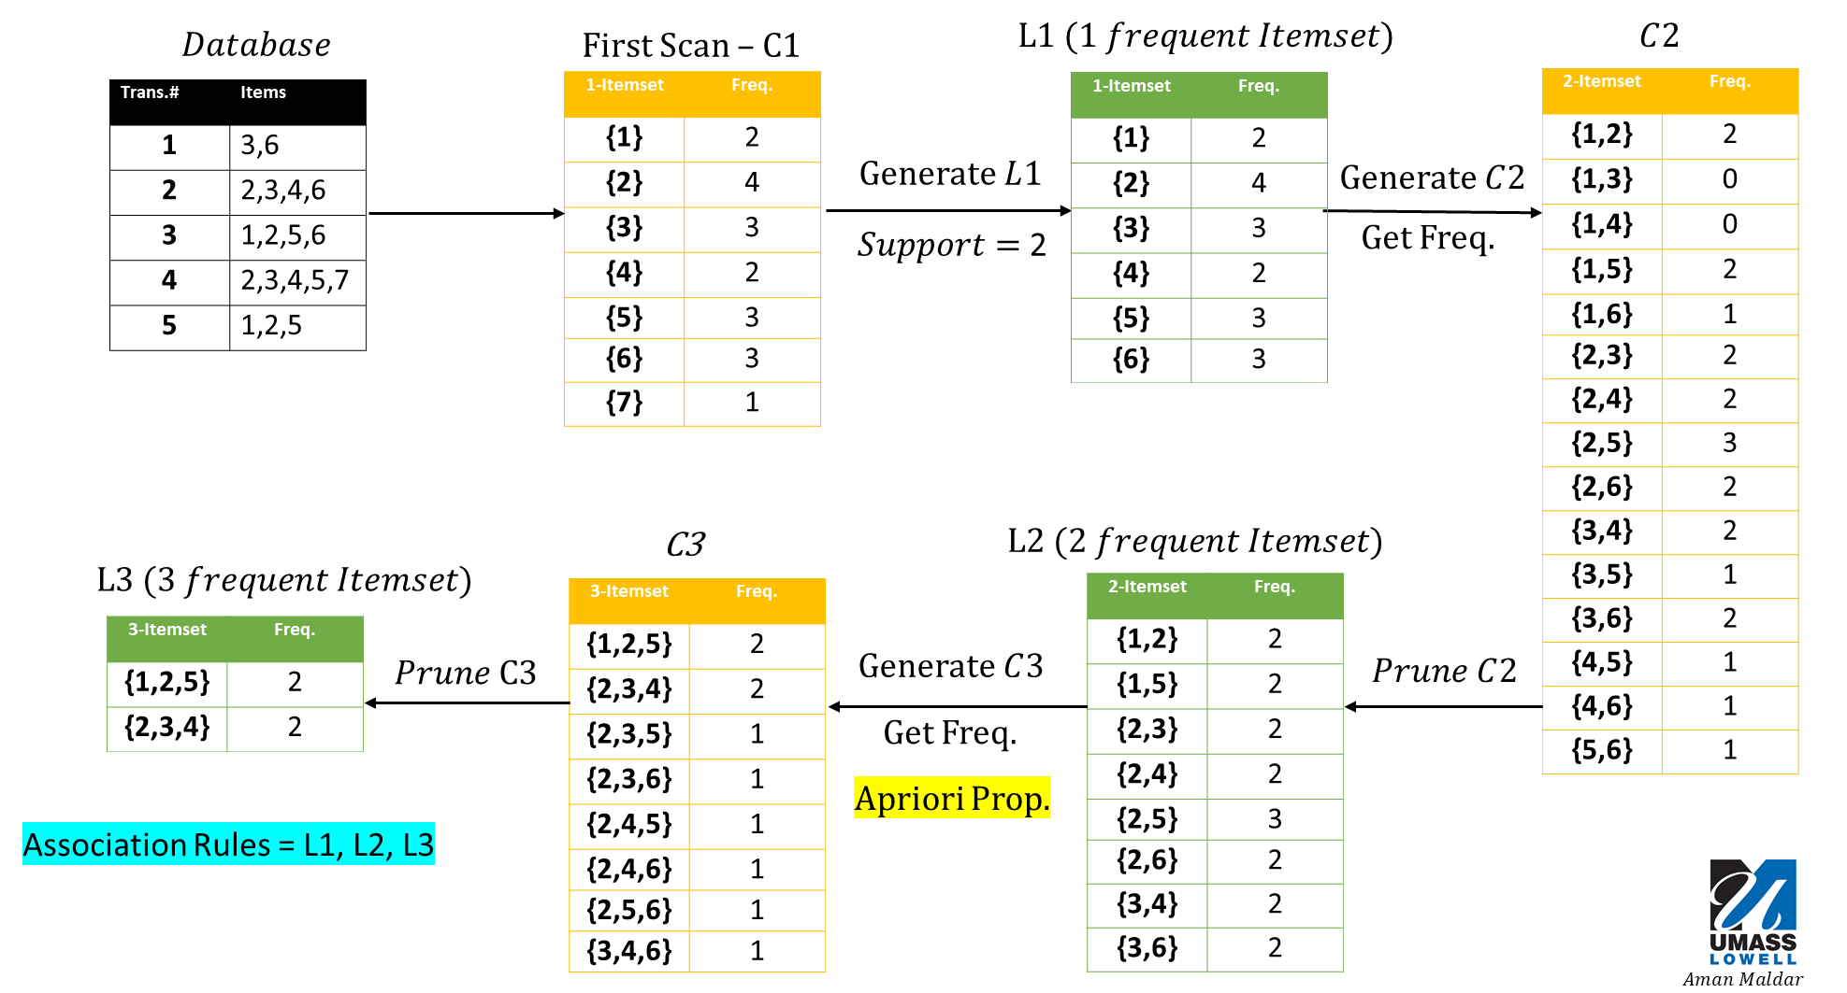
Analysis (cont.)
Notes:
Before going into pseudo algorithm I will run you through the steps involved in this algorithm.
TID is just a transaction number.
Apriori Property -
Itemset Generation – Itemset is not frequent if it’s subsets are not frequent. This is used in pruning. AB is not frequent and hence no point in generating its supersets.
Support = 2
Prune -
If you observed, we manually went through each transaction to calculate the number of occurrences. For M itemsets and N transactions, MN iterations are done.
The Apriori algorithm uses a same principle.
L1, L2 and L3 are our final datasets.

Slide 9
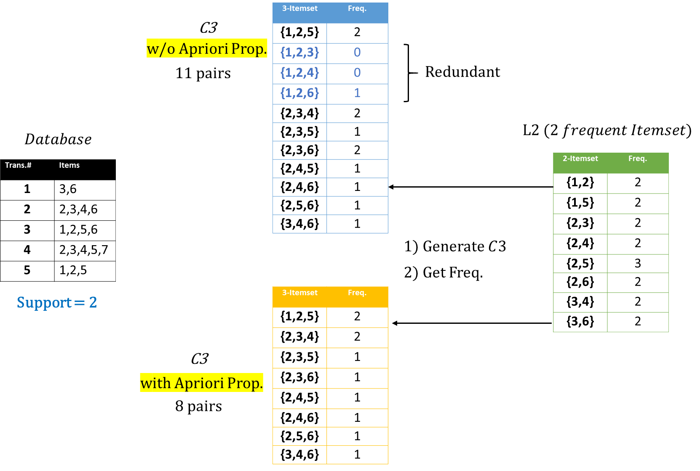
How Apriori Works?

Slide 10
Apriori algorithm in pseudocode
Identify Repetitive Functions
C_{k}: Candidate itemsets of size k, L_{k} : frequent itemsets of size k
L₁ = {frequent 1-itemsets};
for (k = 2; L_{k} != ∅; k++)
C_{k+1} = GenerateCandidates(L_{k})‏ CPU | GPU
for each candidate in Ck, do CPU | GPU
count the number of transactions in database containing a candidate (support for candidate)
endfor
L_{k+1} = candidates in C_{k+1} with support ≥support [pruning] CPU | GPU
endfor
return ∪_{k} L_{k};
Notes:
Candidate generation is not compute intensive application and can be taken care by CPU.
--------------------------------------
It performs a level-wise search. In each iteration (line 2 to 10), firstly, a set of k candidates is generated by joining two frequent (k - 1)- itemsets if they share a common (k - 2)-prefix. A pruning procedure is invoked to eliminate any candidate which contains an infrequent subset; secondly, the support of every candidate itemset is counted by scanning the database. The It performs a level-wise search. In each iteration (line 2 to 10), firstly, a set of kcandidates is generated by joining two frequent (k - 1)- itemsets if they share a common (k - 2)-prefix. A pruning procedure is invoked to eliminate any candidate which contains an infrequent subset; secondly, the support of every candidate itemset is counted by scanning the database. The
----discuss this ---
Bottlenecks
1) Candidate Generation depends on result of previous steps
2) Needs several iterations on the database to calculate support***

Slide 11
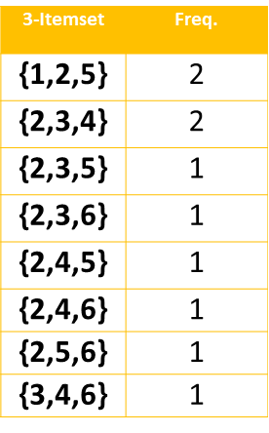


GPU Kernel Implementation
$$GPU DRAM$$
Trans.# | Items
1 | 3,6
2 | 2,3,4,6
3 | 1,2,5,6
4 | 2,3,4,5,7
5 | 1,2,5
Pair $\{2,3,4\}$
Copy the Transaction Database to DRAM
Generate the pairs on CPU
Copy the pairs to GPU
Each thread works on single pair to find freq.
Return the freq. counter to CPU
Any Problem???

Slide 12

GPU Kernel Implementation (cont.)
Problems with shared Memory!
$$GPU DRAM$$
Trans.# | Items
1 | 3,6
2 | 2,3,4,6
3 | 1,2,5,6
4 | 2,3,4,5,7
5 | 1,2,5
Pair $\{2,3,4\}$
Number of blocks = 128
Number of threads = 32
Total Elements accessible = 4096
Shared Memory = 48KB
Transcation Elements in shared memory= 6K
Use the BitMap format!

Slide 13
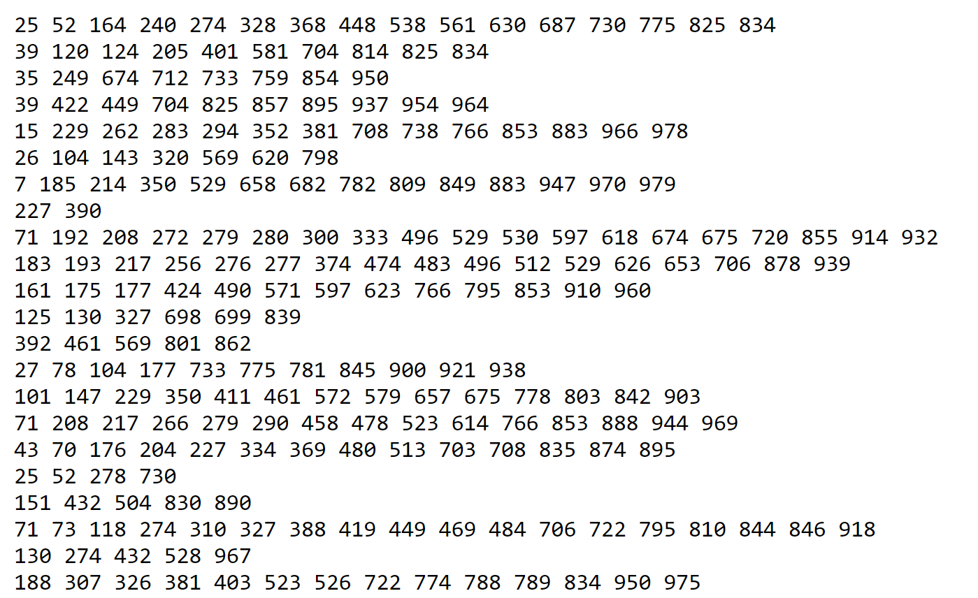
Observations and Results
Dataset:
Research datasets
100,000,000 items!
Support = 1
Database Items | CPU Time (mS) | GPU Time (mS)
32 | 1 | 1200
3000 | 15 | 1220
32000 | 305 | 1250
Notes:
The data access on device memory, global memory, texture memory, and constant memory varies the performance of the algorithm. Also, CUDA environment gives flexibility to share combined memory, offers very less communication overheads

Slide 14
Conclusion
GPU execution time increase is slow
CPU execution time increases rapidly with increase in size of dataset
The dataset has to be optimized to achieve better memory utilization

Slide 15
References
[1] cs-people.bu.edu/evimaria/cs565-12/lect2.pptx
[2] https://www.codeproject.com/articles/70371/apriori-algorithm
[3] Parallelizing Apriori Algorithm on GPU , K. Spandana, D. Sirisha, S. Shahida International Journal of Computer Applications (0975 – 8887) Volume 155 – No 10, December 2016 [4] http://www.comp.nus.edu.sg/~hebs/pub/wenfrequent_sigmod09.pdf
[5] https://link.springer.com/article/10.1007/s11227-011-0672-7

Slide 16
Thank You

Slide 17
Backup slides

Slide 18
Progress and Concerns (cont…)
Concerns
Size of the shared memory is not sufficient
May need to partition the database
I have a kickstart by using small datasets.
Expected to deal with large size databases.

Slide 19
Progress and Concerns
Progress
CPU version of the program is completed.
Measurement Metrics:
one_freq_itemset: 500
two_freq_itemset: 51532
three_freq_itemset: 33105
four_freq_itemset: 6644
Database Entries | Support | Time (Sec) | Memory
1000 | 0.001 | 0.650 | 2.61 MB
10000 | 0.0001 | 34 | 9.39 MB
20000 | 0.00005 | 138 | 11.96 MB
Notes:
Database entries =1000, 10000, 20000
Number of Entries in each transaction = 2, 3 or 4.
Confidence value = 0.5
Ref for memory usage: (Memory used by the process)
https://stackoverflow.com/questions/131303/how-to-measure-actual-memory-usage-of-an-application-or-process?utm_medium=organic&utm_source=google_rich_qa&utm_campaign=google_rich_qa
For original prog it is 8.52 MB max.

Slide 20
Limitations of Approach
Bottlenecks and improvements
Bottlenecks
1) Candidate Generation depends on result of previous steps
2) Needs several iterations on the database to calculate support***
Notes:
This algorithm is computationally intensive due to multiple scans of the database in order to find the frequent itemsets.
It works efficiently for small databases whereas for large databases, due to its large size, its performance decreases.
So to increase its performance and to make it efficient even for the large databases, the algorithm is parallelized on GPU using CUDA
Candidate generation generates large numbers of subsets (the algorithm attempts to load up the candidate set with as many as possible before each scan)
BOTTLENECK 1) we cannot generate pair of three unless all the pair of two are pruned using Apriori property. Uses a uniform minimum support threshold
Difficulties to find rarely occuring events
Some competing alternative approaches focus on partition and sampling

Slide 21
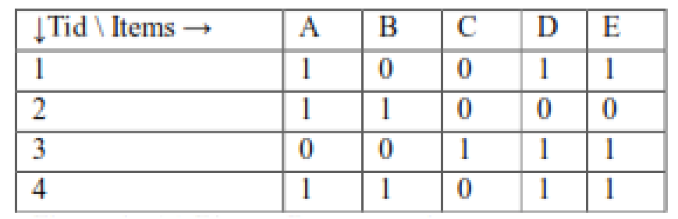
Proposed Strategy
Determining CPU and GPU Functions [3]
CPU converts the transaction details into BitMap representation to reduce memory
Candidate generation can be still done by CPU
Counting the number of occurrence of candidate in the given database using GPU (uses 1000s of threads)
Pruning of the itemset is done by CPU
Notes:
10000 TID, with each TID having 32 entries
- 4 Byte * 10000 = 40 Mb of database

Slide 22
Apriori algorithm in pseudocode [1]
Identify Repetitive Functions
C_{k}: Candidate itemsets of size k, L_{k} : frequent itemsets of size k
L₁ = {frequent 1-itemsets};
for (k = 2; L_{k} != ∅; k++)
C_{k+1} = GenerateCandidates(L_{k})‏ CPU*
for each candidate in Ck, do GPU*
count the number of transactions in database containing a candidate (support for candidate)
endfor
L_{k+1} = candidates in C_{k+1} with support ≥min_sup /pruning CPU*
endfor
return ∪_{k} L_{k};
Notes:
Candidate generation is not compute intensive application and can be taken care by CPU.
--------------------------------------
It performs a level-wise search.
In each iteration (line 2 to 10), firstly, a set of k candidates is generated by joining two frequent (k - 1)- itemsets if they share a common (k - 2)-prefix. A pruning procedure is invoked to eliminate any candidate which contains an infrequent subset; secondly, the support of every candidate itemset is counted by scanning the database. The It performs a level-wise search

