Slide 1


CROP YIELD PREDICTION
PROJECT DETAILS
PROJECT MEMBERS:
V Sree Pragnya – 2520030238
MD Aman - 2520030190
USING RANDOM FOREST, XGBOOST AND SUPPORT VECTOR REGRESSION
COURSE
Machine Learning
COURSE CODE
25SC2107E
SECTION / BRANCH
Section 4 • CSE
GUIDED BY
Ms. Jyothsna Datti

Slide 2


INTRODUCTION
WHY CROP YIELD PREDICTION MATTERS
WHY MACHINE LEARNING MODELS
Agriculture plays an important role in food production and the economy. Crop yield is affected by several factors such as rainfall, temperature, humidity, soil type, irrigation, fertilizer usage, crop type, and cultivated area. Accurate yield prediction can help farmers plan cultivation, manage resources efficiently, and reduce possible losses.
Machine learning models can learn relationships between agricultural and environmental factors from historical data and use them to predict crop yield. Random Forest can capture complex relationships, XGBoost provides powerful boosting-based prediction, and Support Vector Regression (SVR) can model non-linear relationships. Comparing these models using MAE, MSE, RMSE, and R² Score helps identify the most suitable model for crop yield prediction.
→
DATA
→
→
→
XGBOOST
→
SVR
→
YIELD PREDICTION
AGRICULTURE
PREPROCESSING
RANDOM FOREST

Slide 3

ABSTRACT
Project motivation and proposed learning strategy
Agriculture is an important sector that depends on several factors such as rainfall, temperature, humidity, soil type, irrigation, fertilizer usage, and crop type. Accurate crop yield prediction can help farmers improve planning, manage resources, and reduce potential losses.
This project develops a machine learning-based crop yield prediction system using Random Forest, XGBoost, and Support Vector Regression (SVR). The agricultural data is cleaned and preprocessed before training the models. Their performance is compared using MAE, MSE, RMSE, and R² Score to identify the best-performing model.
The proposed system can assist farmers and agricultural organizations in making better decisions related to crop selection, irrigation, fertilizer usage, resource management, and agricultural planning.
Crop Yield Prediction
Machine Learning
Random Forest
XGBoost , SVR

Slide 4
LITERATURE REVIEW • PART 1
Papers 1–5
Paper / Year | Dataset | Methodology | Limitation
1. Maya Gopal & Bhargavi • 2019 A Novel Approach for Efficient Crop Yield Prediction | 30 years of paddy crop data from districts of Tamil Nadu | Hybrid MLR-ANN, compared with SVR, KNN and RF | Mainly focused on paddy and Tamil Nadu; hybrid model is more complex
2. Khosla et al. • 2020 Crop Yield Prediction Using Aggregated Rainfall-Based MANN and SVR | Kharif crops in Visakhapatnam, Andhra Pradesh; rainfall and crop-area data | MANN for rainfall prediction + SVR for crop-yield prediction | Limited to one district and strongly dependent on rainfall and area
3. Kumar et al. • 2020 Supervised Machine Learning Approach for Crop Yield Prediction in Agriculture Sector | Indian agricultural/crop-yield data | Supervised Machine Learning for crop-yield prediction | Does not provide the same three-model comparison as our project
4. Nishant et al. • 2022 | Indian crop data using state, district, season, area and related features | Kernel Ridge, Lasso, Elastic Net and Stacking Regression | Does not focus on RF/XGBoost/SVR comparison
5. Elavarasan & Vincent • 2021 A Reinforced Random Forest Model for Enhanced Crop Yield Prediction | Agrarian climate, soil and water parameters | Reinforced Random Forest, compared with RF, DT, Gradient Boosting, ANN and Deep Q-learning | Framework is more complex than a basic model-comparison approach

Slide 5
LITERATURE REVIEW • PART 2
Papers 6–10
Paper / Year | Dataset | Methodology | Limitation
6. N. R. Prasad et al. • 2021 Crop Yield Prediction in Cotton for Regional Level Using Random Forest Approach | Cotton yield in Maharashtra, 2001–2017; satellite and agrometeorological variables | Random Forest + CART + Recursive Feature Elimination | Restricted to cotton and Maharashtra, limiting generalization to multiple crops
7. Mahender Reddy Sheri et al. • 2021 An Optimized Machine Learning Approach for Predicting Various Crop Yields | Telangana agricultural data: temperature, humidity, groundwater, canals, soil type and season | Random Forest, Multiple Linear Regression, normalization and correlation analysis | Focused on Telangana and does not include the full RF–XGBoost–SVR comparison
8. N. BanuPriya et al. • 2021 Crop Yield Prediction Based on Indian Agriculture Using Machine Learning | Indian Government agricultural repository; about 2.5 lakh observations | Random Forest, Gradient Boosting, Decision Tree and ensemble methods | Mainly uses administrative/agricultural attributes and lacks richer weather and soil information
9. Disha Chiplonker et al. • 2021 Crop Yield Prediction and Alternate Crop Prediction Using ML | Crop, location and weather-related information | Linear Regression and Random Forest Regression | Combines crop recommendation and yield prediction, so yield prediction is only one part of the system
10. Kiran Moraye et al. • 2021 Crop Yield Prediction Using Random Forest Algorithm for Major Cities in Maharashtra State | Agricultural data from major cities in Maharashtra | Random Forest | Geographically restricted and primarily evaluates only one ML algorithm

Slide 6
LITERATURE REVIEW • PART 3
Papers 11–15
Paper / Year | Dataset | Methodology | Limitation
11. Ponraj Arumugam et al. • 2021 Remote Sensing Based Yield Estimation of Rice Using Gradient Boosted Regression in India | Indian rice-growing areas, MODIS LAI and district-level yield data, 2003–2017 | Gradient Boosted Regression + remote sensing | Focuses on rice and satellite-derived LAI rather than general agricultural/soil features
12. Ashmitha Nihar et al. • 2022 Machine-Learning-Based Regional Yield Forecasting for Sugarcane Crop in Uttar Pradesh, India | 18 years of MODIS satellite data for sugarcane in Uttar Pradesh | SVR, Gradient Boosting, XGBoost and Random Forest | Crop-specific and dependent on remote-sensing variables, making it more complex than tabular ML
13. Kavita Jhajharia & Pratistha Mathur • 2022 Machine Learning Approaches to Predict Crop Yield Using Integrated Satellite and Climate Data | Wheat yield data from Rajasthan + satellite vegetation indices + climate data | LASSO, SVM, Random Forest and Linear Regression | Limited to wheat/Rajasthan and requires satellite-data processing
14. Sobhana M. et al. • 2022 CROPUP – A Crop Yield Prediction and Recommendation System with Geographical Data using DNN and XGBoost | Geographical, soil and environmental agricultural data | DNN for yield prediction + XGBoost for crop recommendation | Combines two different tasks, making the architecture more complicated than pure yield regression
15. Pankaj Das et al. • 2023 Crop Yield Prediction Using Hybrid Machine Learning Approach: A Case Study of Lentil | 518 lentil genotypes with agronomic traits | MARS feature selection + SVR + ANN | Limited to one crop and genotype-level data; not a multi-crop agricultural dataset

Slide 7
LITERATURE REVIEW • PART 4
Papers 16–20
Paper / Year | Dataset | Methodology | Limitation
16. Sangeetham Rohini, S. Narayana Reddy • 2023 Machine Learning Based Techniques for Paddy Yield Prediction for the State of Andhra Pradesh | Andhra Pradesh paddy yield, 2001–2020 + ET, LAI, LST, NDVI and rainfall | MLR, SVR and Random Forest Regression | Uses a limited dataset and does not include XGBoost
17. Kavita Jhajharia, Pratistha Mathur • 2023 Prediction of Crop Yield Using Satellite Vegetation Indices Combined with Machine Learning Approaches | Rajasthan crop-yield data + vegetation indices + weather data | Decision Tree, Random Forest, LASSO and SVR | Focused on Rajasthan and requires satellite/remote-sensing data
18. Sonam Sah et al. • 2024 Rice Yield Prediction Through Integration of Biophysical Parameters with SAR and Optical Remote Sensing Data Using Machine Learning Models | Indian rice data + SAR/optical remote sensing + biophysical parameters | Machine-learning models using SAR and optical satellite information | Focuses specifically on rice and requires specialized remote-sensing data
19. Anand Digambarrao Kadam, Nagsen Samadhan Bansod • 2025 Enhancing Crop Yield Prediction Using Machine Learning: A Comprehensive Study for Sustainable Agriculture | Soil characteristics and major crops in Maharashtra | Random Forest, XGBoost, SVR and LightGBM | Maharashtra-specific; performs a very similar RF/XGBoost/SVR comparison to our project
20. Ahmad Alsaber et al. • 2025 Optimizing Potato Yield Predictions in Uttar Pradesh, India: A Comparative Analysis of Machine Learning Models | 16 years of potato yield and weather data from 7 UP districts, 2005–2021 | Elastic Net, Random Forest, ANN, XGBoost and SVR | Limited to potato and seven districts; model performance varies significantly by locatior

Slide 8
PROBLEM STATEMENT
Traditional crop yield estimation methods may not provide accurate predictions.
Crop yield depends on various factors such as rainfall, fertilizer, pesticide, and cultivated area.
Farmers face challenges in estimating crop productivity before harvesting.
Analyzing large agricultural datasets manually is time-consuming.
There is a need for a machine learning-based system to predict crop yield efficiently.
Comparing different machine learning models can help evaluate their prediction performance.
A user-friendly web application is required to provide crop yield predictions and store prediction history.

Slide 9

DATASET DESCRIPTION
What is actually present in the supplied crop-yield data
SUPPLIED DATASET
SOURCE / DATA OVERVIEW
Crop Yield Prediction Dataset
The dataset contains agricultural and environmental information used to predict crop yield. It includes factors such as crop type, cultivation area, production, rainfall, fertilizer, pesticide usage, year, state, and season.The data is used for preprocessing, exploratory analysis, and training Random Forest, XGBoost, and Support Vector Regression (SVR) models.
RAW SHAPE
17,400 rows × 10 columns
TARGET
Yield
CLEANED ROWS
17,400 rows
MISSING DATA
0 missing values
FEATURE TYPES
Year, State, Crop, Season, Area, Production, Annual Rainfall, Fertilizer, Pesticide
CROP YIELD PREDICTION

Slide 10


EDA • DATASET QUALITY
17,400
RAW RECORDS
9
FEATURE COLUMNS
0
DUPLICATES
0
MISSING CELLS
1
TARGET VARIABLE
EDA PROCESS
Inspect dataset dimensions, feature names, and data types
Check missing values and duplicate records
Analyze categorical features such as State, Crop, and Season
Examine numerical features such as Area, Production, Rainfall, Fertilizer, and Pesticide
Analyze the distribution of the Yield target variable
Visualize feature distributions, boxplots, and correlations
Identify important factors affecting crop yield
The dataset contains 17,400 records and 10 total columns, including 9 input features and the Yield target. No missing values or duplicate records were found..

Slide 11
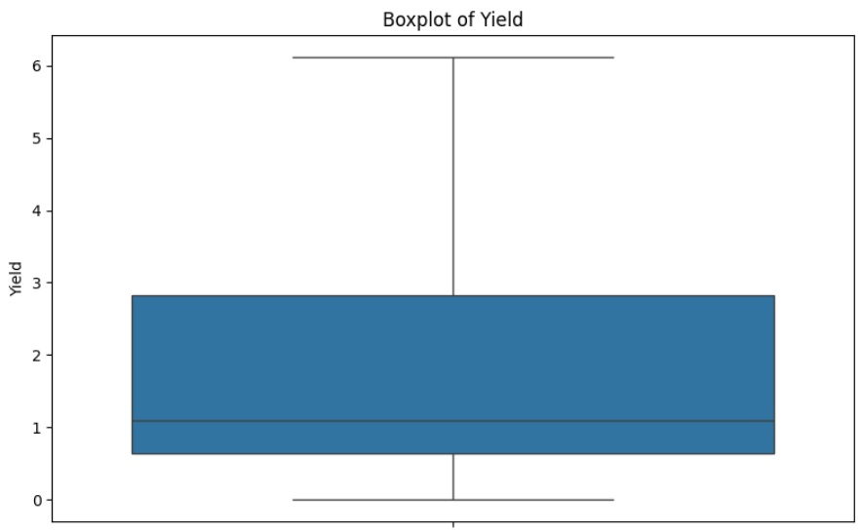

EDA • DATASET QUALITY
CLEANED DATASET
17,400
crop-yield records
0 • MISSING VALUES
0 • DUPLICATE RECORDS
The dataset is clean and contains no missing values or duplicate records, making it suitable for model training and evaluation.

Slide 12
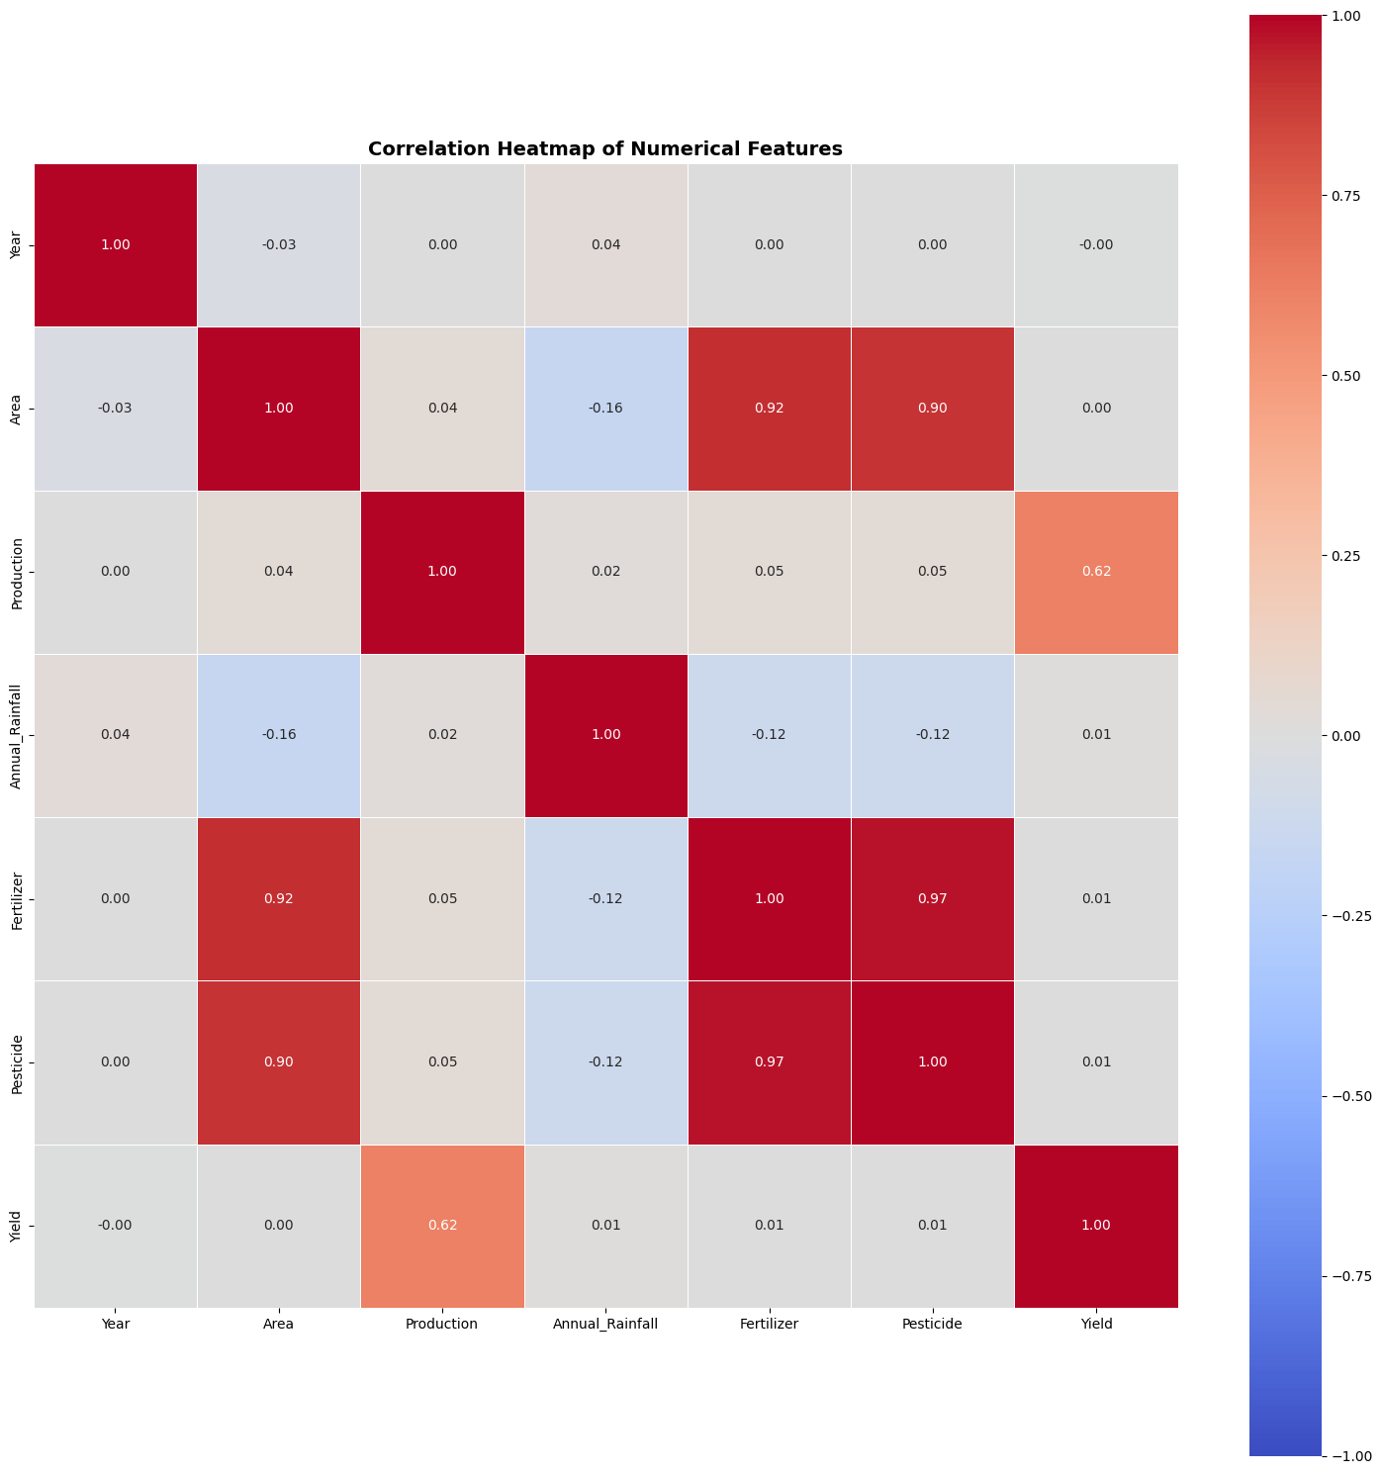

EDA • CORRELATION HEATMAP
WHAT THIS SHOWS
Correlation analysis shows the relationship between the numerical agricultural features and crop yield.
Features with stronger correlation with Yield may have a greater influence on prediction.
The heatmap helps identify relationships between variables and possible redundant features.
This analysis supports feature selection and model preparation before training Random Forest, XGBoost, and SVR.

Slide 13
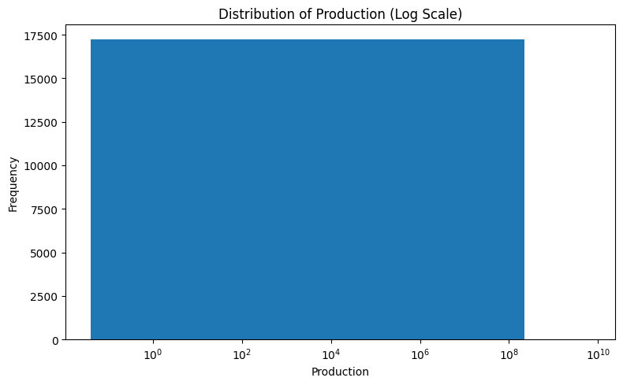
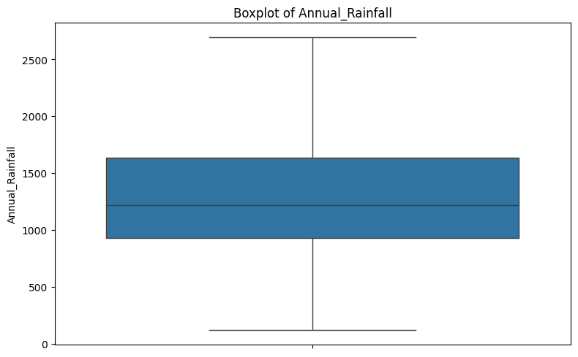
EDA • AGRICULTURAL FEATURES
Distribution of important agricultural input features
PRODUCTION DISTRIBUTION
ANNUAL RAINFALL DISTRIBUTION
Production values vary widely across records. The log scale helps visualize differences and reduces the effect of extremely large values.
Annual rainfall ranges approximately from 100 to 2,700 mm, with a median near 1,200 mm. The boxplot shows the spread and variation in rainfall across the dataset.

Slide 14
METHODOLOGY
Data Collection: Collect crop yield data containing rainfall, fertilizer, pesticide, area, production, crop, and season.
Data Preprocessing: Handle missing values, remove duplicates, and encode categorical features.
Exploratory Data Analysis: Analyze dataset patterns using graphs and statistical visualizations.
Model Training: Train Random Forest, XGBoost, and Support Vector Regression (SVR) models using Python.
Model Evaluation: Compare models using MAE, MSE, RMSE, and R² Score.
Backend Development: Use Node.js and Express.js to manage APIs and application logic.
Machine Learning API: Integrate Python FastAPI for real-time crop yield predictions.
Database Integration: Use Firebase Firestore to store prediction results and history.
Frontend Development: Build an interactive React.js website for data input, prediction, and visualization.

Slide 15
RESULTS AND DISCUSSION
Model Performance Evaluation:
Three models were evaluated: Random Forest, XGBoost, and SVR.
Evaluation metrics: MAE, MSE, RMSE, and R² Score.
Model Comparison:
Model | MAE | MSE | RMSE | R²
Random Forest | 5.99 | 6091.78 | 78.05 | 0.9932
XGBoost | 8.31 | 9779.24 | 98.89 | 0.9890
SVR | 80.49 | 777746.28 | 881.90 | 0.1260
Random Forest and XGBoost demonstrated stronger test-set performance than SVR in this evaluation.

Slide 16


PROPOSED MODEL WORKFLOW
1
2
5
6
DATASET
PREPROCESS
FEATURE PREPARATION
RANDOM FOREST
XGBOOST + SVR
MODEL COMPARISON
            Load the crop yield dataset containing agricultural and environmental features.
Clean the data and encode categorical features. Prepare the input variables for model training.
Select the relevant input features such as Year, State, Crop, Season, Area, Production, Annual Rainfall, Fertilizer, and Pesticide.
Train a Random Forest regression model to learn relationships between input features and crop yield.
Train XGBoost and Support Vector Regression (SVR) models for crop-yield prediction.
Compare the three models and select the best-performing model based on evaluation metrics.
Evaluation: MAE • MSE • RMSE • R² Score

Slide 17
MODEL COMPARISON TABLE
Model | MAE | MSE | RMSE | R²
Random Forest | 5.99 | 6091.78 | 78.05 | 0.9932
XGBoost | 8.31 | 9779.24 | 98.89 | 0.9890
SVR | 80.49 | 777746.24 | 881.90 | 0.1260

Slide 18
REQUIREMENT ANALYSIS
Core tools needed to execute the proposed pipeline
Python 3.x
Programming language used for data preprocessing, model training, and prediction.
Pandas / NumPy
Used for data handling, cleaning, numerical operations, and dataset preparation.
Scikit-learn
Used for preprocessing, Support Vector Regression, model evaluation, and performance comparison.
Jupyter / Google Colab
Interactive development and experimentation environment

Slide 19

CONCLUSION
Key takeaways from the project foundation
This project presents a machine learning-based approach for predicting crop yield using agricultural and environmental factors such as crop type, area, production, rainfall, fertilizer usage, and pesticide usage. The dataset was preprocessed and analyzed using Random Forest, XGBoost, and Support Vector Regression (SVR).
The models were evaluated using MAE, MSE, RMSE, and R² Score. Random Forest achieved an R² Score of 0.9932, while XGBoost achieved 0.9890 and SVR achieved 0.1260. Random Forest recorded the lowest MAE and RMSE among the tested models.
The results demonstrate that machine learning can support crop yield prediction. Future improvements can focus on feature engineering, model optimization, and additional agricultural data to improve prediction reliability.

Slide 20
THANK YOU

